Slide 1
IEEE EMC-S Sendai Chapter Report
Shinobu Ishigami, Chair
Tohoku Gakuin University, Tagajo, JAPAN
shinobu@mail.tohoku-gakuin.ac.jp

Slide 2
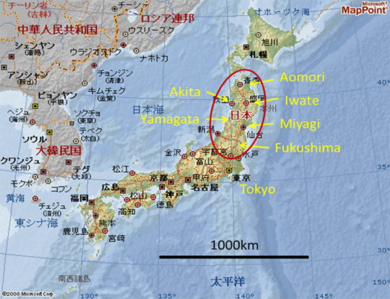
Our Location

Slide 3
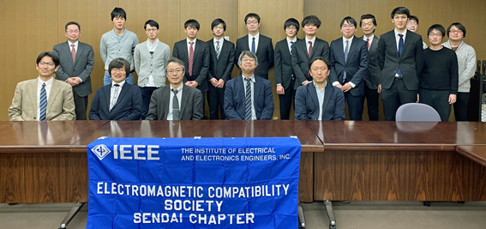
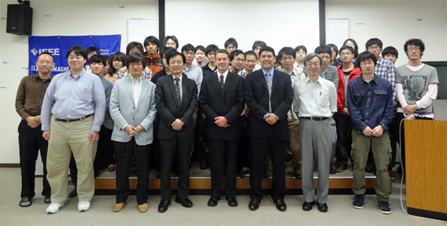
About us
Sendai Chapter was officially approved by the IEEE EMC Society on December 20th, 2001 established by Professor R. Sato (Chair), Prof. T. Takagi (Vice-chair), Prof. A. Sugiura (Secretary), and Prof. H. Sone (Treasurer).
Number of Chapter Members : 21
Chair: Shinobu Ishigami
Vice-Chair: Teruo Tobana
Secretary: Ken Sato
Treasurer: Sho Muroga

Slide 4
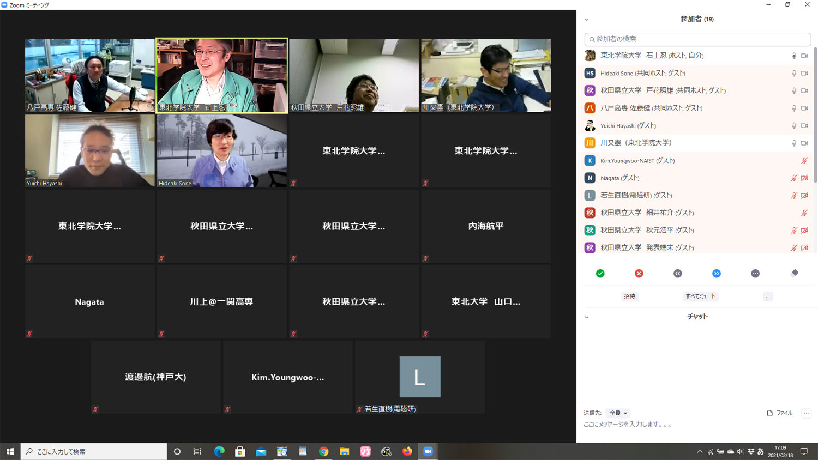
Hosted our events in 2020 and 2021
Colloquium and technical meetings
February 20, 2020, Research Meeting for Students (10 speakers + 25 audience)
December 10, 2020, Technical Lecture (3 speakers +32 audience)
February 18, 2021, Research Meeting for Students (9 speakers + 29 audience)
Technical meetings of co-sponsorship with the IEICE: 10
Administrative meeting: By e-mail as needed
2021 Research Meeting for Students by Webinar (Zoom)

