Slide 1
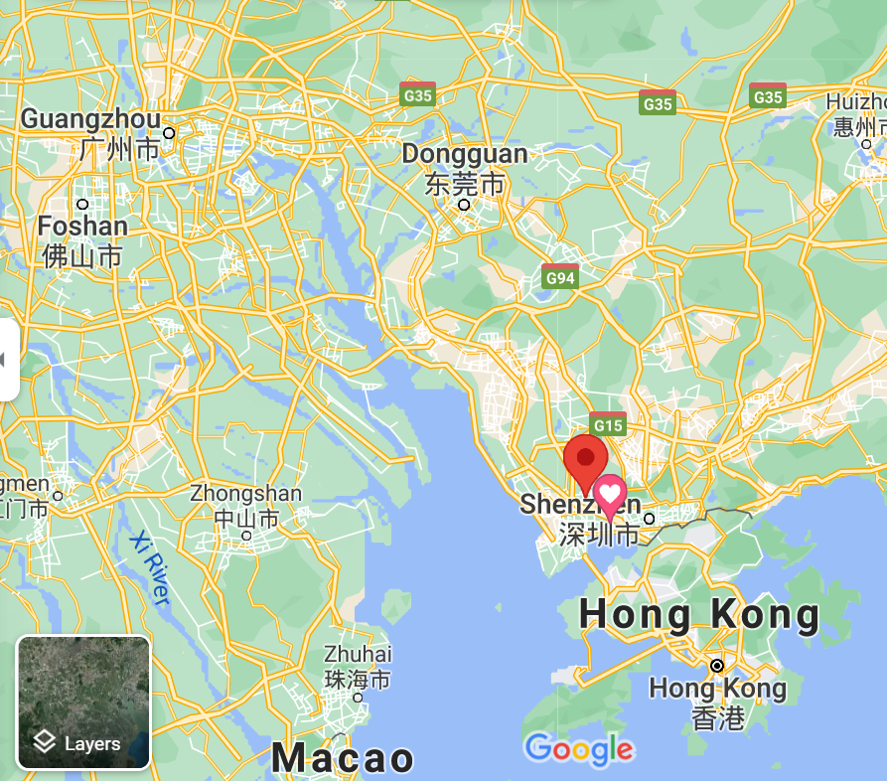
Guangzhou Section Jt. Chapter, EMC27/AP03
Chair: Dr. Lie Liu (General Test Systems, liulie_leo@hotmail.com)
Vice Chair: Dr. Tian Zhou (KC)
Secretary : Mr. Nan Li (Chengen) and Dr. Jiyu Wu (GTS)
Around 30 active members
Notes:
Good afternoon, everyone! We have around 30 members, most of them from Shenzhen. Shenzhen is the neighbor of HK, also called Silicone Valley of China.

Slide 2
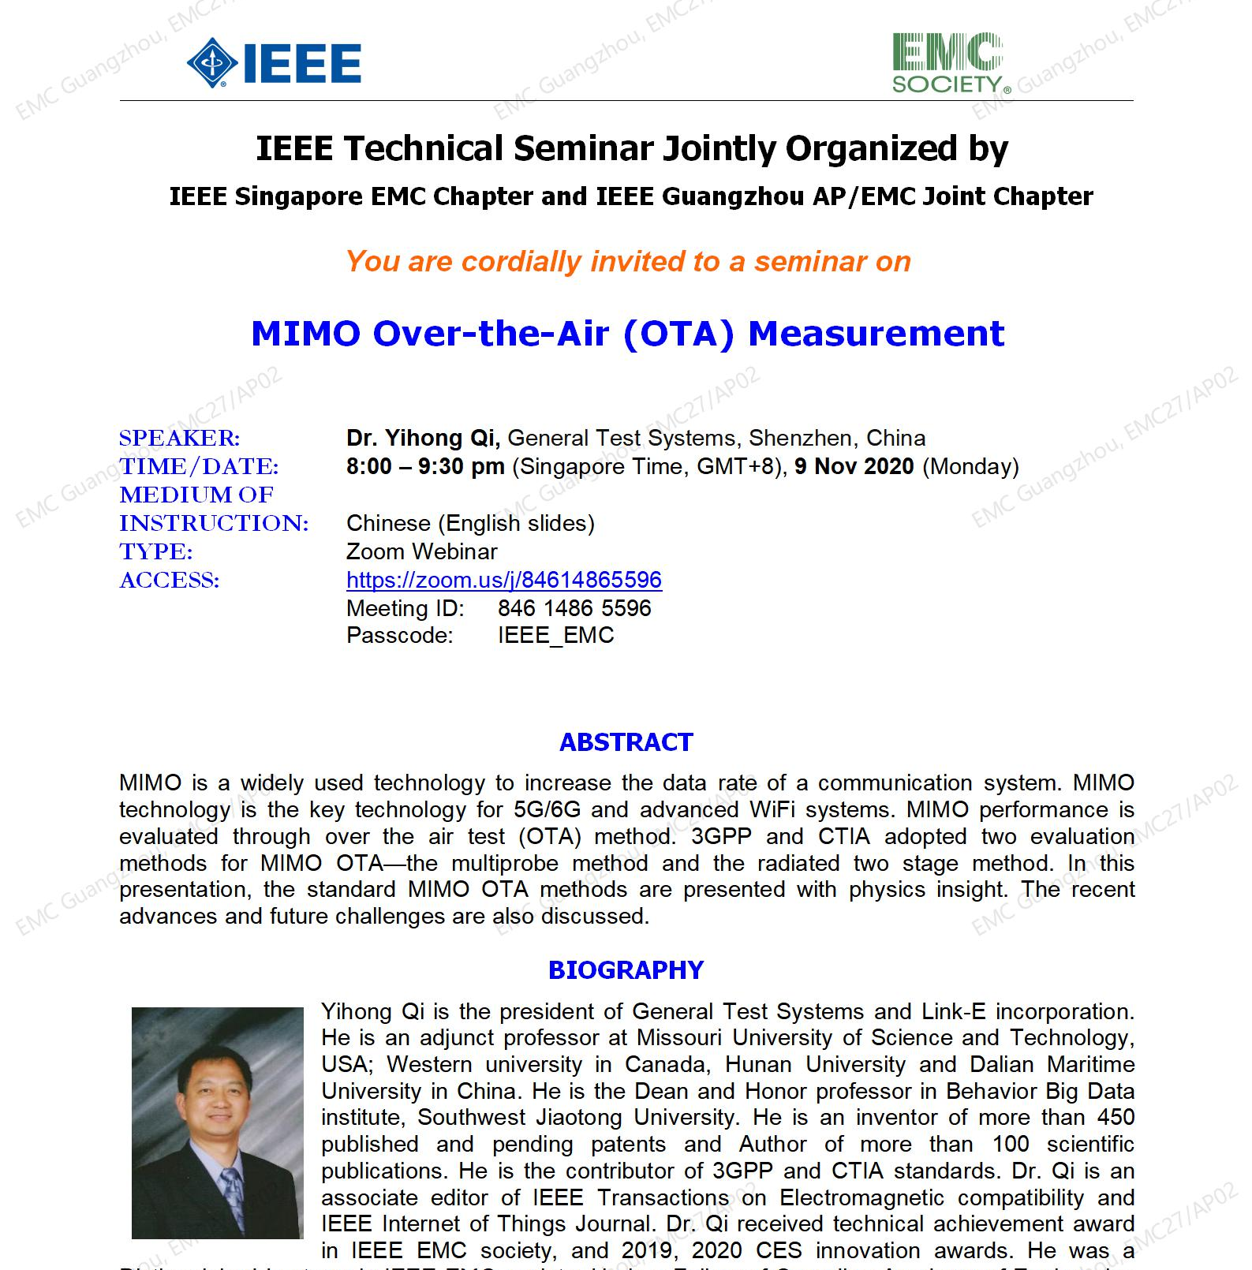
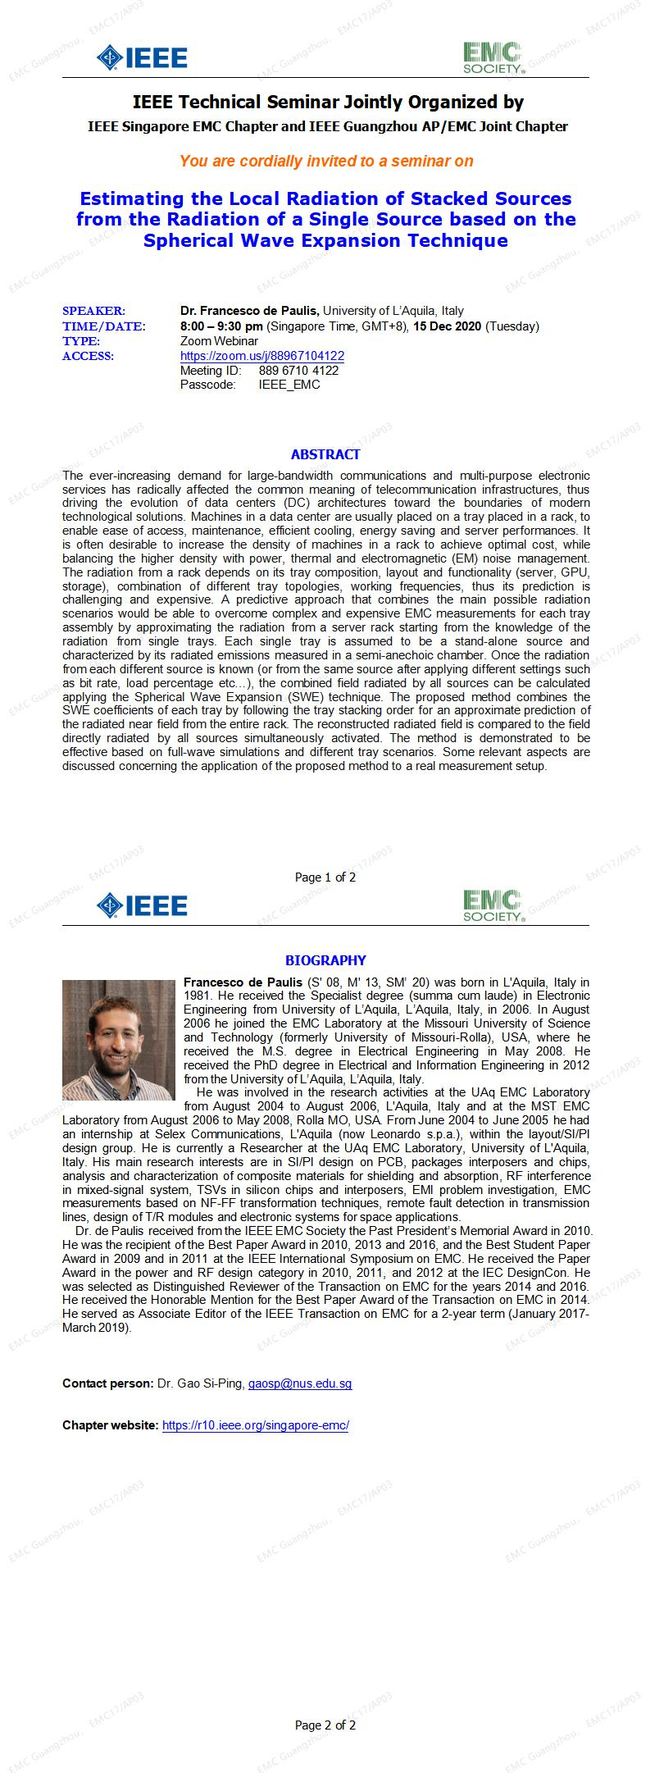
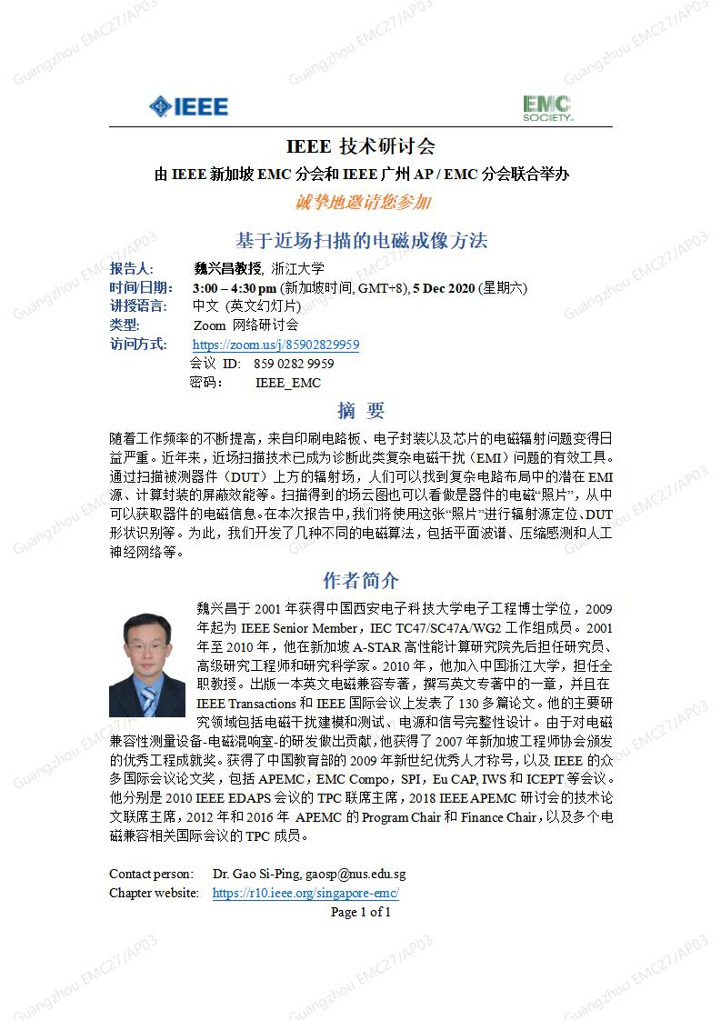
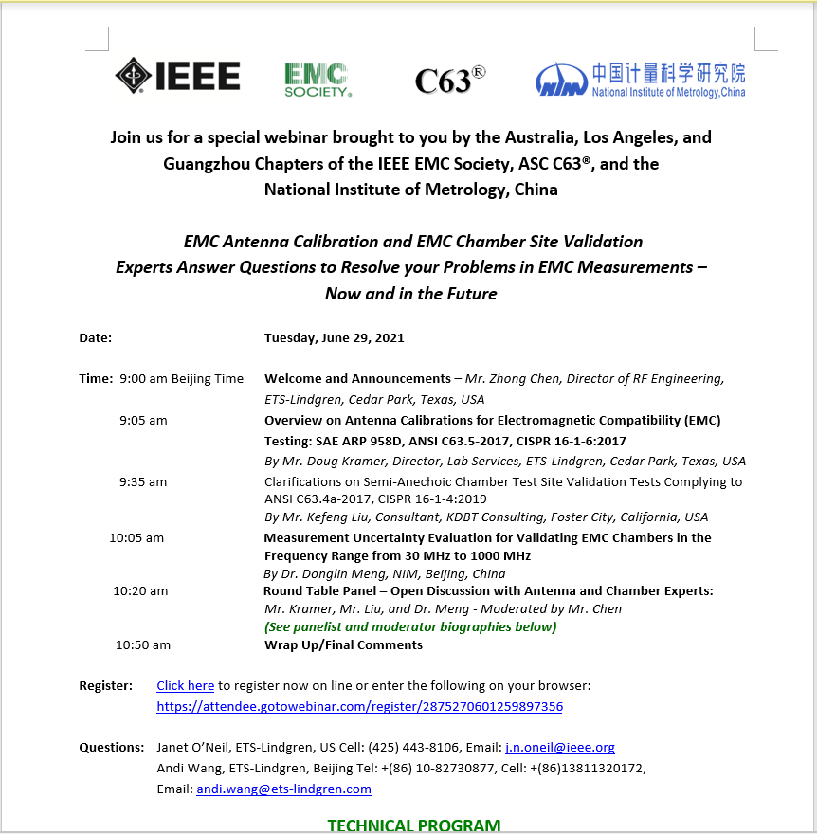
Guangzhou Section Jt. Chapter, EMC27/AP03
5 Joint Seminars with Singapore EMC Chapter from Nov. to Dec. 2020
1 Joint Seminar with IEEE EMC Coastal Los Angeles Section Chapter on June 29, 2021
Notes:
Beside 5G, we also pay attention on Intelligent vehicles, or autonumous car. A senimar has been organized with emphasis on EMC and OTA measurement.

Slide 3
Summary
Mission： Serve EMC and Wireless communication community around Zhujiang Bay area, including Guangzhou, Shenzhen, Hongkong, Zhuhai etc.
Connect people from different cities and by holding seminars, either in-person or virtual one
Bridge the gap between people from different culture and background
Educate young professionals and promote EMC society.

Slide 4
New hobbies during pandemic
Wear a facial mask
Clean hands more often than before
Enjoy one-person quarantined vacations

