Slide 1
Cedar Rapids
West Michigan
Milwaukee
Southeastern Michigan

Slide 2
Angel Report
Region 4:
Cedar Rapids
West Michigan
Milwaukee
Southeastern Michigan

Slide 3
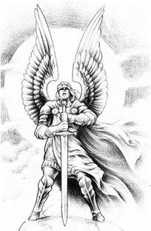
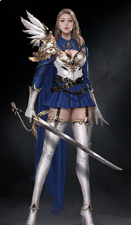
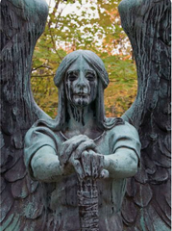

Slide 4
Angel Functions
“The Chapter Angels serve as liaisons between the EMC Society Board of Directors and the Chapters on all matters relating to Chapter Activities.”
Angels are intended to:
a) Initiate Chapter contacts
b) Keep in close communications
c) Evaluate "Angel Funds" requests
d) Help the Chapter Coordinator to communicate with Chapters

Slide 5
Angel Functions
e) Encourage activity reports and check next years officer’s status.
f) Request a copy of meeting L-31 reports.
g) Request meeting invitations, and attend Chapter meetings
h) Act as "coaches" or "mentors"
i) Respond to chapter communications.

Slide 6
vTools (Tools)

Slide 7
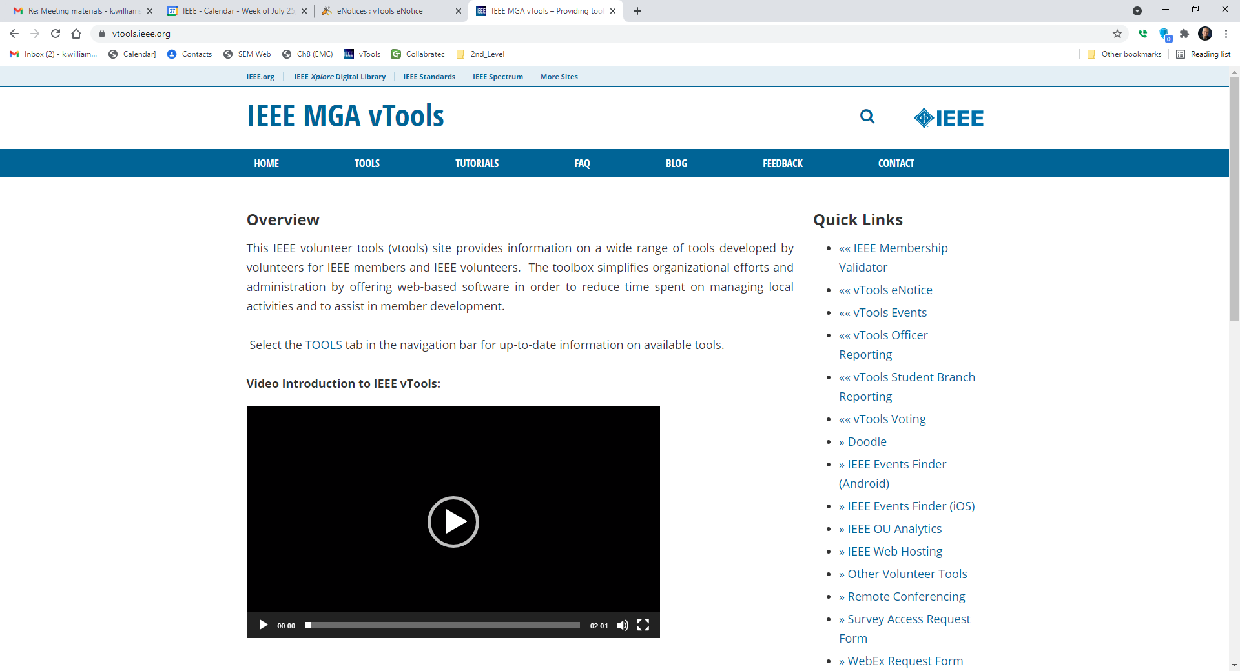

Slide 8
vTools
Find out how to identify your Chapter(s)

Slide 9
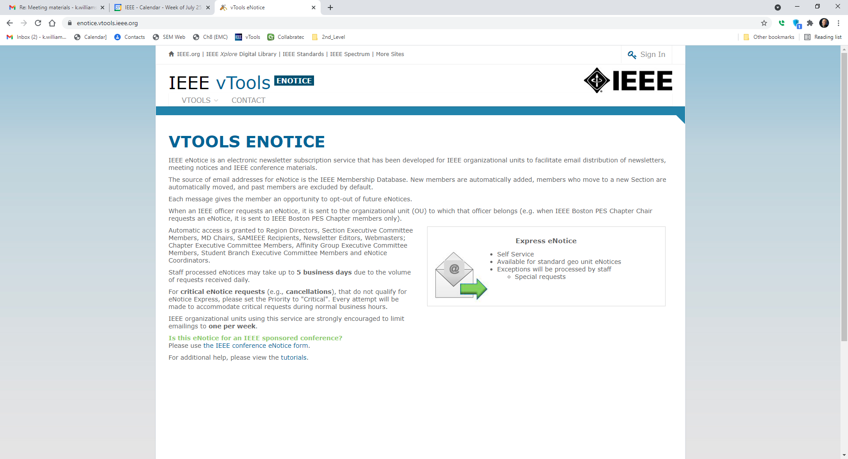

Slide 11
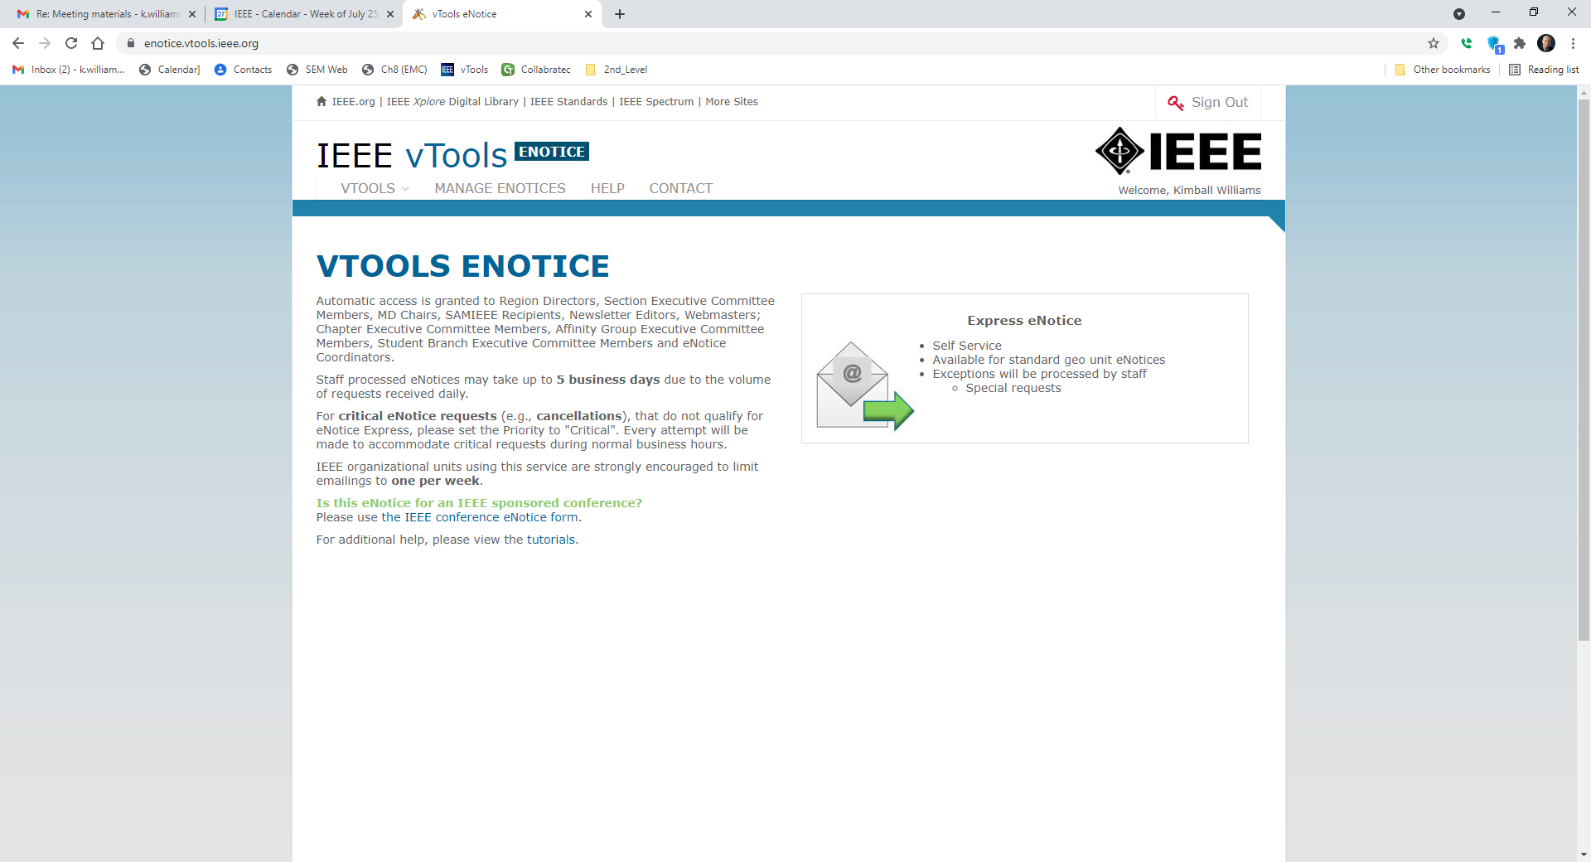

Slide 12
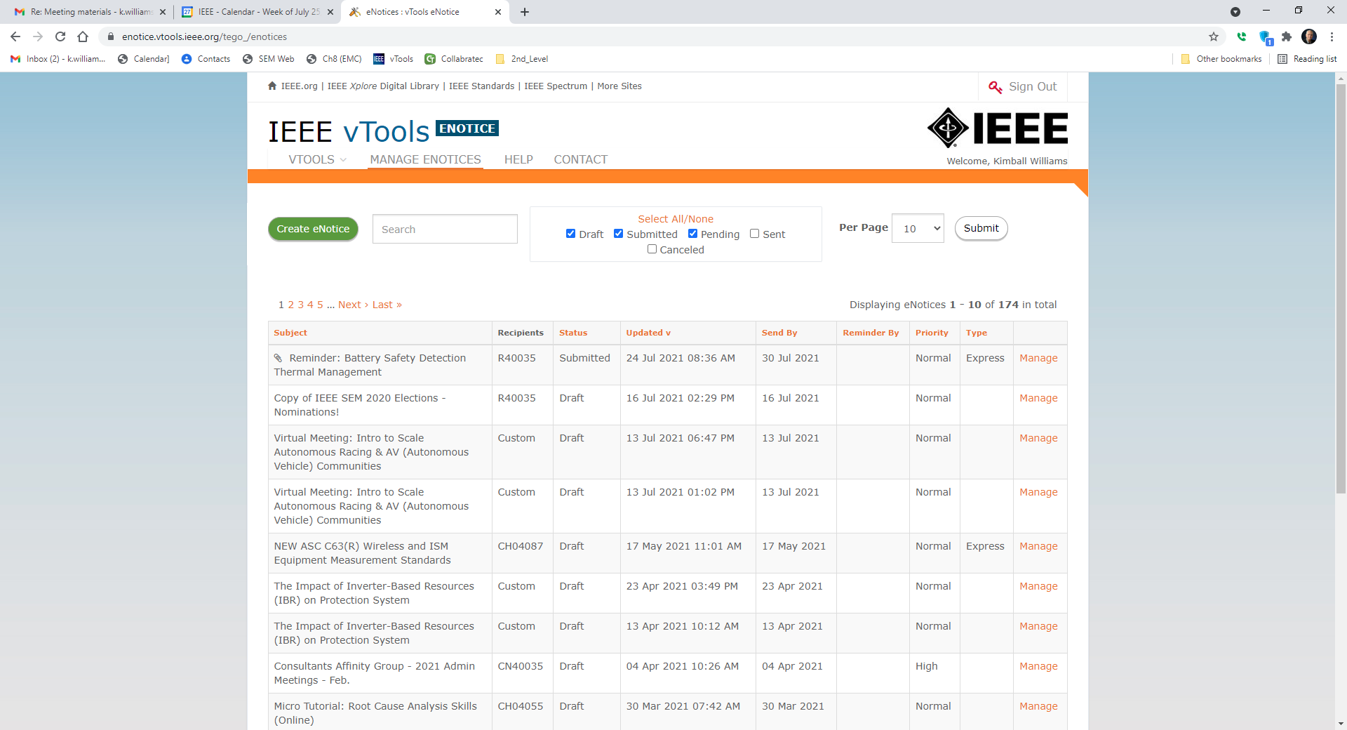

Slide 13
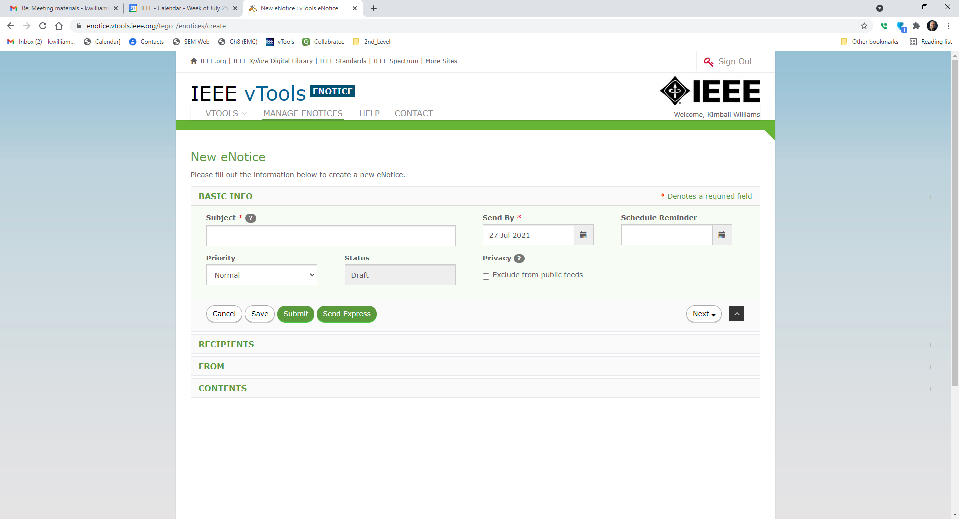

Slide 14
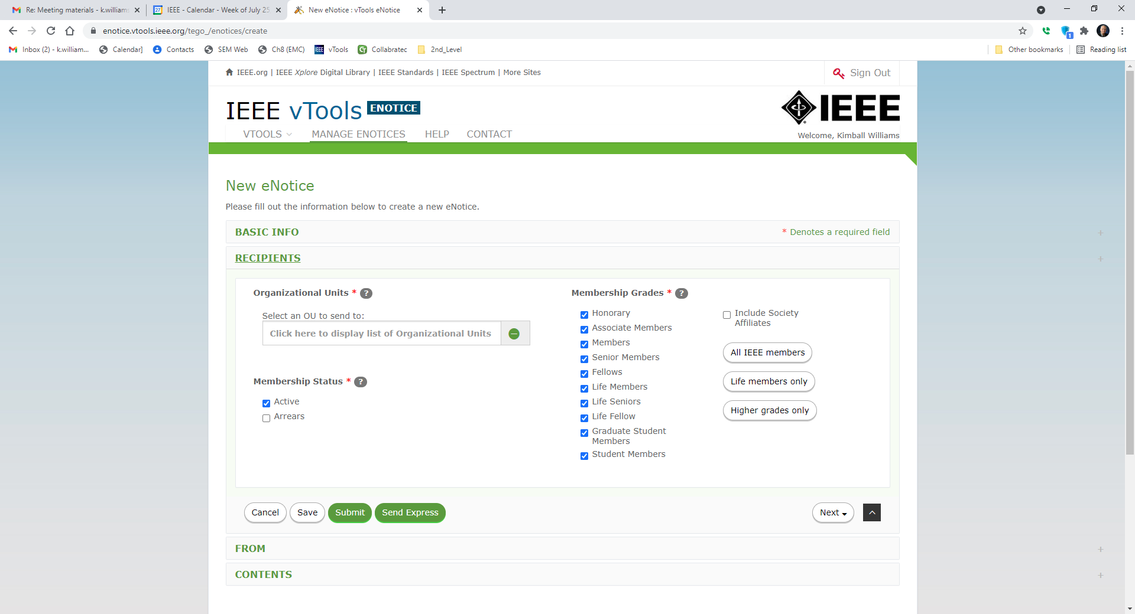

Slide 15
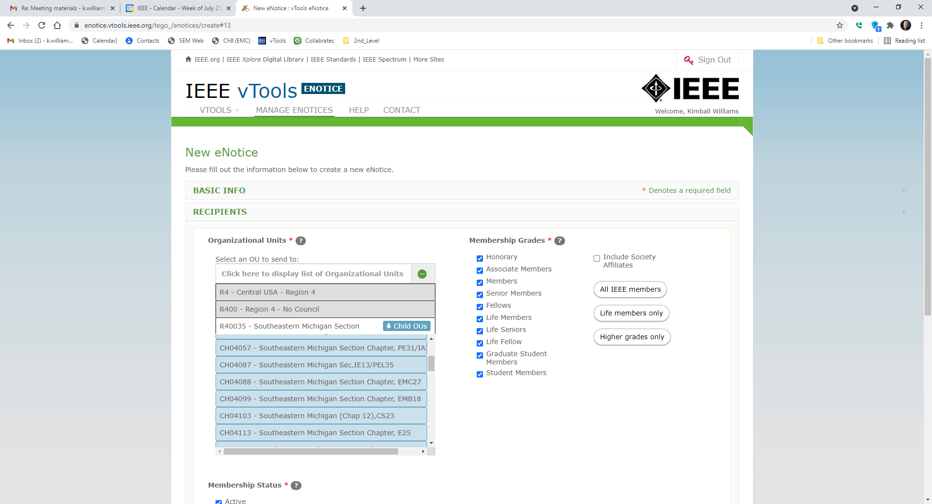
Chapter ID# (Record This!)
EMC27 – All EMC-S Chapters carry this ID.

Slide 16
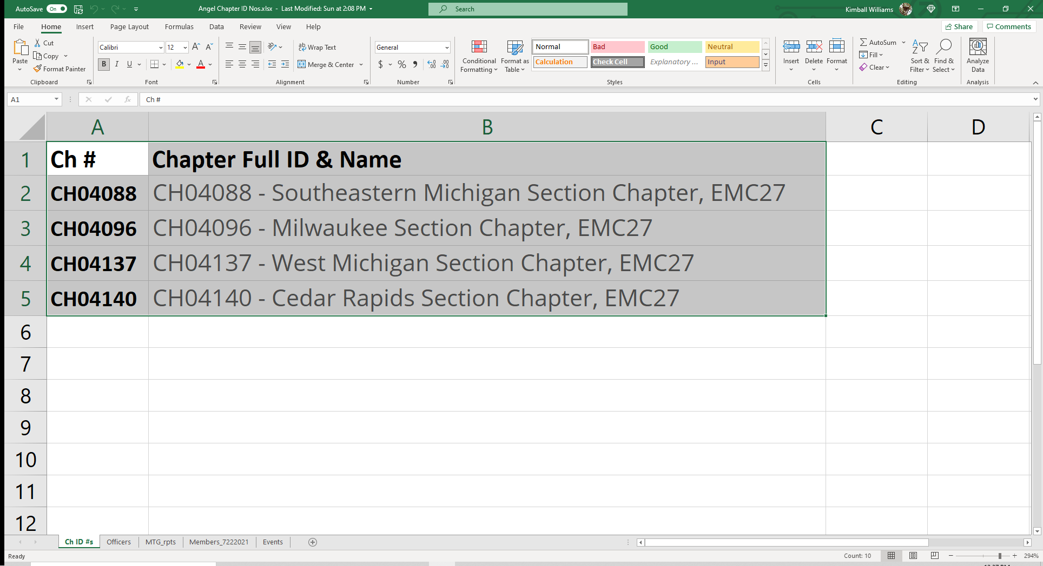

Slide 17
vTools
Who is currently in a Chapter office?

Slide 18
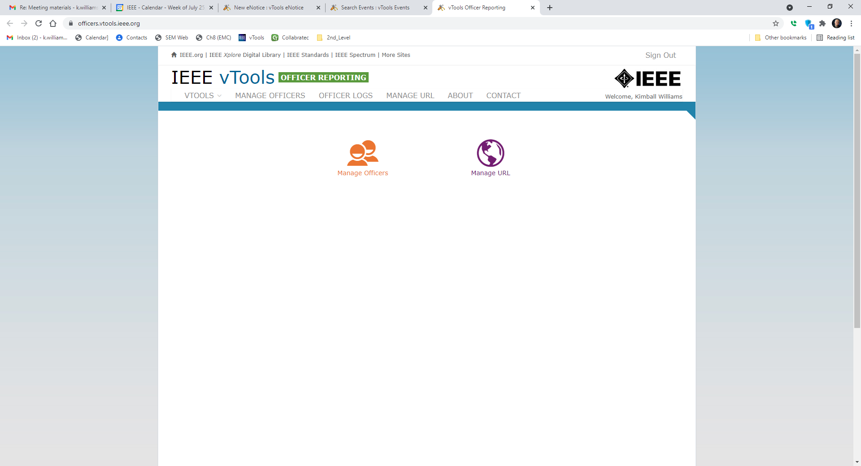

Slide 19
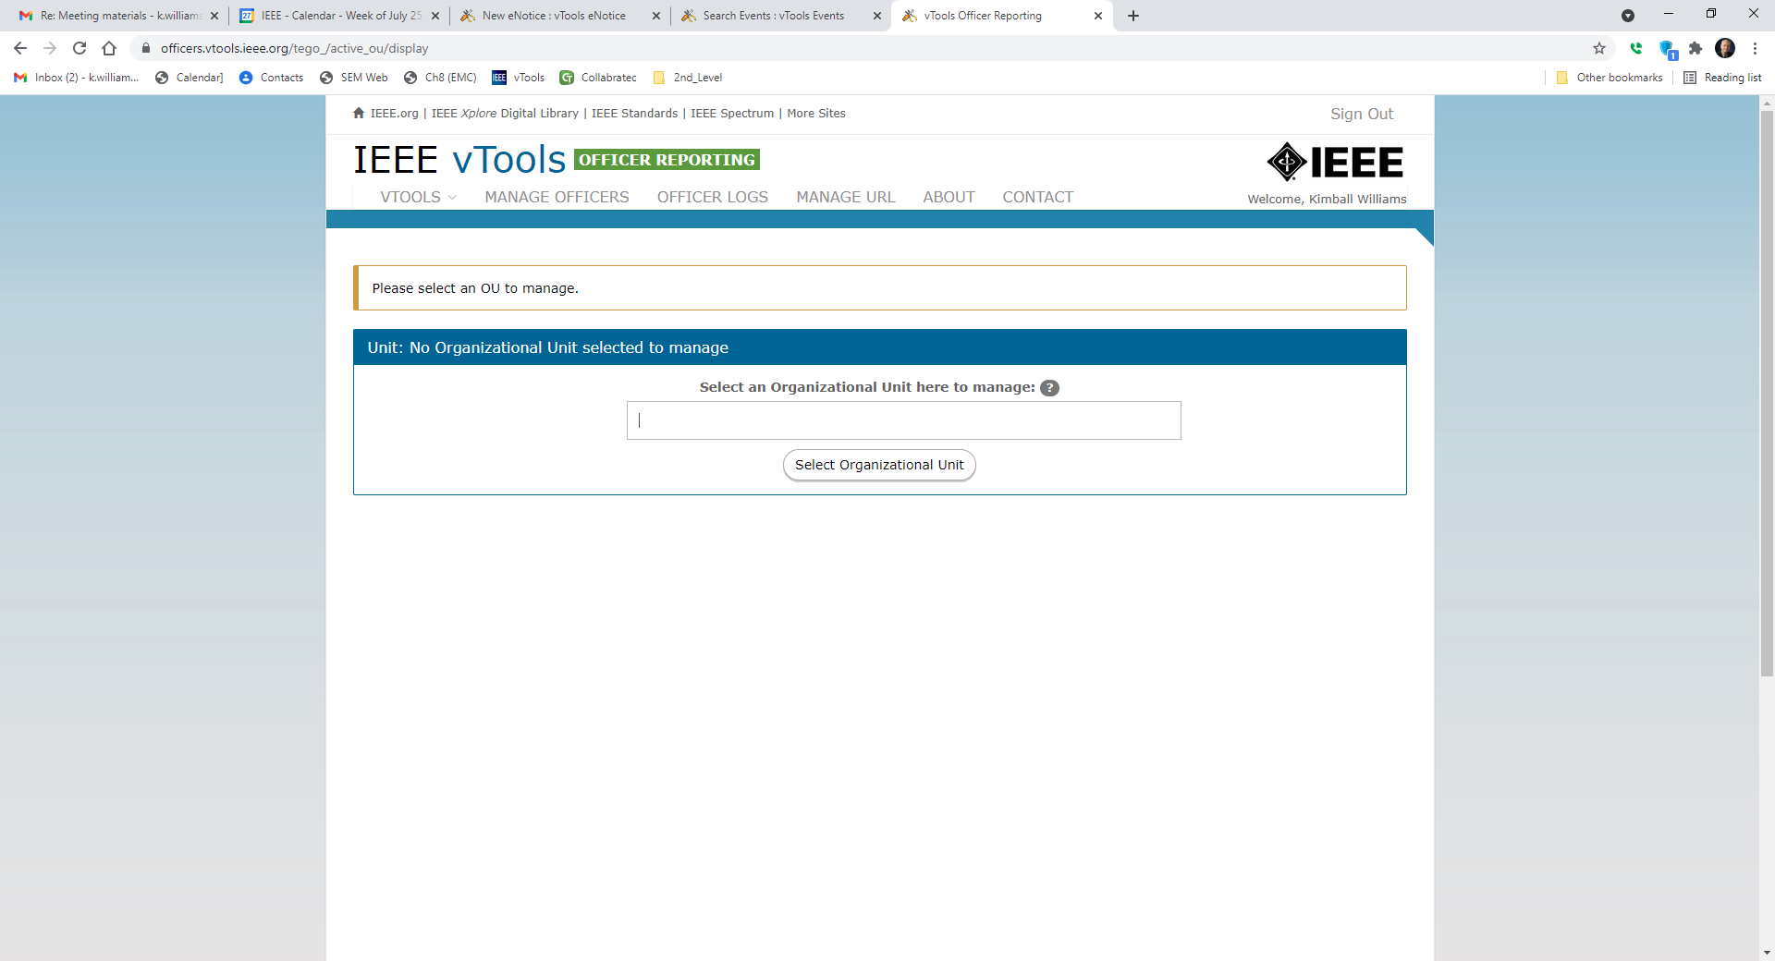
Enter your Chapter ID#

Slide 20
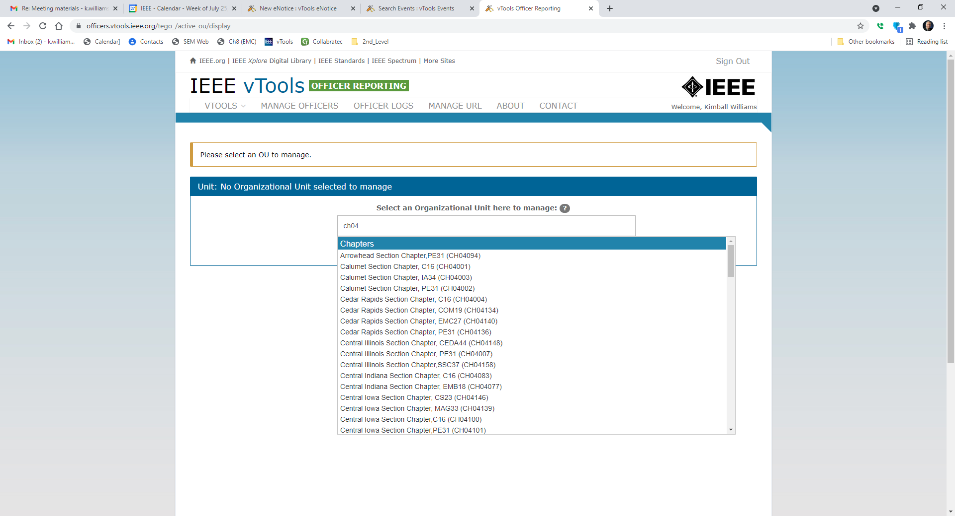

Slide 21
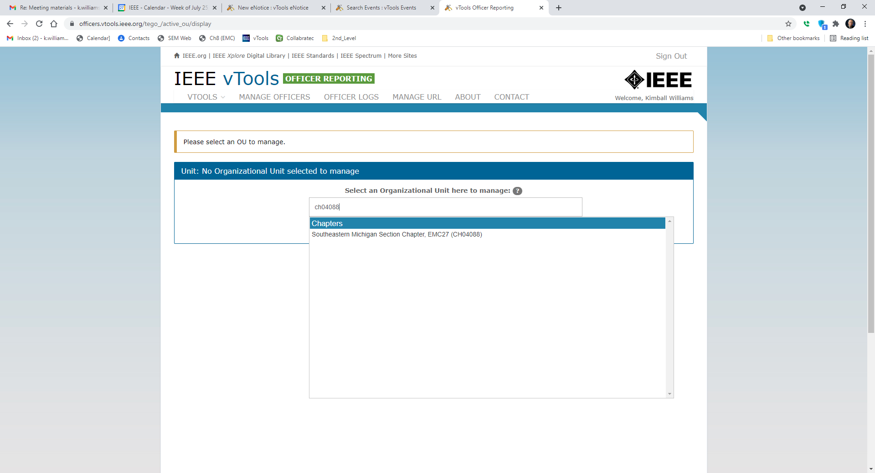

Slide 22
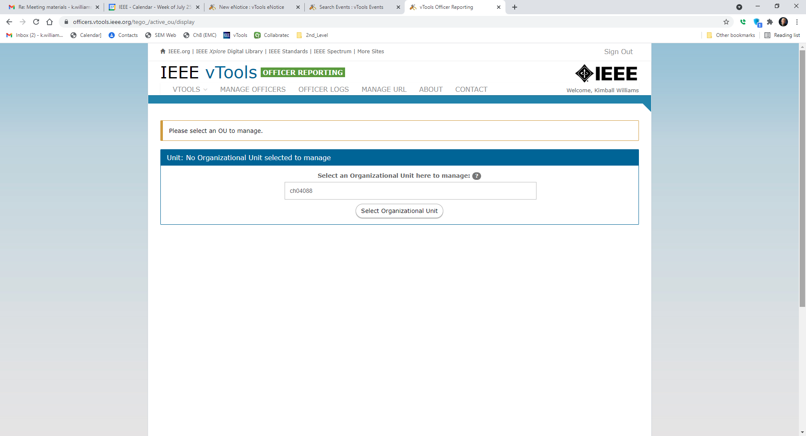

Slide 23
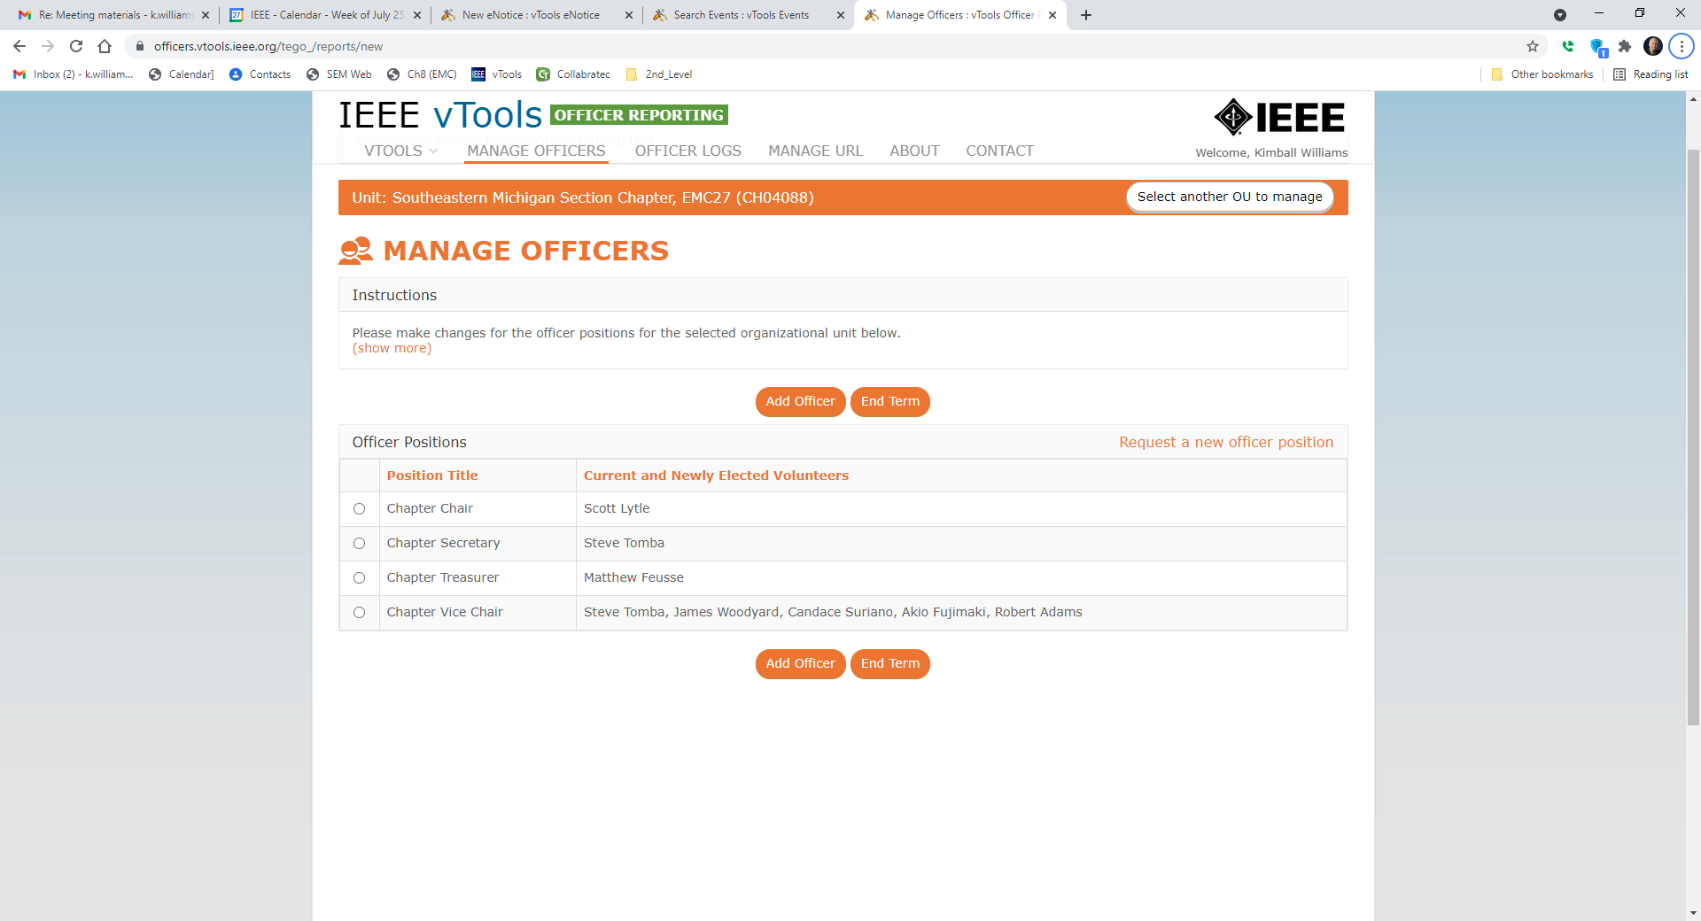

Slide 24
vTools (Tools)

Slide 25
vTools
Find a list of Chapter activities:

Slide 26
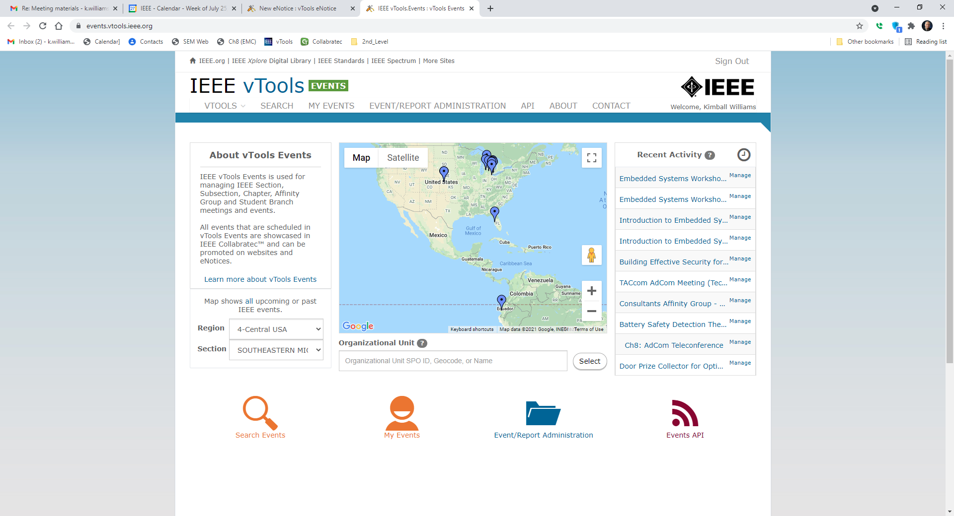

Slide 27
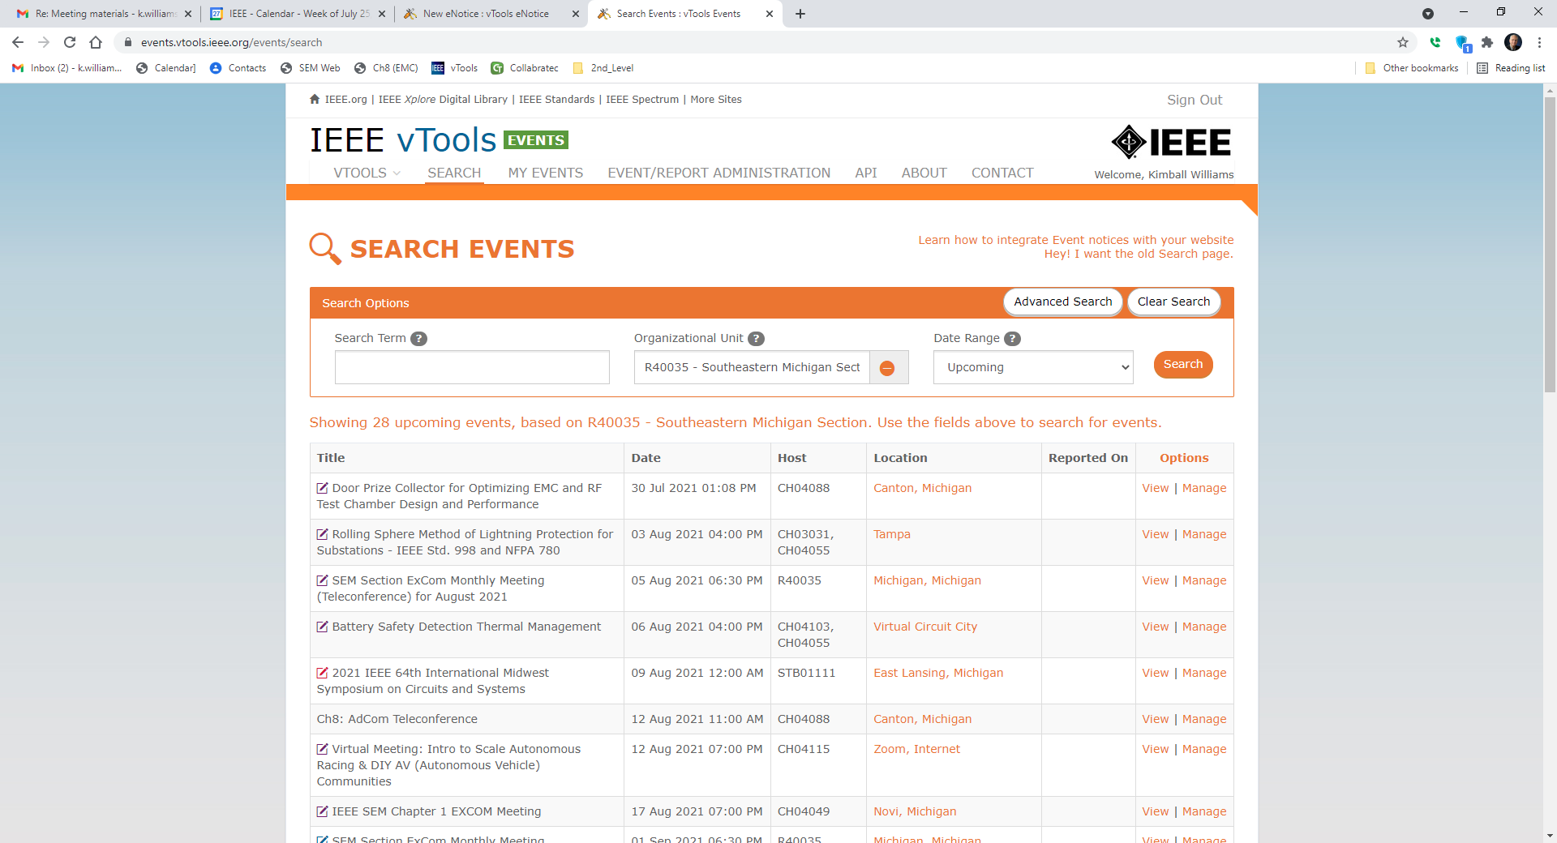

Slide 28
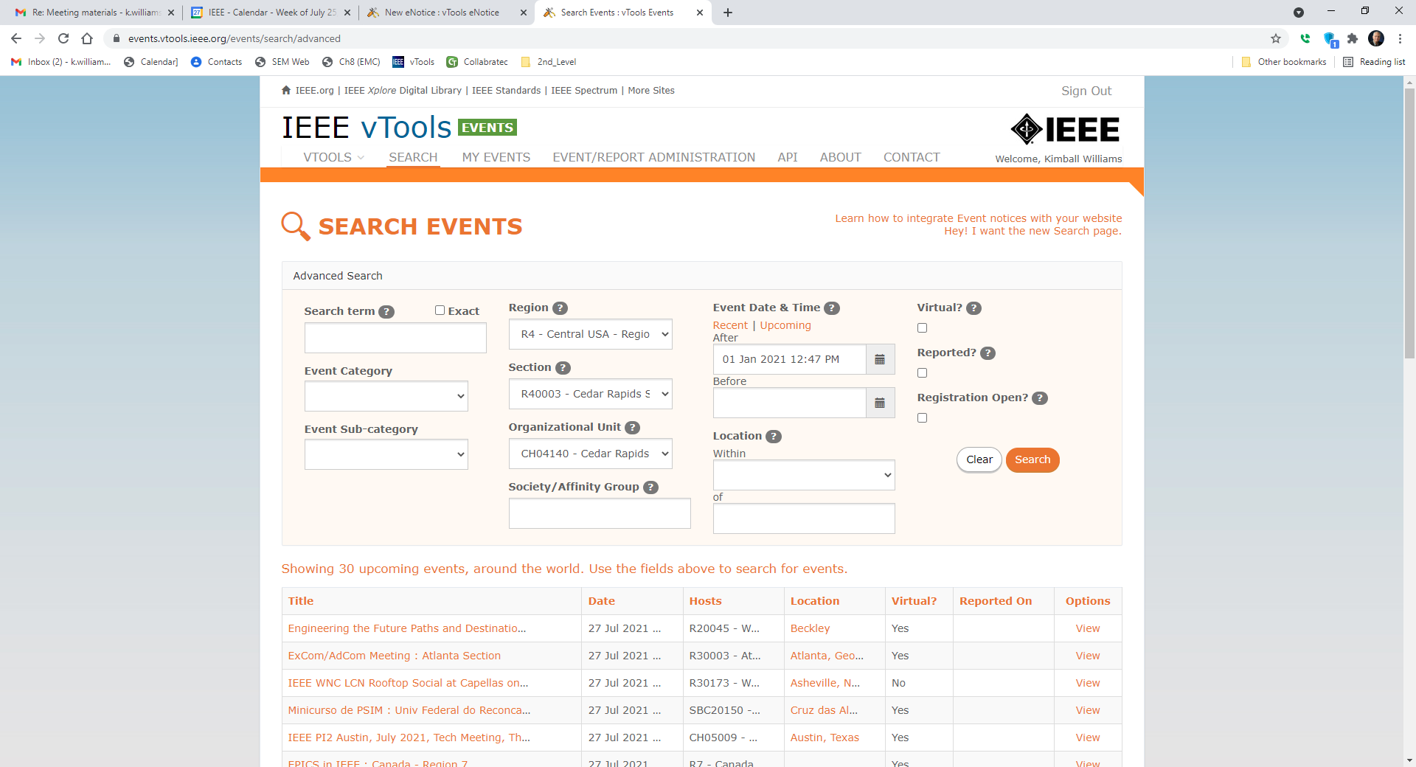

Slide 29
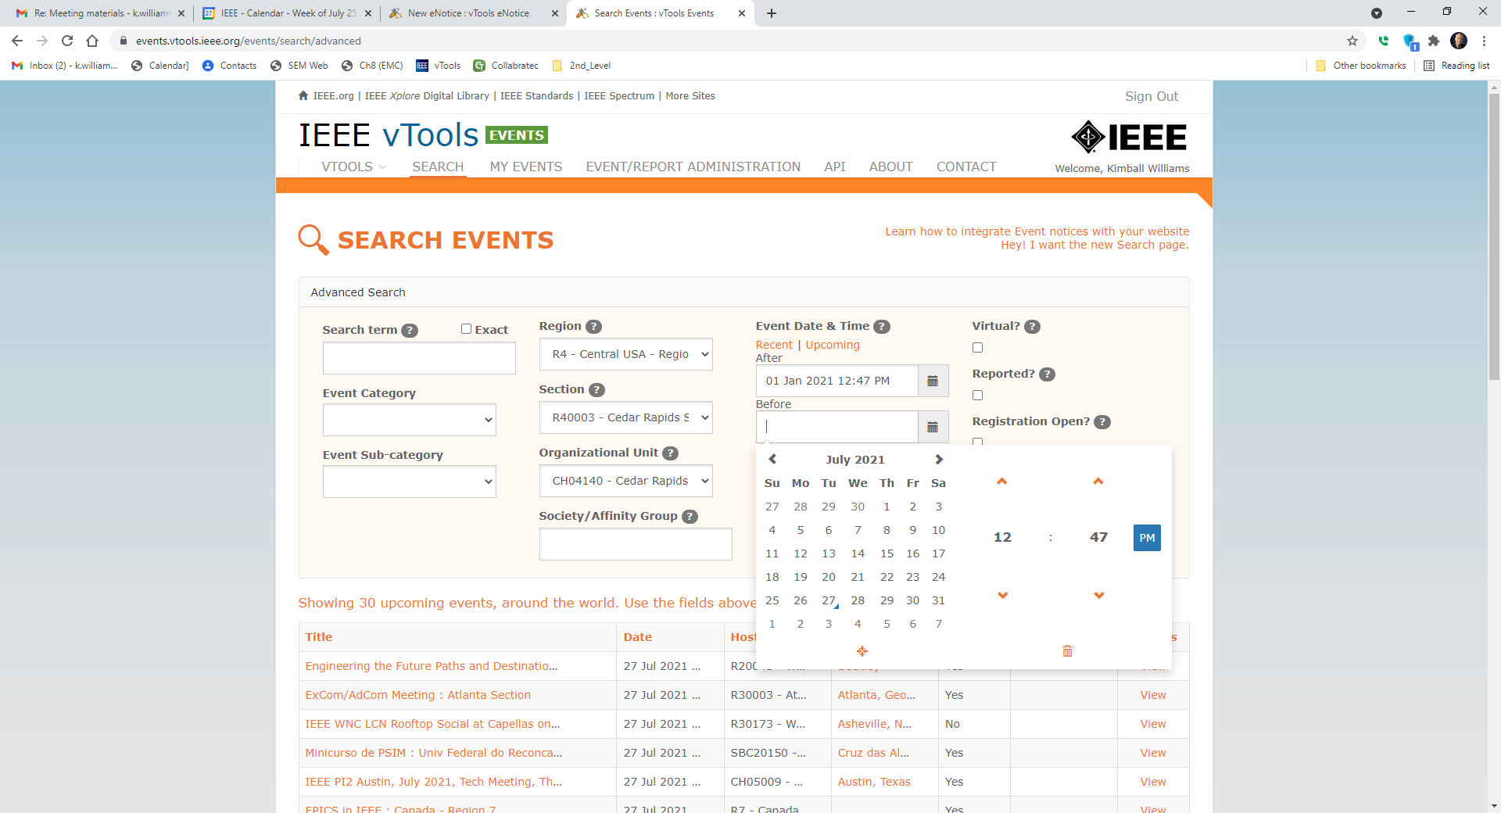

Slide 31
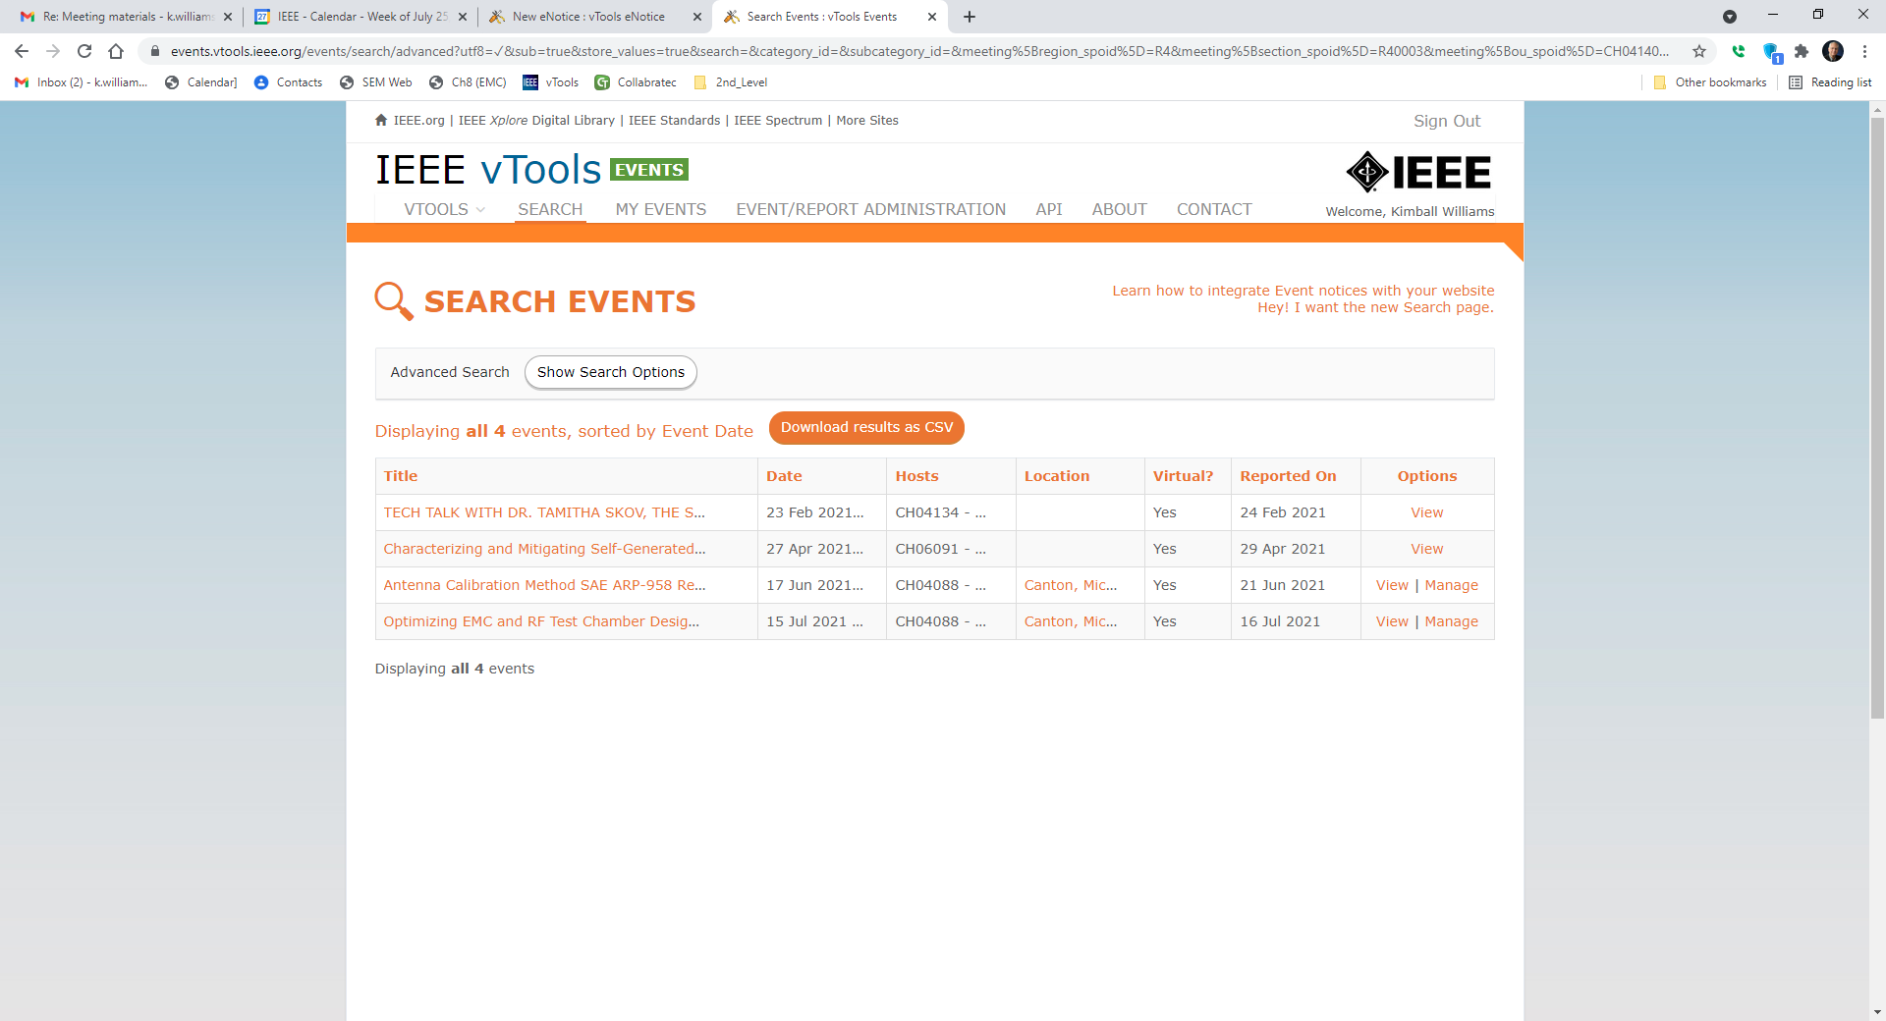

Slide 32
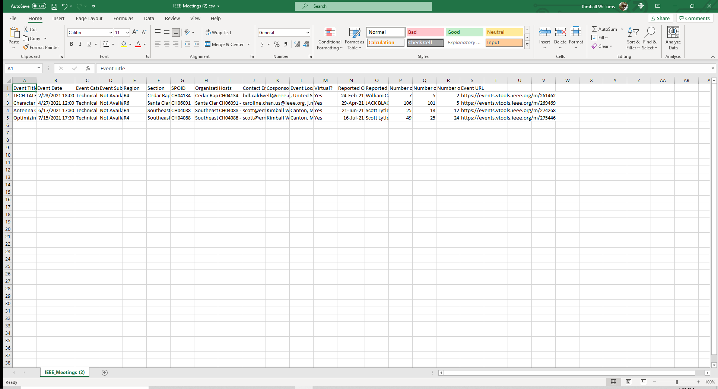

Slide 33
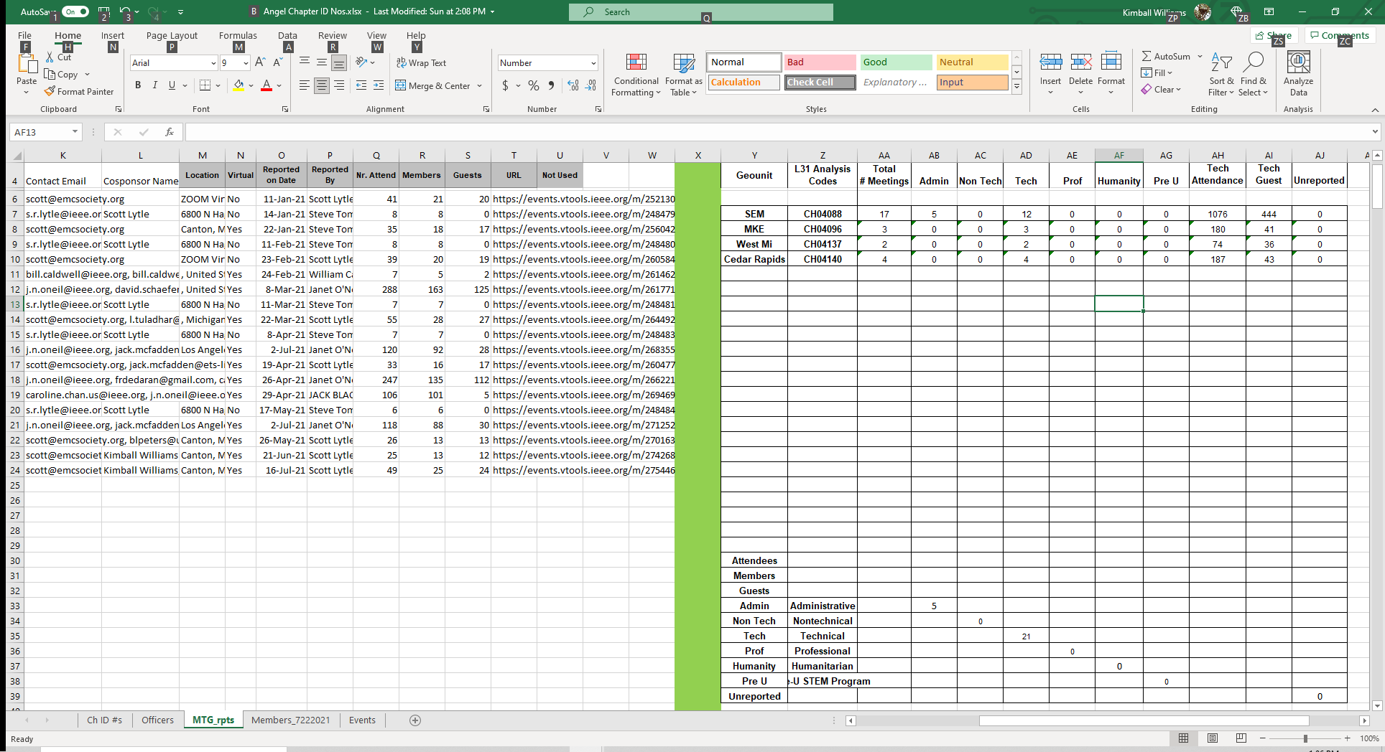

Slide 34
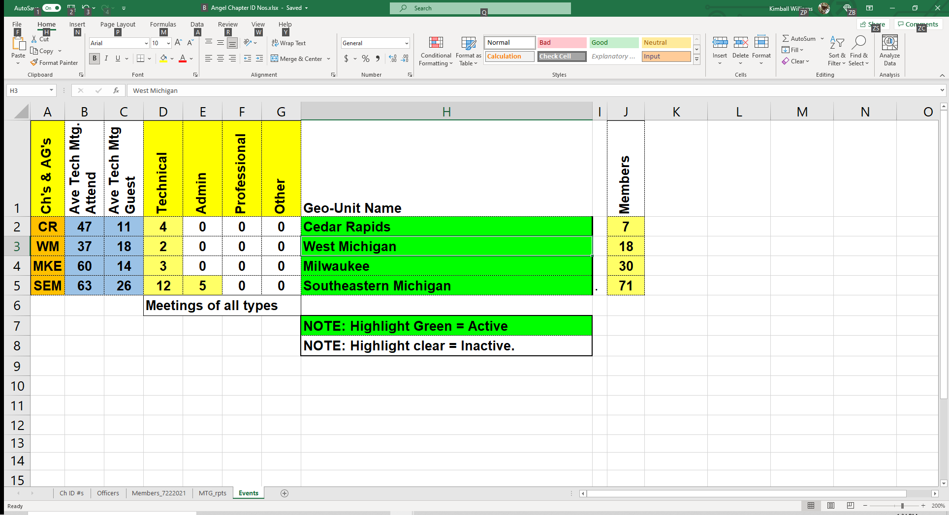

Slide 35
vTools
Find a listing of all Chapter members:

Slide 36
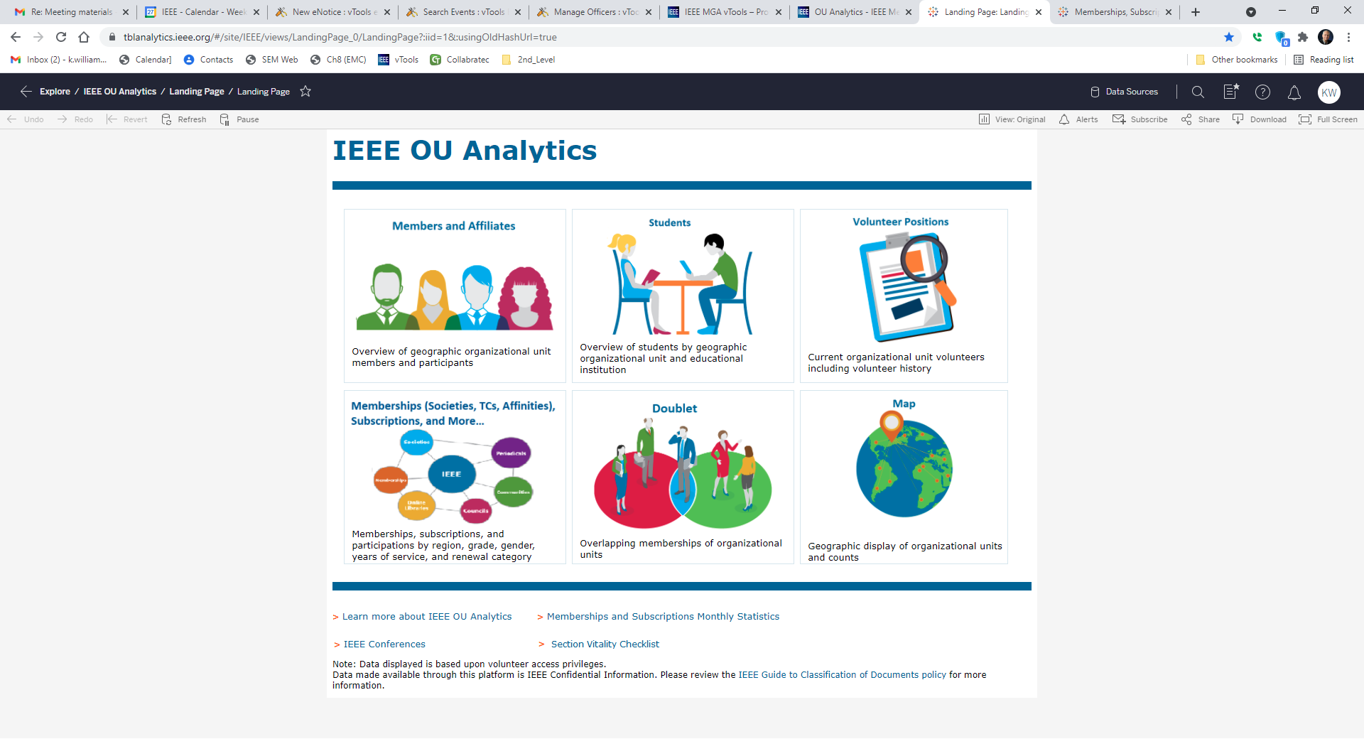

Slide 37
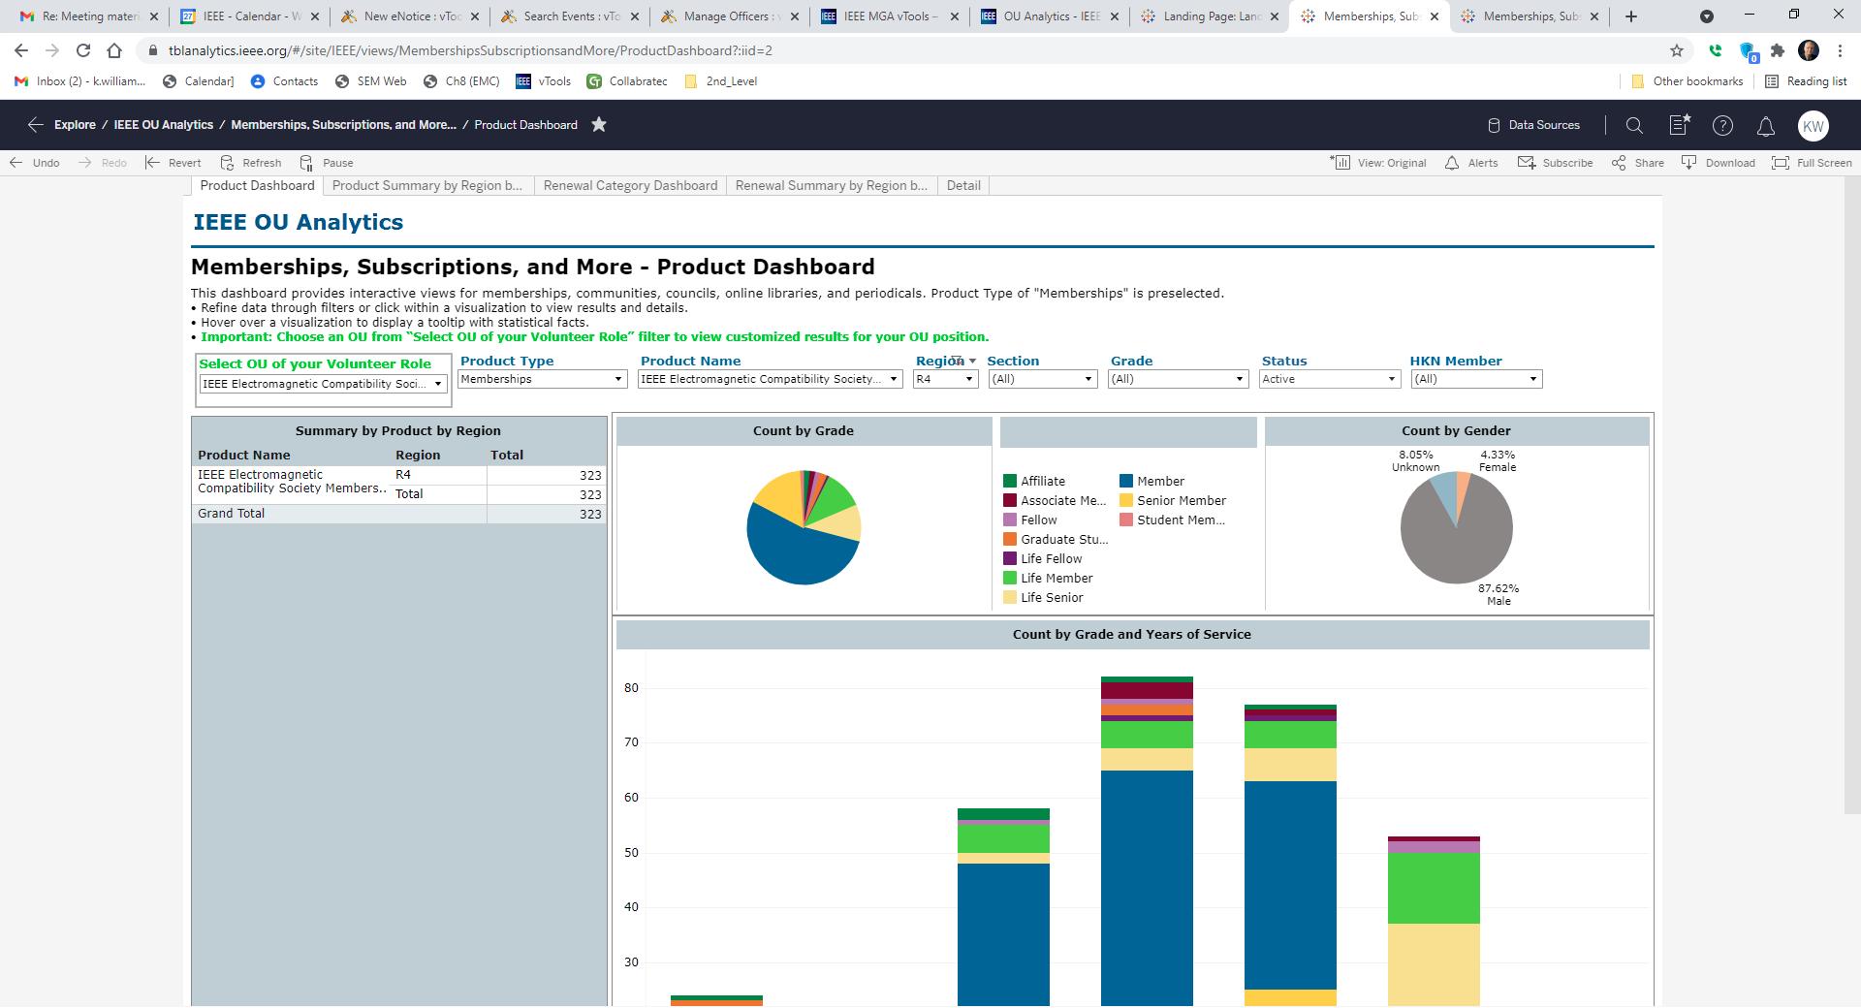

Slide 38
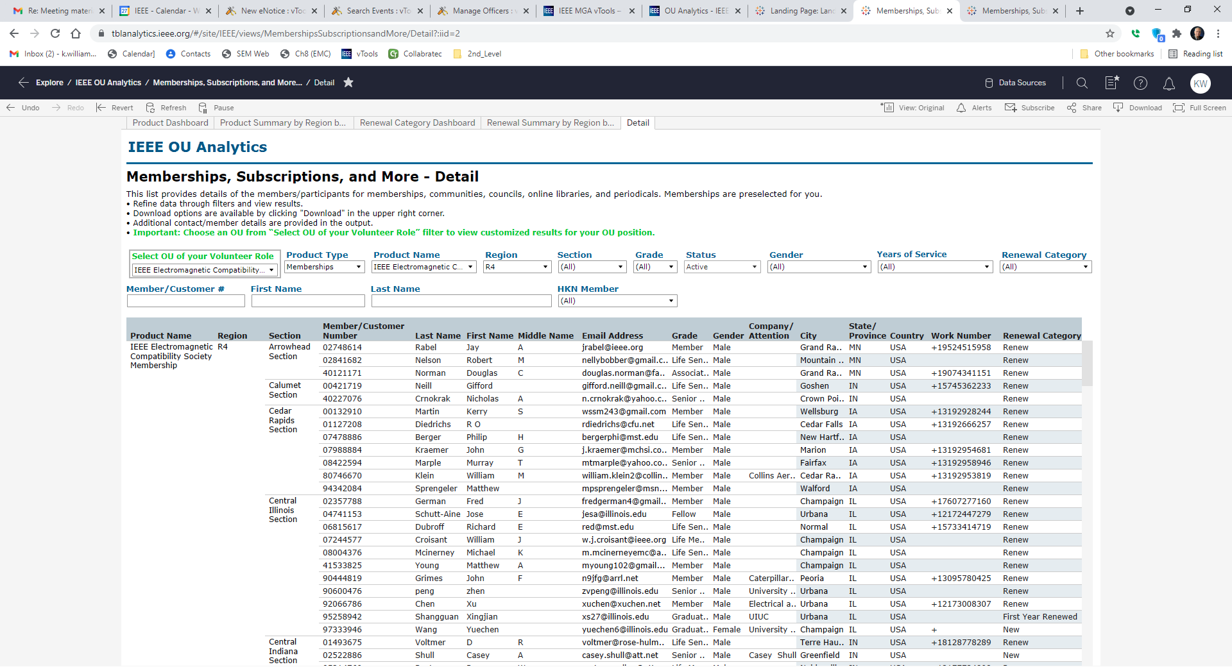
Click on any member number

Slide 39
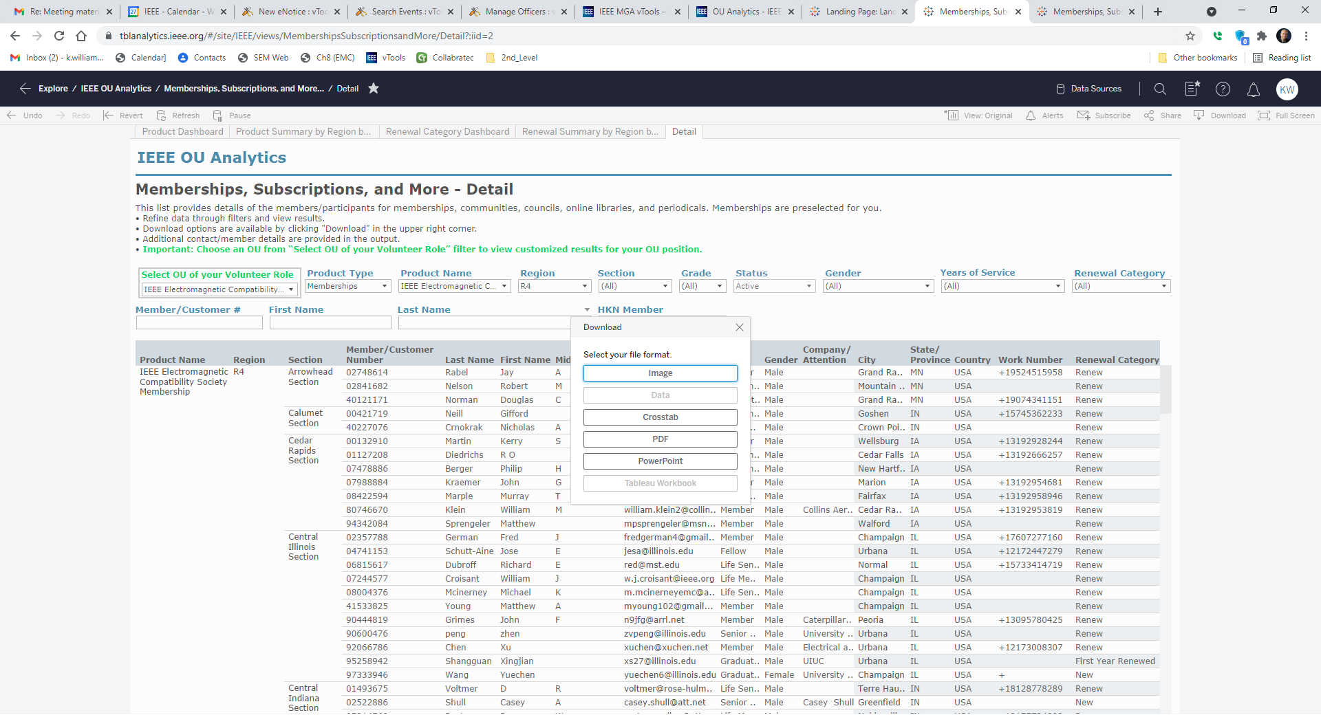

Slide 40
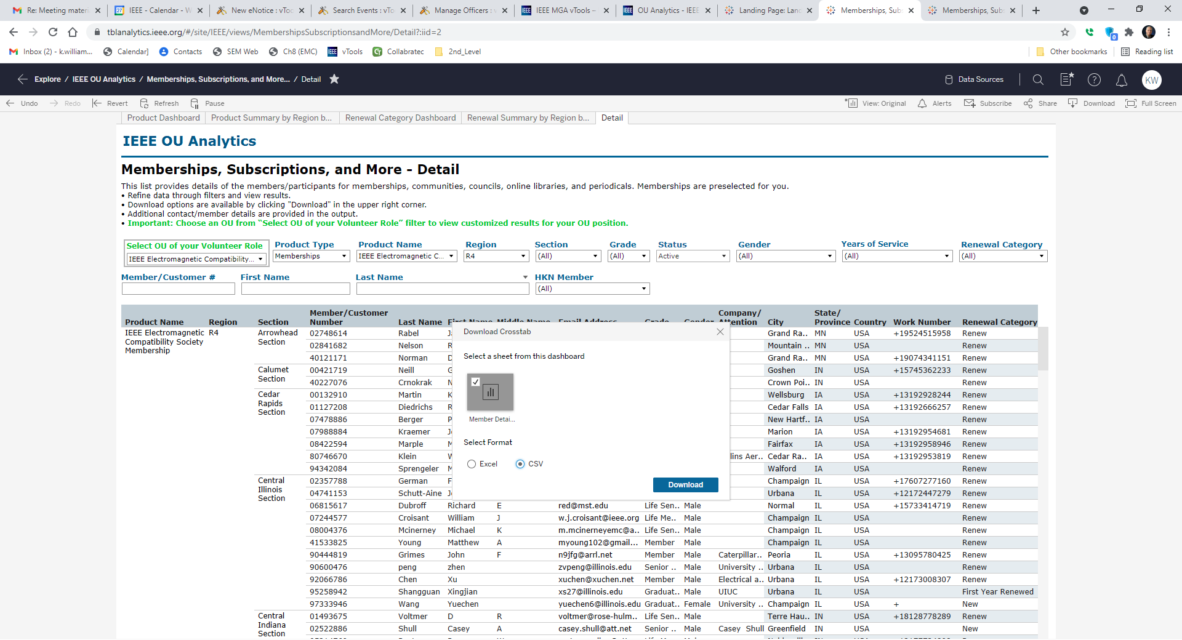

Slide 41
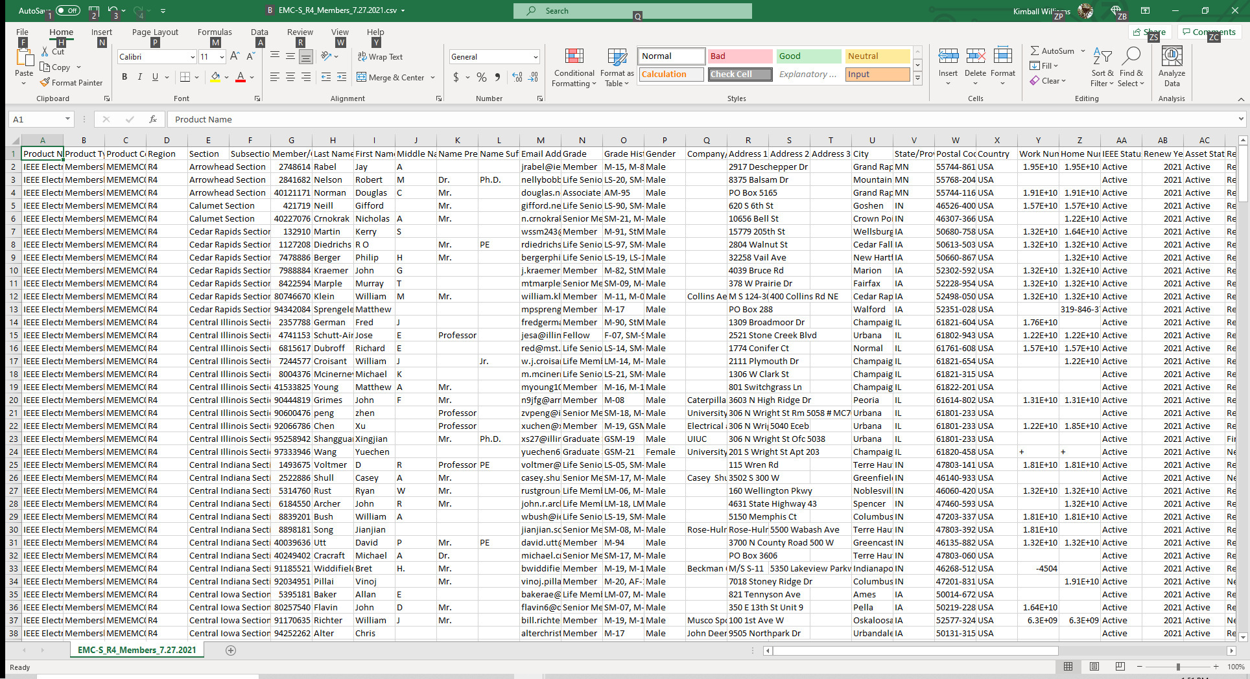

Slide 42
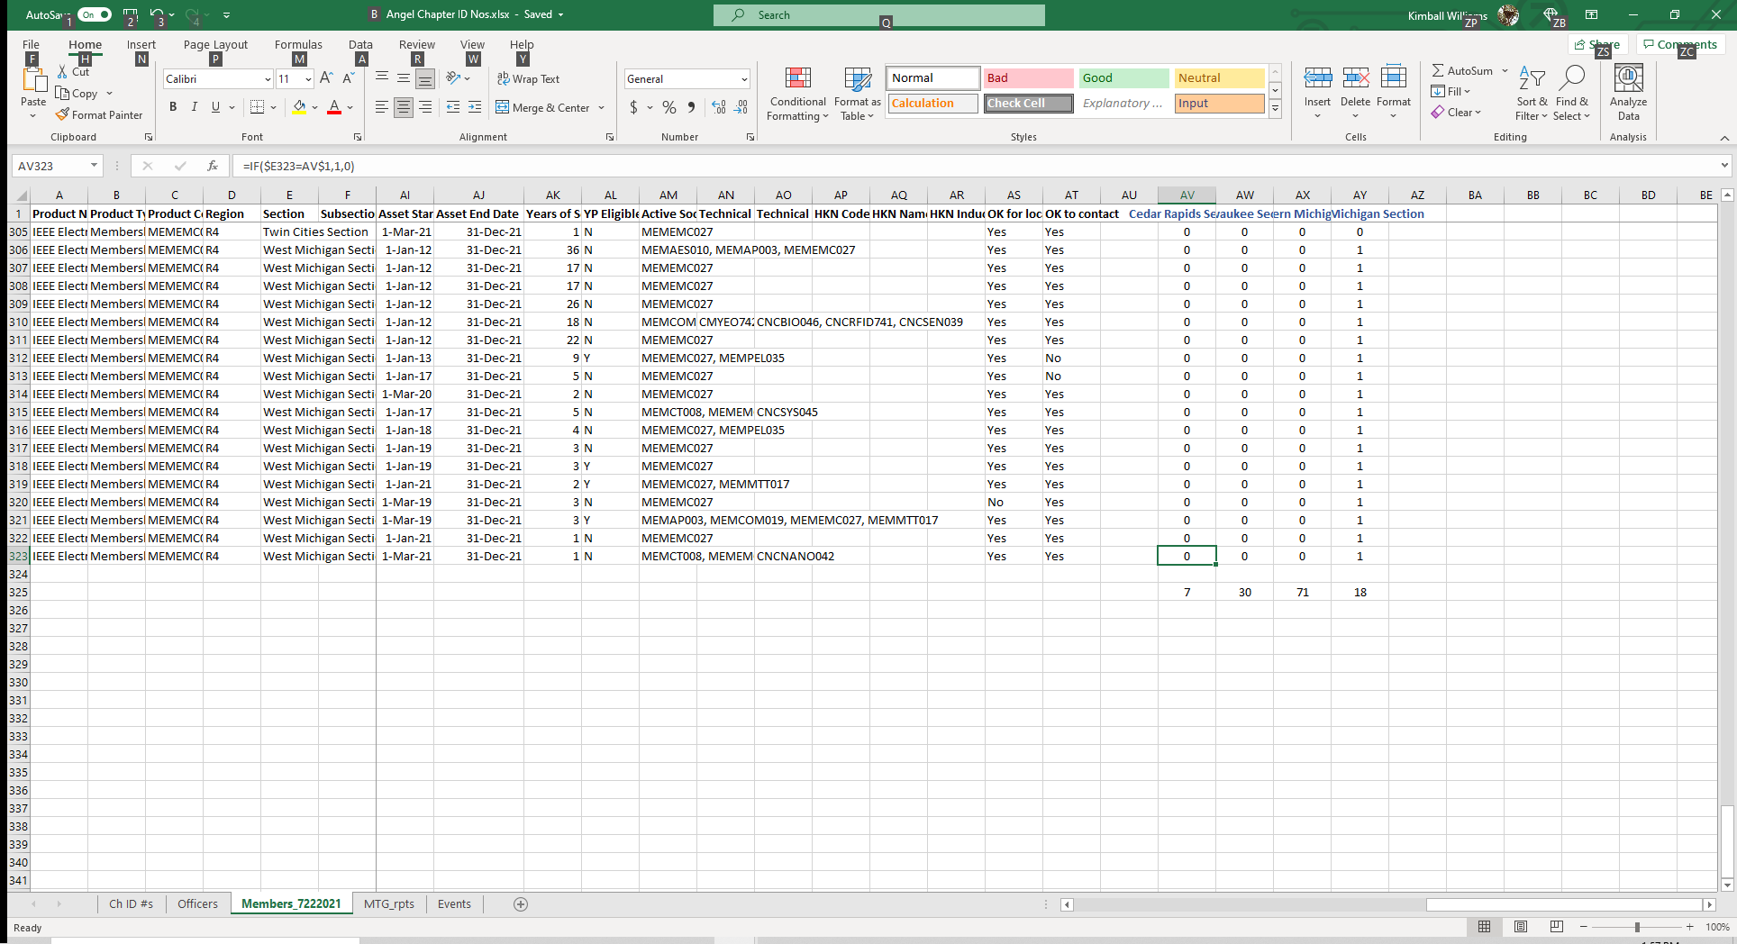

Slide 44
Questions?
DE N8FNC

