Slide 2
EMC Society
of the IEEE Long Island Section
www.ieee.li/emc

Slide 3
2021 Activity Thus Far
Hosted “Underexplored Three-Phase Power Failure Conditions”
Virtual lecture given on May 26
107 attended from 6 countries
Allowed other sections to co-host
Was approved for CEU/PDH credit
Presented suggested enhancements to MIL-STD-704 and RTCA DO-160 to clarify phase failure definition and to add conditions to help capture a more comprehensive suite of three-phase power failure modes.
Co-sponsored “Wireless Power Transfer and Lighting Devices”
Virtual meeting held on May 20
C63.30, “American National Standard for Methods of Measurement of RF Emissions from Wireless Power Transfer Equipment” provided an overview of methods for testing closely coupled wireless power transfer devices.
Forthcoming ANSI C63.29 standard, “American National Standard for Methods of Measurement of RF Emissions from Lighting Devices” covered topics including how to test programmable LED drivers to high-power dimmer towers.

Slide 4
Planned Additional Activity for 2021
Virtual lecture on “Power Factor”
NASA Chief EMC Engineer expressed interest in providing a virtual lecture but no commitments as of yet
ETS-Lindgren EMC Engineer expressed interest in providing a virtual lecture but no commitments as of yet
IEEE LI Power Electronics Symposium
Co-Hosted with IEEE LI PELS
Scheduled for November 4
In-person event
More Information: www.ieee.li/pes

Slide 5
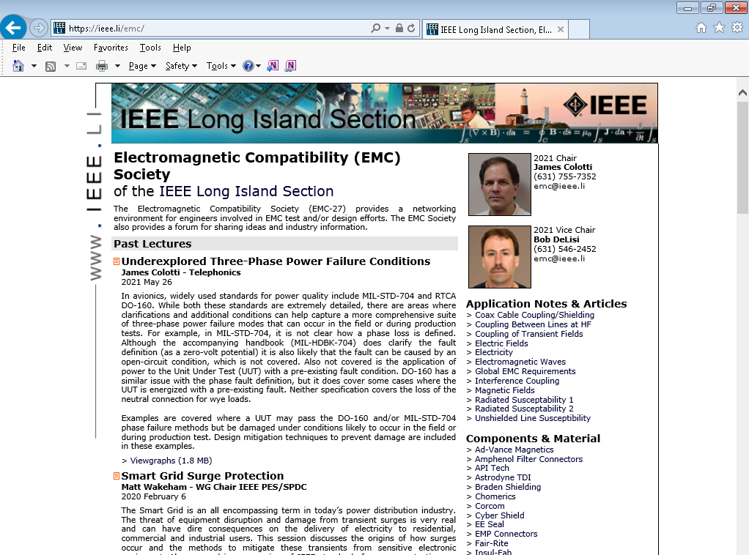
Webpage
www.ieee.li/emc
Lists past EMC lectures in chronological order (most recent on top)
Provides contact info for chair and co-chair
Email is generic (emc@ieee.li) so that when new officers take over, it does not need to change
EMI/EMC reference information provided in right column with a focus on the LI section (although most info is applicable to all involved in EMI/EMC)

Slide 6
Contact Information
IEEE LI EMC Chair
James Colotti
631-755-7352
emc@ieee.li
IEEE LI EMC Vice Chair
Bob DeLisi
631-546-2452
emc@ieee.li

