Slide 3
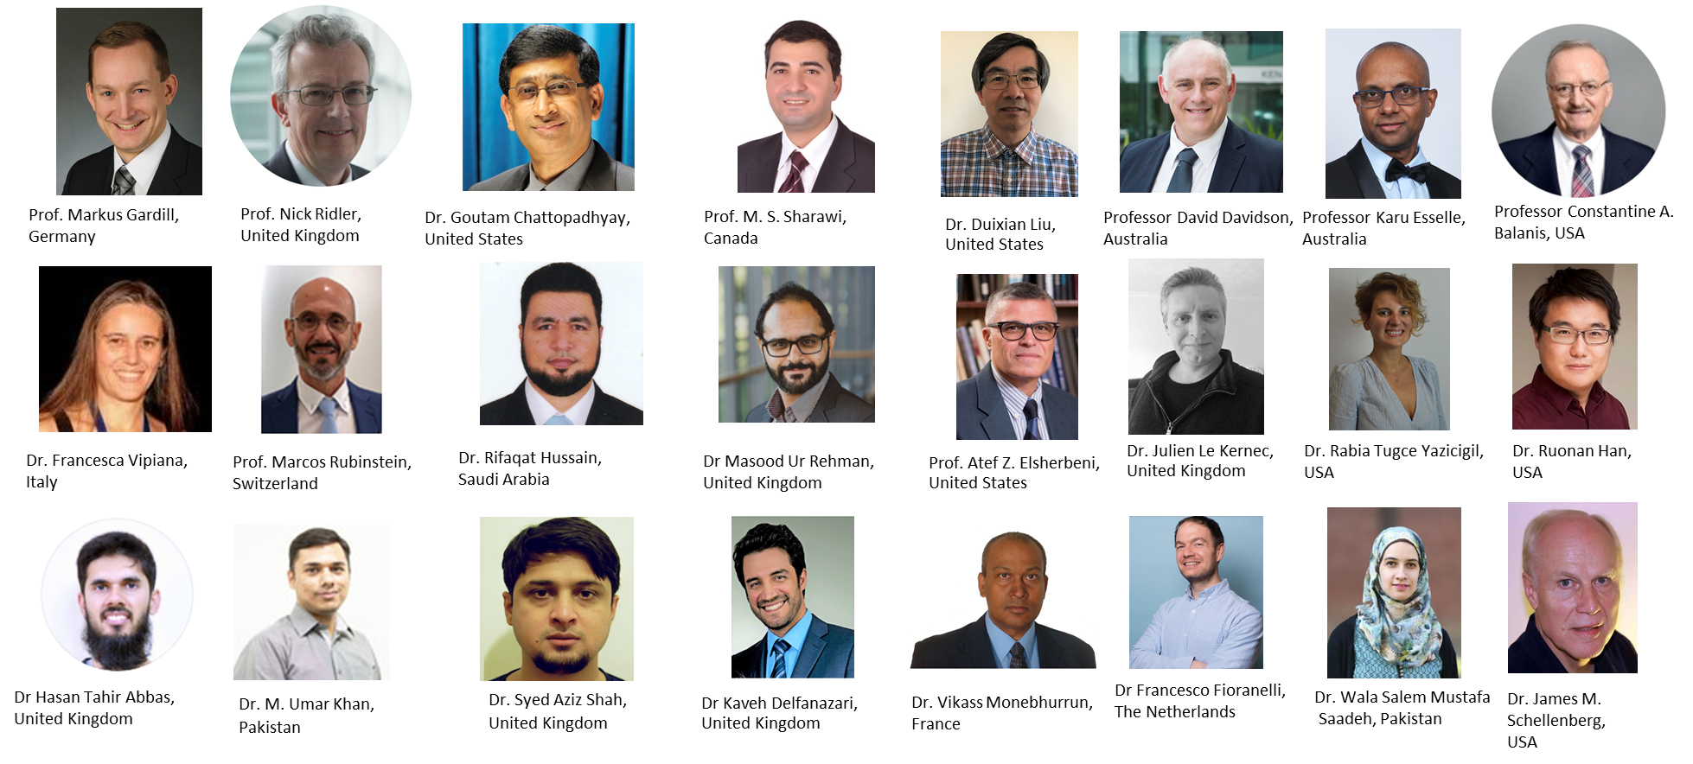
Webinar Series (>30 conducted so far)

Slide 4
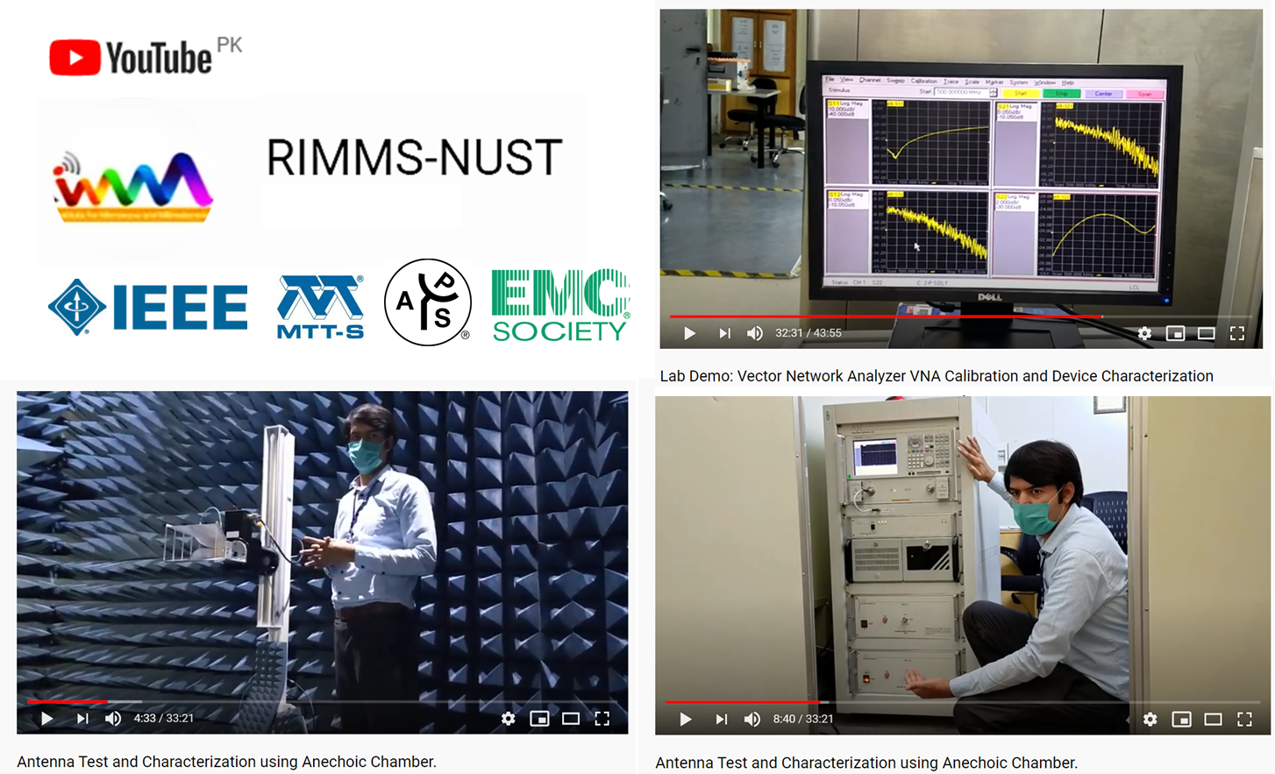
Online Education Initiatives

Slide 5
2020 IEEE International Seminar on Women in Circuits & Systems (WiCAS)

Slide 6
Future Plans
Pakistan's first RF & Microwave Conference - 2021
Chapter Expansion to other cities of Pakistan i.e., Karachi and Lahore
Establishment of Student Chapters
Online Education via Webinars and recorded Videos

