Slide 1



Slide 2


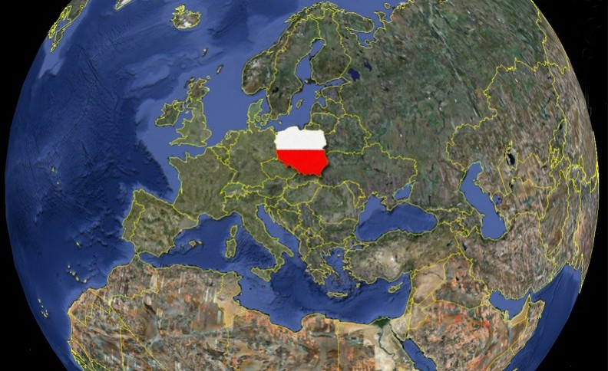
IEEE EMC-S
POLISH CHAPTER
Activity Report
2020-2021

Slide 3
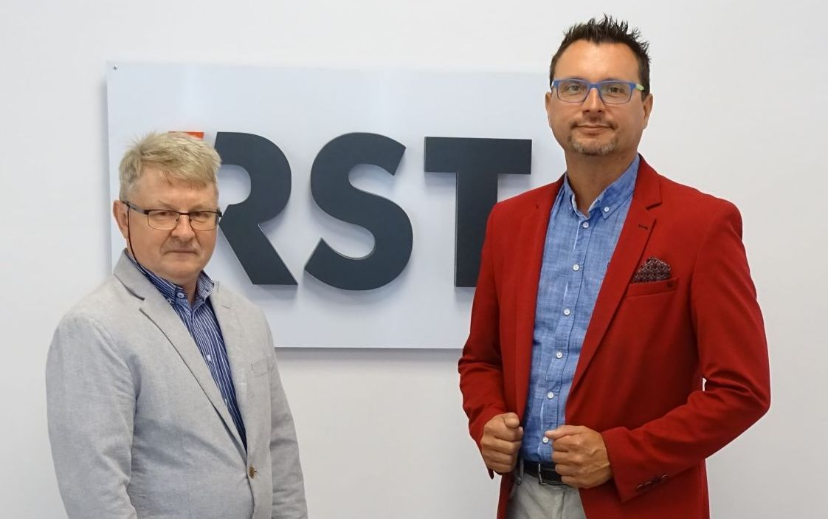
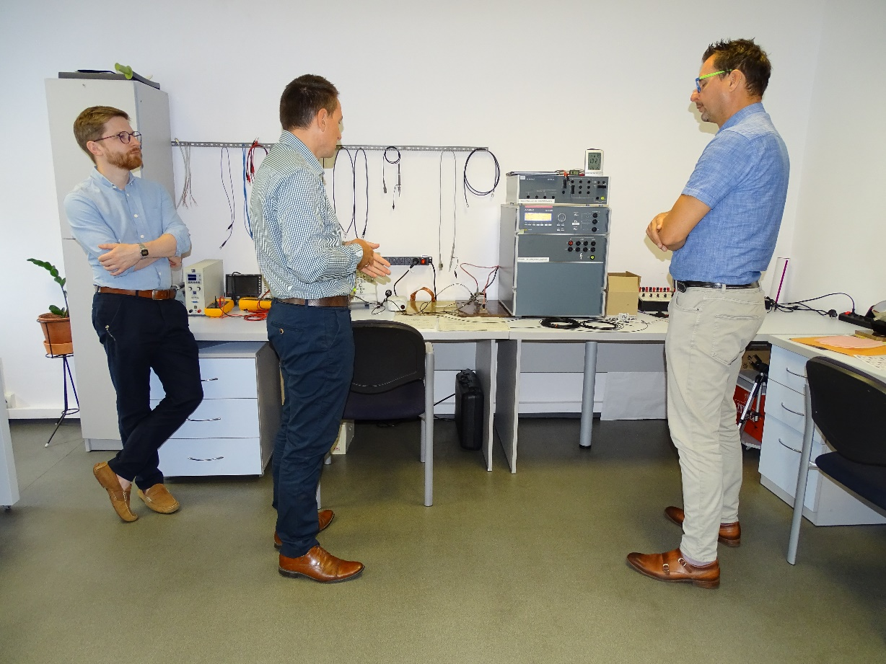
ADMINISTRATIVE ACTIVITY
Meeting no. 1
Aug. 19 – 20, 2020
Bialystok, Poland
Inaugural meeting of the newly elected EMC-S PL Management Board - definition of an action plan for the 2020-2022 term
Participants: Krzysztof Sieczkarek – Chapter Chair
Mirosław Zielenkiewicz – Vice Chair/Secretary/Treasurer
Vice
Chair
Visit in overvoltage protection
laboratory of the RST
Adoption and specification of pre-election declarations as a framework program of activities for the new
EMC-S PL Management Board in the 2020-2022 term

Slide 4
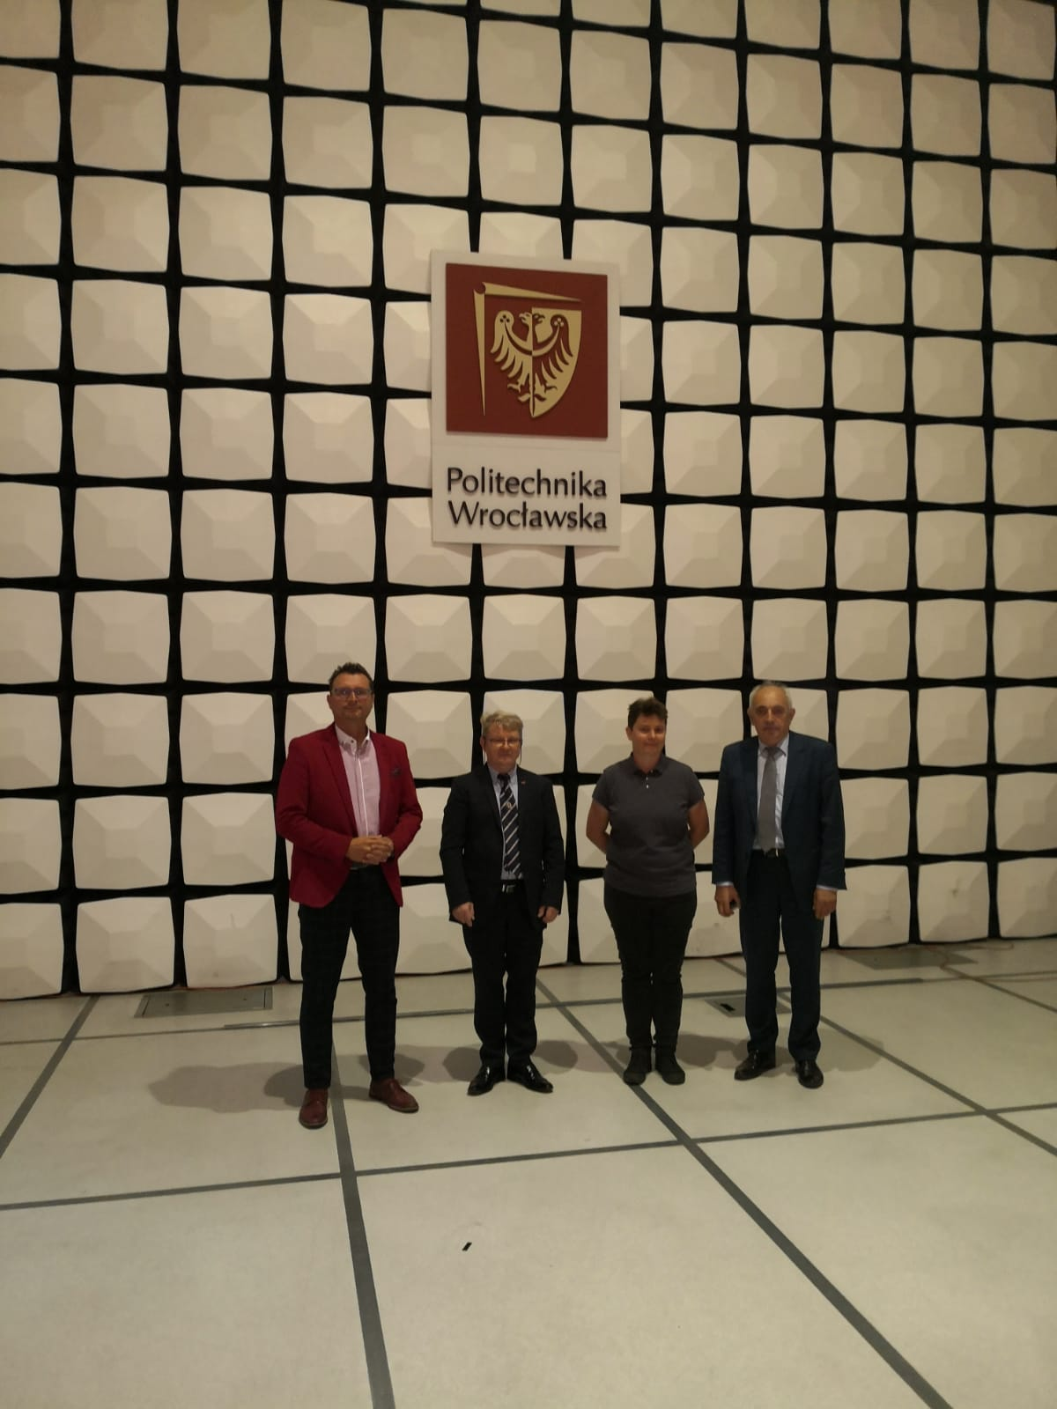
PROFESSIONAL ACTIVITY
Meeting no. 05 – Sept. 30, 2020 Wroclaw, Poland
Organizational meeting at the initiative of Board of the IEEE EMC-S PL with the Chairman of the Electromagnetic Safety Section of the Electronics and Telecommunications Committee at the POLISH ACADEMY of SCIENCES
The main goal - determining possible directions of cooperation

Slide 5
ADMINISTRATIVE ACTIVITY
Program assumptions of the Management Board of the Polish Chapter of IEEE EMC-S (2020-2022)
Spreading knowledge and engineering ideas in the field of electromagnetic compatibility.
Integrating activities Polish EMC environment, both of the scientific research and industry.
Creating a "LIVE" EMC-S PL website activating the EMC environment in Poland, addressed to a wide range of specialists - not only to IEEE EMC-S PL members.
Activities encouraging the accession of new members to the ranks of IEEE EMC-S PL, with particular emphasis on popularizing IEEE EMC-S activities among young engineering and student staff, by increasing emphasis on the practical aspects of EMC assessment and the correct design of electronic devices and systems for use in professional activity.

Slide 6
ADMINISTRATIVE ACTIVITY
New WEB SIDE - http://www.ieee-emcs.org.pl/
September, 2020
"LIVE" EMC-S PL website activating the EMC society in Poland, addressed to a wide range of specialists - not only to IEEE EMC-S PL members

Slide 7
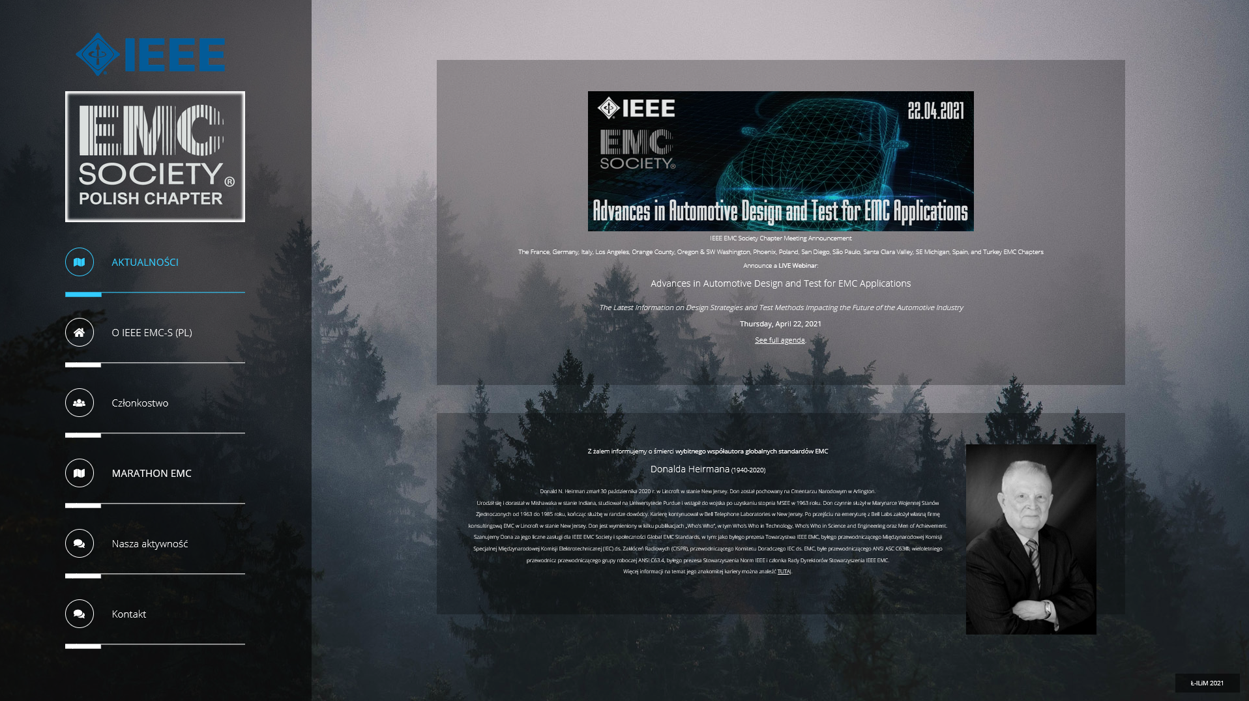
New WEB SIDE –
http://www.ieee-emcs.org.pl/
Sept. 01, 2020
New "LIVE" EMC-S PL website

Slide 8
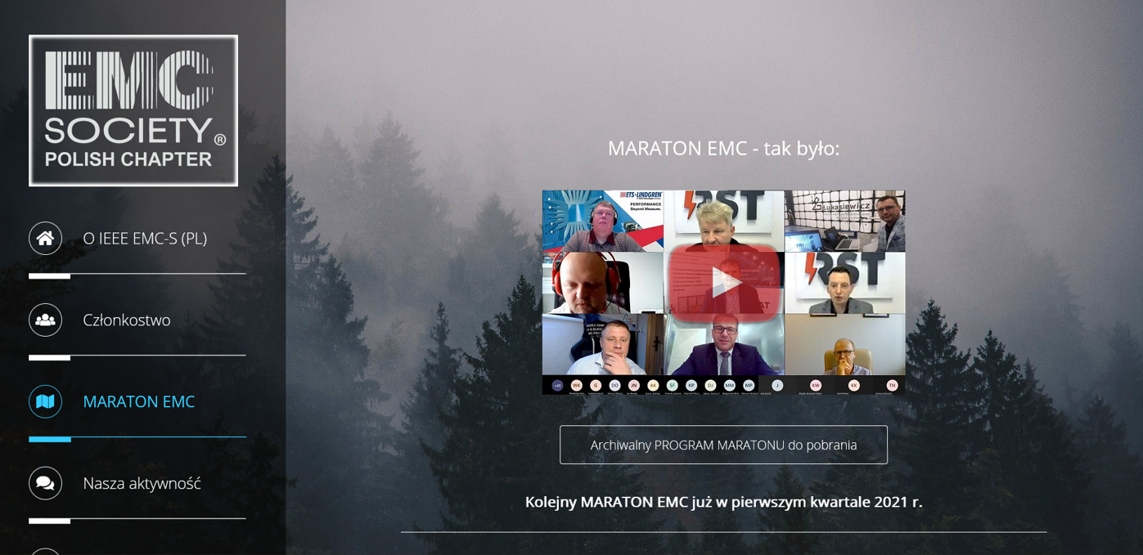
New WEB SIDE –
http://www.ieee-emcs.org.pl/
Sept. 01, 2020
The new educational and integration idea
MARATHON EMC

Slide 9
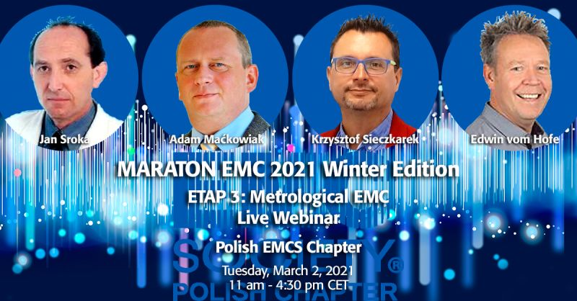
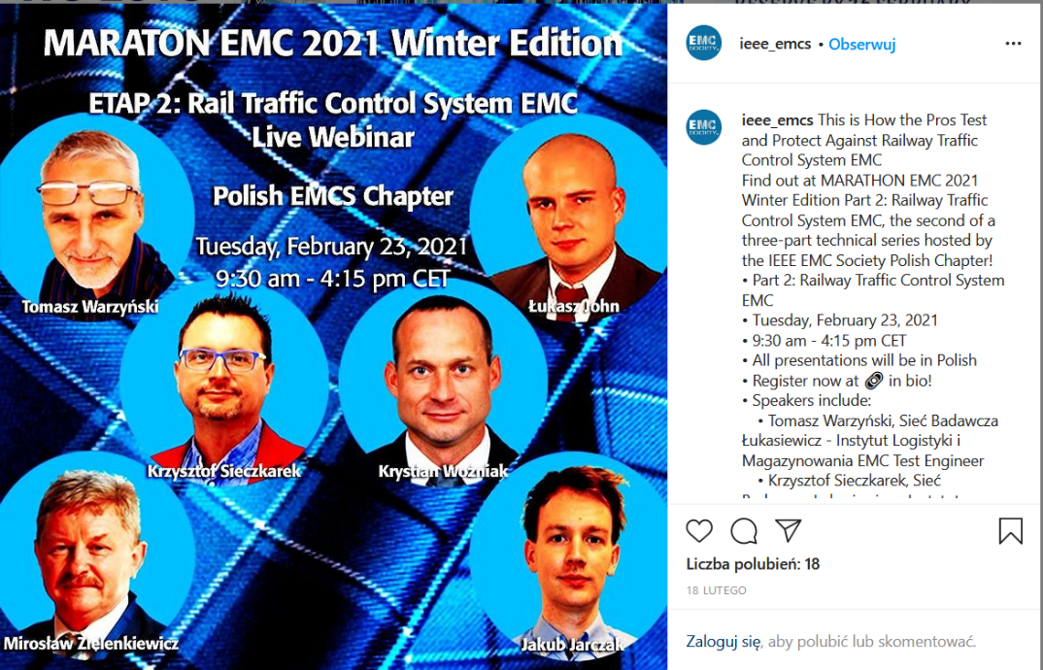
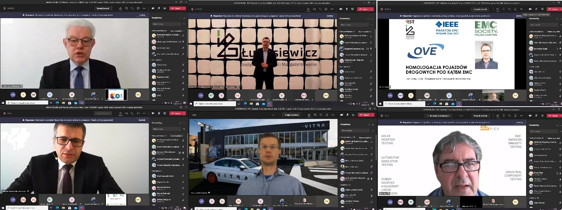
MARATHON EMC - new idea
MARATHON EMC – Etap 3
MetrologicalEMC
MARATHON EMC – Etap 1
Automotive EMC
MARATHON EMC – Etap 2
Rail Traffic Control System EMC

Slide 10


Slide 11
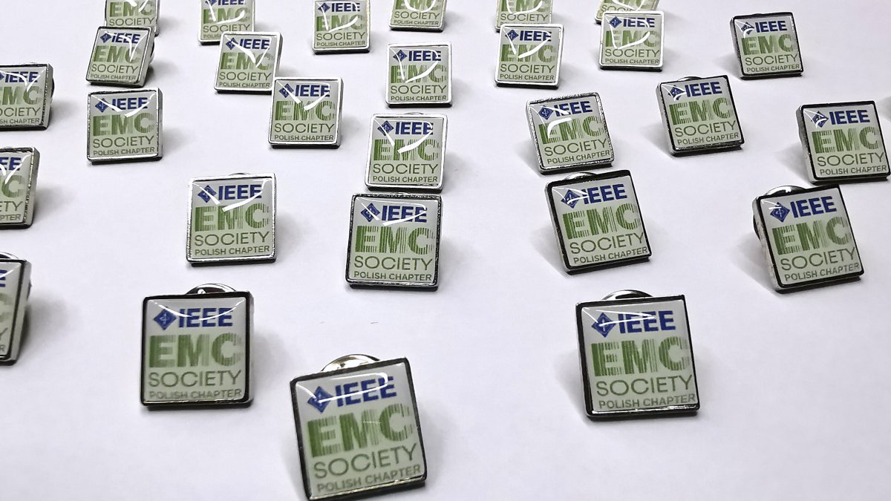
Planned jubilee activities
On the occasion
of 16 years of IEEE EMC-S PL since its inception in 2005
of 50 years of the IEEE Poland Section in 2022,
in order to increase the recognition of our Chapter,
the Board of IEEE EMC-S PL decided to honor all its members with badges with the logo of our Chapter

