Slide 2
IEEE EMC27 Croatian Chapter Report
CH08442 - Croatia Section Chapter,EMC27

Slide 3
Who are we?
Region 8
Europe, Middle East, Africa
CH08442 - Croatia Section Chapter,
EMC27

Slide 4
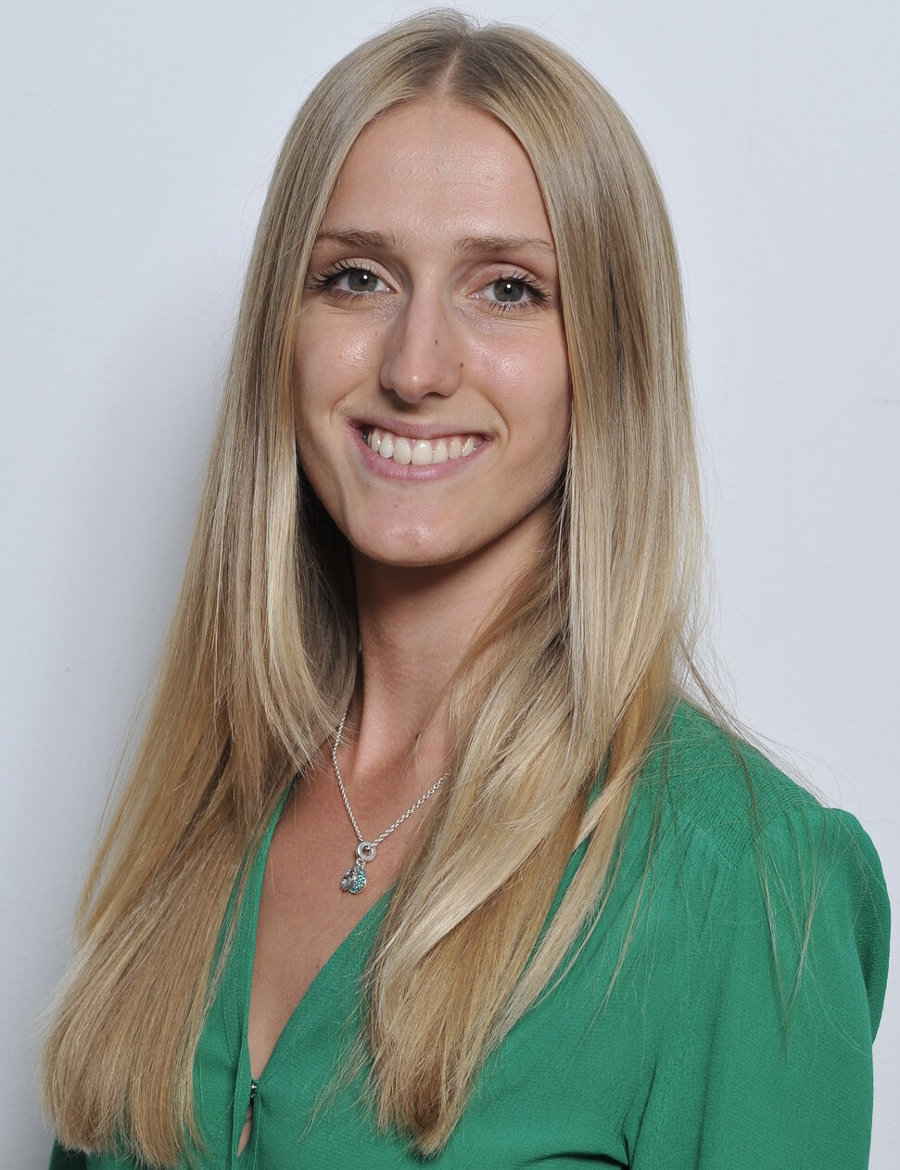
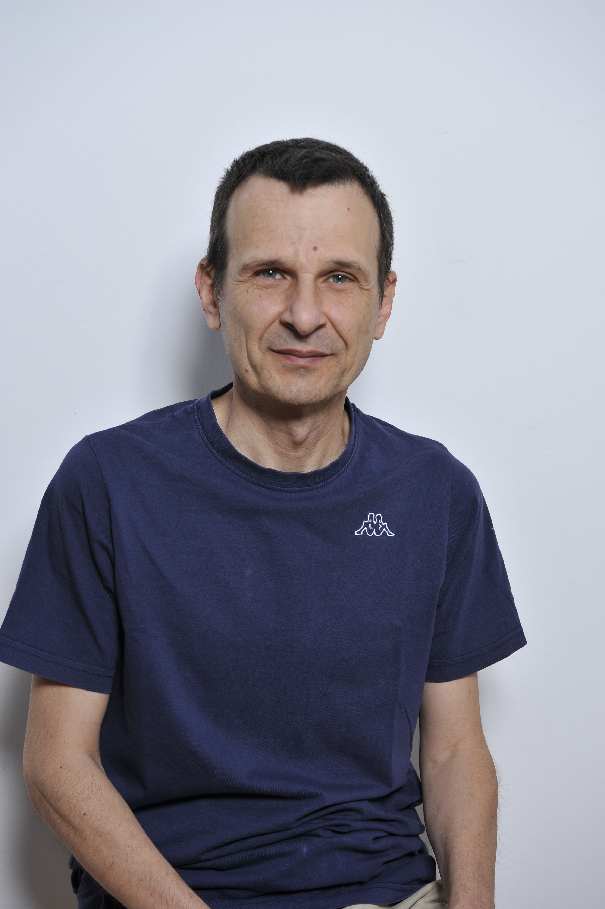
20 members from:
University of Split, Faculty of Electrical Engineering, Mechanical Engineering and Naval Architecture
University of Zagreb, Faculty of Electrical Engineering and Computing
University of Osijek, Faculty of Electrical Engineering, Computer Science and Information Technology
INTIS engineering
Prof. Zoran Blažević, PhD
University of Split, Faculty of Electrical Engineering, Mechanical Engineering and Naval Architecture
zblazev@fesb.hr
Chapter president
Anna Šušnjara, PhD
University of Split, Faculty of Electrical Engineering, Mechanical Engineering and Naval Architecture
ansusnja@fesb.hr
Chapter vice-president

Slide 5
Events in 2020

Slide 6
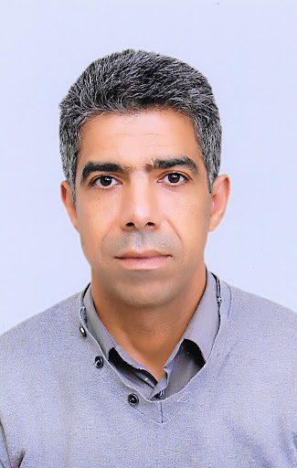
ANALYSIS OF ELECTROPHYSIOLOGICAL ACTIVITIES USING MATRIX PENCIL METHOD
Speaker:
Khalil El Khamlichi Drissi of Institut Pascal, CNRS, UMR6602, Clermont Auvergne University, France

Slide 7
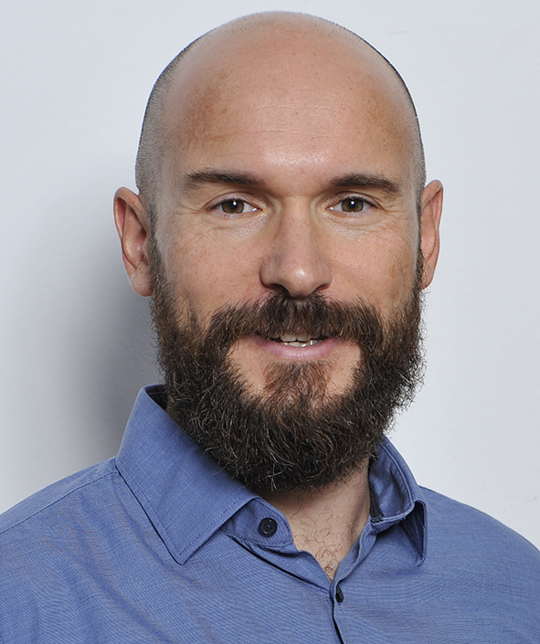
INTERACTION OF HUMANS WITH ELECTROMAGNETIC FIELDS
Dragan Poljak of University of Split, FESB, Department of Electronics and Computer Science
Mario Cvetković of University of Split, FESB, Department of Electrical Engineering

Slide 8
The recipient of the 2021 George Green Medal.
The Medal was established in 2014 by three international entities, Elsevier Publishing Co., Wessex Institute of Technology (UK), and University of Mississippi (US).

Slide 9
THE END Thank you for attention!
IEEE EMC27 Croatian Chapter Report
CH08442 - Croatia Section Chapter,EMC27

