Slide 2
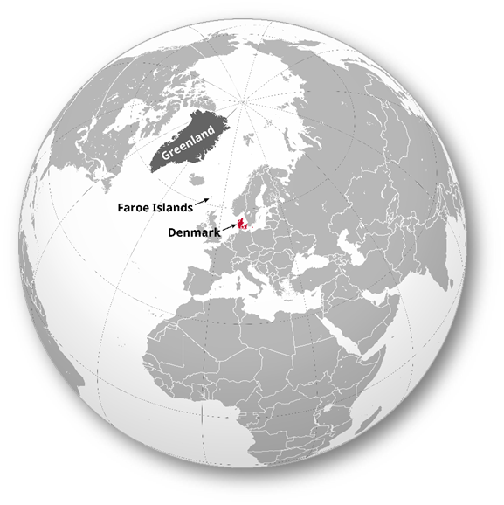
EMC Society
of the IEEE DENMARK Section
https://r8.ieee.org/denmark-emcs

Slide 3
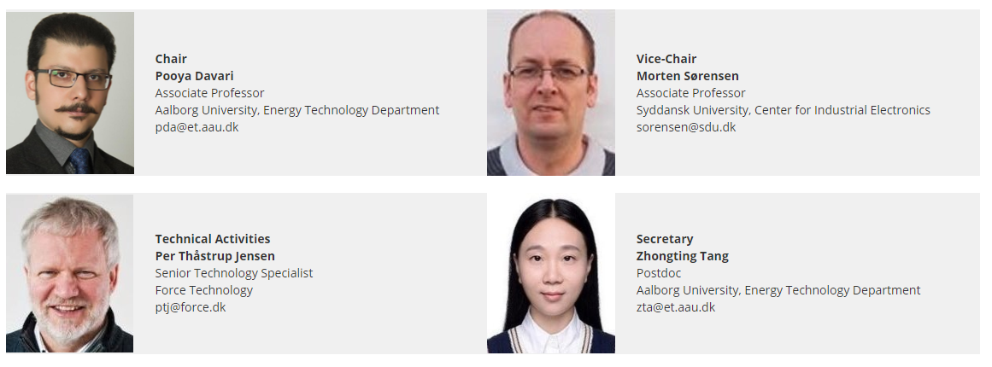
Overview
The IEEE Denmark EMC Society Chapter was approved on 12 Feb 2021
Election of the society chapter was done on May 2021
The society chapter website is available since June 2021
2021 hosted + co-sponsored activities thus far: 2
2021 planned additional activities: 5

Slide 4
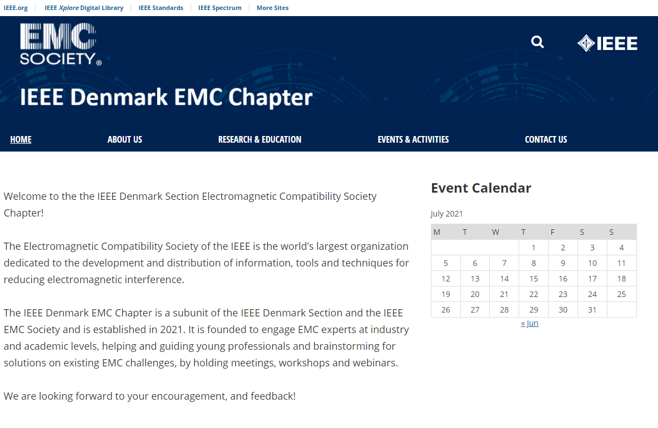
Webpage
https://r8.ieee.org/denmark-emcs
List the society upcoming and past events
Provides contact info for executive committee
Research & Education part will be updated soon with upcoming virtual/physical education courses and seminars
PhD and Master Thesis Award will be included soon for outstanding contributions to the field of EMC from Danish research institutes

Slide 5
2021 Activity Thus Far
Hosted “EMC for Fixed Installations”
Virtual lecture given on June 18th 2021
75 attended
Allowed other sections to co-host
Topics:
EMC directive 2014/30/EU: Compliance for fixed installations
EMC management of fixed installation
Measurement campaign and wind turbines
Interference examples from Danish center for telecommunications
Drones for electromagnetics measurements
Co-sponsored “Active Cancellation of Electromagnetic Emissions of Power Electronic Systems”
Virtual meeting held on June 28th 2021
Co-sponsored “Characterizing and Mitigating Self-Generated EMI in Wireless & IoT Devices”
Virtual meeting held on April 27th 2021

Slide 6
Planned Additional Activity for 2021
Hosting Virtual lecture on “Grid Measurements Methods 9 to 150 kHz”
Hosting Virtual lecture on “Design of EMC filter for an automotive onboard charger”
Joint activity with EMC Club Denmark (Hosted by FORCE Technology A/S) on “EMI/EMC”
Co-sponsoring “Nonlinear Shielding: A New Paradigm in EMI Control”, August 23rd 2021
Co-sponsoring “Hybrid doctoral student meeting 2021 in Magdeburg IEEE German EMC Chapter” Nov 9-10 2021.

