Slide 1


Slide 2
Chicago Chapter IEEE EMC Society July 30, 2021 Jack Black Chapter Chair
2020-2021 Covid 19 Challenges:
Worked with Chicago Section to Access Section Wide Zoom Account
Held Virtual Monthly Executive Committee Meeting
Scheduled Monthly Virtual Chapter Meeting with Virtual Presenters
Chicago Chapter Invited Presenters for Chicago Chapter Meetings
Co Sponsored Virtual Presentations with Other EMC Societies Chapters
Co Sponsored Virtual Presentation with other IEEE Societies
Accessed EMC Society Sponsored Presentations
In Person Picnic and Held Virtual Chicago Chapter Christmas Party
Rescheduled Annual Mini Symposium to September 2021

Slide 3
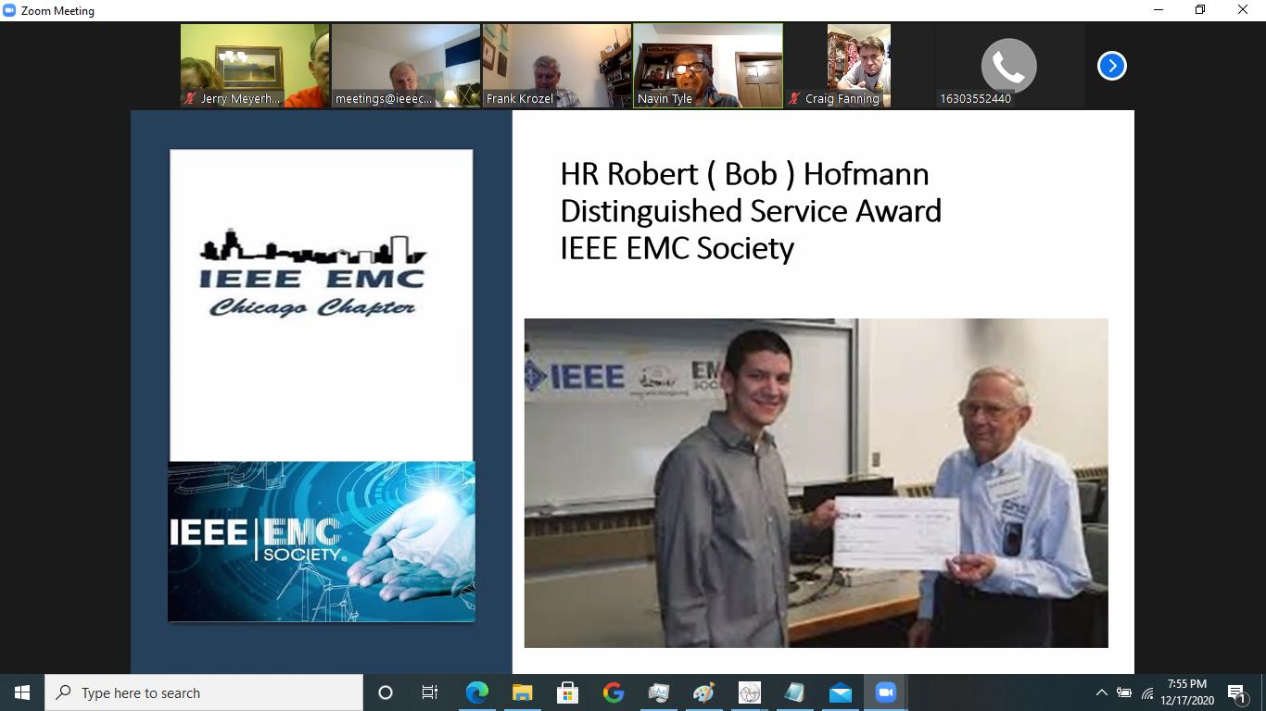
Chicago Chapter IEEE EMC Society
Connecting with the Section
Bob Hofmann Award
Stayed Active with Chicago Section
Accessed Section Zoom Account
Participated in Chicago Section Anniversity Conference

Slide 4
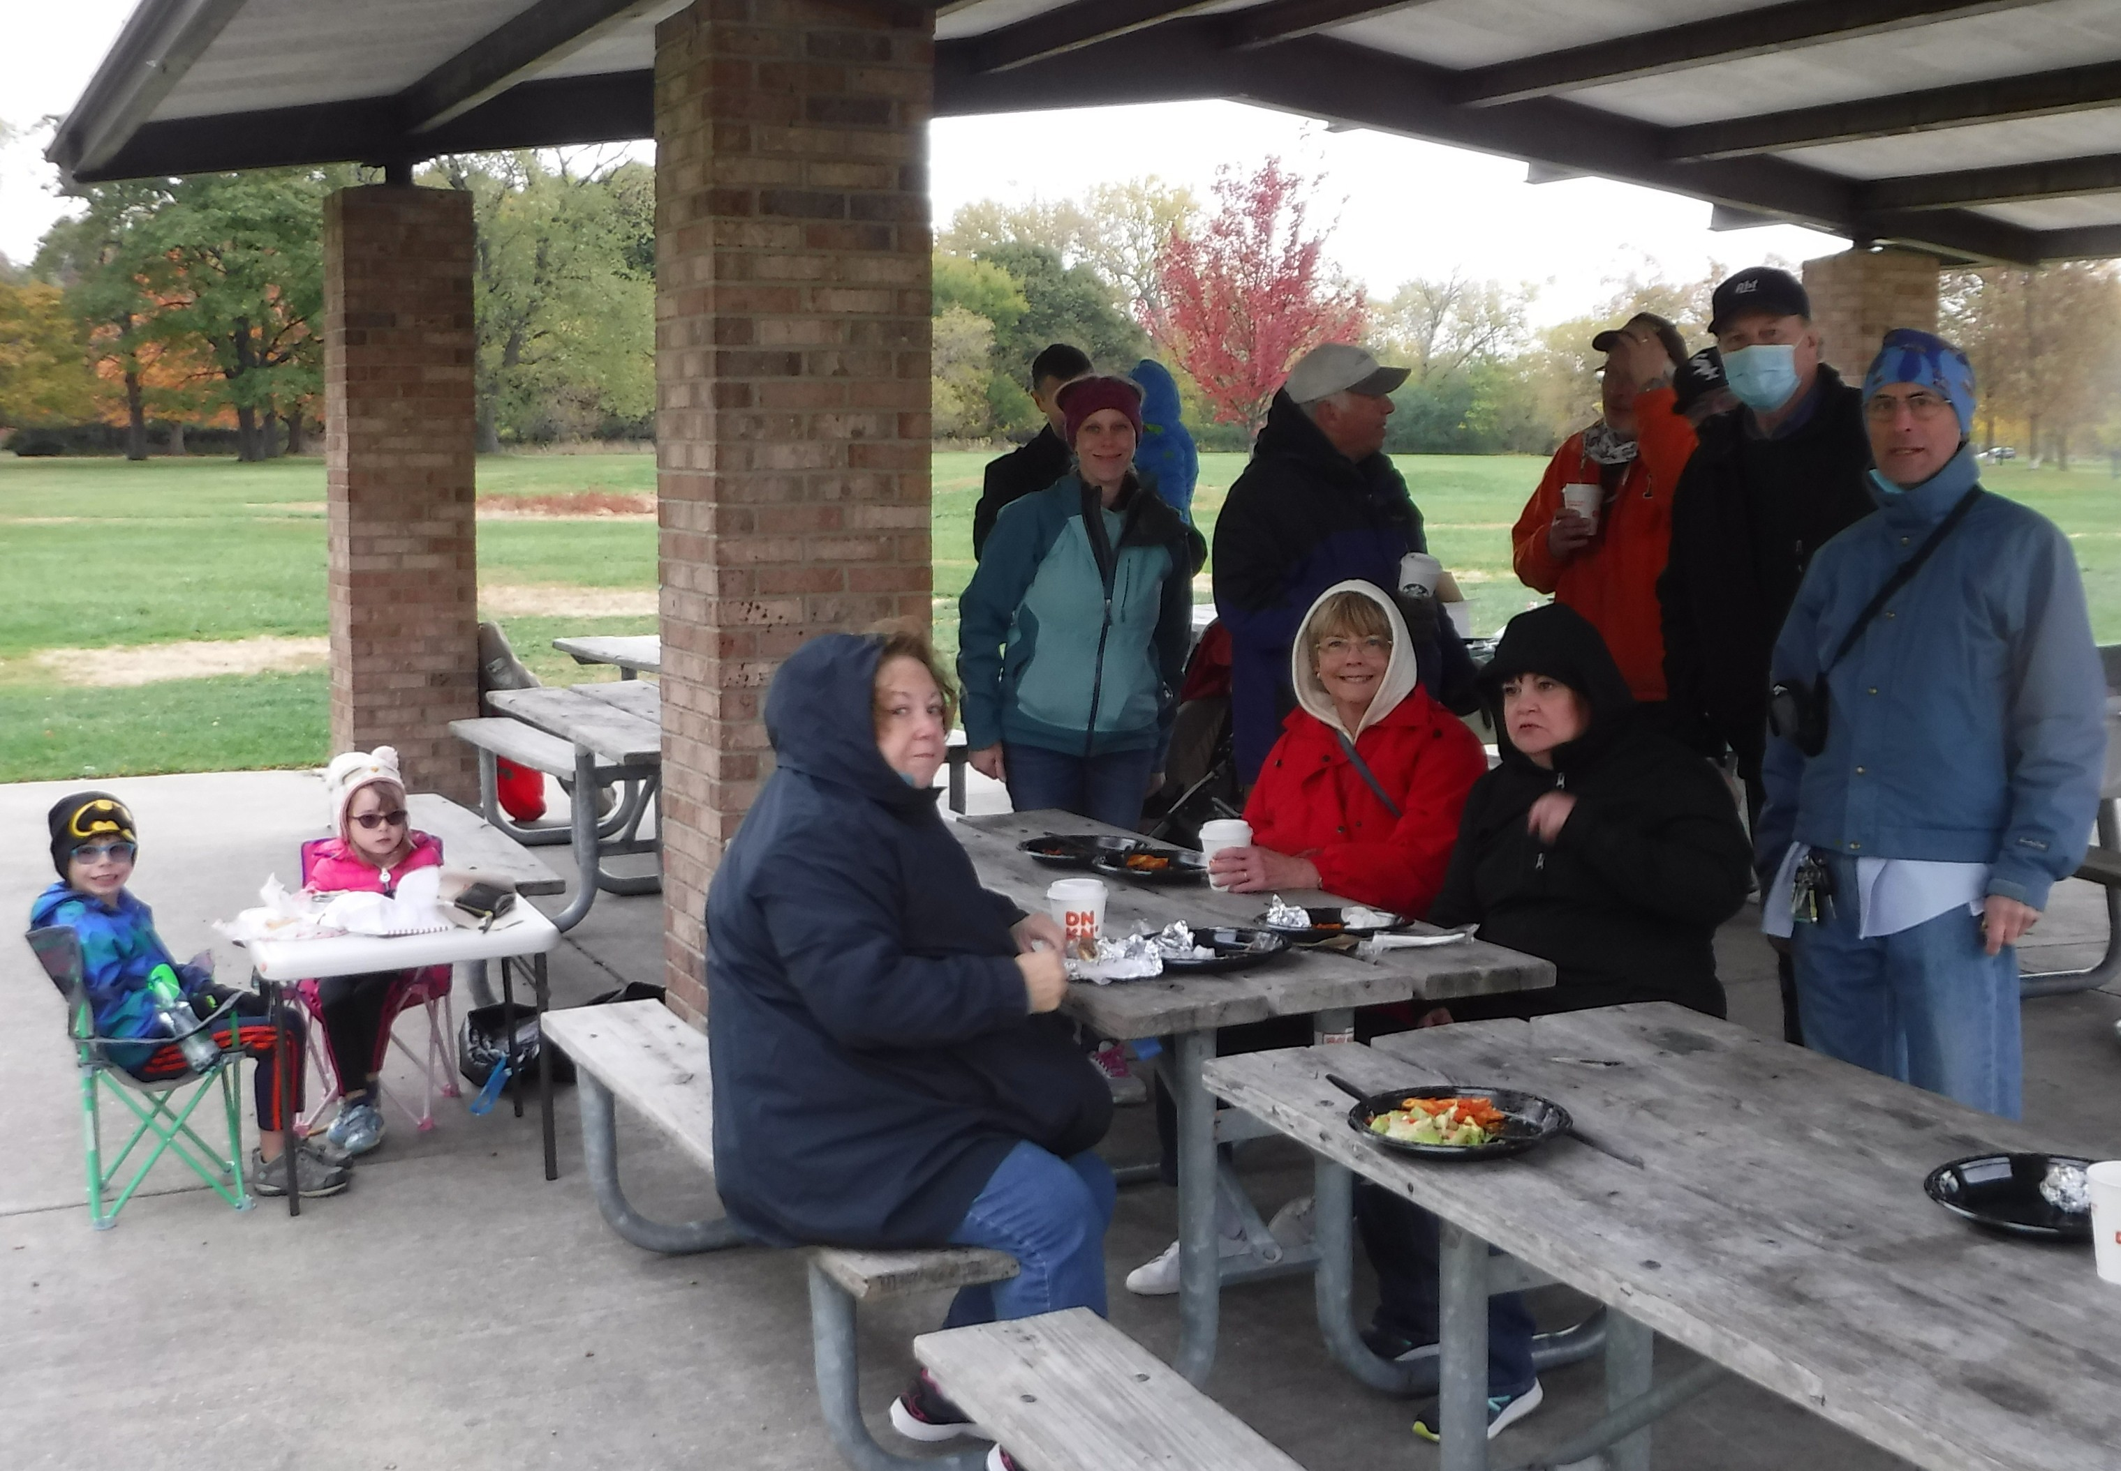
Chicago Chapter IEEE EMC Society
Keep Chapter Active
EMC Society Picnic
Organized Chapter Activities
Chicago EMC Society Picnic
Virtual Christmas Party

Slide 5
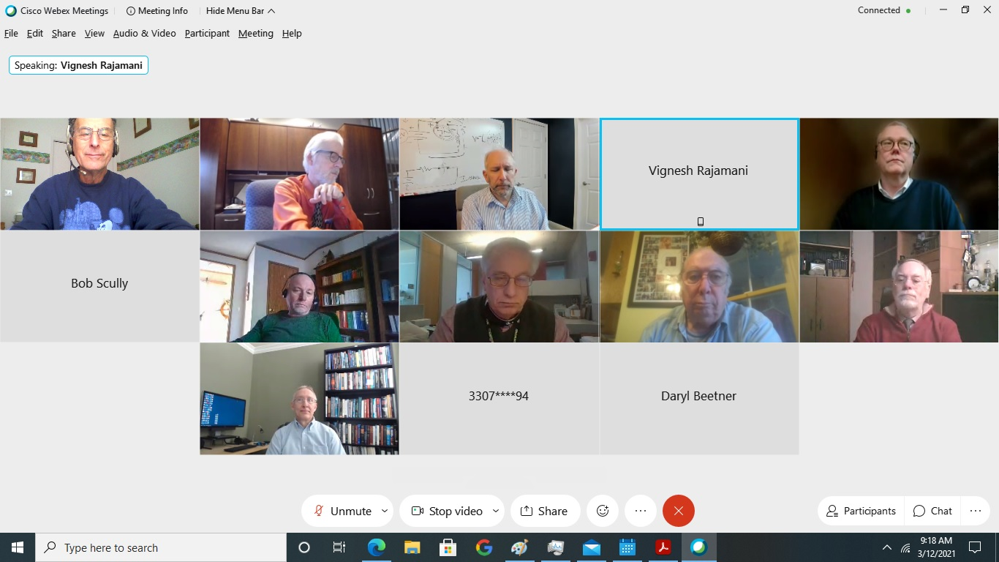
Chicago Chapter IEEE EMC Society
Continued Chapter Meetings
Accessing Virtual Presentations
Scheduled Monthly Virtual Chapter Meeting with Virtual Presenters
Local Chapter Scheduled Presenters
Co Sponsored with other EMC Society Chapters
Co Sponsored with Other IEEE Societies Chapters
Accessed other IEEE Virtual Presentations

Slide 6
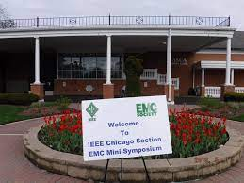
Chicago Chapter IEEE EMC Society
Moving Forward
Annual Mini Symposium
Rescheduled Annual EMC Mini Symposium
September 28, 2021
www.emcchicago.org

Slide 7
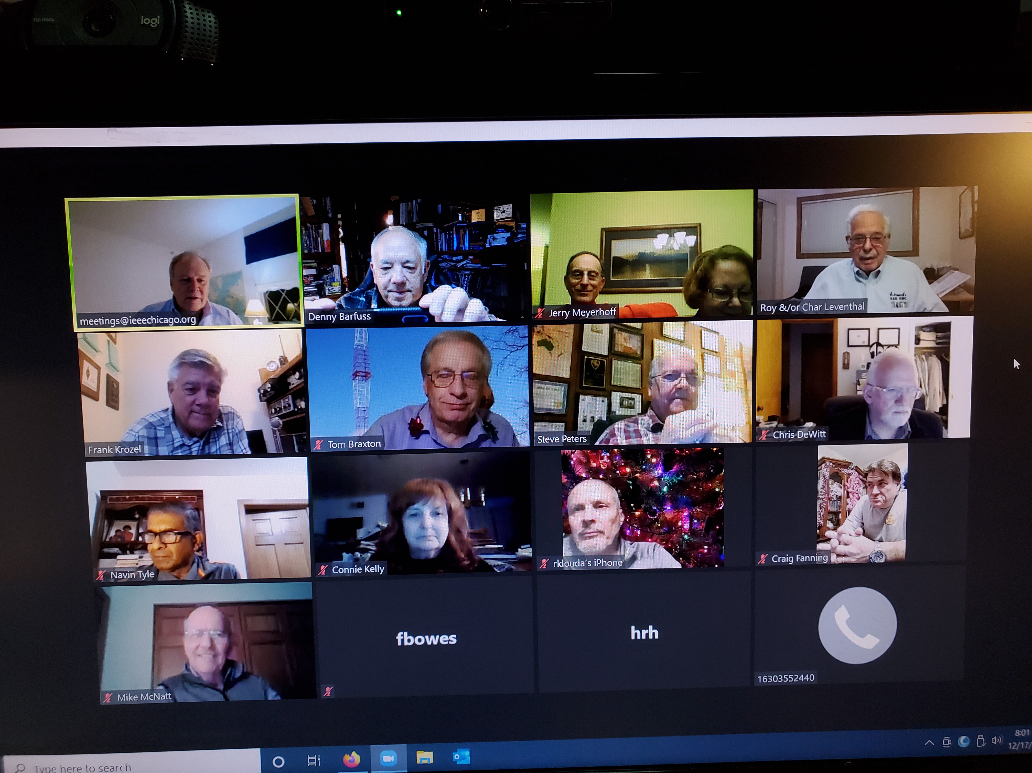
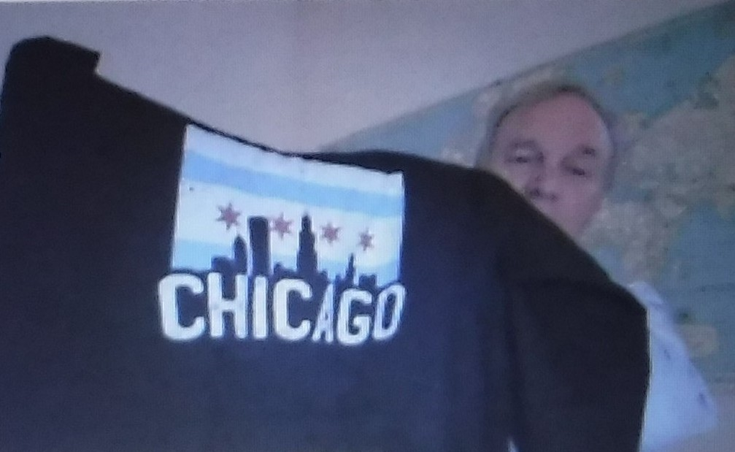
IEEE EMC Society Chicago Chapter www.emcchicago.org

