Slide 1
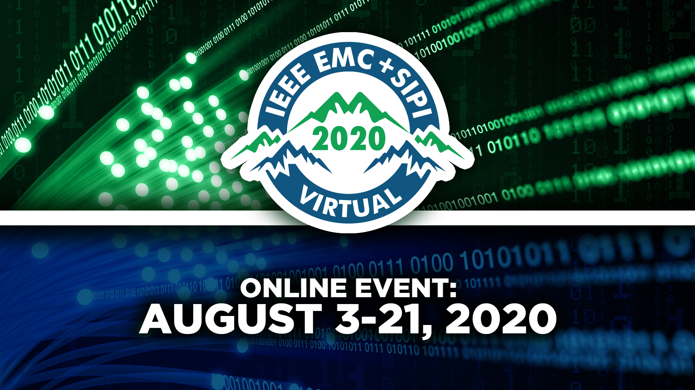

Slide 2
IEEE Santa Clara Valley
EMC Chapter Report
Caroline Chan
Treasurer
Caroline.chan.us@ieee.org

Slide 3
Chapter Snapshot up to date in 2020
  Members (101):
    1 Affiliate Members
    1 Life Fellow Members
    16 Life Member
    6 Life Senior Member
    1 Graduate Student Member
    1 Associate Members
    53 Members
    23 Senior Members
  Elected Officers :
      Chair : Caroline Chan (Interim)
      Vice-Chair : vacant
      Treasurer : Caroline Chan, Lockheed Martin
      Secretary : Len Goldschmidt, NTS
  Non Elected Officers :
      WebMaster : Joseph Nghiem
      Photographer : Jerry Ramie, ARC

Slide 4
 | 2014 | 2015 | 2016 | 2017 | 2018 | 2019 | 2020
EMC Society Members | 96 | 105 | 105 | 128 | ? | 120 | 101
  We need to reaching out to the arrears in order to have their membership reinstated
  We also have been soliciting the elevation to Senior Membership at every meeting
  Social Media, something that we need to improve: need to post often. Schedule post in advance when possible

Slide 5
  7 Technical Meetings in 2019 - 2nd Tuesday of each Month - currently held @ Bureau Veritas 775 Montague Expressway, Milpitas
  2 Technical Meetings held so far in 2020. All meetings canceled after and will resumed in Sept/Oct with Virtual Meetings (Summer time is our break time).
  Website : http://www.ewh.ieee.org/r6/scv/emc
  Mini-Symposium held on October 3rd 2019 in Embassy Suites, Milpitas: 22 exhibitors and 63 attendees/speakers
  Open and welcoming of joint meetings

Slide 6
m | Date | Presenter
The case for measurement and analysis of ESD fields in semi-conductor manufacturing | 01/08/2019 | Timothy Maloney
Advances in Automotive Design and Test for EMC and Wireless Applications | 02/05/2019 | Todd Hubing, Garth D’Abreu (ETS Lindgren)
Automated Design Rule Check for EMC Design | 03/12/2019 | Frederico Centola
Interference between RF Device Modeling and Best Practices for using CAD Information in 3D Simulation of Electromagnetic Effects | 04/16/2019 | Timothy McDonald & Matt Miller (EMA)
Nivagating Compliance in the BRIC Marketplace | 05/7/2019 | Mark Maynard
Best Measurements Practices for Power Rails: The good, the bad and the ugly | 09/10/2019 | Eric Bogatin
EMC Mini-Symposium | 10/19/2019 | 6 speakers
Advanced Antenna Meaurement Techniques using Time Domain Transformation | 12/03/2019 | Zhong Chen

Slide 7
m | Date | Presenter
Preventing Utility Power Cable Outages by Early Detection and Diagnosis of RF Signatures | 01/14/2020 | Ashley Harkness
The Lightning Phenomenon | 02/18/2020 | Marcos Rubinstein

Slide 8
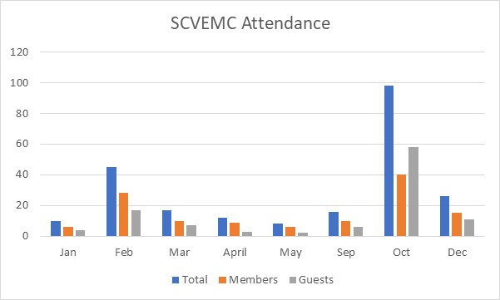
2019 Technical Meeting Attendance Summary

Slide 9
2020 Technical Meeting Attendance Summary
 | Total | Members | Guests
Jan | 16 | 10 | 6
Feb | 22 | 14 | 8

