Slide 1
IEEE EMC Society Chapter Chairs Training/Report Virtual Session Daejeon-Seoul Joint Chapter (Korea Chapter)
August 24, 2020
Seungyoung Ahn

Slide 2
Chapter Status
Daejeon-Seoul Joint Chapter (Korea Chapter)
Re-Established in Oct. 2019
Organizers
Chair: Seungyoung Ahn (KAIST)
Co-Chair: Hyun-Ho Park (Univ. of Suwon)
Secretary: Eakhwan Song (Kwangwoon Univ.)
Members: 50 (Daejeon 15 + Seoul 35)
Encouraging more memberships of IEEE EMC Society

Slide 3
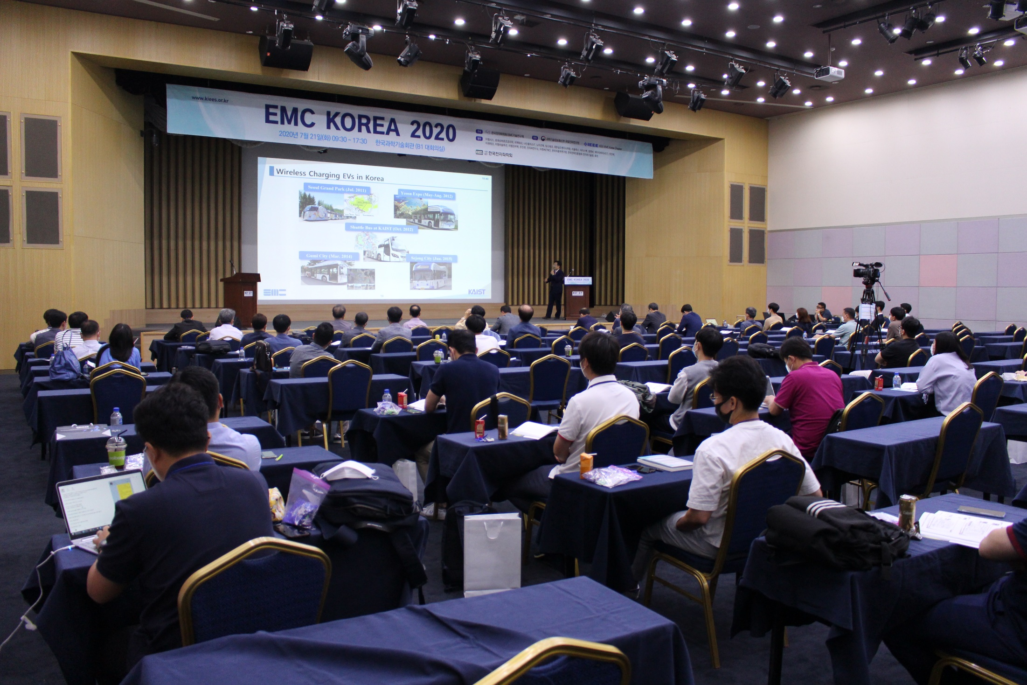
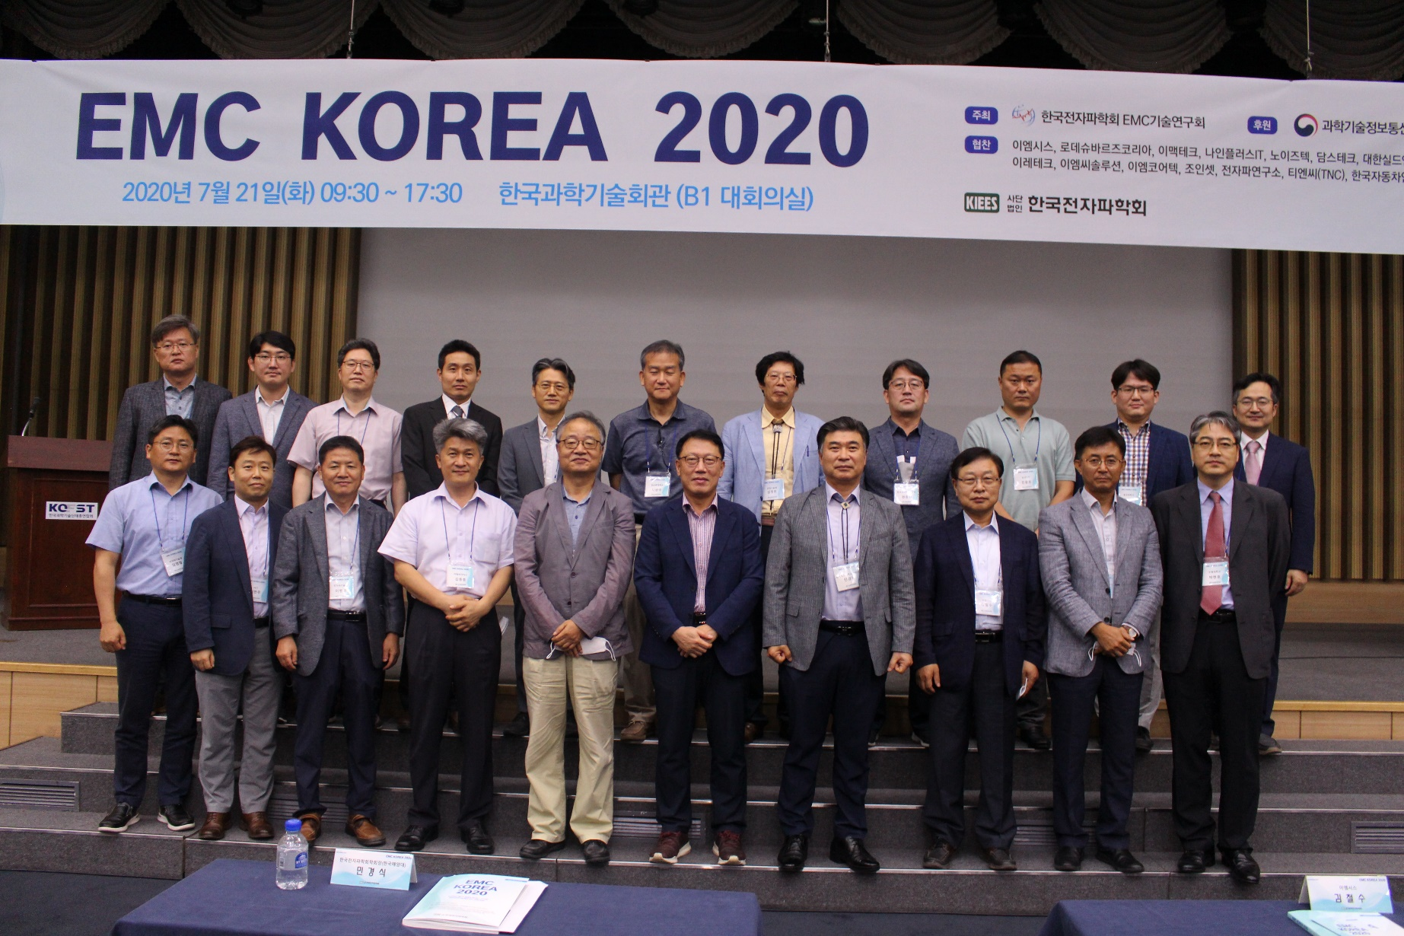
Chapter Activities – Workshops
EMC Korea 2020 (July 21, 2020)
* EMC Korea is a workshop series of Korean EMC engineers since 1999.
Total 7 invited presentations in 2020 (Reduced due to COVID-19)
2 on-line presentations from Missouri S&T in US.
150 Attendees (100 on-site + 50 on-line)

Slide 4
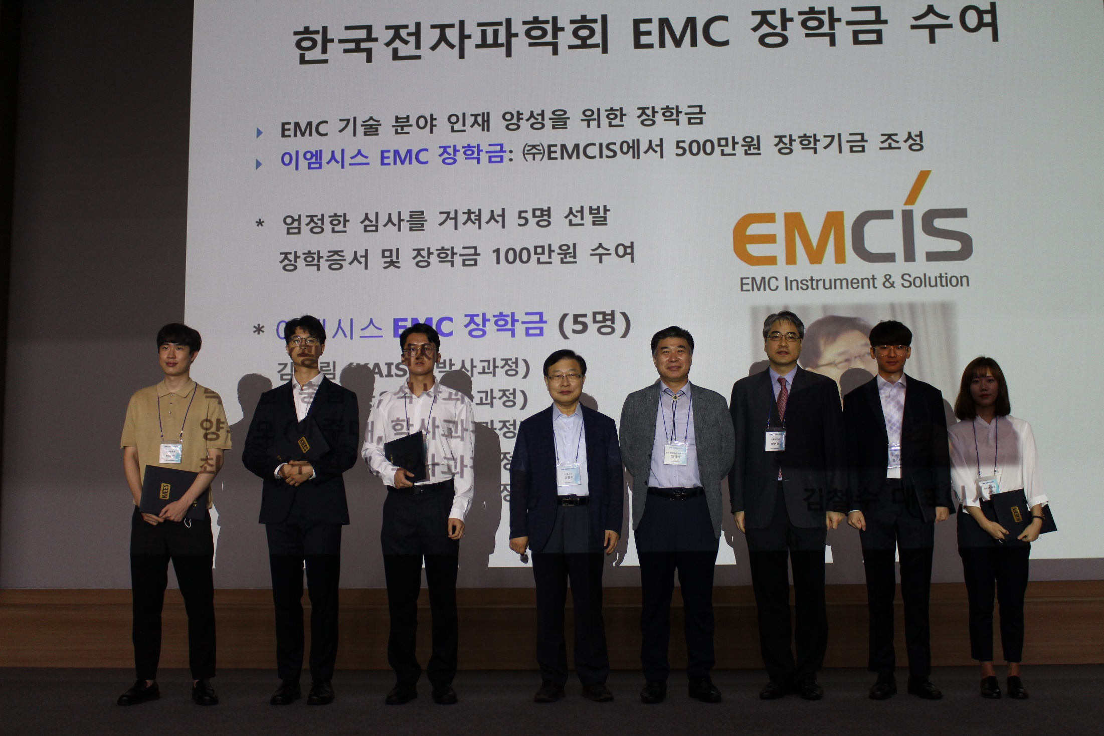
Chapter Activities – Scholarship Program
EMC Scholarship Since 2013
To encourage EMC researches for grad/undergrad students
5 students received $1,000 per student
Sponsors: EMCIS, Chang Sung Corp., EM Engineering

Slide 5
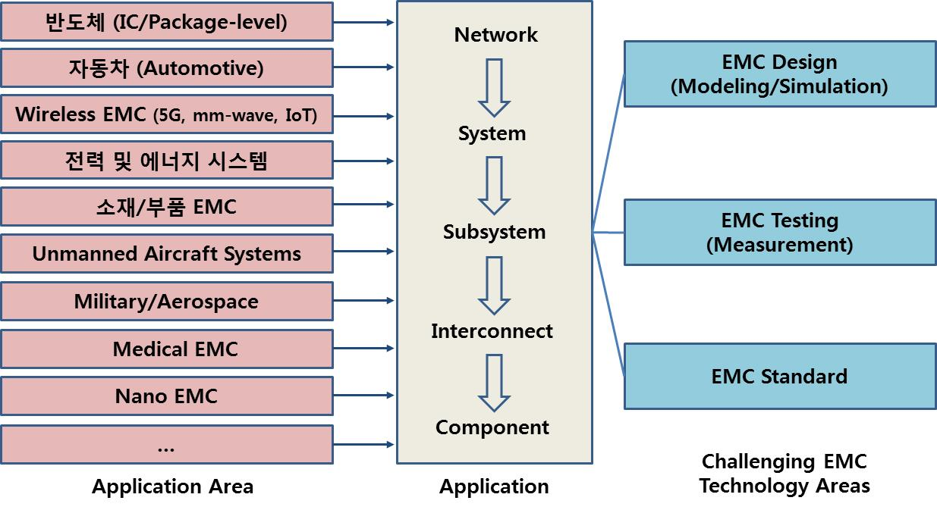
Chapter Activities – EMC Roadmap
Planning of EMC Technology Roadmap
Short-term and long-term plan of EMC researches
Mostly supported by Korean government
Updated and announced to public every one or two years

Slide 6
Chapter Activities – Chapter Meetings
Chapter meeting on Dec. 13, 2019
11 members and 7 observers attended
Chapter committee election
2 invited seminars
Chapter meeting on Feb. 14, 2020
11 members and 14 observers attended
Workshop preparation
Next meeting
Dec. 10, 2020 (Plan)
Feb. 11, 2021 (Plan)

Slide 7
Chapter Activities – DL Talks
No DL talks in Korea chapter in 2020 yet.
Planning to have virtual DL talks in 2020 and 2021.

