Slide 1
Kitchener-Waterloo Chapter Reporting
Vice-Chair: Mingchang Wang
Secretary: Jandrew Gonzales

Slide 2
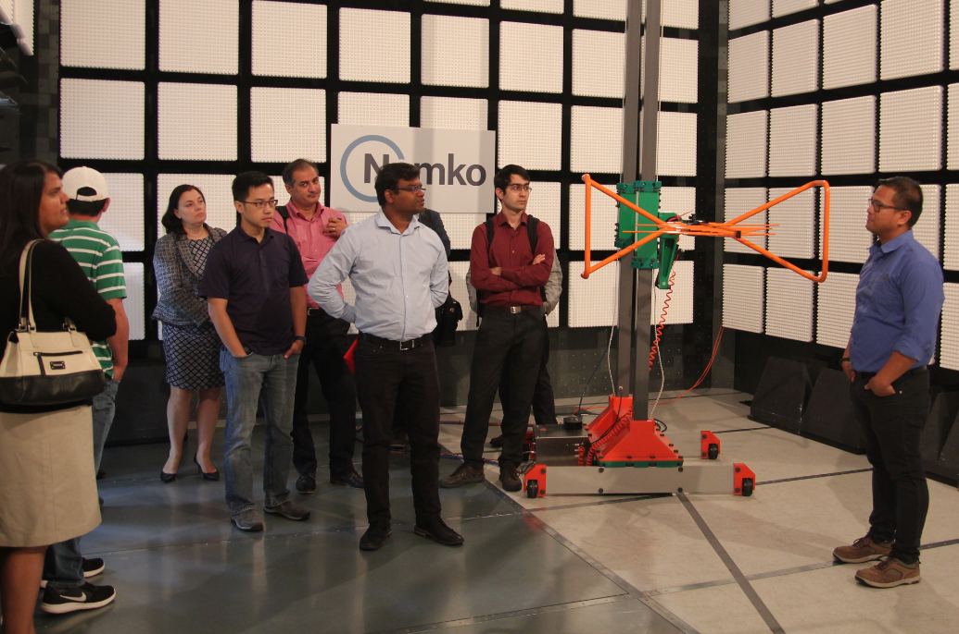
Kitchener-Waterloo IEEE EMC/MAG Chapter
Found in 2013
6 Active Members
Half day technical session in Aug 2019 @ Nemko, Cambridge, Canada (three presentations includes one IEEE DL presentation; 25+ attendees)
One day technical session in Oct 2019 @ Christie Digital, Kitchener, Canada (six presentations include one IEEE DL presentation; 40+ attendees)

Slide 3
Future
Virtual Webex is being arranged
IEEE EMC membership pitch
Collaboration with Toronto Chapter and London Chapter
More collaboration with local University of Waterloo and Conestoga College!

Slide 4
Gambling Movie
Much less new released movie in 2020
Year 2020 is a live “Gamble” show
Economic Stimulus Vs. Credit Risk
Mask Vs. No Mask
Send child back to school Vs. Online study at Home
Etc… and on-going
As an engineer, I tend to use data (raw data), probability and worst-case analysis to “Gamble” in 2020 and beyond!
Stay Safe!

