Slide 1
IEEE EMC-S Sendai Chapter Report
Shinobu Ishigami, Chair
Tohoku Gakuin University, Tagajo, JAPAN
shinobu@mail.tohoku-gakuin.ac.jp

Slide 2
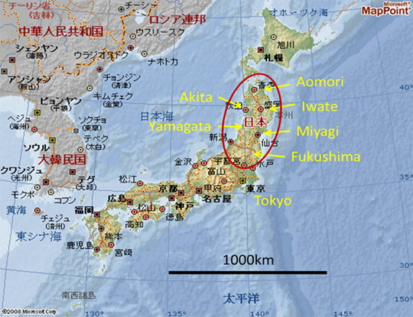
Our Location

Slide 3
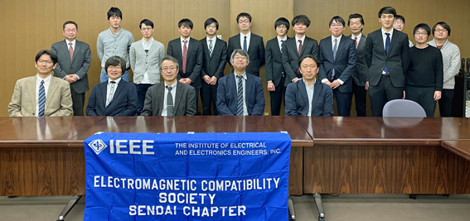
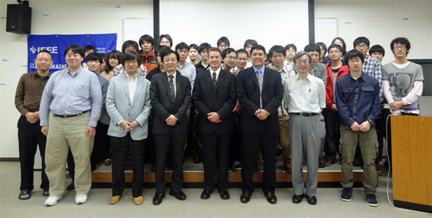
About us
Sendai Chapter was officially approved by the IEEE EMC Society on December 20th, 2001 established by Professor R.Sato (Chair), Prof. T.Takagi (Vice-chair), Prof. A.Sugiura (Secretary), and Prof. H.Sone (Treasurer).
Number of Chapter Members : 21
Chair: Shinobu Ishigami
Vice-Chair: Teruo Tobana
Secretary: Ken Sato
Treasurer: Sho Muroga

Slide 4
Hosted our events in 2019 and 2020
Colloquium and technical meetings
February 12, 2019, Research Meeting for Students (7 speakers + 13 audience)
June 7, 2019, DL meeting (Dr. Zhong Chen, ETS-Lindgren, USA, 50 audience)
November 8, 2019, Colloquium (1 speaker +15 audience)
December 18, 2019, Technical Lecture (4 speakers +30 audience)
February 20, 2020, Research Meeting for Students (10 speakers + 25 audience)
Technical meetings of co-sponsorship with the IEICE: 16 +1 (EMC Sapporo & APEMC 2020)
Administrative meeting: 2

Slide 5
EMC Sapporo & APEMC 2019
“EMC Sapporo+APEMC 2019” = 2019 Joint International Symposium on Electromagnetic Compatibility and Asia-Pacific International Symposium on Electromagnetic Compatibility, Sapporo
Submitted papers
Accepted papers
 | Regular Session | Organized Session （OS+α*） | →Total
1-page | 71 | 43 (0) | 114
Full-length | 153 | 50 (30) | 203
↓Total | 224 | 93 (30) | 317
 | Regular Session | Organized Session （OS+α*） | →Total
1-page | 58 | 43 (0) | 101
Full-length | 122 | 48 (28) | 169
↓Total | 180 | 91 (28) | 271
Acceptance Rate for 1-page & Full-length, RS & OS+alpha: 81.9 %
OS-α: Organized + alpha:
"Organized" was split. One is the "Organized", in which paper will not be published in the IEEE Xplore.
Another is the "Organized+a", in which paper will be published in the IEEE Xplore.
The "Organized+a " paper will be reviewed by the same process of the Regular full-length paper.

Slide 6
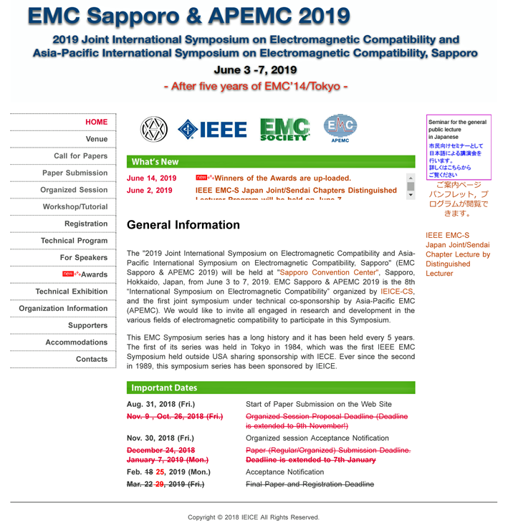
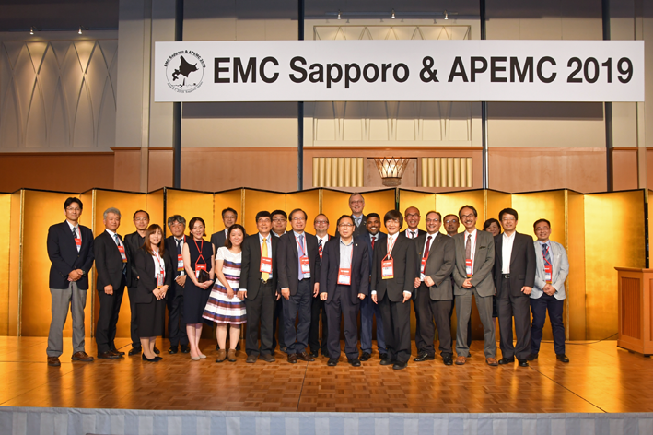
EMC Sapporo & APEMC 2019 (Cont’d)
Thank you for your kind attention!

