Slide 1

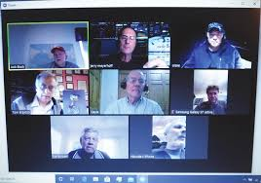

IEEE EMC Society Chicago Chapter 2020 Presentation

Slide 2
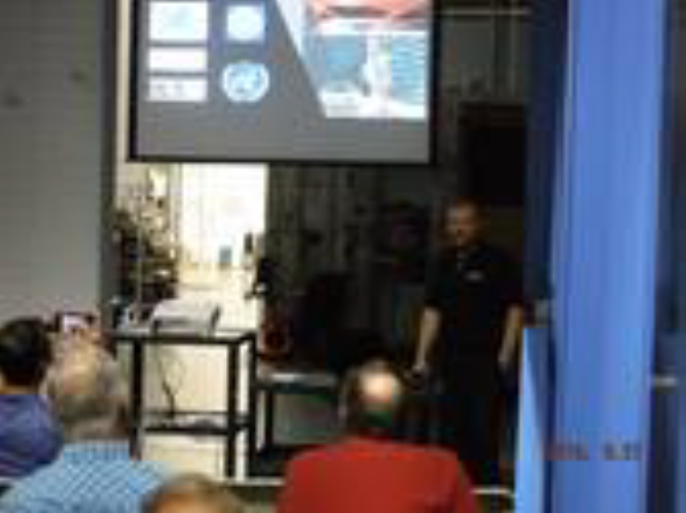
IEEE EMC Society Chicago Chapter 2020 Presentation
    September Oktoberfest at Elite Electronics
    Cory Bradshaw DLS Joint Venture with Detroit and Minneapolis Chapters
    Dr. Andy Marvin

Slide 3
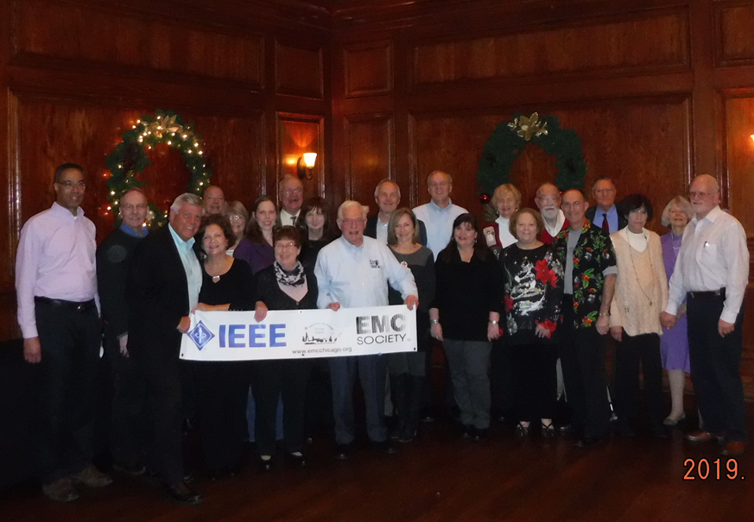
IEEE EMC Society Chicago Chapter 2020 Presentation
    November Joint Meeting Annual Holiday Party
    with NW Sub Section December
    Mike Hertz LeCroy

Slide 4
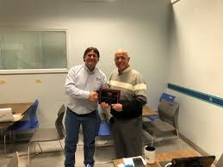
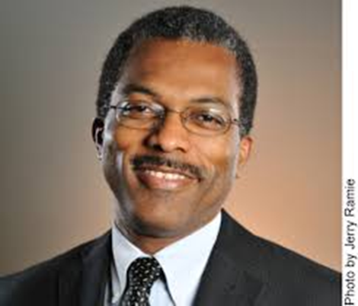
IEEE EMC Society Chicago Chapter 2020 Presentation
    February April Virtual Meeting
    Louis Feudi- Raymond Garth D’Abreau ETS Lindgren
    Joint Meeting with Chicago
    Chapter Vehicle Technology
    Society

Slide 5
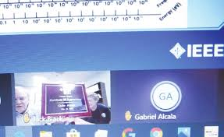
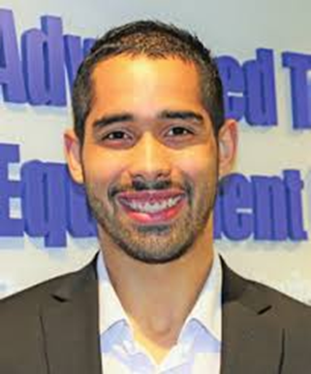
IEEE EMC Society Chicago Chapter Presentation 2020
    May Virtual Meeting Gabe Alcala ATS

Slide 6
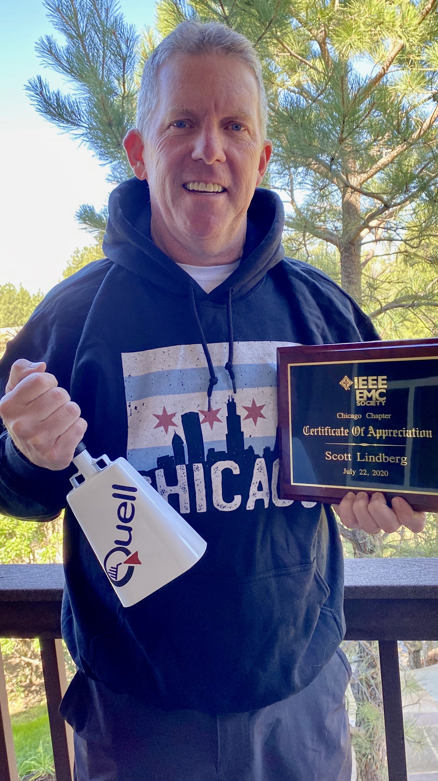

IEEE EMC Society Chicago Chapter Presentation 2020
    June-Virtual Meeting July- Virtual Meeting
    Jari Vikstedt Scott Lindberg
    ETS Lindgren Quell Corp

Slide 7
IEEE EMC Society Chicago Chapter Presentation 2020
    125th Anniversary
    Chicago Section
    Illinois Institute Of Technology

Slide 8
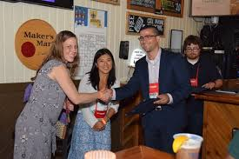
IEEE EMC Society Chicago Chapter Presentation 2020
    Sponsor of Young Professions Activities-
    Louann Mlekodaj

Slide 9
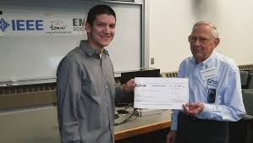
IEEE EMC Society Chicago Chapter Presentation
2020
    IEEE EMC Society Chicago Chapter
    Scholarship Program-HR Bob Hoffman

Slide 10
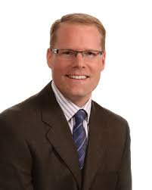

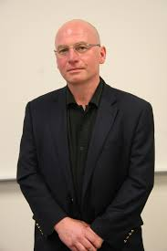
IEEE EMC Society Chicago Chapter Presentation 2020
    Rescheduled 23rd Annual EMC MiniSymposium May 2021
    Scott Mee Jim Teune Bogdan Adamczyk

Slide 11
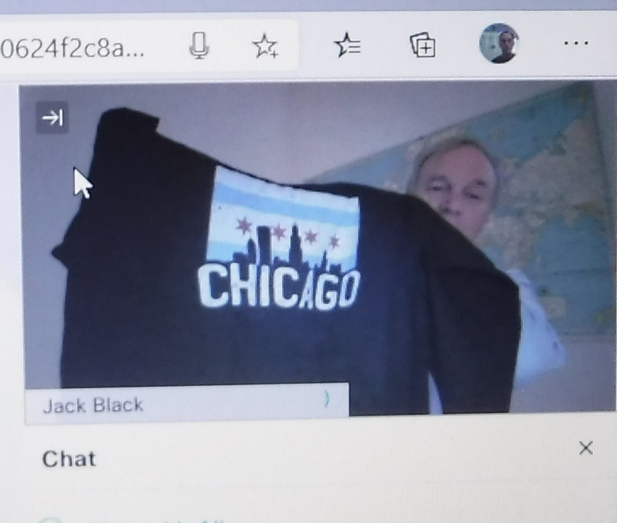
IEEE EMC Society Chicago Chapter 2020 Presentation
    j.black@ieee.org
    www.emcchicago.org

Slide 12

IEEE EMC Society Chicago Chapter 2020 Presentation
    Gambling Movie
    HARD 8

