Slide 1
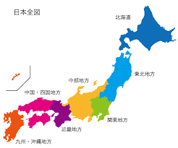
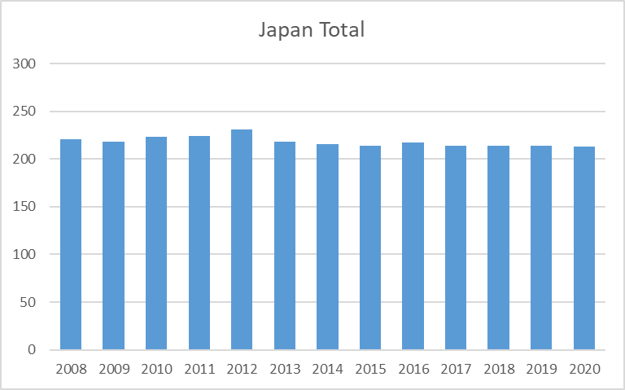
Japan Joint Chapter Repot
Aug.2019-July 2020
Sendai
Officers:
  Chair: Kimihiro TAJIMA (NTT Advanced Technology)
  Vice Chair: Yoshitaka TOYOTA (OKAYAMA University)
  Secretary: Takashi KASUGA (National Institute of Technology, Nagano College)
  Treasurer: Takehiro MORIOKA (National Institute of Advanced Industrial Science
  and Technology)
Number of members:
213 (2020, Including Sendai Chapter )
Tokyo
213

Slide 2
Activities
  Japan Joint/Sendai Chapter Annual Meeting (Dec. 2019)
  Student Award 2019 (March 2020)
  Technical Meetings (August 2019 - July 2020)
  7 meetings in co-operation with meetings on EMC sponsored
  by EMCJ of IEICE* Communications Society.
  Special Lecture by Distinguished Lecturer 2020 (postponed)
*IEICE: The Institute of Electronics, Information Communication Engineers

Slide 3
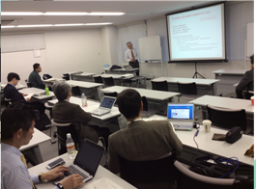
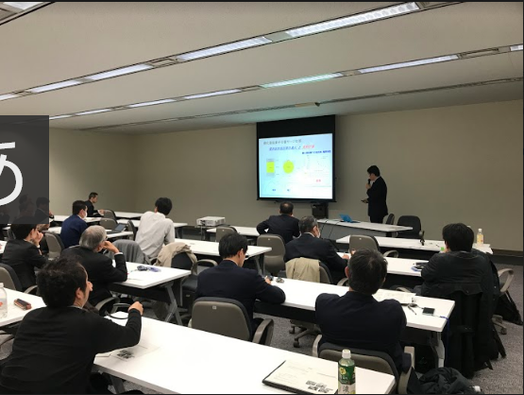
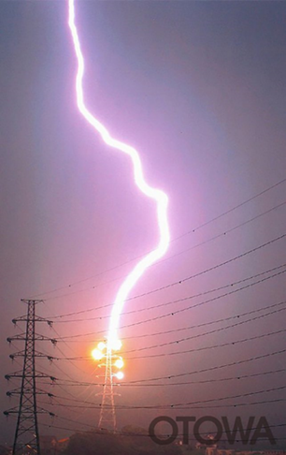
New event
Annual chapter meeting
by Japan Joint /Sendai Chapters
New IEEE Fellow Lecture
by prof. Baba (Doshisya Univ.)
  DATE: Dec. 18, 2019
  PLACE: Tokyo (NTT R&D Center)
  Title: 3 Lectures & discussions
  Attendees: 22
  DATE: Dec. 18, 2019
  PLACE: Tokyo (NTT R&D Center)
  Title: Study on Lightning Electromagnetic
  Field Pulse Surge
  Attendees: 30

Slide 4
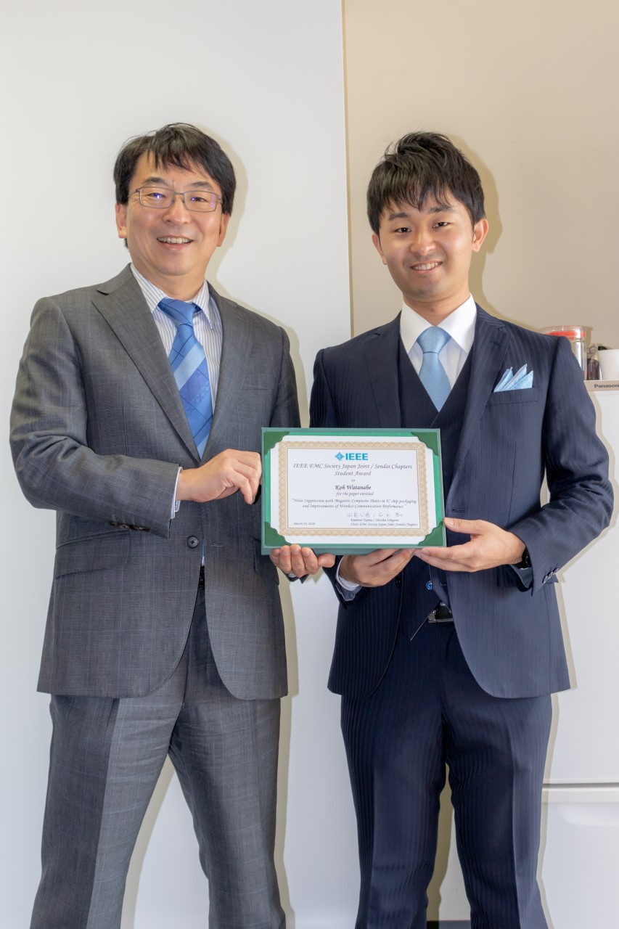

Student Award
The 3rd prize ceremony was held on March 18, 2020
Purpose: To motivate students, and increase of young members
Recognition: A young student who made the most excellent presentation at the
sponsored or co-sponsored technical meetings

