Slide 2
Washington DC/Northern Virginia Joint Chapter Report
Current Officers:
Mike Violette, Chair
Steve Ferguson, Vice Chair
Mohammad Ali, Secretary
Sam Violette Treasurer

Slide 3
Summary of Activities since Ottawa
Chapter Meetings:
International Approvals, Mark Maynard November 2016
Joint Meeting with ComSoc, January
FCC IoT Overview with Ira Keltz, February 2017
Organized 2017 IEEE EMC+ SIPI with a stellar committee
You’re Here!

Slide 4
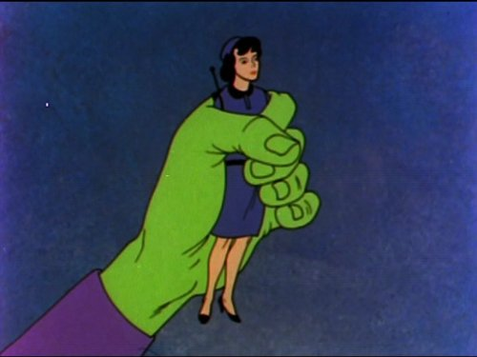
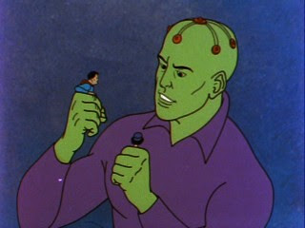
My Favorite EMI Movie (cartoon)
The Return of Brainiac, ca 1966
Brainiac is a robot menace created by Dr. Megma that has come to Earth to shrink humans
Superman and Lois are shrunken and entrapped
Lois lane has an HF radio because she is reporting live.
Superman realizes that Brainiac is made up of “wires and transistors” and tells Lois to turn up the high frequencies at full power.
Brainiac is jammed and rendered powerless
I like this because it shows the good use of EMI
Note antenna

