Slide 2
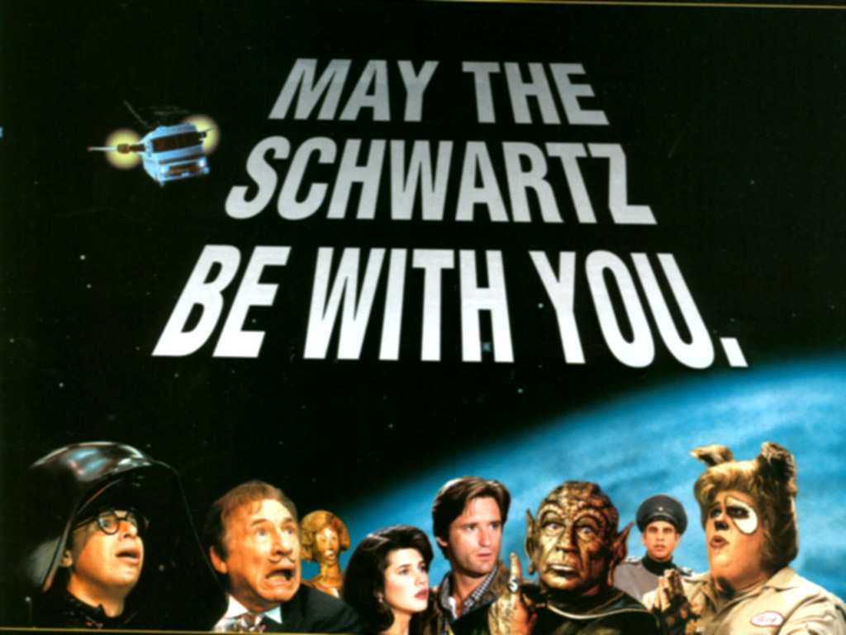
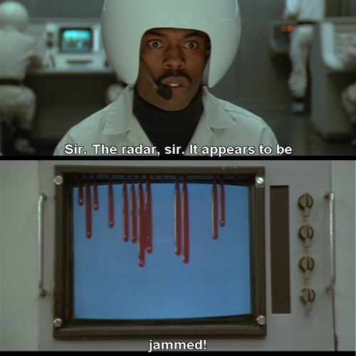
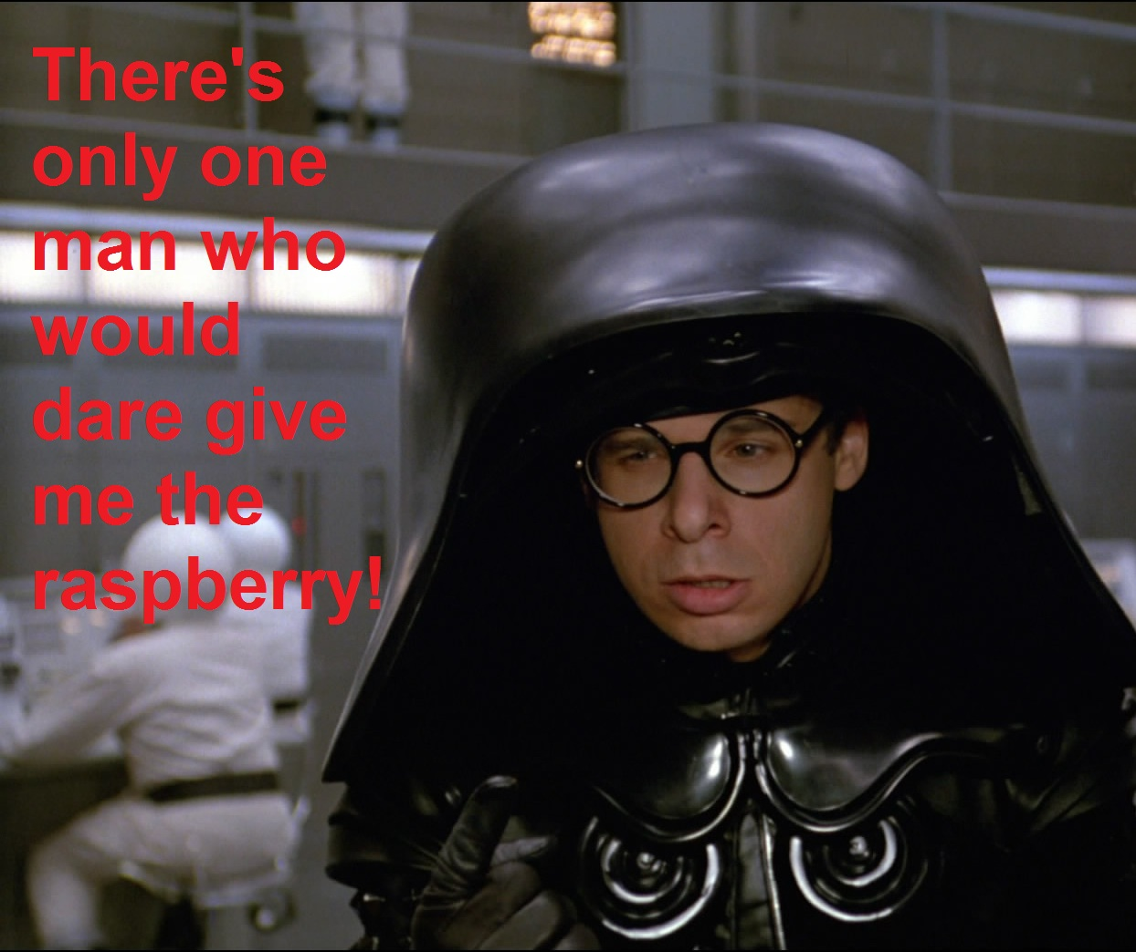
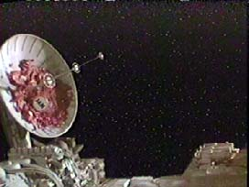
Favorite EMI Movie – Space Balls (Radio Jamming)

Slide 3
South Africa Chapter Activities – 2016/2017
Combined AP/MTT/EMC Chapter – Vibrant leadership team
EMC Vice-Chair – Gideon Wiid – wiidg@sun.ac.za or gwiid@ska.ac.za
Local Chapter conference held July 2016 – 150 attendees, 26 invited talks, 2 international talks, 8 exhibitors
Monthly SKA RFI Workgroup Meetings – Scheduled via vTools
Numerous SKA Measurement campaigns on SKA Radio Astronomy site
Distinguished lecturer visits:
Andy Marvin in November 2017
Next year July – Following edition of Chapter
conference planned

Slide 4
The Good and the Bad
Activities are on the increase, especially with SKA Project ☺
Vice-chair Gideon Wiid in combined University/SKA SA research post – good position to try and consolidate activities ☺
Challenge – sparse and ageing EMC Community (only 5 EMCS…) ☹
SKA Young Professionals (HCD) Initiative used to start EMC and RFI Training program ☺
We have started hands-on training of 5 YP’s at accredited EMC facility ☺
We hope to revive other EMC test facilities who have lost accreditation due to lack of trained staff ☺

Slide 5
Goal for next 12 Months
Increase IEEE EMC activities through SKA SA and Stellenbosch University, also involving other universities and technical universities
Planning GEMCCon 2018 in Stellenbosch
Invest in Young Professionals training and development
Start with “SKA RFI Training Academy” training course material on EMC, EMI, RFI and Measurements
Extend this to increase SA EMC footprint
Suggestions and support welcome! ☺

