Slide 1
IEEE EMC Society
Phoenix Chapter Update

Slide 2
Officers for 2016 – 2017

Slide 3
Last Year’s Accomplishments:
Website completely updated
Officer team stabilized
Added to treasury
Meetings attendance increased
Major symposium last spring.

Slide 4
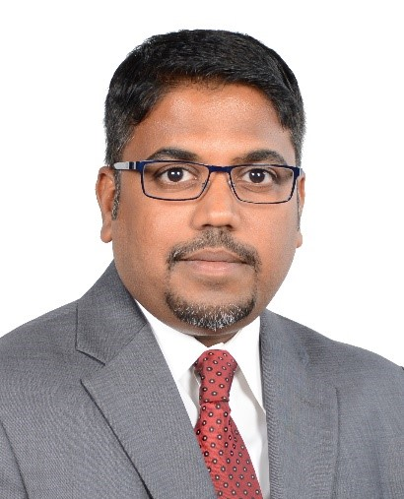
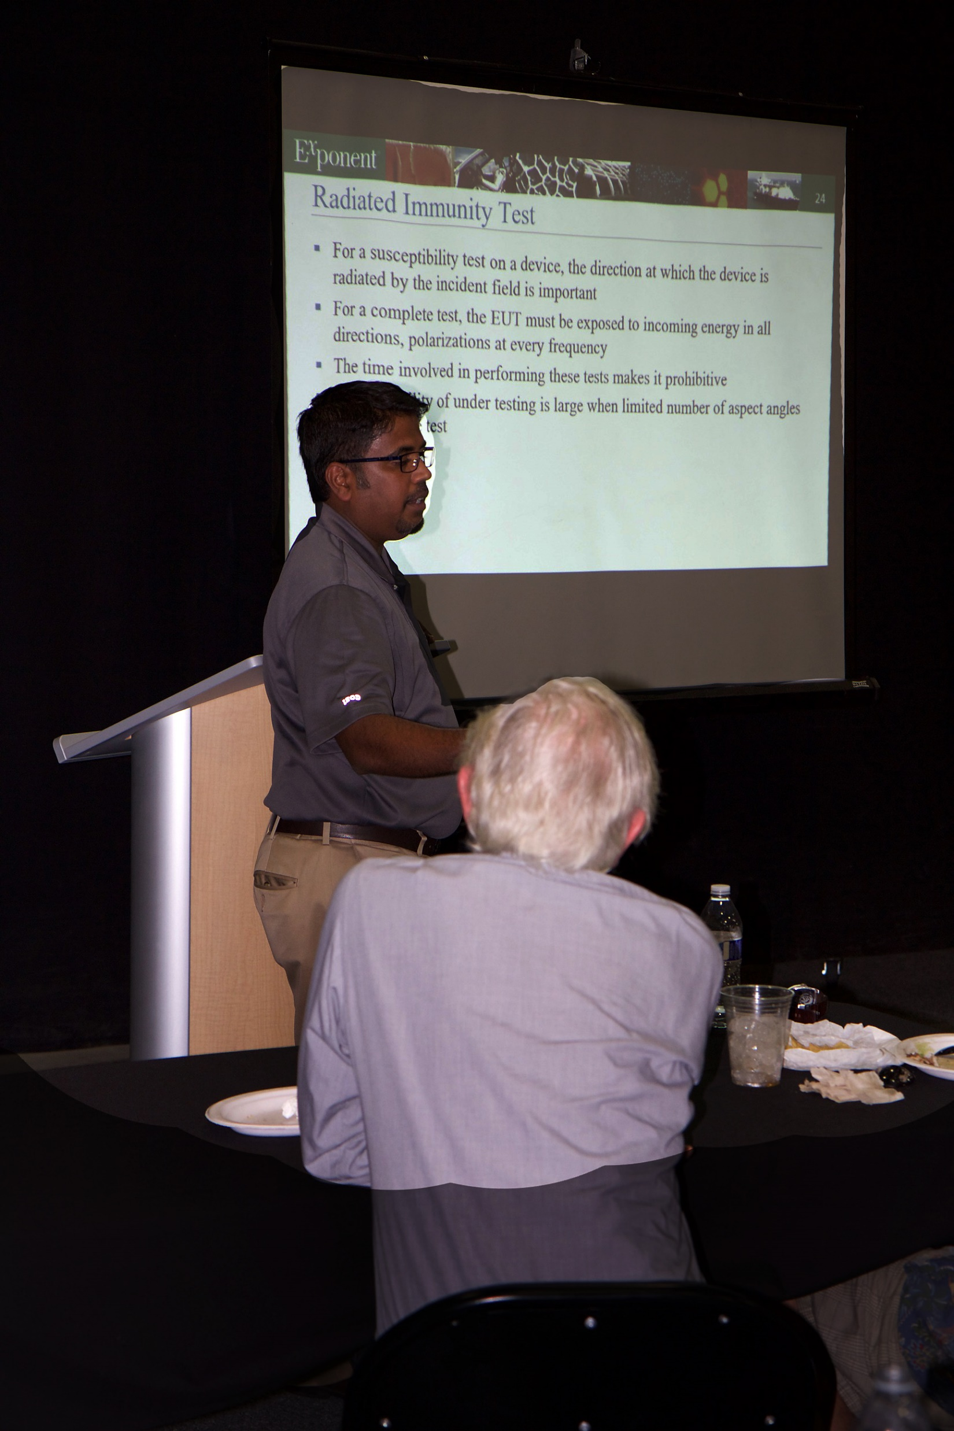
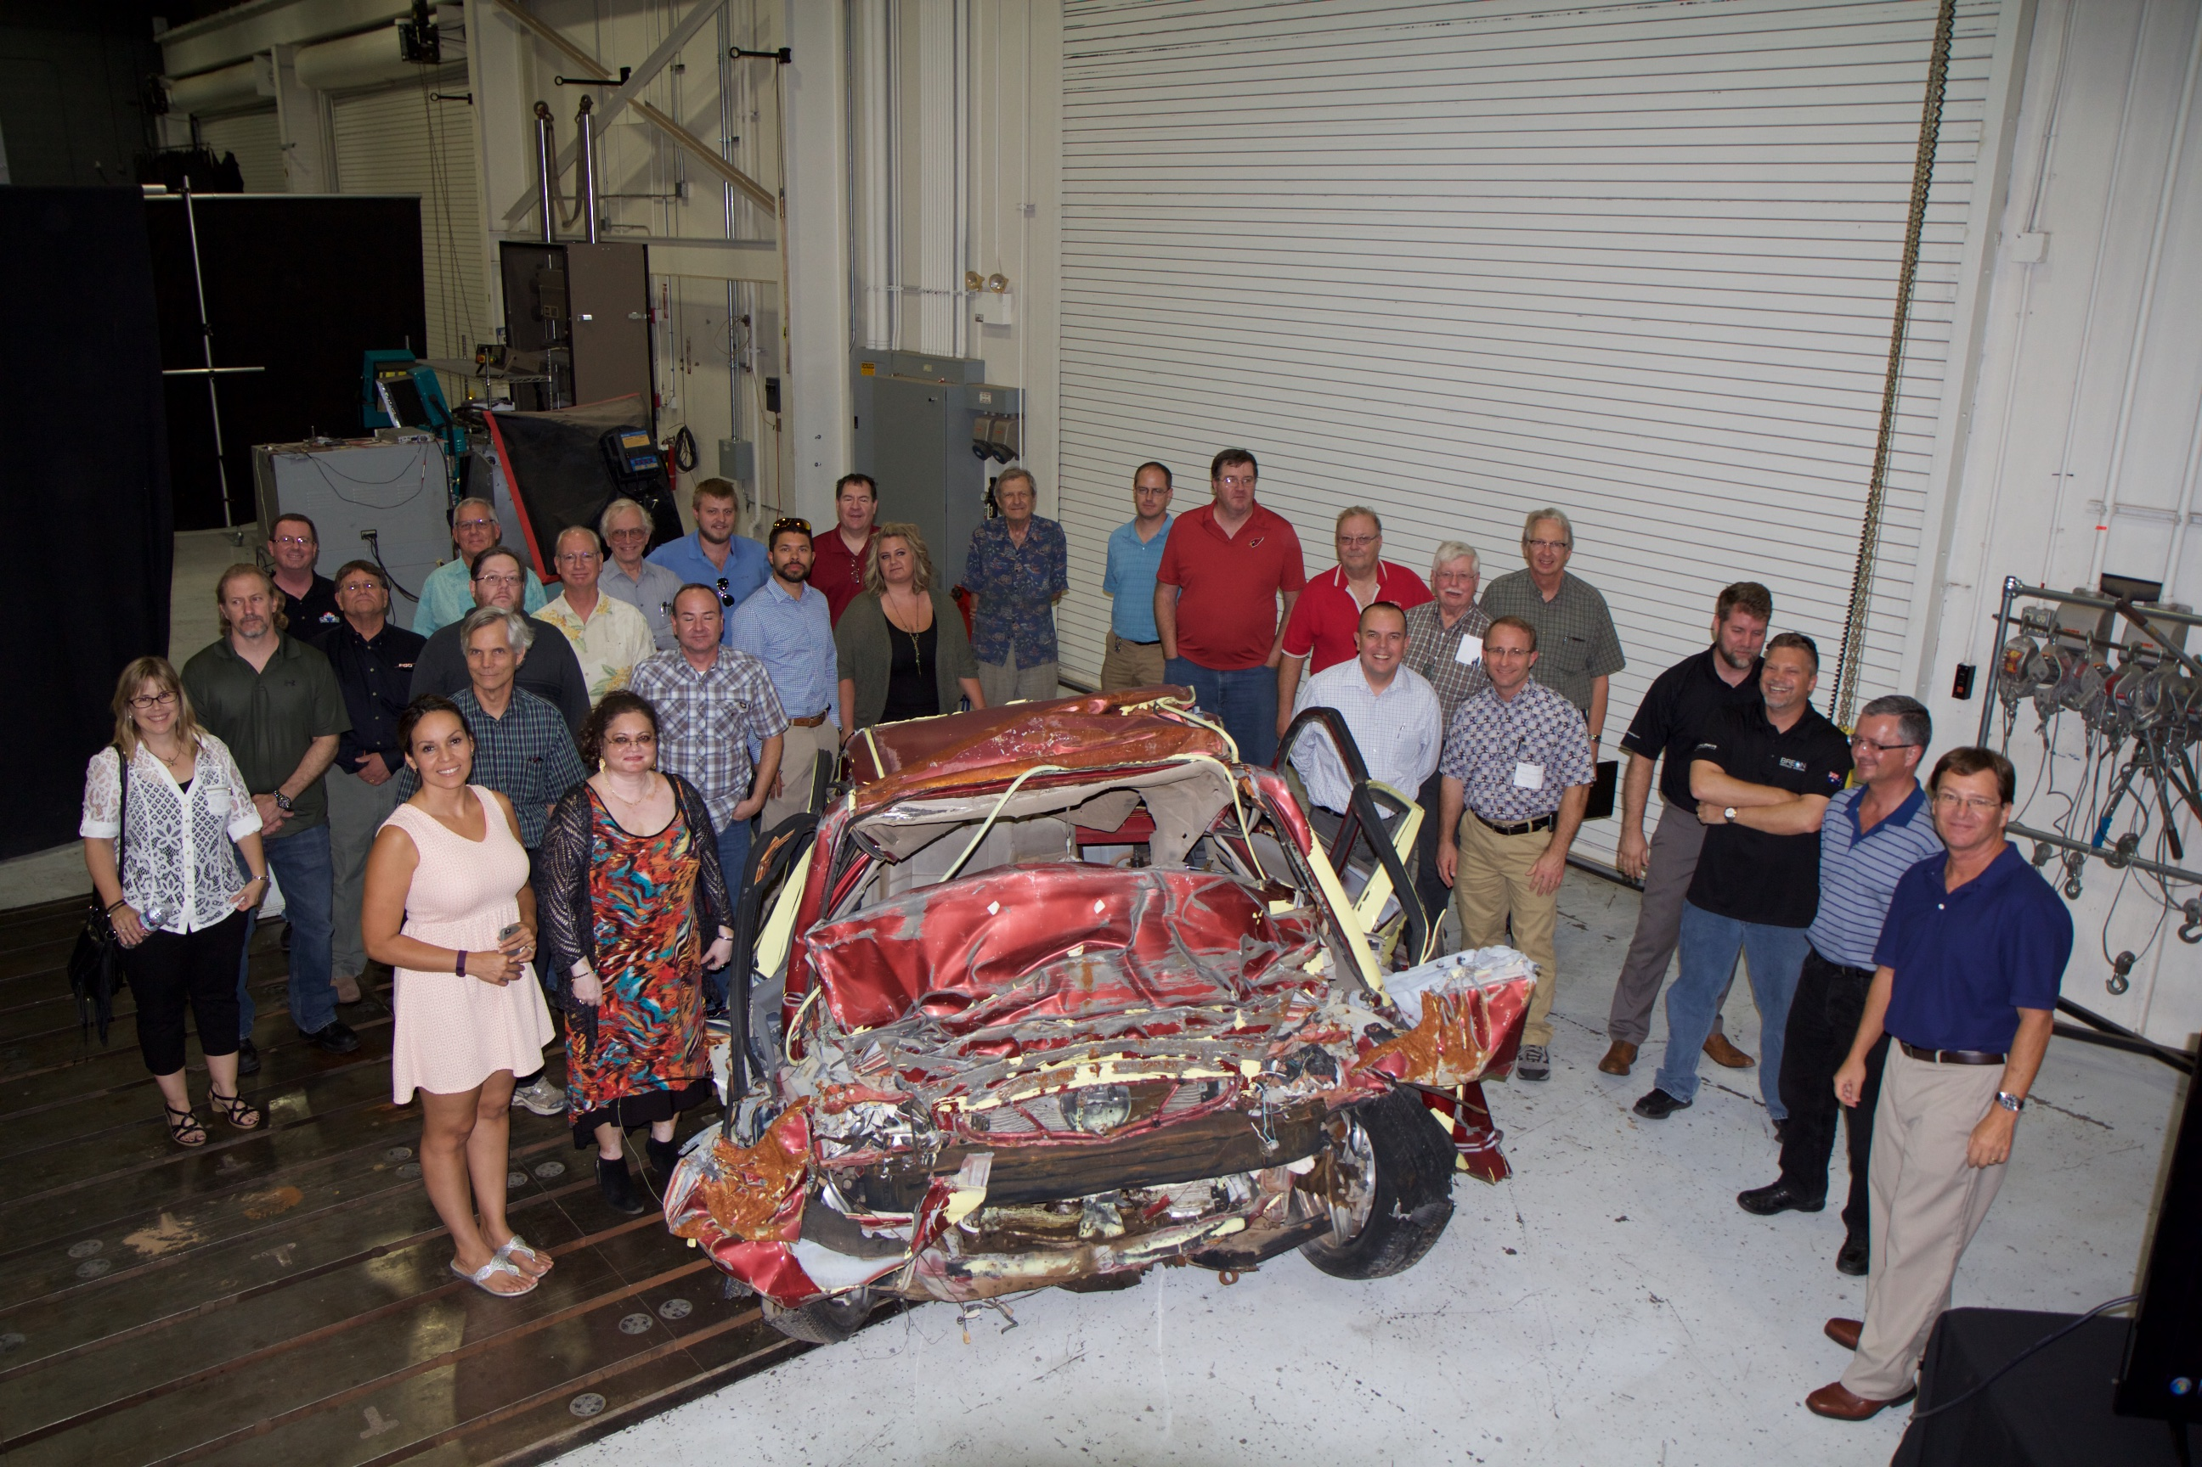
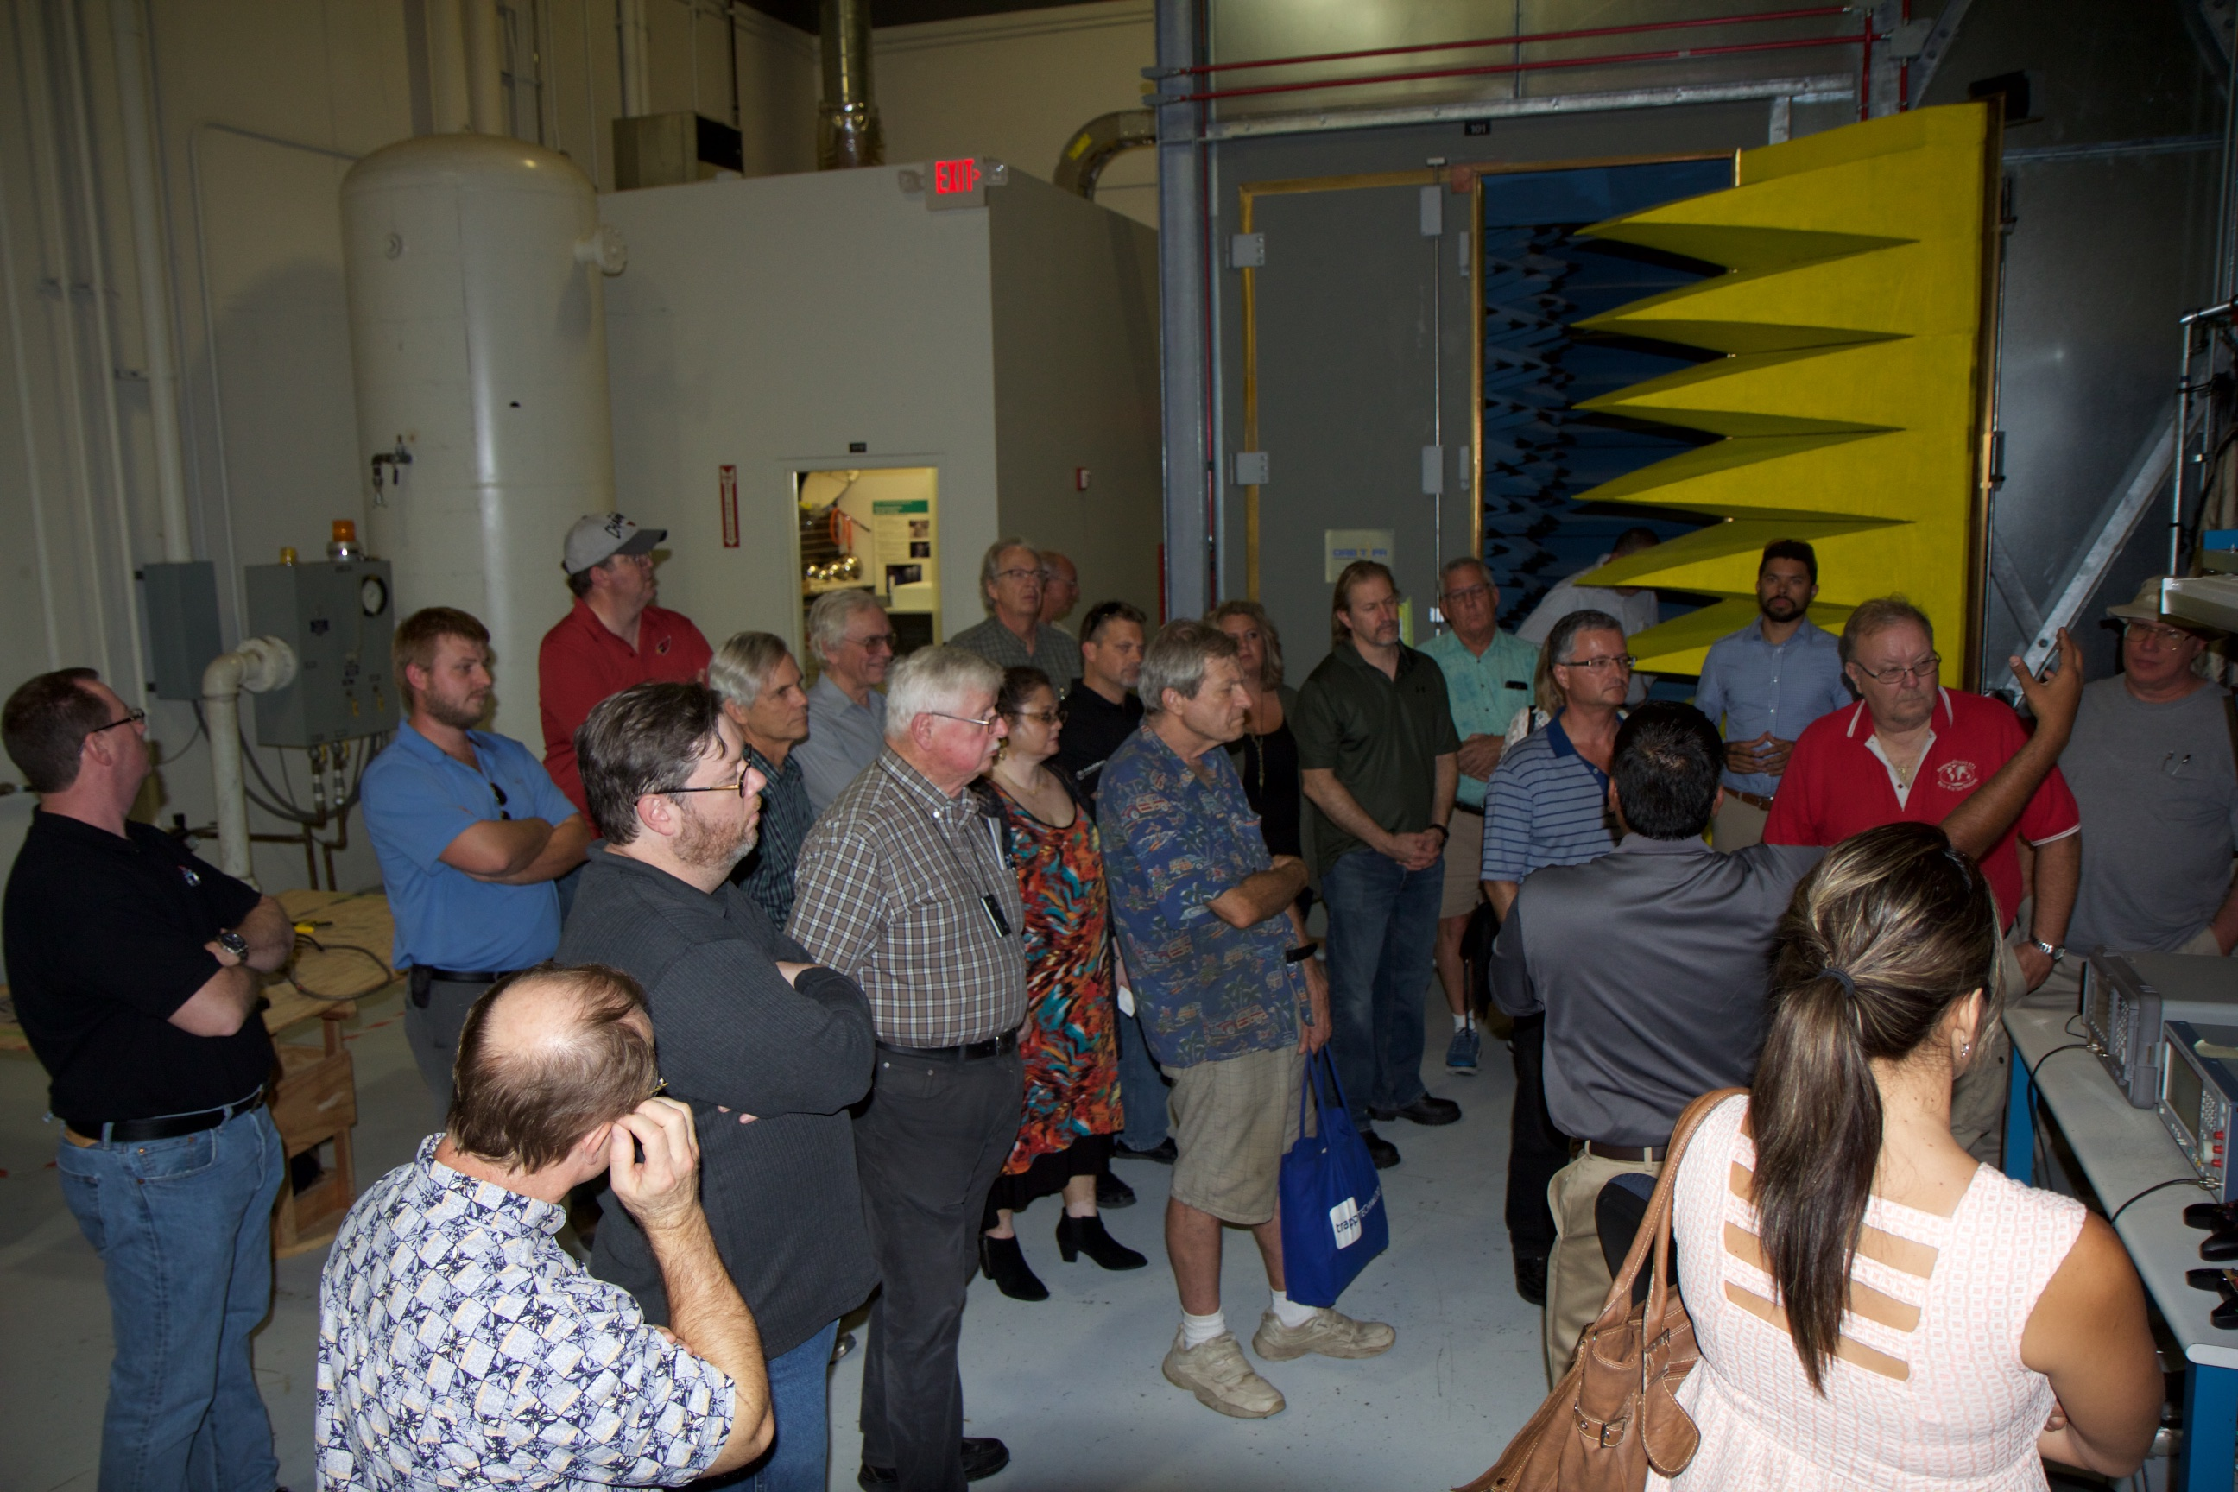
2016 Meetings and Activities
August 25th – “A PRACTITIONERS APPROACH TO EMC TESTING WITH REVERBERATION CHAMBERS”, by Dr. Vignesh Rajamani, Senior Associate Technology Development and Practice, Exponent, Inc.
>30 attendees at Exponent Inc, 23445 N 19thAvenue in Phoenix

Slide 5
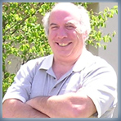
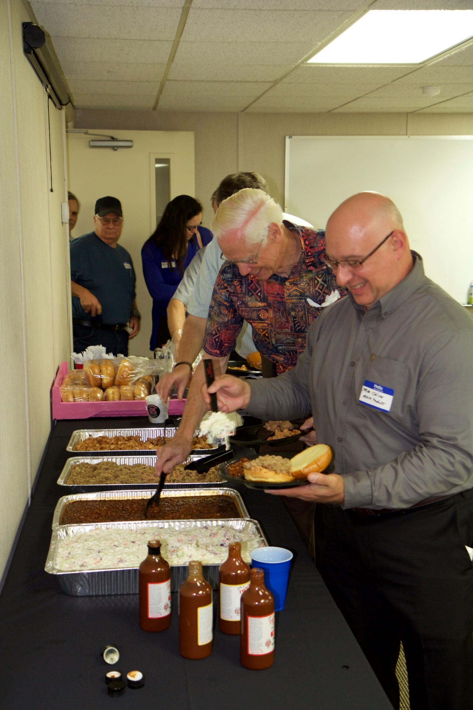
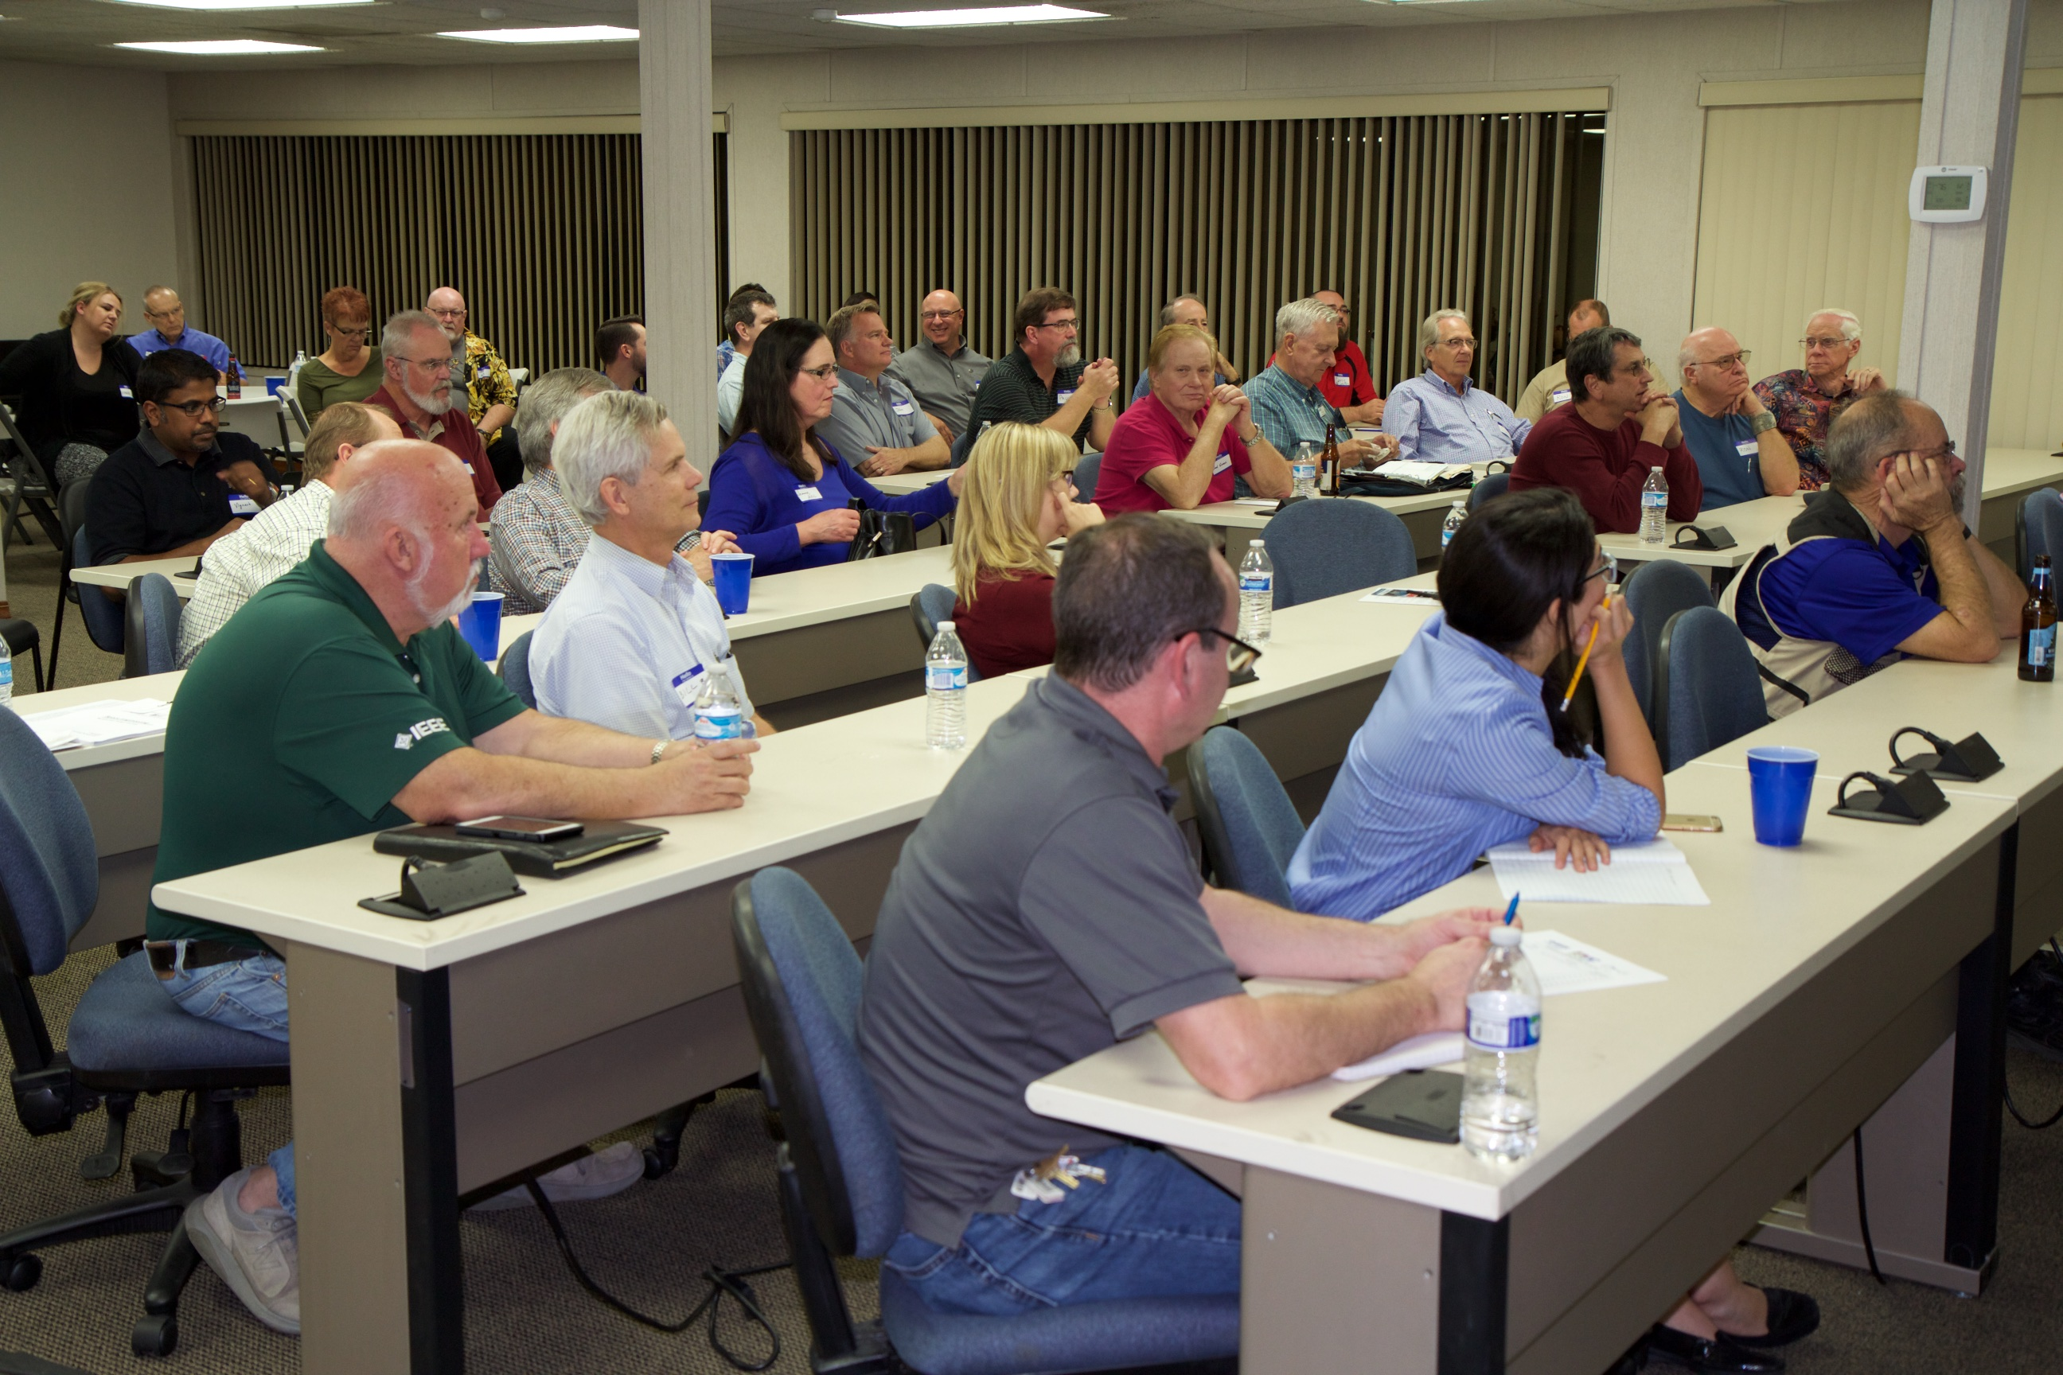
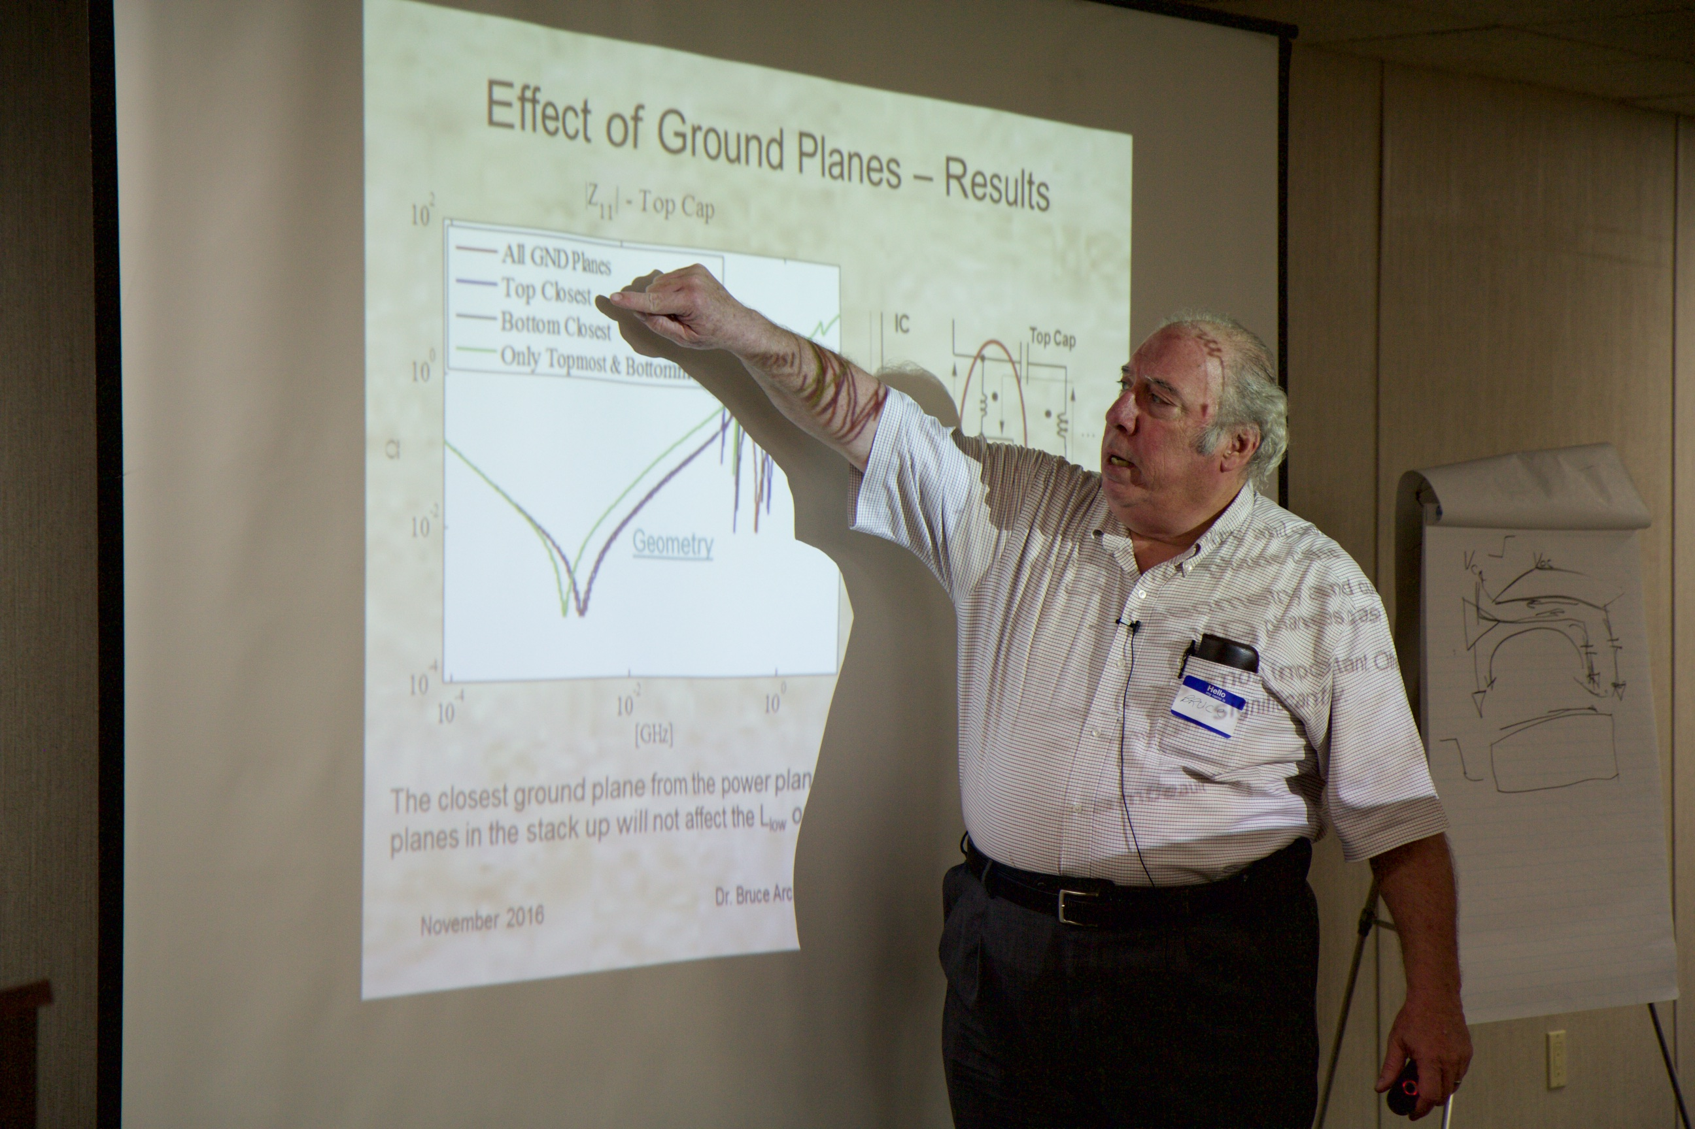
2016 Meetings and Activities
November 10th – “Facts about Decoupling Capacitors and PCBs!”, by Dr. Bruce Archambeault, Distinguished Engineer (emeritus) at IBM in Research Triangle Park, NC and 2017 EMC Society Chair.
>40 attendees at Compliance Testing Labs in Mesa Az

Slide 6
2017 Phoenix IEEE EMC Symposium
A full day event at the Embassy Suites Hotel Tempe, AZ
Wednesday, April 26
tp://sites.ieee.org/phoenix-emcs/279-2/future-meetings-programs/

Slide 7
2017 Phoenix IEEE EMC Symposium
EMC Design Review By Daryl Gerke, EMC Consultant, Kimmel Gerke and Assoc
Smart Antennas: Technology Integrating Antennas, DSP, Communications and Networks By Dr. Constantine Balanis, Regent’s Professor,Department of Electrical Engineering, Arizona State University
Wireless Integration Interference Challenges By Harry Skinner, Director and Senior Principal Engineer, Intel Labs
Understanding Device Performance in a Crowded RF Environment: An Overview of ANSI C63.27 and Coexistence Testing By Dr. William Young, Group Leader, Shared Spectrum Metrology, NIST
Anechoic Absorber Consideration in the W Band and Absorbers Under High Power Incident Field By Zhong Chen, Director of RF Engineering, ETS-Lindgren
IoT EMI By Dr. Vignesh Rajamani, Senior Associate, Electrical Engineering & Computer Science Practice, Exponent; Mark Goldstein, President, International Research Center
Panel Discussion – EMC Across Industries Panel Directed by Vignesh Rajamani of Exponent and Glen Gassaway of Southwest EMI.

Slide 8
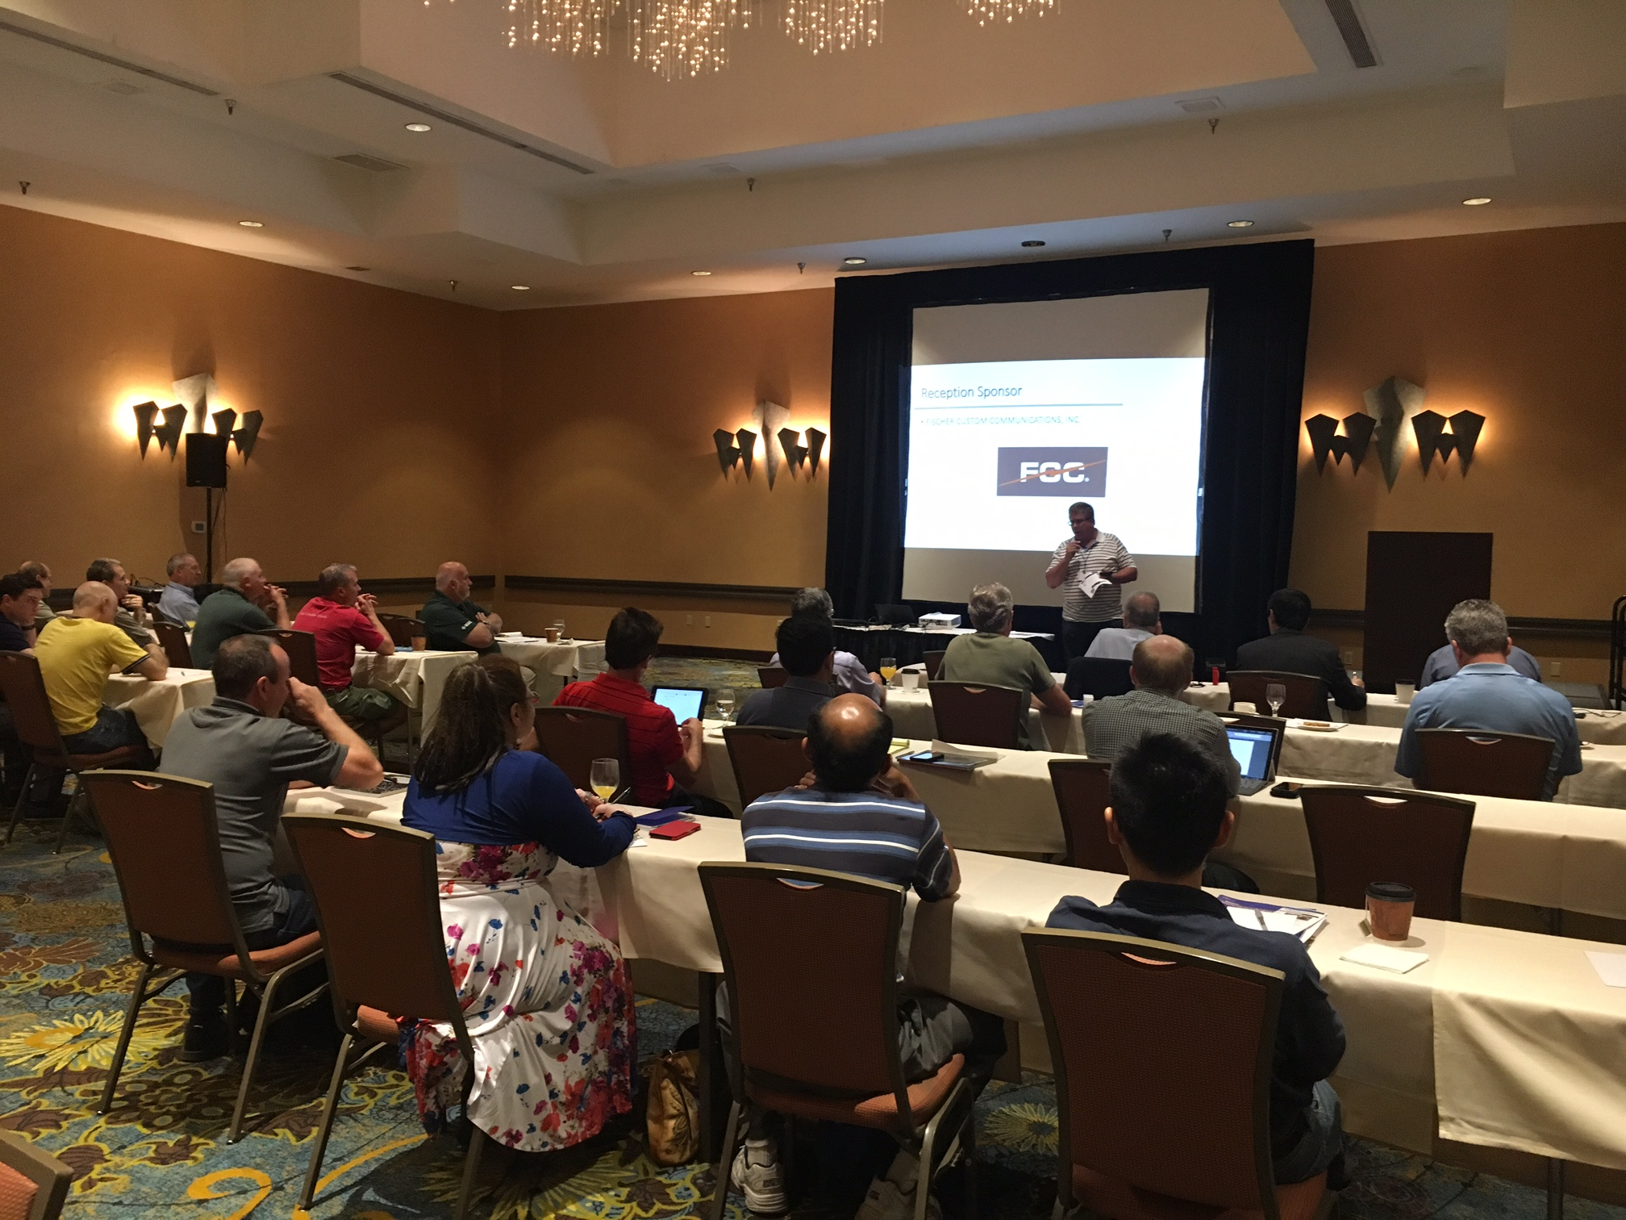
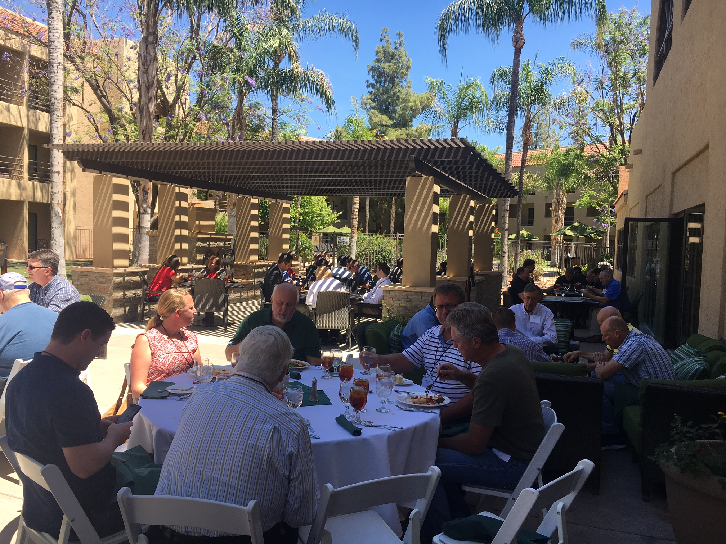
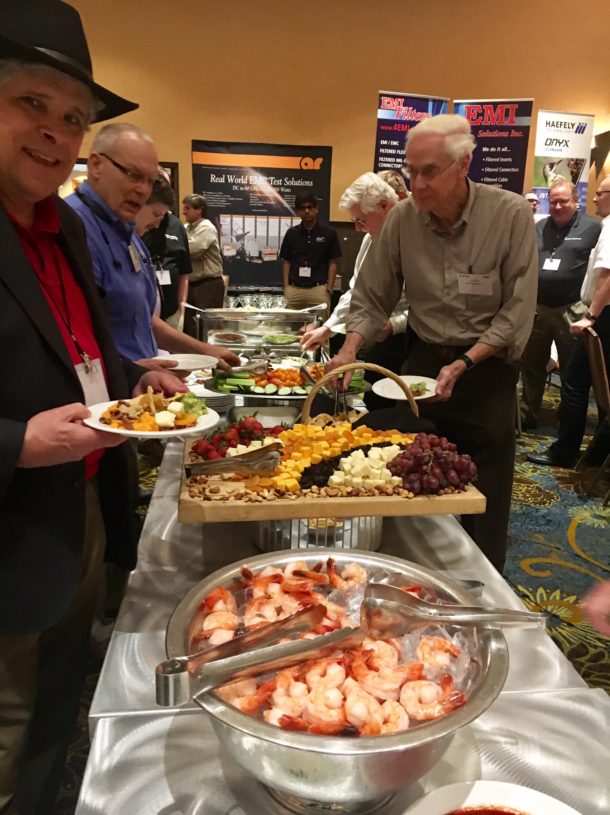
2017 Phoenix IEEE EMC Symposium
> 80 Attendees with multiple speakers and vendors
Breakfast, Lunch and Light Dinner Provided

Slide 9
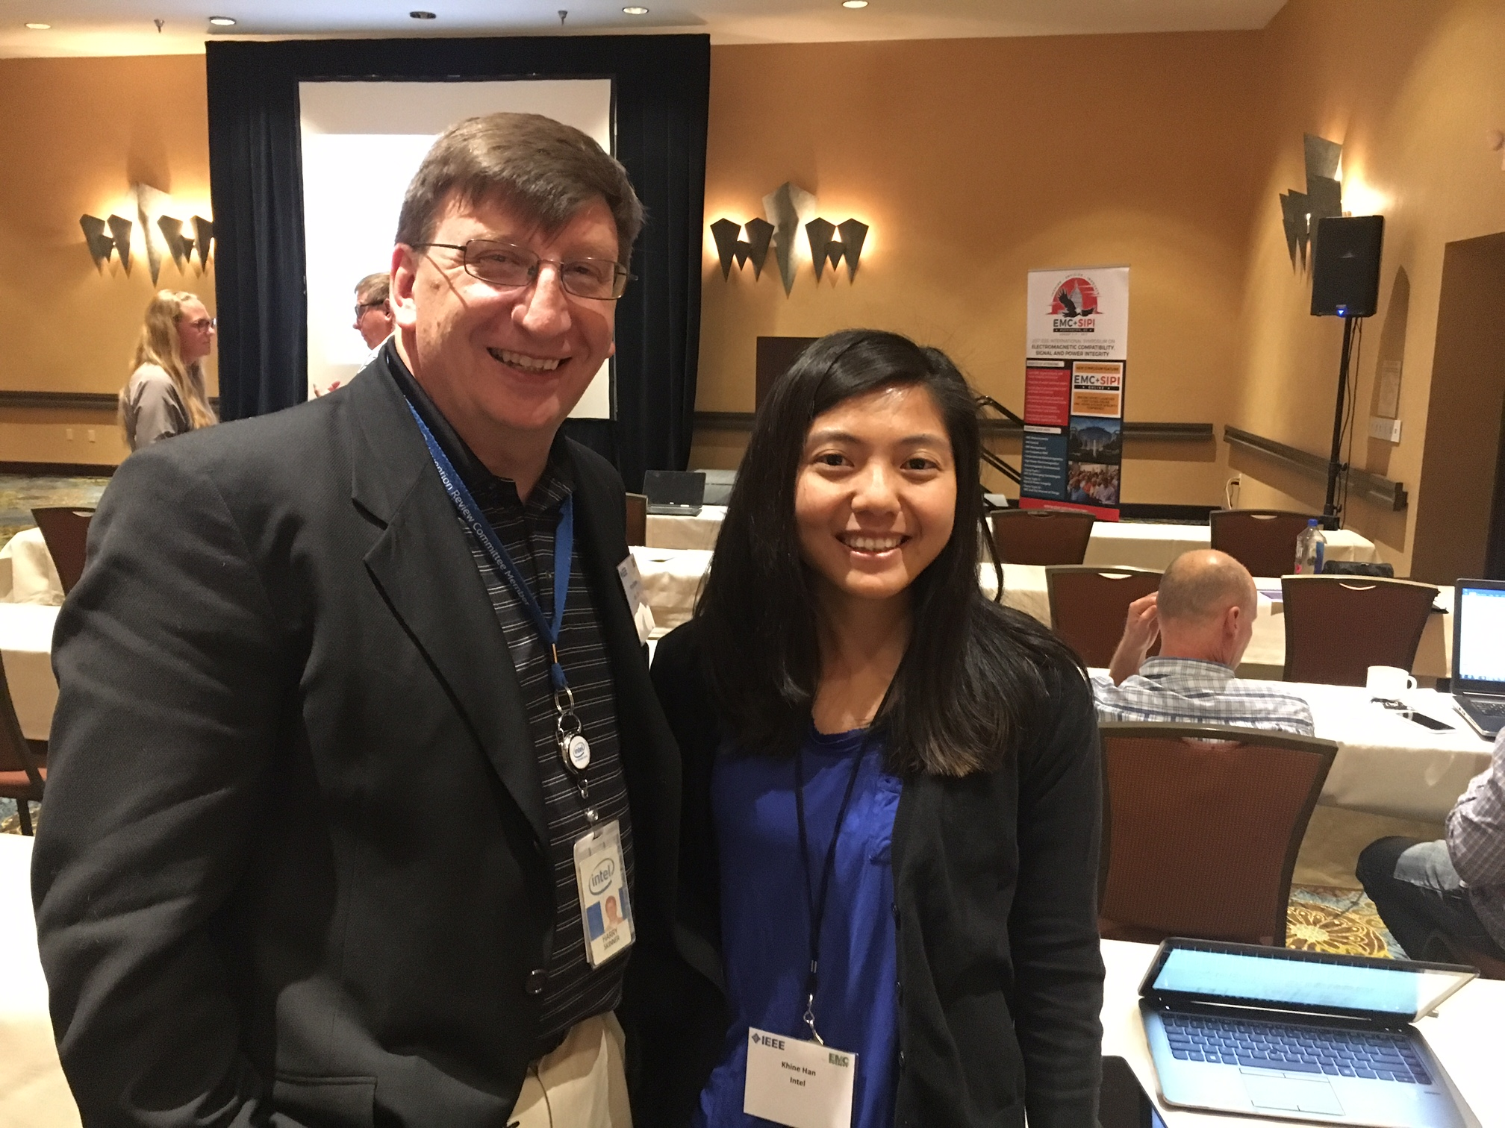
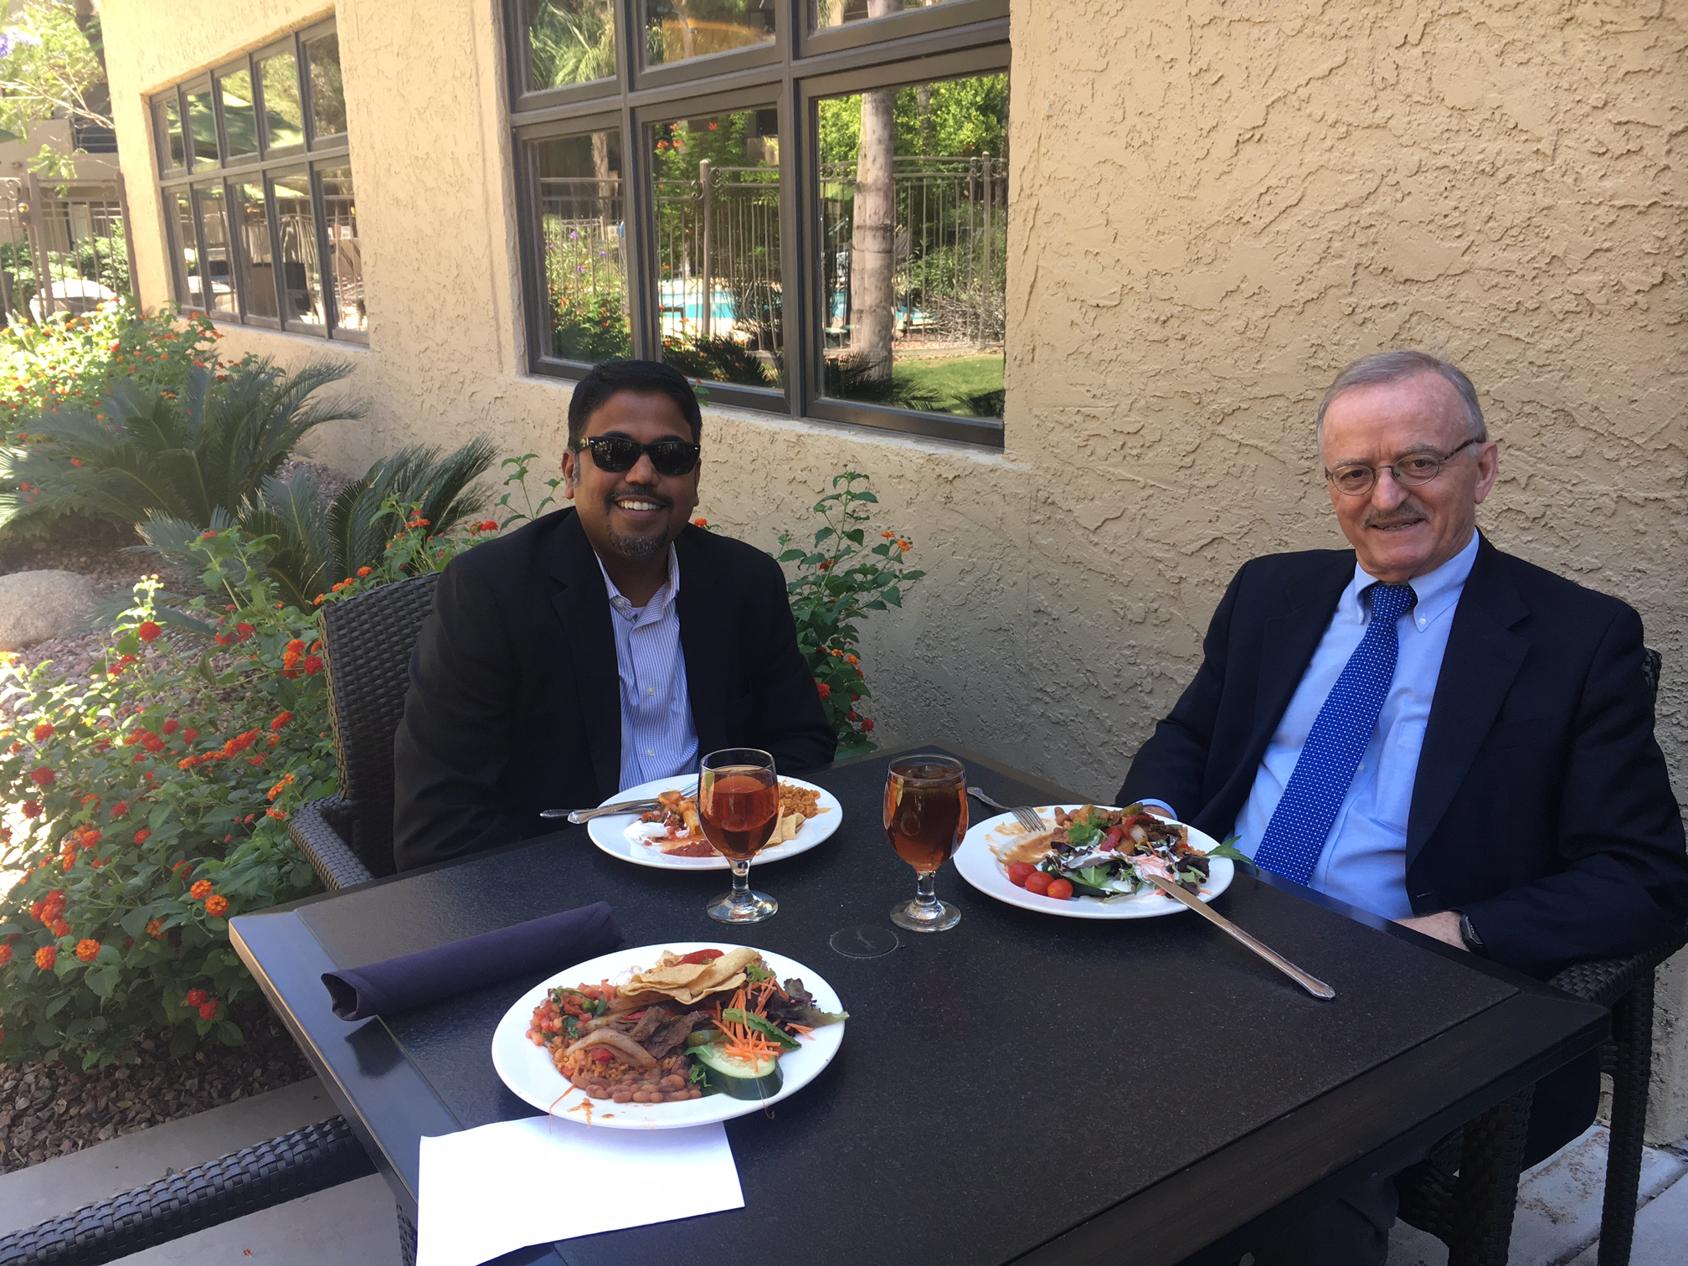
2017 Phoenix IEEE EMC Symposium
Speakers Vignesh Rajamani (left) of Exponent and Keynote Speaker Constantine Balanis of Arizona State University enjoyed lunch with perfect weather. Vignesh addressed IoT in his presentation; Professor Balanis discussed smart antennas.
Speaker Harry Skinner (left) of Intel in Hillsboro, Oregon visited with Khine Han of Intel in Phoenix following his presentation on “Wireless Integration Interference Challenges

Slide 10
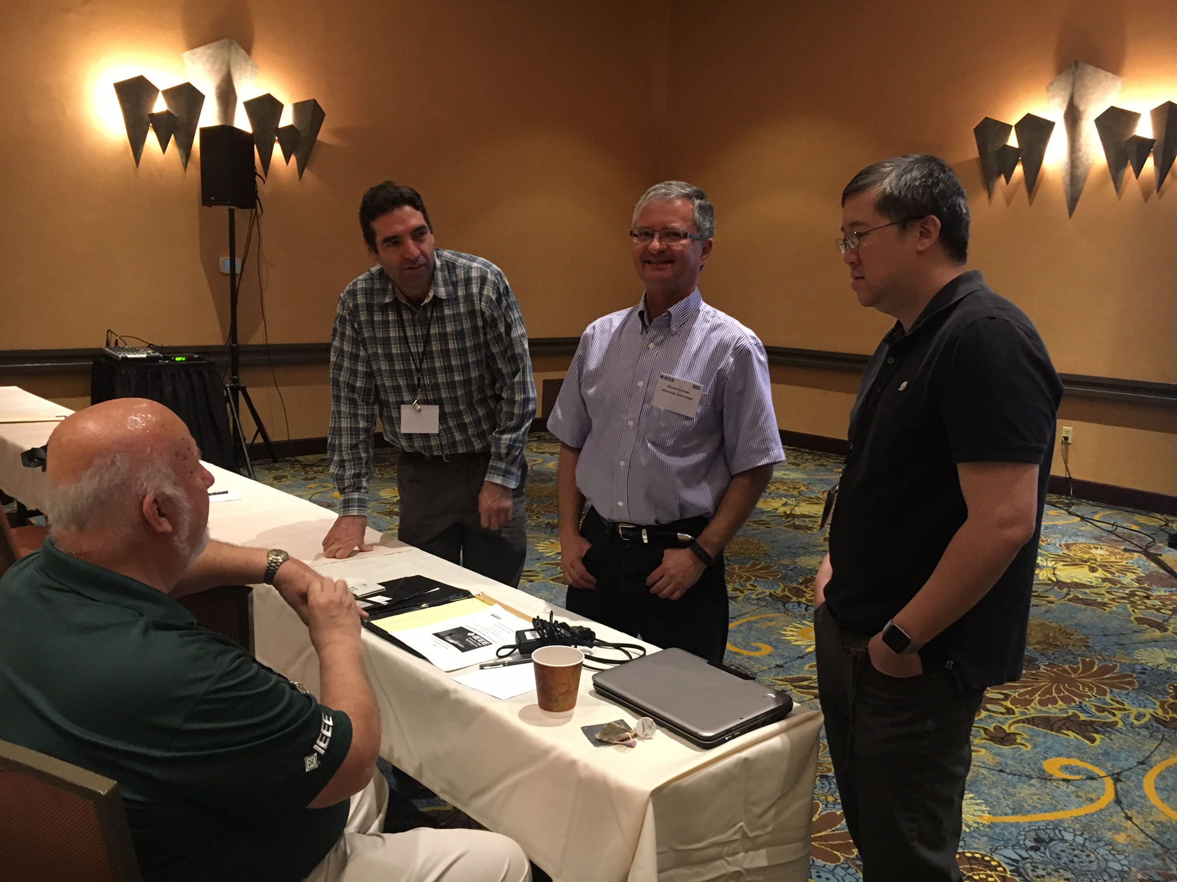
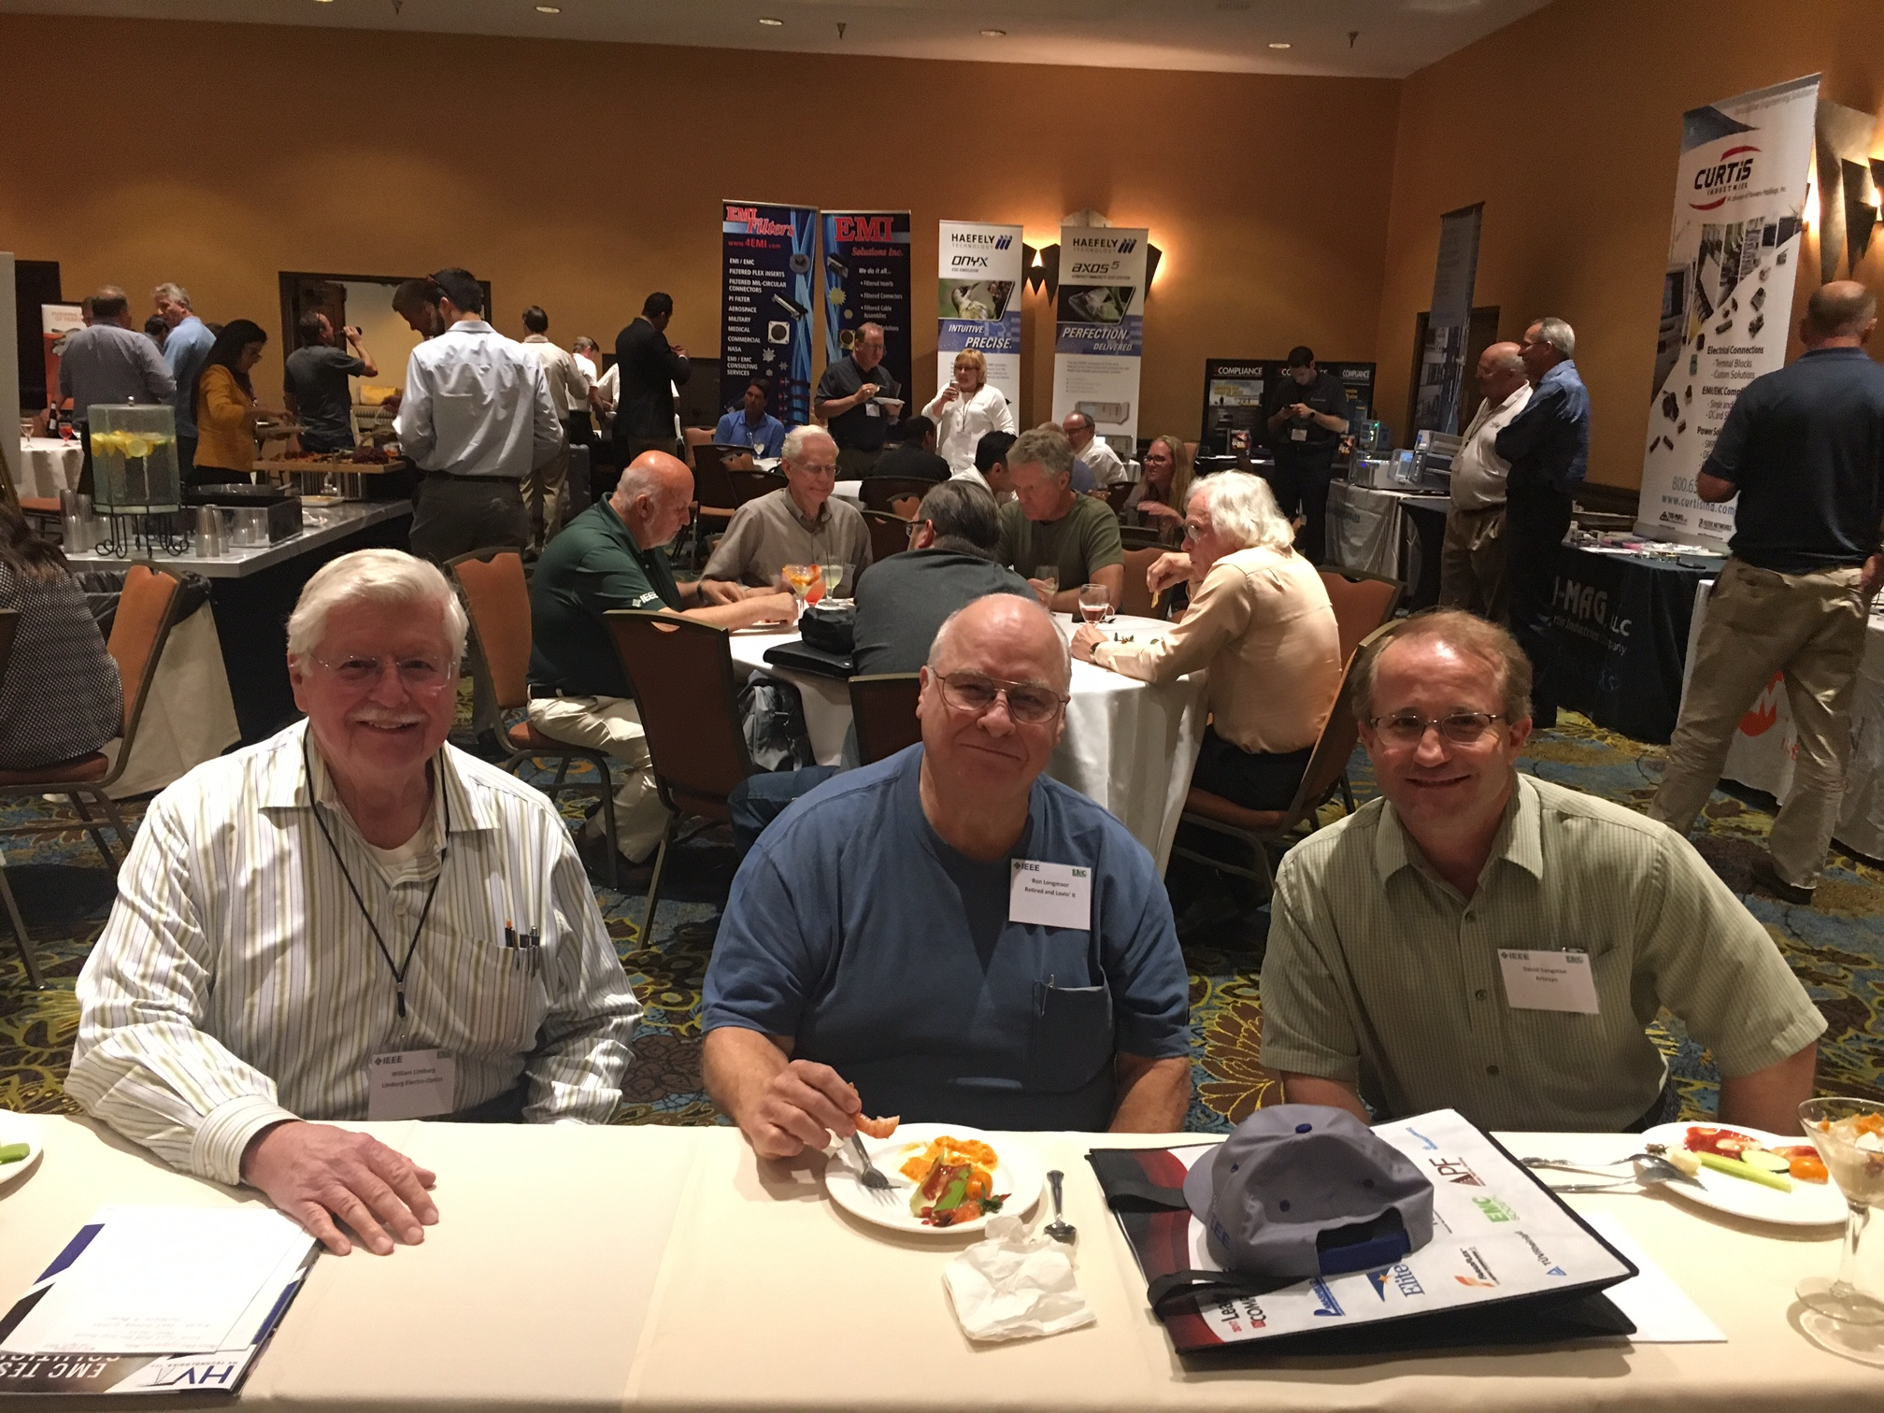
2017 Phoenix IEEE EMC Symposium
Speaker Daryl Gerke (far left) of Kimmel Gerke and Associates answered questions following his “EMC Design Review” presentation.
Phoenix EMC Chapter members (from left) Bill Limburg, Ron Longmoor and David Sangston enjoyed networking during the reception.

Slide 11
2017 Future Plans
At least two meetings in the fall.
September/October: – TBD (working with well-know equipment vendor)
December: Penciled-in Kris Hatashita of Canadian Army. Coordinate Timing with EMC Society Board Meeting in Phoenix.
Continue to enhance leadership team.
Continue to increase meeting interest.
2019 Phoenix Symposium.

