Slide 2
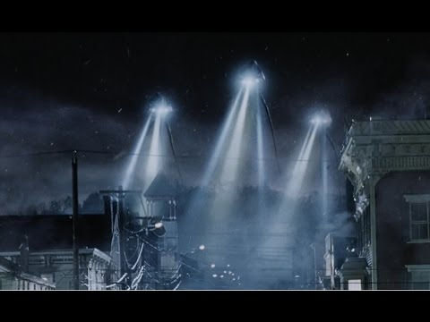
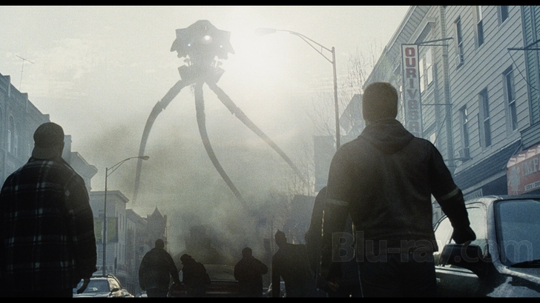
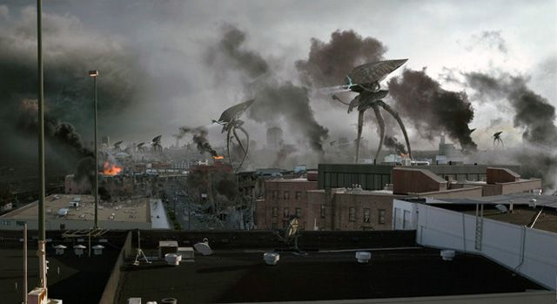
Philadelphia Chapter Favorite EMI Movie:
The War of the Worlds (2005)
“Ain’t nothing like some good ol’ lightning to wake up a few bad aliens…!

Slide 3
Philadelphia Chapter
Executive Committee:
Chair- Graham Kilshaw (ITEM Media)
Vice Chair – Fin O’Connor (Alion)
Secretary- Dean Landers (Retlif)
Rafik Stepanian (ITG Electronics)
Larry Lederer (Imagitron Sales)
Gil Condon (Lockheed Martin)

Slide 4
Philadelphia Chapter
2015: 4 chapter meetings, average attendance 45
2016 : 4 chapter meetings, average attendance 45
2017: 1 chapter meeting to date, attendance 30

Slide 5
Philadelphia Chapter
What We Excel At:
Marketing
When we can find a speaker, we promote it well and get good attendances

Slide 6
Philadelphia Chapter
Where Improvement Is Needed:
Finding Speakers
It takes time. Also finding meeting space.

Slide 7
Philadelphia Chapter
Goals for 2017 and 2018:
1.Continue to hit 4 meetings per year

Slide 8
Philadelphia Chapter
Thank You

