Slide 2
Japan Joint Chapter Repot Aug.2016-July 2017
Officers:
Chair: Masao Taki (Tokyo Metropolitan University)
Vice Chair: Takashi Harada (Tokin EMC Engineering)
Secretary: Kengo Iokibe (Okayama University)
Treasurer: Ifong Wu (National Institute of Information and Communications Technology)
Number of members:
217 (2016, Including Sendai Chapter )

Slide 3
Activities
Japan Joint/Sendai Chapter Meeting
Establishment of “Young Student Award”
Technical Meetings
10 meetings in co-operation with meetings on EMC sponsored by EMCJ of IEICE Communications Society.

Slide 4
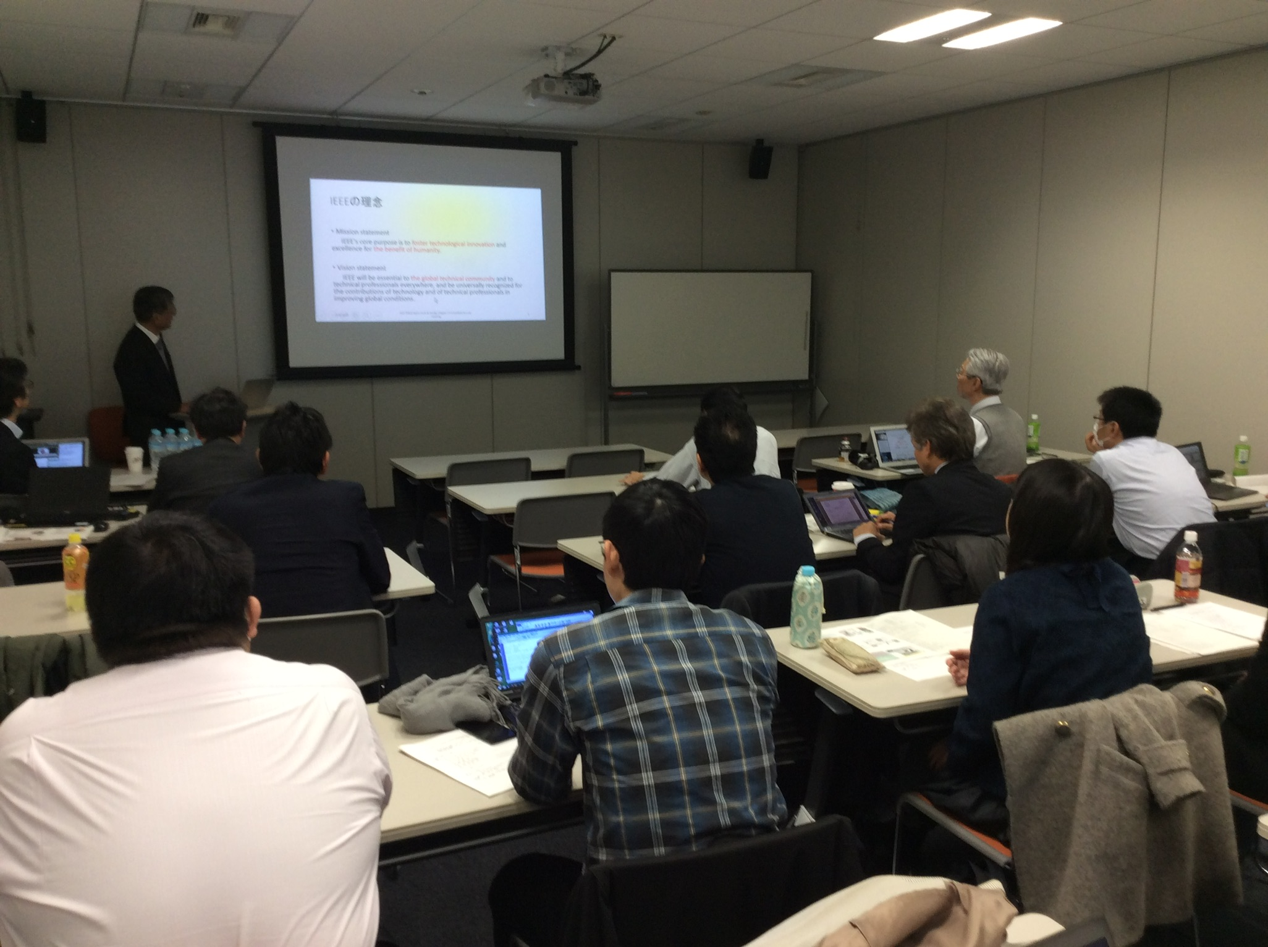
Japan Joint/Sendai Chapter Meeting (12/06/2016)
Lecture by Prof. M. Shinohara, DL of MTT-S
“Wireless Power Transfer”
Lecture by Dr. K. Araki
“Noise Coupling Path Analysis for RF Interference”
Reports on recent EMC-S activities and topics

Slide 5
Japan joint /Sendai Chapters have established a new award.
Purpose:
To motivate students, and increase of young members
Recognition:
A young student who made the most excellent presentation at the sponsored or co-sponsored technical meetings
“Young Student Award”

