Slide 2
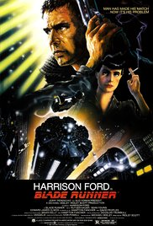
MY FAVORITE EMI/EMC MOVIE
Blade Runner
Do Androids Dream of Electric Sheep?

Slide 3
EMC 2017 Chapter Chair Dinner and Training
IEEE EMC Society Italy Chapter Luigi Caputo (luigi.caputo@aseasistemi.com)

Slide 4
Chapter Status
Chair: Luigi Caputo
Vice-Chair: Antonio Sorrentino
Secretary: Domenico Festa
Treasure: Domenico Festa
Members: 82

Slide 5
Chapter Activities
Seminar: Progettazione EMC 2016
Papers on EMC project, analysis and solutions –
November 2016 – Politecnico of Turin – Italy
Seminar: Giornata Studio sulla Compatibilità Elettromagnetica –
Electromagnetic Compatibility - In memory of Prof. Paolo Corona
December 2016 - Università degli Studi di Napoli "Partenope" – Italy
Seminar: Reproducibility of CISPR 25 ALSE test method
Electromagnetic Compatibility - CISPR 25 - Interlaboratory comparison
February 2017 - Bozen - Italy

Slide 6
Chapter goals
Increase the number of Members, Seminars, Workshop

