Slide 2
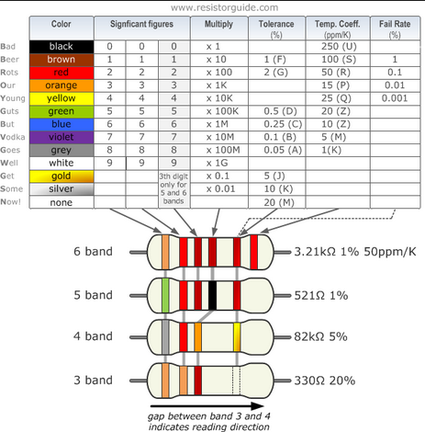
Pick up a lip balm and write down your name/Chapter/resistor value at the panel
Resistor Coding: Please

Slide 3
“YOU MATTER
unless you multiply yourself by the speed of light squared… then YOU ENERGY”
“Volunteers DO NOT necessarily have the time; THEY HAVE THE HEART”
quote by Elisabeth Andrew

Slide 4
Agenda
Introduction
Angel Trip: Kimball Williams
Young Professionals
What’s new with the EMC Society?
Overview: Chapter Officer Duties and Center for Leadership Excellence
Two-way Communication:
Collabratec App
IEEE Events App
Overview: Understanding the Chapter Rebate
Overview: IEEE vTools (hands-on SAMIEEE)
Overview: Wordpress – Chapter Website
Special Presentation:
Chicago: How to run a successful Mini Symposium
Germany: What’s an EMC Bootcamp and how to organize one
Chapter Reports
Questions?

Slide 5
Introduction
Name/Chapter
(if first time being Chair, please state)

Slide 6
My favorite EMI movie
Cars 2: The EMP causes the cars with alternative fuel called "Allinol" to explode when affected by the pulse

Slide 7
Angel Trip
Angel Kimball volunteered himself to drive to all the chapters he is Angel for and did a presentation.
You as chapter chair, perhaps could talk to “neighbor chapters” and see if a Speaker could arrange such accommodation. Distinguished Lecturer (DL) has been doing that

Slide 8
PACE
“Suggestions for Leading a Committee" by Kimball Williams – 12 mins
http://sites.ieee.org/sem/files/2015/02/Suggestions_for_Leading_a_CommitteeA1_720.mp4
Free audio book: “Staying Sharp - Volume 1: Tips for Staying Sharp Inside Your Company ” http://shop.ieeeusa.org/usashop/content/careers/662694
Check your email as IEEE USA will send out book promotion (free with Promo Code) – Share with your members since many don’t read their emails sent by IEEE

Slide 9
Young Professionals in IEEE
New Logo http://yp.ieee.org/volunteers/templates/
Business Plan: http://yp.ieee.org/bp/ (Challenges, plans, progression)
Challenges:
lack of visibility of YP program within IEEE
Lack of visibility of IEEE and YP especially in industry
Poor advertisement and promotion of IEEE conferences and technical events among YP membership
Lack of involvement of YP in EEE conferences and Technical conferences
Lack of awareness of IEEE events taking place in various locations
More than 25% of YP are not involved in IEEE because they were not asked to participate in activities or do not know anyone who attends IEEE events

Slide 10
Young Professionals in EMC
YP Signature events locally (technical and non-technical): joint even with YP affinity groups
YP involvement as Co-Chair during EMC Symposium in DC
Need to find a way to micro-volunteer that can be put on the Resume/CV
Bring your friend along to the exhibit hall or local events
Funding can be provided by PACE/Section/YP (Rafal Sliz, YP Chair)

Slide 11
Young Professionals
Most important items to the Young Professionals:
Online magazine that shows the technical events ran by YP http://yp.ieee.org/impact/
Resume lab: http://www.ieee.org/membership_services/membership/resumelab.html
Job Search: http://careers.ieee.org/

Slide 12
YP 25% of IEEE, YP EMC 14%, IEEE population aging

Slide 13
What’s new in the EMC Society?
- Participation in IoT/5G
- Participation in Environmental Engineer Initiative (EEI)
Sister Societies:
IEEE: MTT, PSES, AP
EMCSA Society of Australia
SEMCEI from India
EOS/EDC Association
EM-TN-IET Electromagnetics Technical and Professional Networking from UK
IEICE from Japan

Slide 14
Officer Handbook
In general, most of the documents on IEEE Chapters can be found at the following link:
http://www.ieee.org/societies_communities/geo_activities/chapters/index.html
*** The IEEE chapter chair reference guide is available on the IEEE website too.
You can get it just using “IEEE chapter chair reference guide” as search key:
http://www.ieee.org/documents/47291_ccrefguide.pdf
*** Similarly, the EMC society Chapter officers' handbook can be find by google by
searching: “EMC society Chapter officers' handbook”
http://www.emcs.org/pdf/Handbook_November_2009.pdf
IEEE EMC Society Website
http://www.emcs.org/chapters_main.html

Slide 15
Two-Way Communication
Ensure that your meetings are login in advance on IEEE vtools
IEEE event App: search any IEEE event around you
Ensure that all the communications to Chapter Chair can be found easily
IEEE Collabratec App: forums but close party
Email will be sent out each time there is a message/reply to the group
IEEE event app: search any IEEE event around you
Work with webmaster to see if Chapter Chair can enter their information directly (proposal)
Engage your section or other societies to have joint meetings even if it is social (such as hiking, etc) to outreach

Slide 16
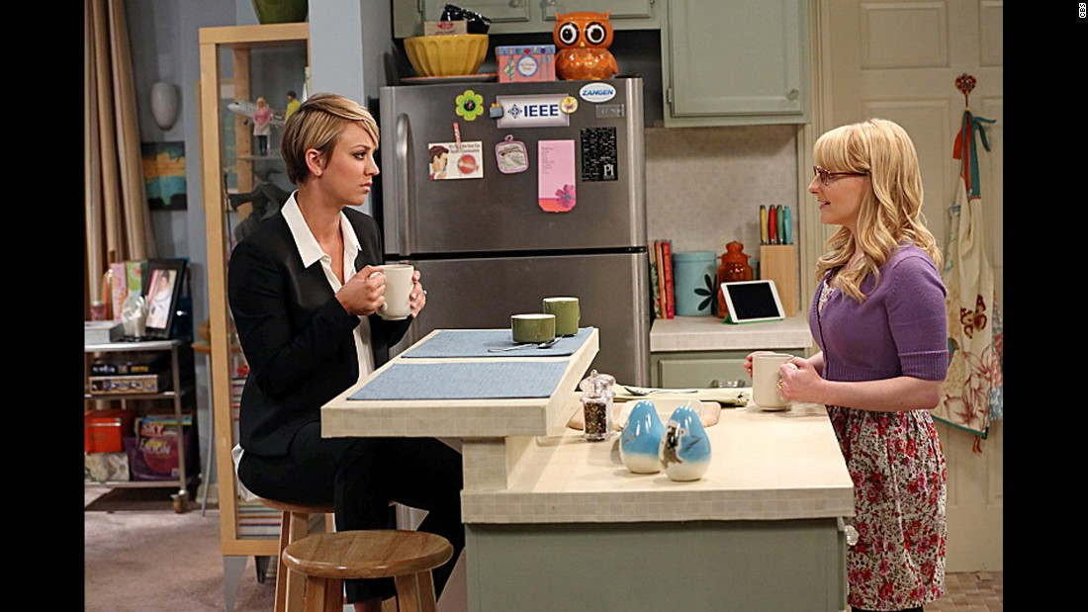
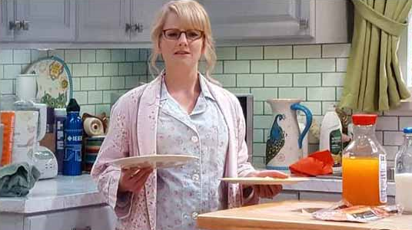
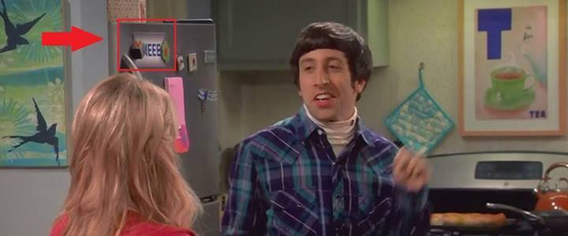

Slide 17
Chapter Rebate and how to get more $$$
Website: http://www.ieee.org/societies_communities/geo_activities/required_reporting/rebate_schedule.html
A- Chapter rebate: US$200 for each chapter and MUST MEET minimum requirement (see below) by doing the L50 (filled by the Chapter Treasurer). Contact your section on how to do L50 https://www.ieee.org/societies_communities/geo_activities/required_reporting/financial_reporting.html
Bonus for timeliness: All sections whose reporting (financial, meeting, and officer) is submitted by the third Friday in February 2016 (exact date might change, verify with your section), will receive a 10% bonus of the total rebate.
Activity bonus: In an effort to encourage activities at the local level, activity bonuses may be awarded as follows:
- All chapters or affinity groups reporting six or more meetings shall receive an additional US$75; in the case of a chapter, at least six of the reported meetings shall be in the technical category. To be filled by the Chapter Secretary in L31 meeting reports https://meetings.vtools.ieee.org/main
Section gets: Membership rebate: US$3 for each member, Graduate Student member, Student, or Associate grade member, US$1.50 for each Affiliate, and US$4 for each Senior or Fellow grade member, based on 31 December 2015 statistics.

Slide 18
Get more $$$
B- Angel Funds $600/year to chapter in financial need. Refer to http://www.emcs.org/chapters/haislmaier.html
C – Chapter Awards: http://www.emcs.org/awards_main.html
Chapter-of-the-Year Award ($250)
Most Improved Chapter Award ($250)
Chapter Founder Award (No monetary fund but recognition)
Tip: start organizing the year before to hit your goal
D- Fundraising/mini symposium: contact Janet O’Neil (j.n.oneil@ieee.org) for any advice on how to organize.
Tip: make it annual to keep consistency, else hard to restart. Organize a technical talk + vendors/exhibit

Slide 19
How to Use vTools
Website: http://sites.ieee.org/vtools/ and also the CLE Training Courses
vTools:
Schedule a meeting
Enter the meeting data (Guest/Non member) L31 (MUST enter ALL by end of the year for ALL chapters)
Chapter officer voting
Chapter officer reporting (MUST do once the election is done)
Create a Survey
Create e-Notice
Financial Report L50 must be reported EACH YEAR to be eligible for the chapter rebate (see Chapter Rebate section)

Slide 20
How to Use SAMIEEE
Tutorial borrowed from R10: http://ewh.ieee.org/ieee/apo/Region10/MembershipPresentations/3.%20SAMIEEE%20Training%20Module.pdf
OR to get the name and email of your members, follow the screen shots after login

Slide 21
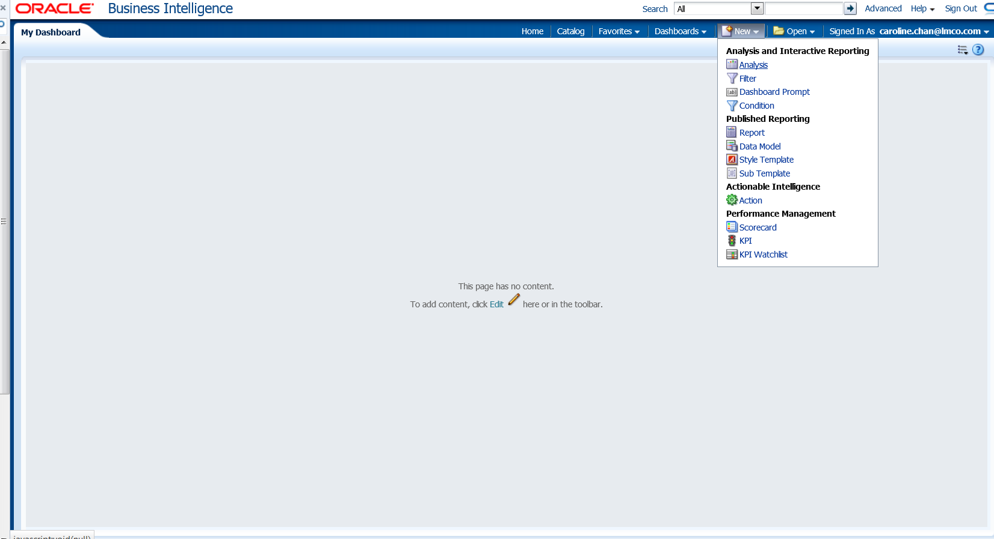
How to Use SAMIEEE
SAMIEEE: how to get the name and email from your chapter: New-> Analysis-> SAMIEEE for Volunteers

Slide 22
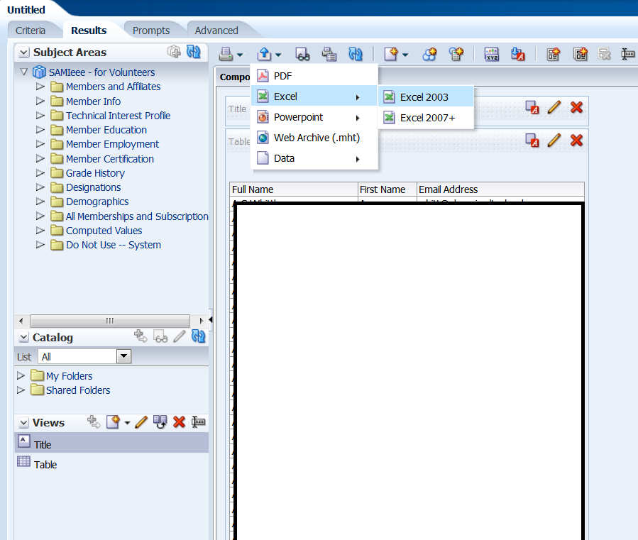
How to Use SAMIEEE
Click on the symbol with Arrow Up to Export.
To understand what each field of the SAMIEEE means, click on this excel document (exacel will merge cells people with the same first name and hard to copy/paste. Instead use .CSV file) OR Data-> .CSV

Slide 23
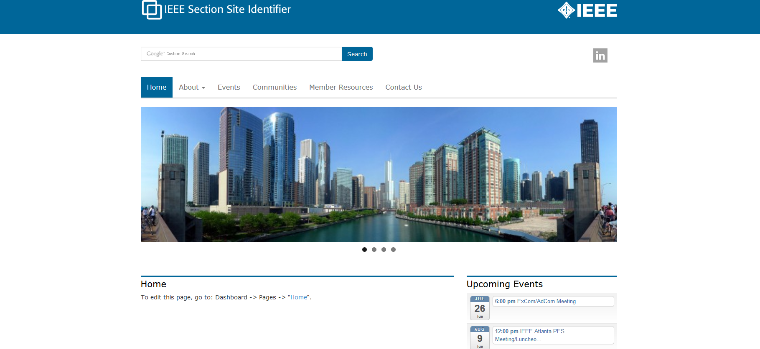
Wordpress
Template and Host:
Based on IEEE Template, no programming experience necessary
This is what the template will look like: http://sites.ieee.org/section-template/
Request the template and for IEEE host: http://sites.ieee.org/hosting/wordpress-hosting/
(you can add other users later once you become the Admin)
If you haven't heard from IEEE within a week, please contact Khanh Luu k.n.luu@ieee.org
Khanh is the Sr. Information Management Analyst of the IEEE Member and Geographic Activities
Department (MGA)
Additional information, refer to the information in the Ottawa Chapter Chair training 2016:
Ottawa Chapter Chair Training (slide 17-20)

Slide 24
Chapter Presentation
Chapter Chair/Representative | Chapter | Angel | Present?
Mike Violette | NoVA | Caroline C. | Y
Davy Pissoort | Benelux | Heyno G. | Y
KC Lee | Hong Kong | Sergio P. | N
Ding-Bing Lin | Taipei | Tzong Lin W. | Y
Carlos Sartori | Brazil | Carlos S. | Y
Enxiao Liu | Singapore | Tzong Lin W. | Y
Matthias Troscher | Germany | Heyno G. | Y
Michael Royer | Boston | Ed H. | Y
Xiao-Wei Zhu | Nanjing | Sergio P. | ?
Luigi Caputo | Italy | Ed H. | N
Robert Berkovits | Baltimore | Don H. | Y
Gideon Wiid | S. Africa | Alistair D. | N
Jamal Shafii | Rock River Valley | Tom B. | N
Graham Kilshaw | Philadelphia | Don H. | Y
Caroline Chan | Santa Clara | Caroline C. | Y
Henry Benitez | Oregon | Henry B. | Y
Glenn Gassaway/ Vignesh R. | Phoenix | Mark M. | Y
Jack Black | Chicago | Tom B. | Y

Slide 25
EMC Chapter Activity Report Short Summary TBD
Washington/No VA:
Benelux:
Brazil
Chicago:
Germany:
Phoenix:
River Rock Valley (no speaker):
Phoenix:
Santa Clara:
South Africa
Taipei:
Italy:
Hong Kong:
Singapore:
Boston
Nanjing
Baltimore
Philadelphia
Oregon

Slide 26
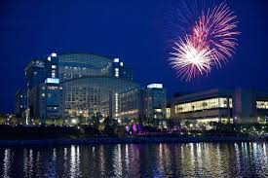
Questions?
Contact Caroline Chan, IEEE EMC-S Chapter Coordinator or your Angels
caroline.chan.us@ieee.org
Each Chapter has an Angel. Please get familiar with who your Angel is.
http://www.emcs.org/chapters_main.html -> Chapter Angel List (To be updated for 2018)
Will have

