Slide 2
IEEE EMC Society United Kingdom and Ireland Chapter Chapter Committee. Roy Ediss Chairman, Event Coordinator Two year term 2017-2018 Paul Duxford Vice Chairman Paul Vertannes Secretary, Treasurer Alan Warner External Liaison, Event Coordinator Tony Swainson ListServe Manager Nick Hooper Membership Development Other committee members: Nick Wainwright, Adrian Monk, Alistair Duffy Membership and activity How many members are in your chapter? 119 Members listed – spread across the UK and Ireland, highest density in SE England What’s the average meeting attendance? 20 average attendees. – meetings are open-to-all without charge What do you think you are doing right? Chapter has held around 80 technical meeting since 1998 Technical meetings often held at sites of added interest Meetings sometimes reported in EMC Magazine Chapter Chatter AGM held each December to agree committee & next year’s meeting dates, locations, topics

Slide 3
IEEE EMC Society United Kingdom and Ireland Chapter
Recent technical meetings
April 2017 at Boscombe Down Aviation Collection (BDAC) Old Sarum Airfield Museum, with content on Radio Equipment Directive, Absorber technology, Conducted immunity testing, Qinetiq test and evaluation group
July 2017 at Buckinghamshire Railway Centre, with content on PLT issues, EM disturbances and Functional Safety, EM modelling and certification of aircraft.
December 2017 at Ofcom Central London, with varied content and presentations by two IEEE EMC Soc Distinguished Lecturers Dr Farhad Rachidi-Haeri and Andy Marvin.
April 2018 Amberley Museum and Heritage Center, West Sussex, with content on World 900 MHz band alignment, Radiated emission measurement below 30 MHz, analyzing the effects of EFT immunity test.

Slide 4
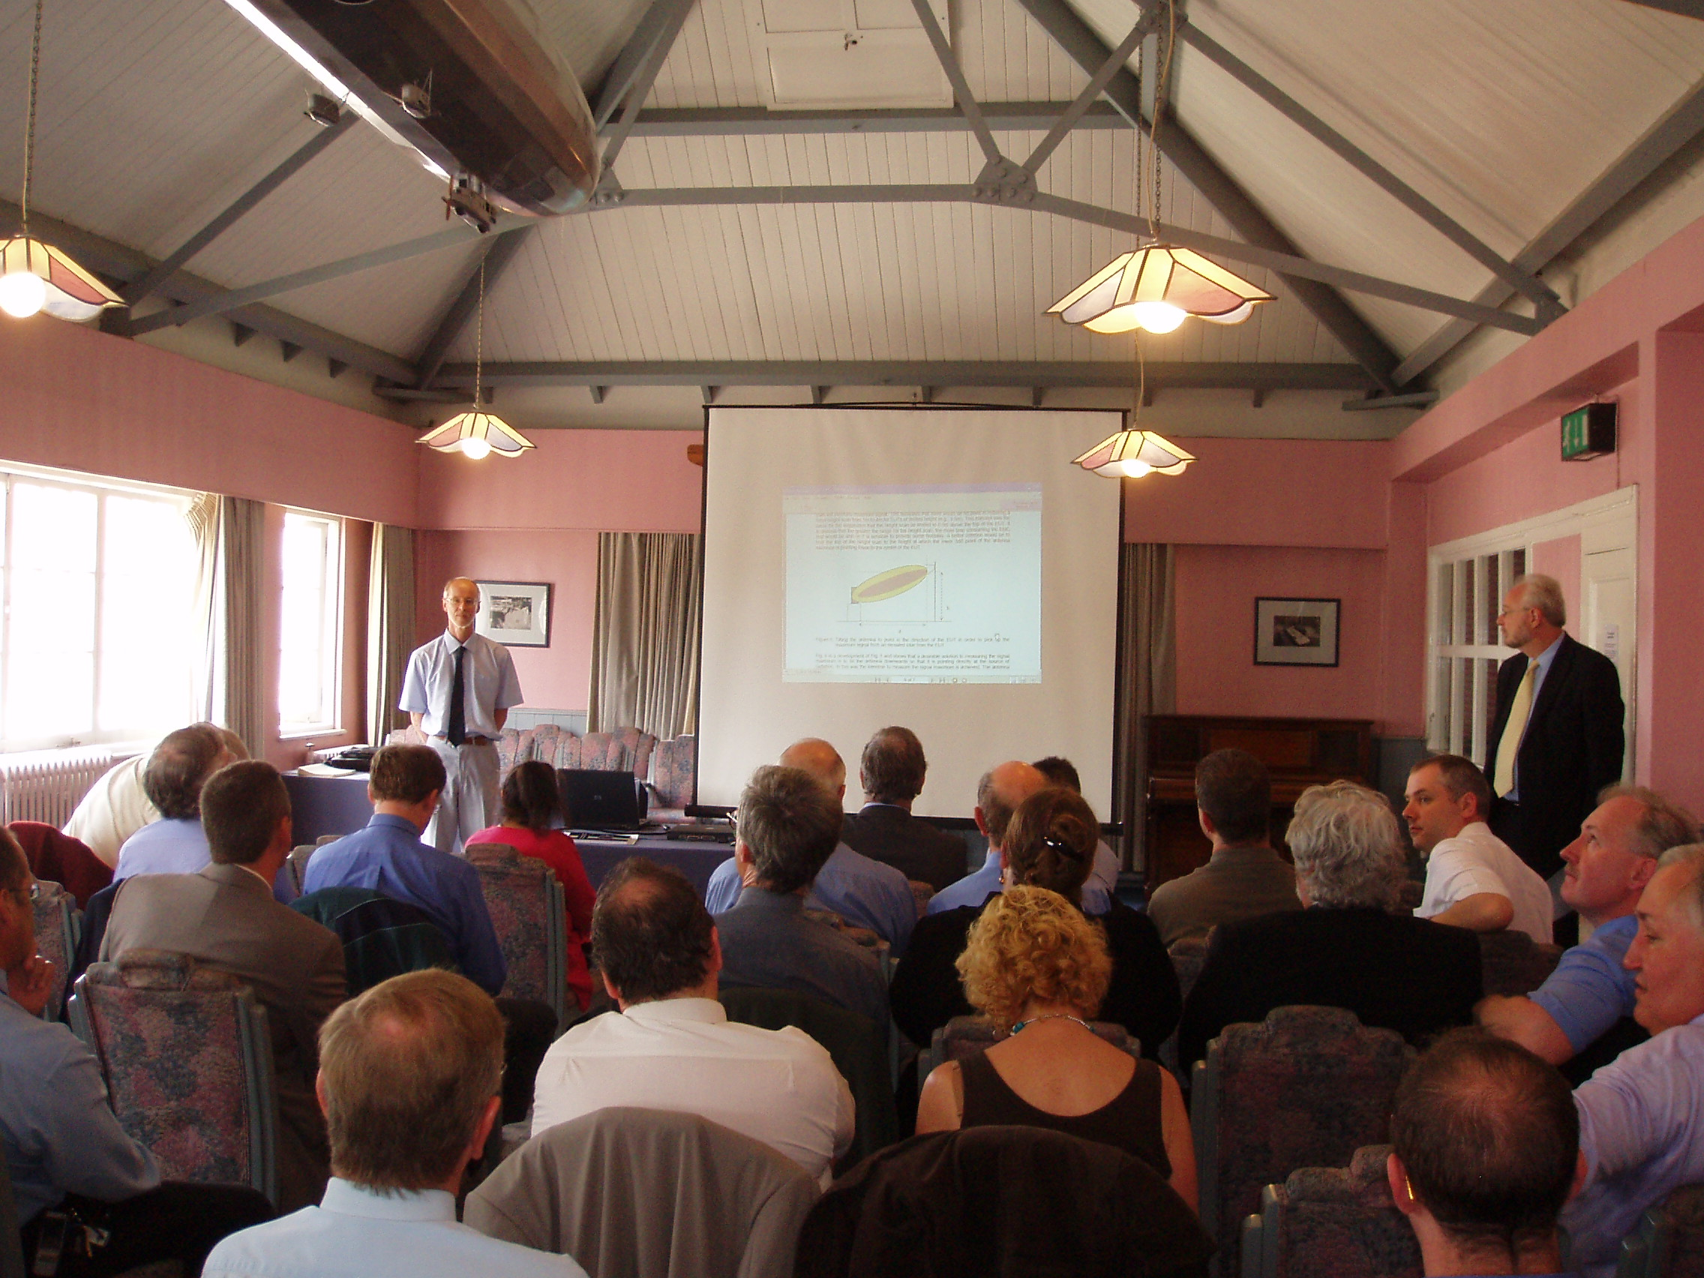
IEEE EMC Society United Kingdom and Ireland Chapter Vtools used to report Chapter meetings. - Which has limited entry format SAMIEEE used to access Chapter membership data. - But more recently IEEE OU Analytics with Tableau, used. - This is SAMIEEE replacement but believed to still use SAMIEEE data, with a data visualization tool. Brooklands Chapter meeting 2003

