Slide 2
Rock River Valley Chapter
Jamal Shafii
Chapter Chair
UTC Aerospace Systems
Rockford, IL, USA
Jamalshafii@ieee.org

Slide 3
Chapter Status
Serving North Central Illinois and extreme South Central Wisconsin
Founded in June 2007
15 EMC Chapter members
Holding EMC meetings in conjunction with Section meeting
Awarded the most improved chapter award in 2011, 2014, 2017

Slide 4
Regular Meetings
October 26, 2017
‒ Speaker: Dennis Lewis
Technical Fellow, Boeing
EMC Society Board Member and Past Distinguished Lecturer
‒ Title: Utilizing Reverberation Chambers as a Versatile Test Environment for Assessing
the Performance of Components and System
‒ About 40 people attended
April 26, 2018
‒ Speaker: Doug Smith
Independent consultant
‒ Title: Electrical Resonances in Physical Structures, A New Approach to Solving
EMC Emissions and Immunity Problems
‒ WebEx meeting (live online webcast)
‒ About 20 people attended

Slide 5
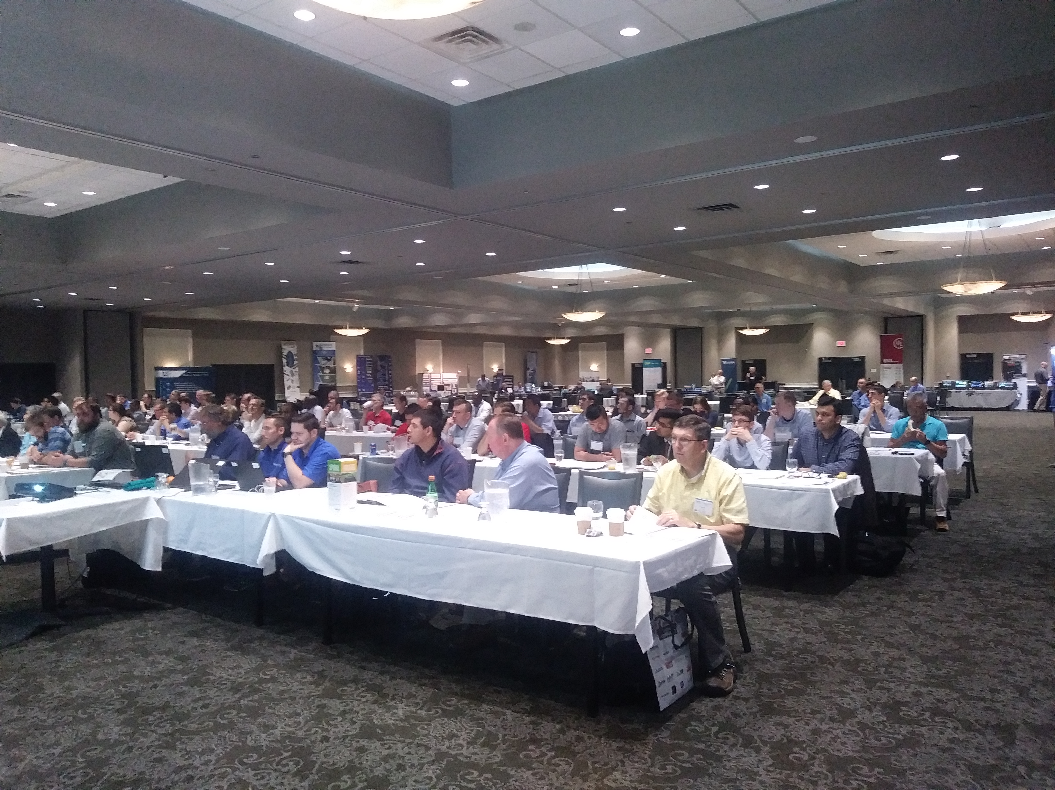
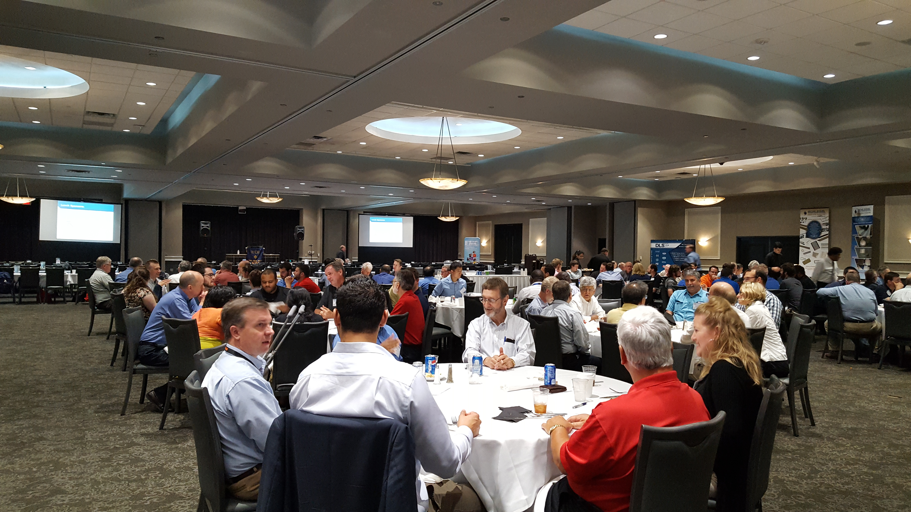
Special event: EMC Seminar
June 12, 2018
Title: Circuit Board Design to Control EMI at the Source
Speaker: Rick Hartley
principal of RHartley Enterprises
One-day seminar, 4 sessions
Over 100 people attended
22 exhibitors
Very positive feedback from attendees/exhibitors
EMC magazine report: next issue

Slide 6
Best Practices
Serving the needs of the local industries and working engineers to further their skills.
Publishing meeting reports in EMC Society magazine
Organized one-day seminars on the 2nd week of June in last 7 years
WebEx meeting (live online webcast)

