Slide 1
IEEE EMC Society
2017 – 2018 Phoenix Chapter Update

Slide 2
Last Year’s Accomplishments:
New Officer Team
Phoenix EMC Symposium
Added to Treasury
Increased Membership

Slide 3
Membership
Officers
Chairman | Glen Gassaway
Vice-Chairman | Chris Williams
Vice-Chairman and Godfather | Daryl Gerke
Secretary | Bob Windell
Treasurer | Cheryl Checketts
Webmaster | Chris Noack
38 EMCS Members (according to IEEE OU)
29 Average Meeting Attendees (EMCS and non-EMCS)
~ 270 on event mailing list!

Slide 4
Technical Meetings
Month | Subject | Speaker(s) | Attendees
April 2017 | Phoenix EMC Symposium | 7 (see next slide) | 42 Attendees, 28 Exhibitors
November 2017 | Military Application of Electromagnetic Environmental Effects | Kris Hatashita | 27
February 2018 | Demystifying EMI Filter Design | Bill Limburg | 25
March 2018 | Modern EMC Receiver Measurement Concepts | Bill Wangard | 26

Slide 5
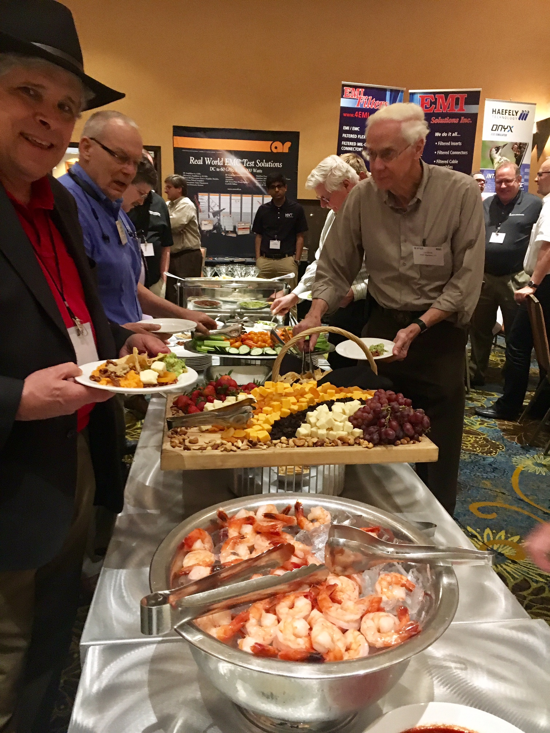
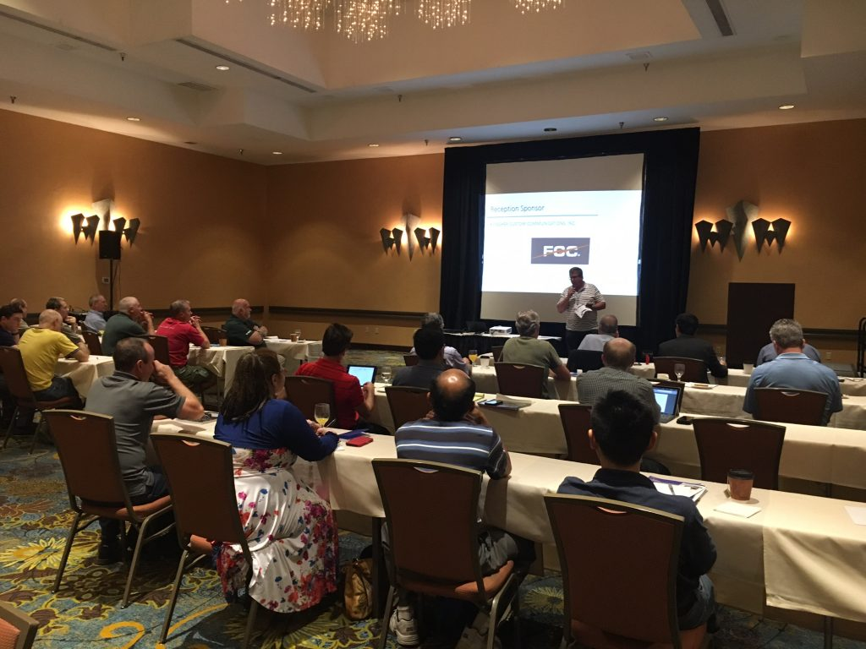
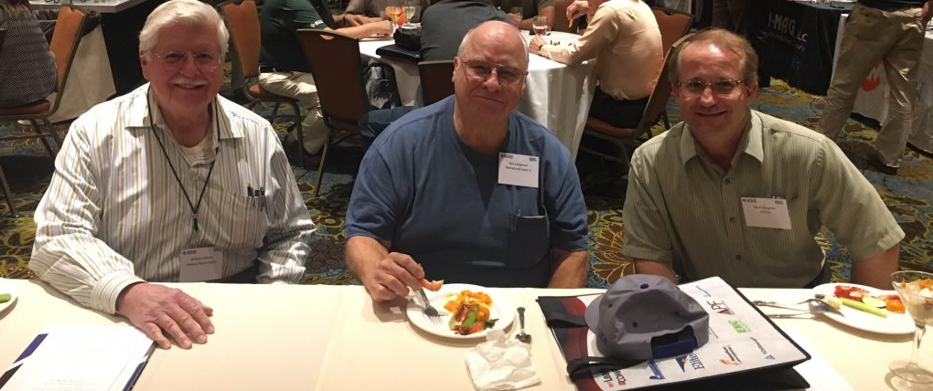
2017 Phoenix EMC Symposium
Program Agenda
EMC Design Review By Daryl Gerke
Smart Antennas By Dr. Constantine Balanis
Wireless Integration Interference Challenges By Harry Skinner
Understanding Device Performance in a Crowded RF Environment: By Dr. William Young
Anechoic Absorber Consideration in the W Band By Zhong Chen
IoT EMI By Dr. Vignesh Rajamani and Mark Goldstein
Panel Session with Speakers

Slide 6
2018-9 Future Plans
At least two meetings in the fall.
Continue to enhance leadership team.
- Add role of “prior year chair”.
Streamline meeting invites
Push for more student and new engineer involvement.
2019 Phoenix Symposium.

Slide 7
“Caroline Quiz”
What do you think you are doing right?
Good local interest
Revenue is better
Where do you think your chapter needs help?
Deeper Officer Bench
Young Engineer/Student Involvement
Funding from Section
Do you know how to use vTools?
Yes, we use it for meeting reporting and officers.
SAMIEEE? (it’s OU now) yes

