Slide 1


Slide 2
Japan Joint Chapter Repot
Aug.2017-July 2018
Officers:
  Chair: Takashi Harada (Tokin EMC Engineering)
  Vice Chair: Kimihiro Tajima(NTT Advanced Technology)
  Secretary: Ifong Wu (National Institute of Information and Communications Technology)
  Treasurer: Takashi Kasuga (National Institute of Technology, Nagano College)
Number of members:
214 (2017, Including Sendai Chapter )

Slide 3
Activities
  Japan Joint/Sendai Chapter Meeting
  Special Lecture by Distinguished Lecturer
  Establishment of “Student Award”
  Technical Meetings
    10 meetings in co-operation with meetings on EMC sponsored by EMCJ of IEICE* Communications Society.
*IEICE: The Institute of Electronics, Information Communication Engineers

Slide 4
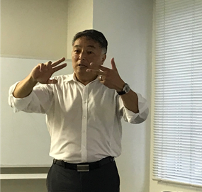
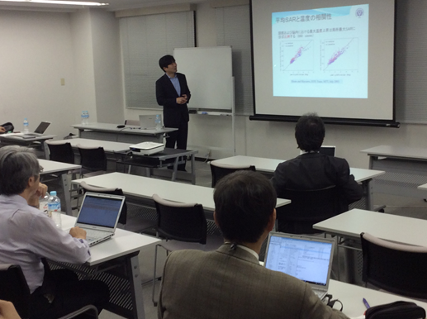
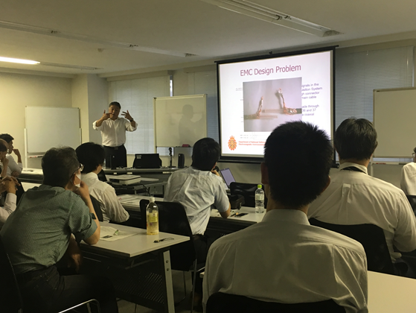
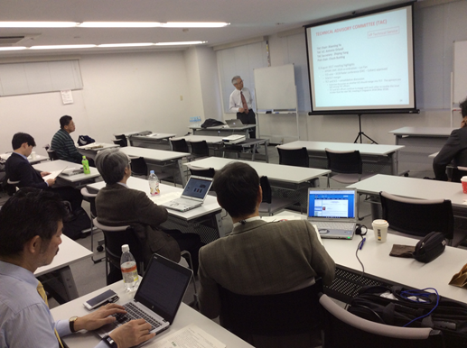
Annual chapter meeting by Japan Joint/Sendai chapters
  The special lecture by DL
  K. Hatashita
Date: December 08, 2017
PLACE: Tokyo (Toho-tochi Conference Room)
Attendees: 17
7 Lectures & a discussion
  DATE: May 30, 2018
  PLACE: Tokyo (Toho-Tochi Conference Room)
  Title: Electromagnetic Environmental Effects in the Military
  Attendees: 29

Slide 5
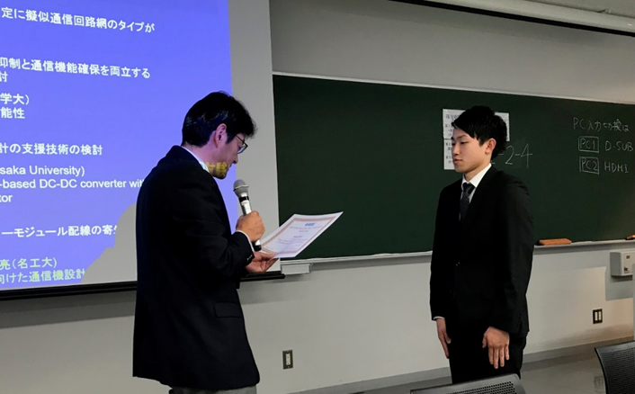
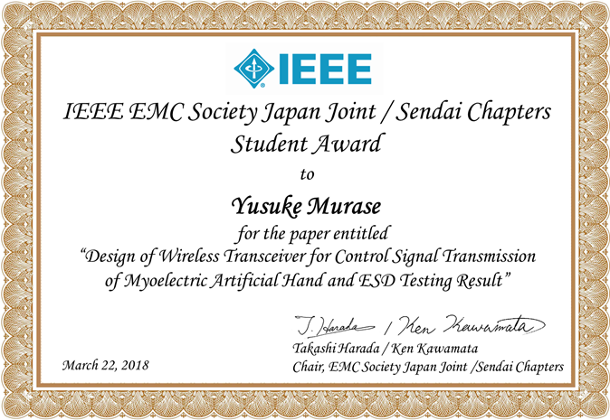
Student Award
First prize ceremony was held on March 22, 2018
Purpose: To motivate students, and increase of young members
Recognition: A young student who made the most excellent presentation at the
sponsored or co-sponsored technical meetings

Slide 6

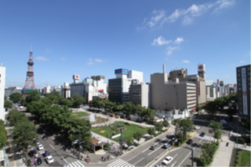
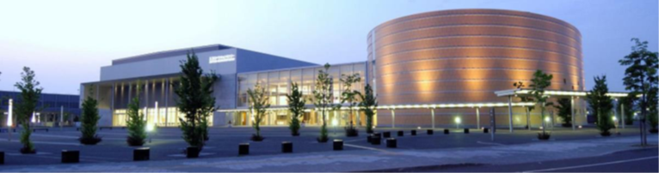


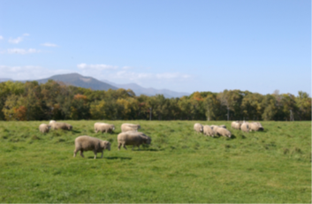
●Sapporo
●Tokyo
Organized Session Proposal Deadline
October 26, 2018
Paper Submission Deadline
December 24, 2018

