Slide 2
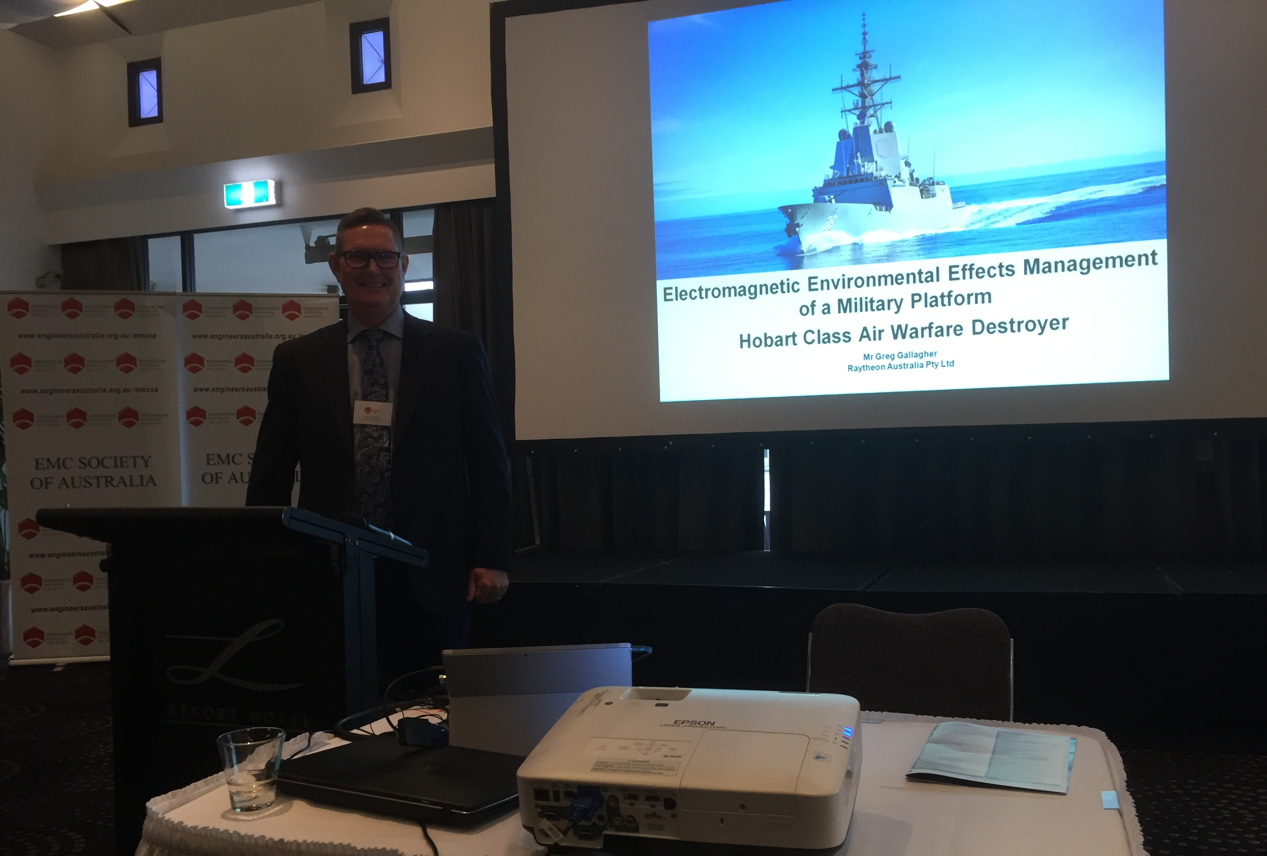
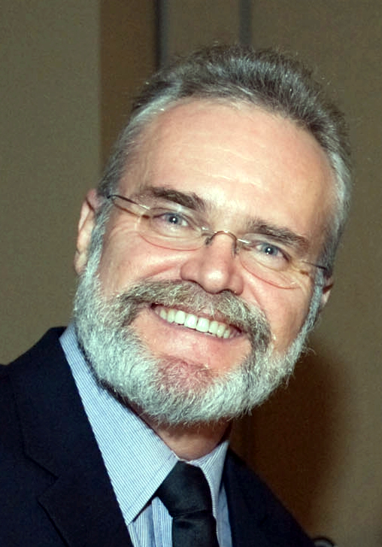
Australian Chapter Activities EMC Workshop in Adelaide, May 2018
3 day Workshop
Featured Bob Scully, Mike Hatfield and Zhong Chen
Attendance: 45 delegates

Slide 3
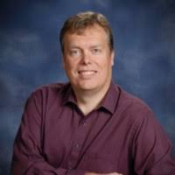
Australian Chapter Activities Complex Challenges in Measuring 5G / Millimeter Wave Devices
Held in Melbourne 5 August 1018
Presenter: Jari Vikstedt | Manager at Wireless Solutions for ETS-Lindgren in Cedar Park, Texas
Attendees: 40 delegates

Slide 4
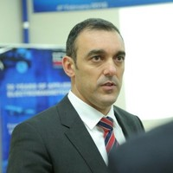
Australian Chapter Activities ICS design of fifth generation fighter and EMI/EMC verification and optimization of a SIGINT Aircraft
Held in Melbourne and Adelaide in February & March Presenter: Giovanni Fumia from IDS in Italy Attendees: 35 delegates

Slide 5
Upcoming Presentations
EMC Software Presentation planned for September
HERF/HERO Presentation TBD

Slide 6
https://www.youtube.com/watch?v=h8v5wTZmpuM

Slide 7
https://www.youtube.com/watch?v=Zlvsl83hDnE

