Slide 2
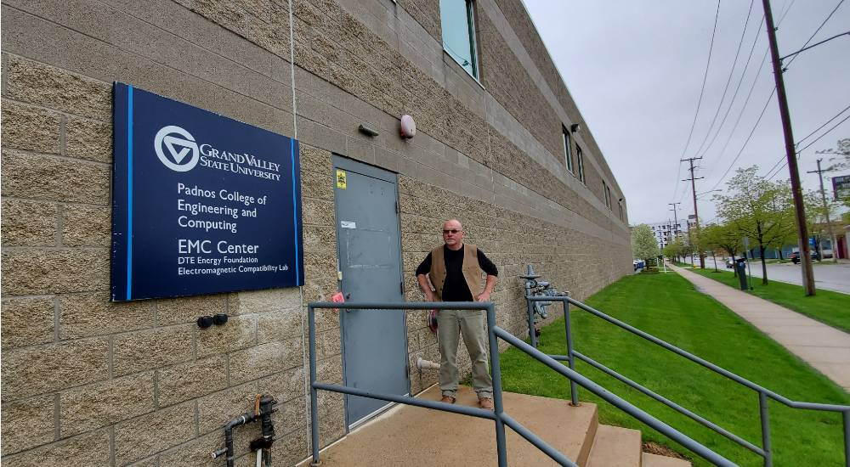
West Michigan Chapter
Meets at Grand Valley State University EMC Center,
facility that supports:
EMC education,
Research
EMC precompliance testing for industry.
www.EmcCenter.com

Slide 3
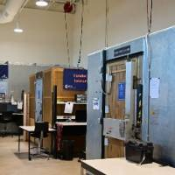
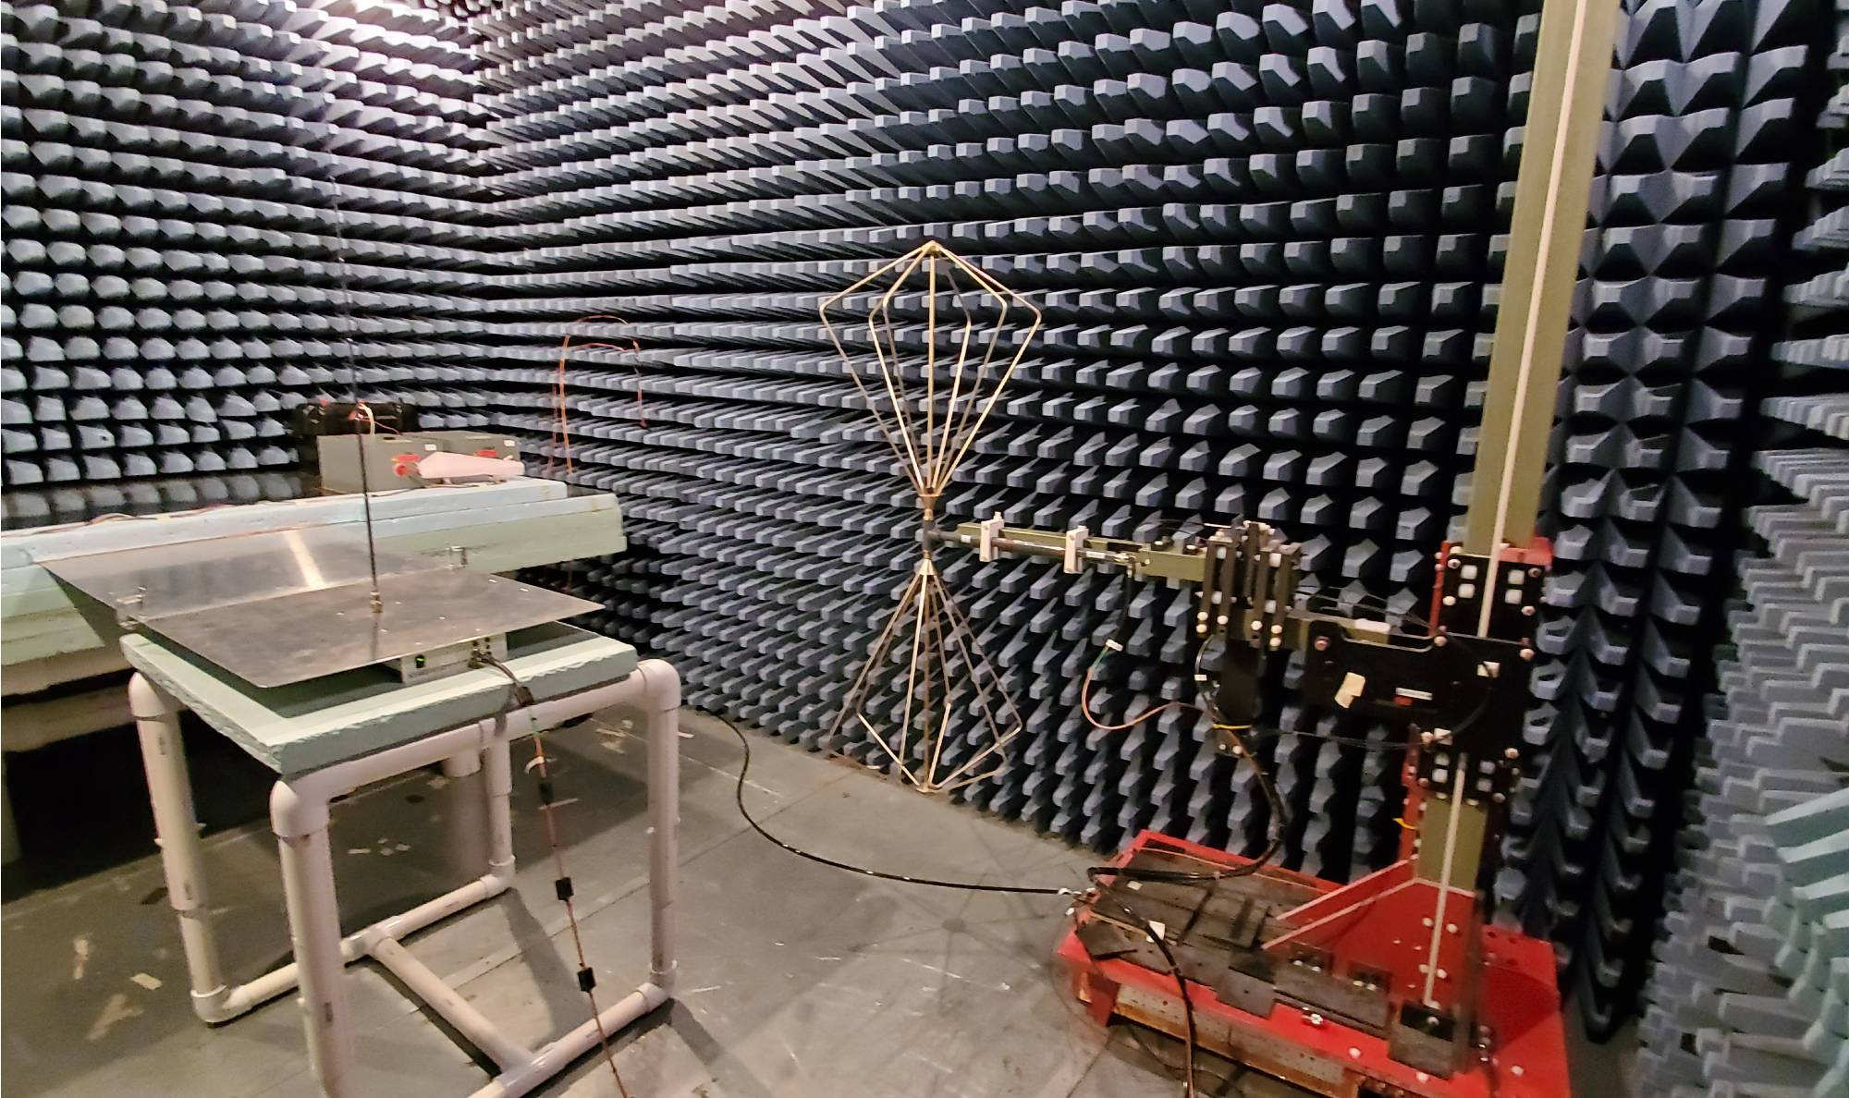
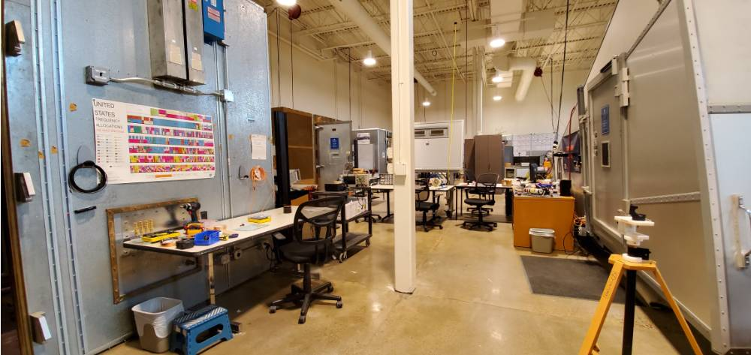
West Michigan Chapter
Inside this 6,000 square-foot facility there are seven EMC test chambers for
radiated and conducted emissions,
radiated and conducted immunity, and
electrostatic discharge testing.

Slide 4
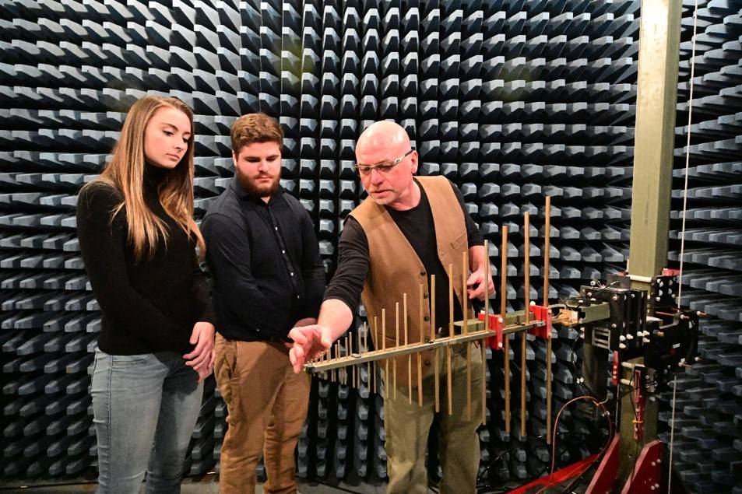
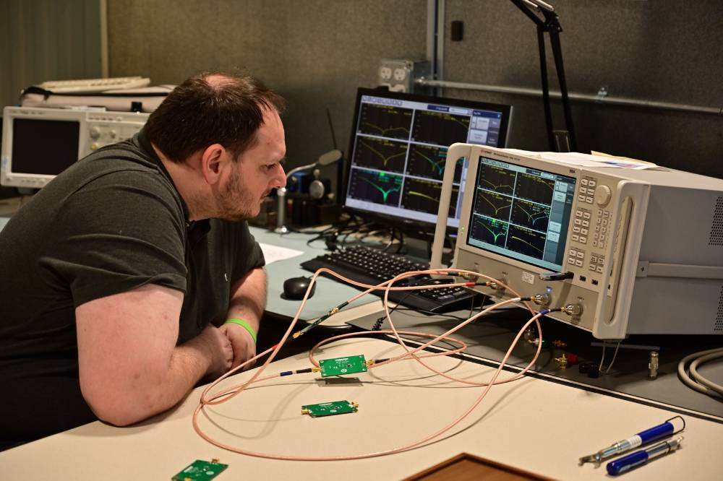
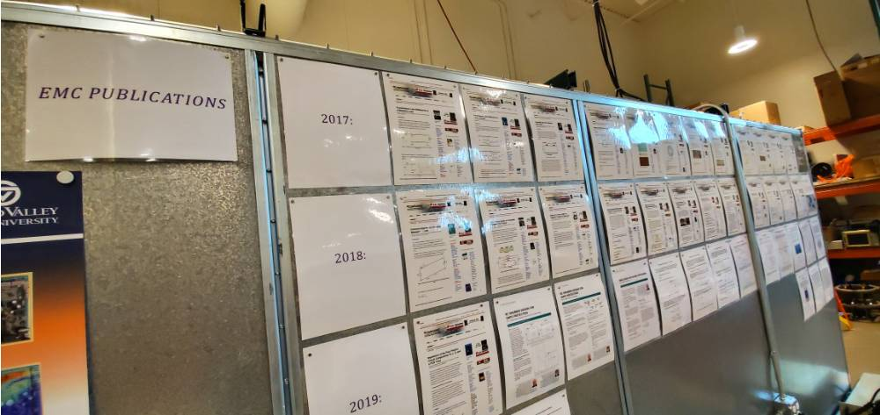
West Michigan Chapter
The center provides support for
university electromagnetic compatibility courses
at undergraduate and graduate level as well as
- EMC certificate courses for industry.

