Slide 1

Report of the
IEEE Korean EMC Chapter
July 22, 2019
Seungyoung Ahn
Notes:
I’m Seungyoung Ahn from KAIST, Korea.
I’d like to briefly introduces EMC activities in Korea.

Slide 2

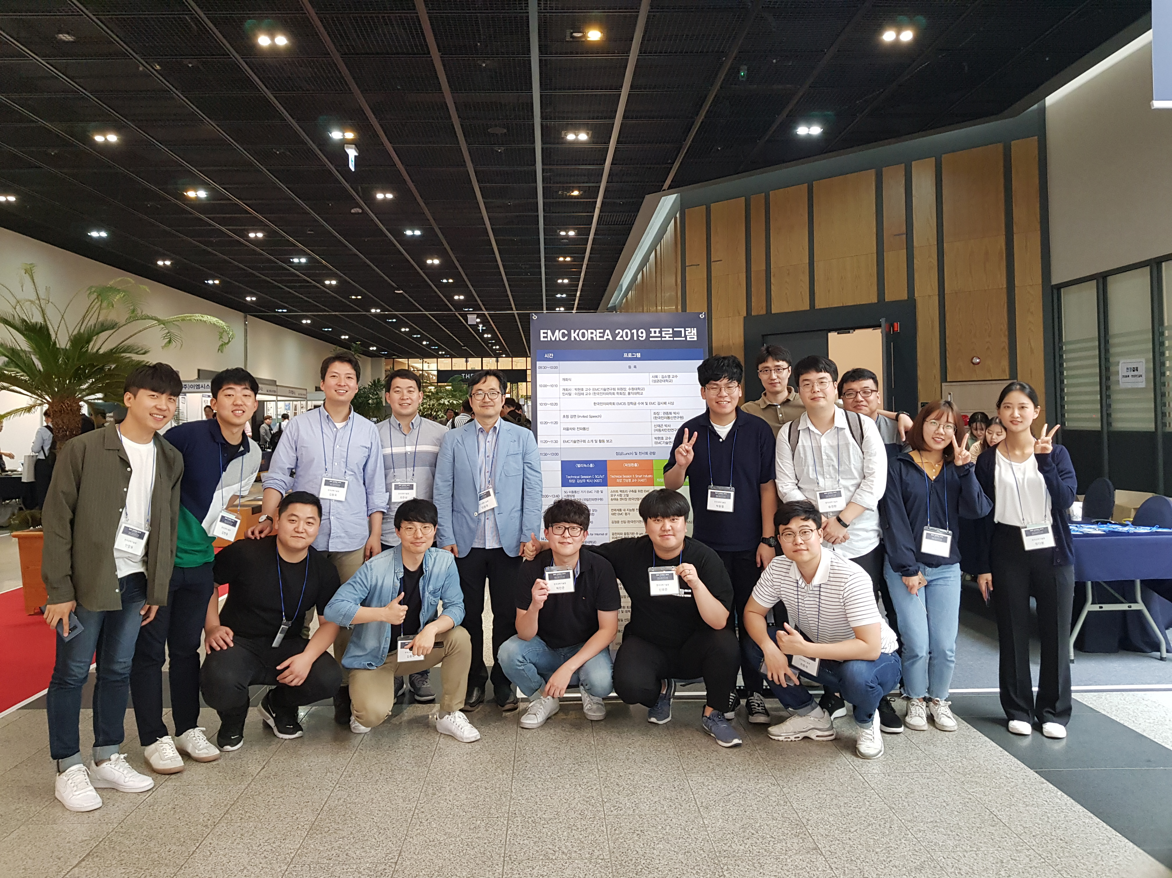
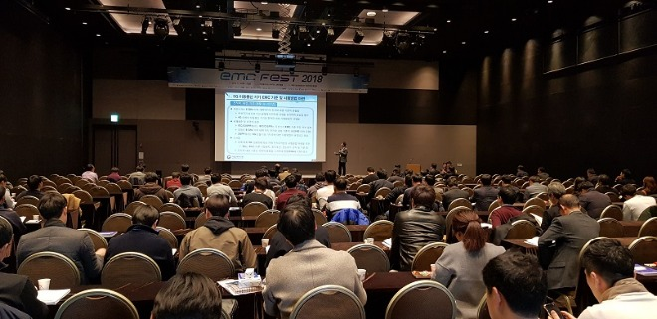
EMC Activities in Korea
Research Committee in Korean Institute of Electromagnetic Engineering and Science
  30 key members
EMC Korea Workshop 2019 (July 11, 2019)
  200+ attendances
  Technical presentations and Tutorials
  Exhibitions
EMC Fest 2018 (Nov. 22-23, 2018)
  500+ attendances
  Keynotes
  Exhibitions
  Meetings & Social Events
Notes:
I think Korea is one of the most active countries in EMC area.
Around 30 key members (most of them are EMCS members) are working in the society.
These are annual domestic workshop and meeting.
EMC Korea workshop is more technical meeting more than 200 attendances, and EMC Fest is much larger meeting for every EMC engineers.

Slide 3
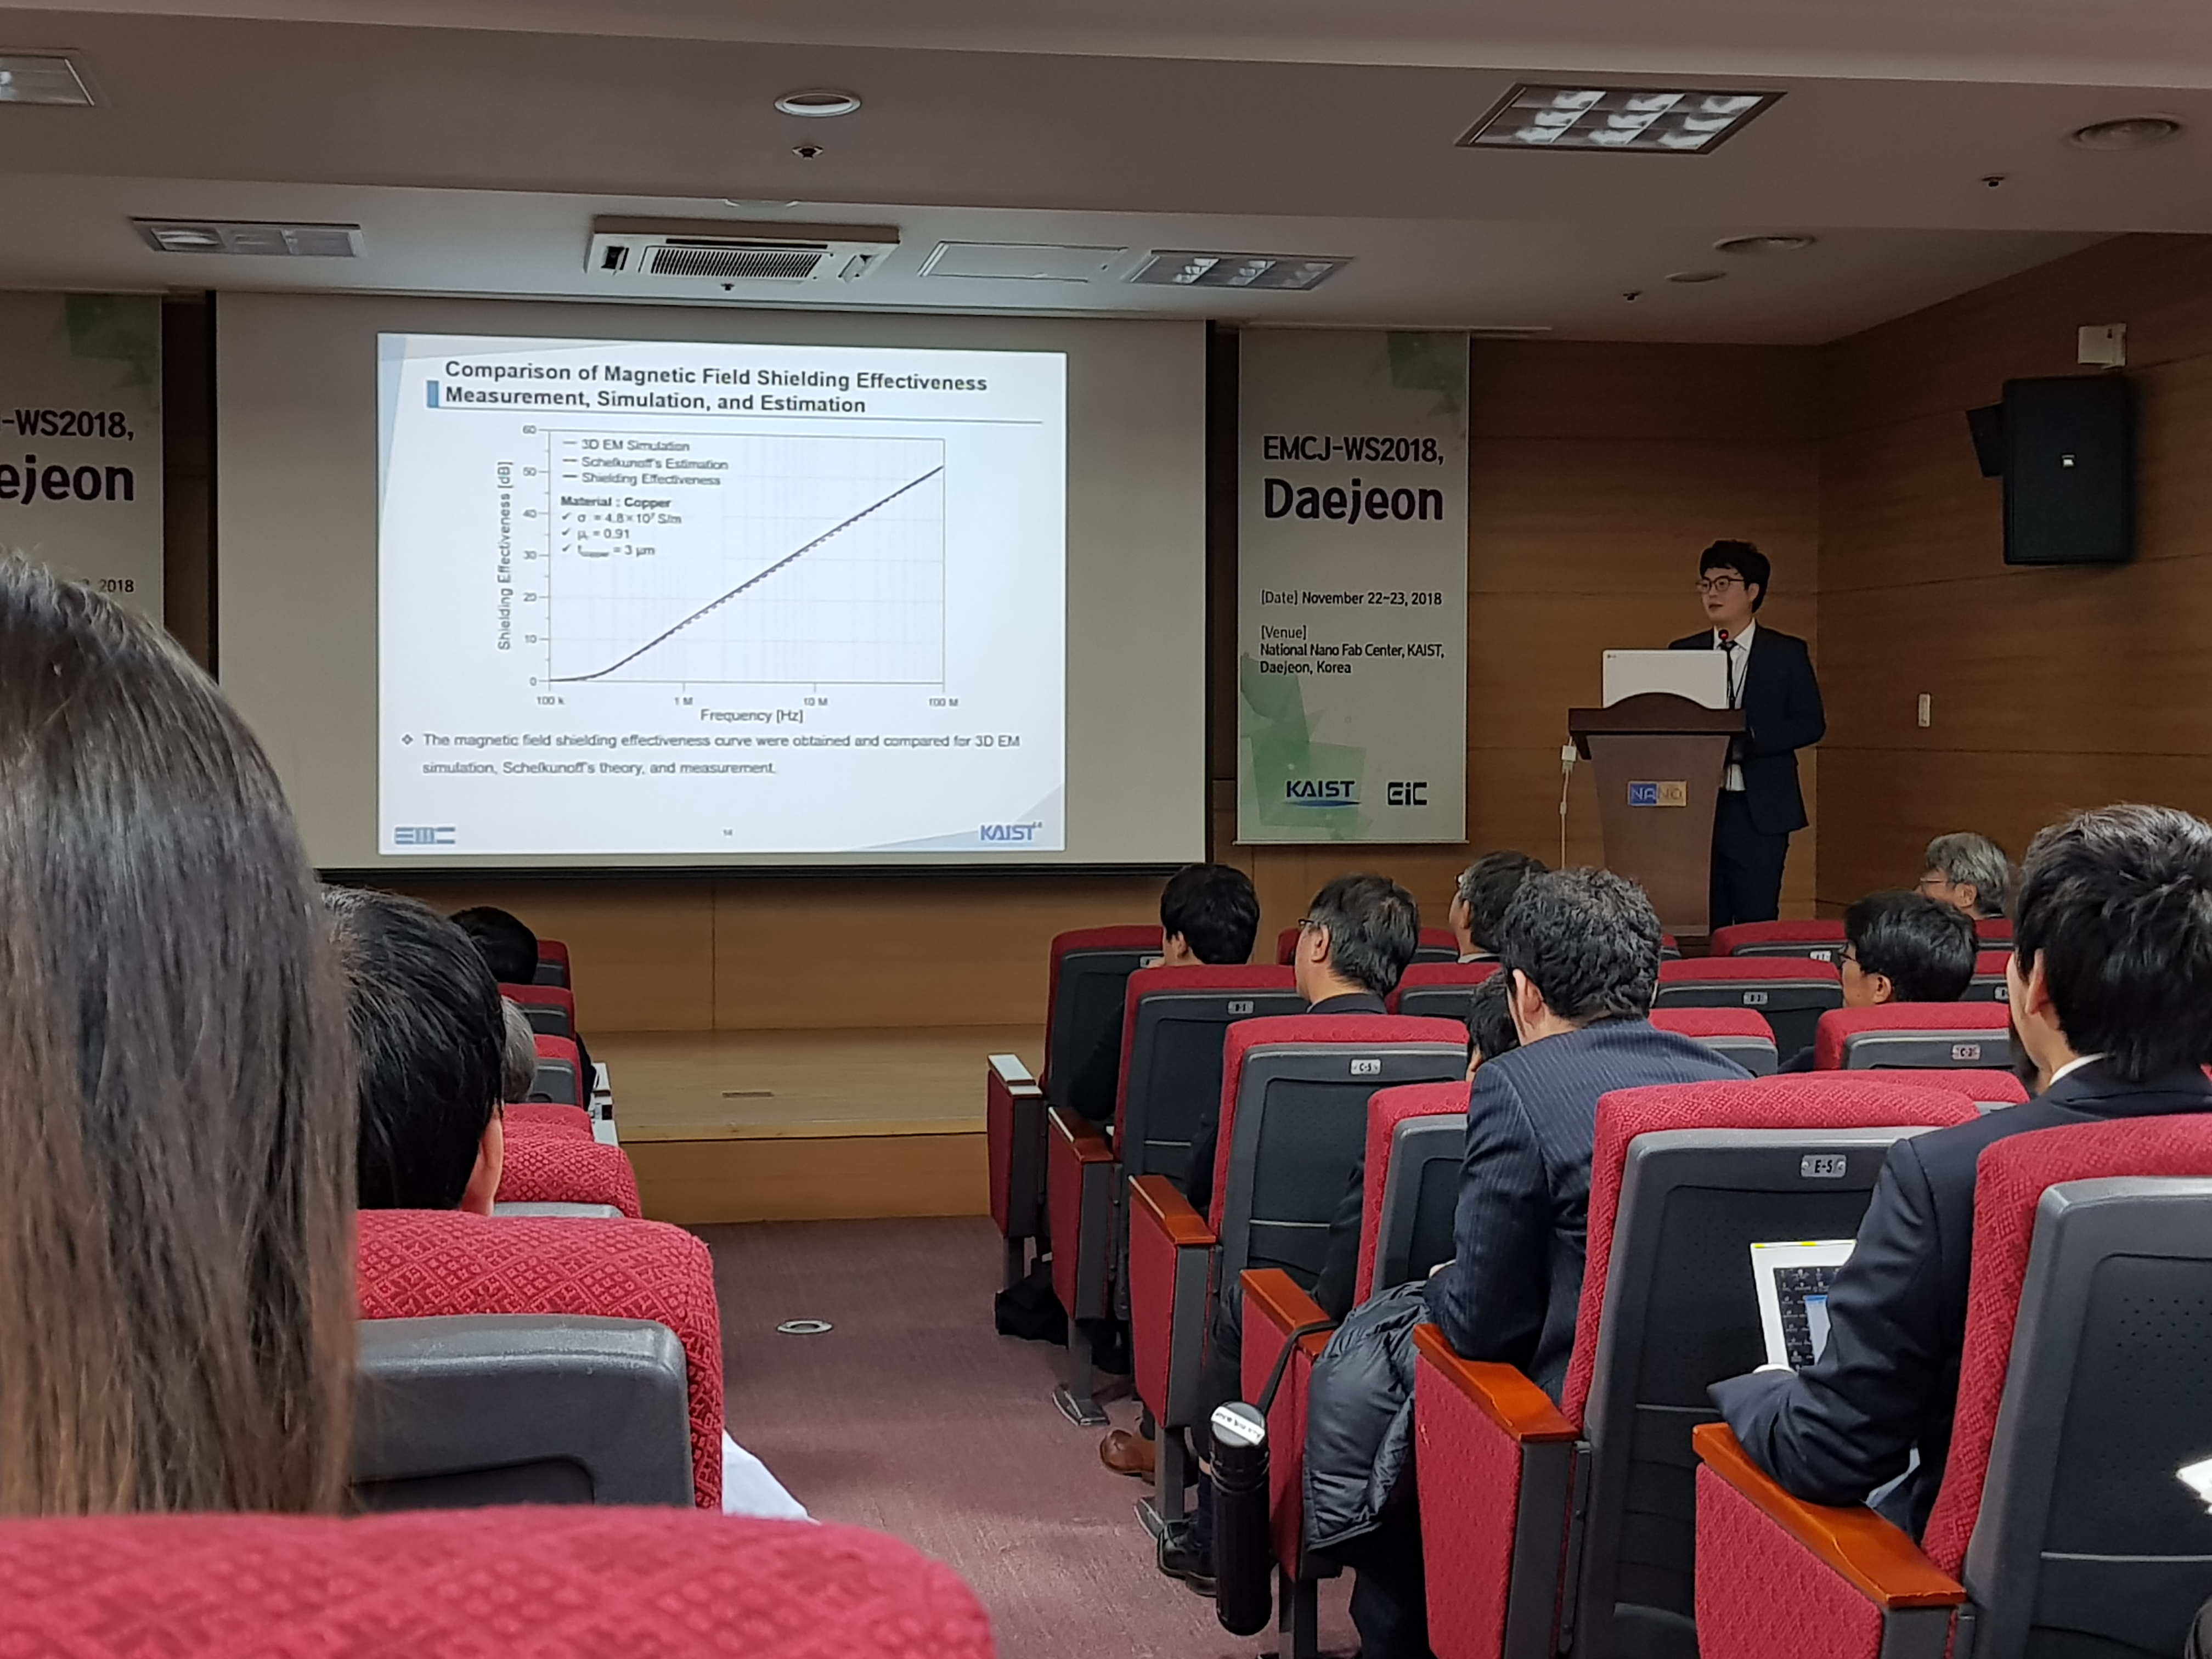
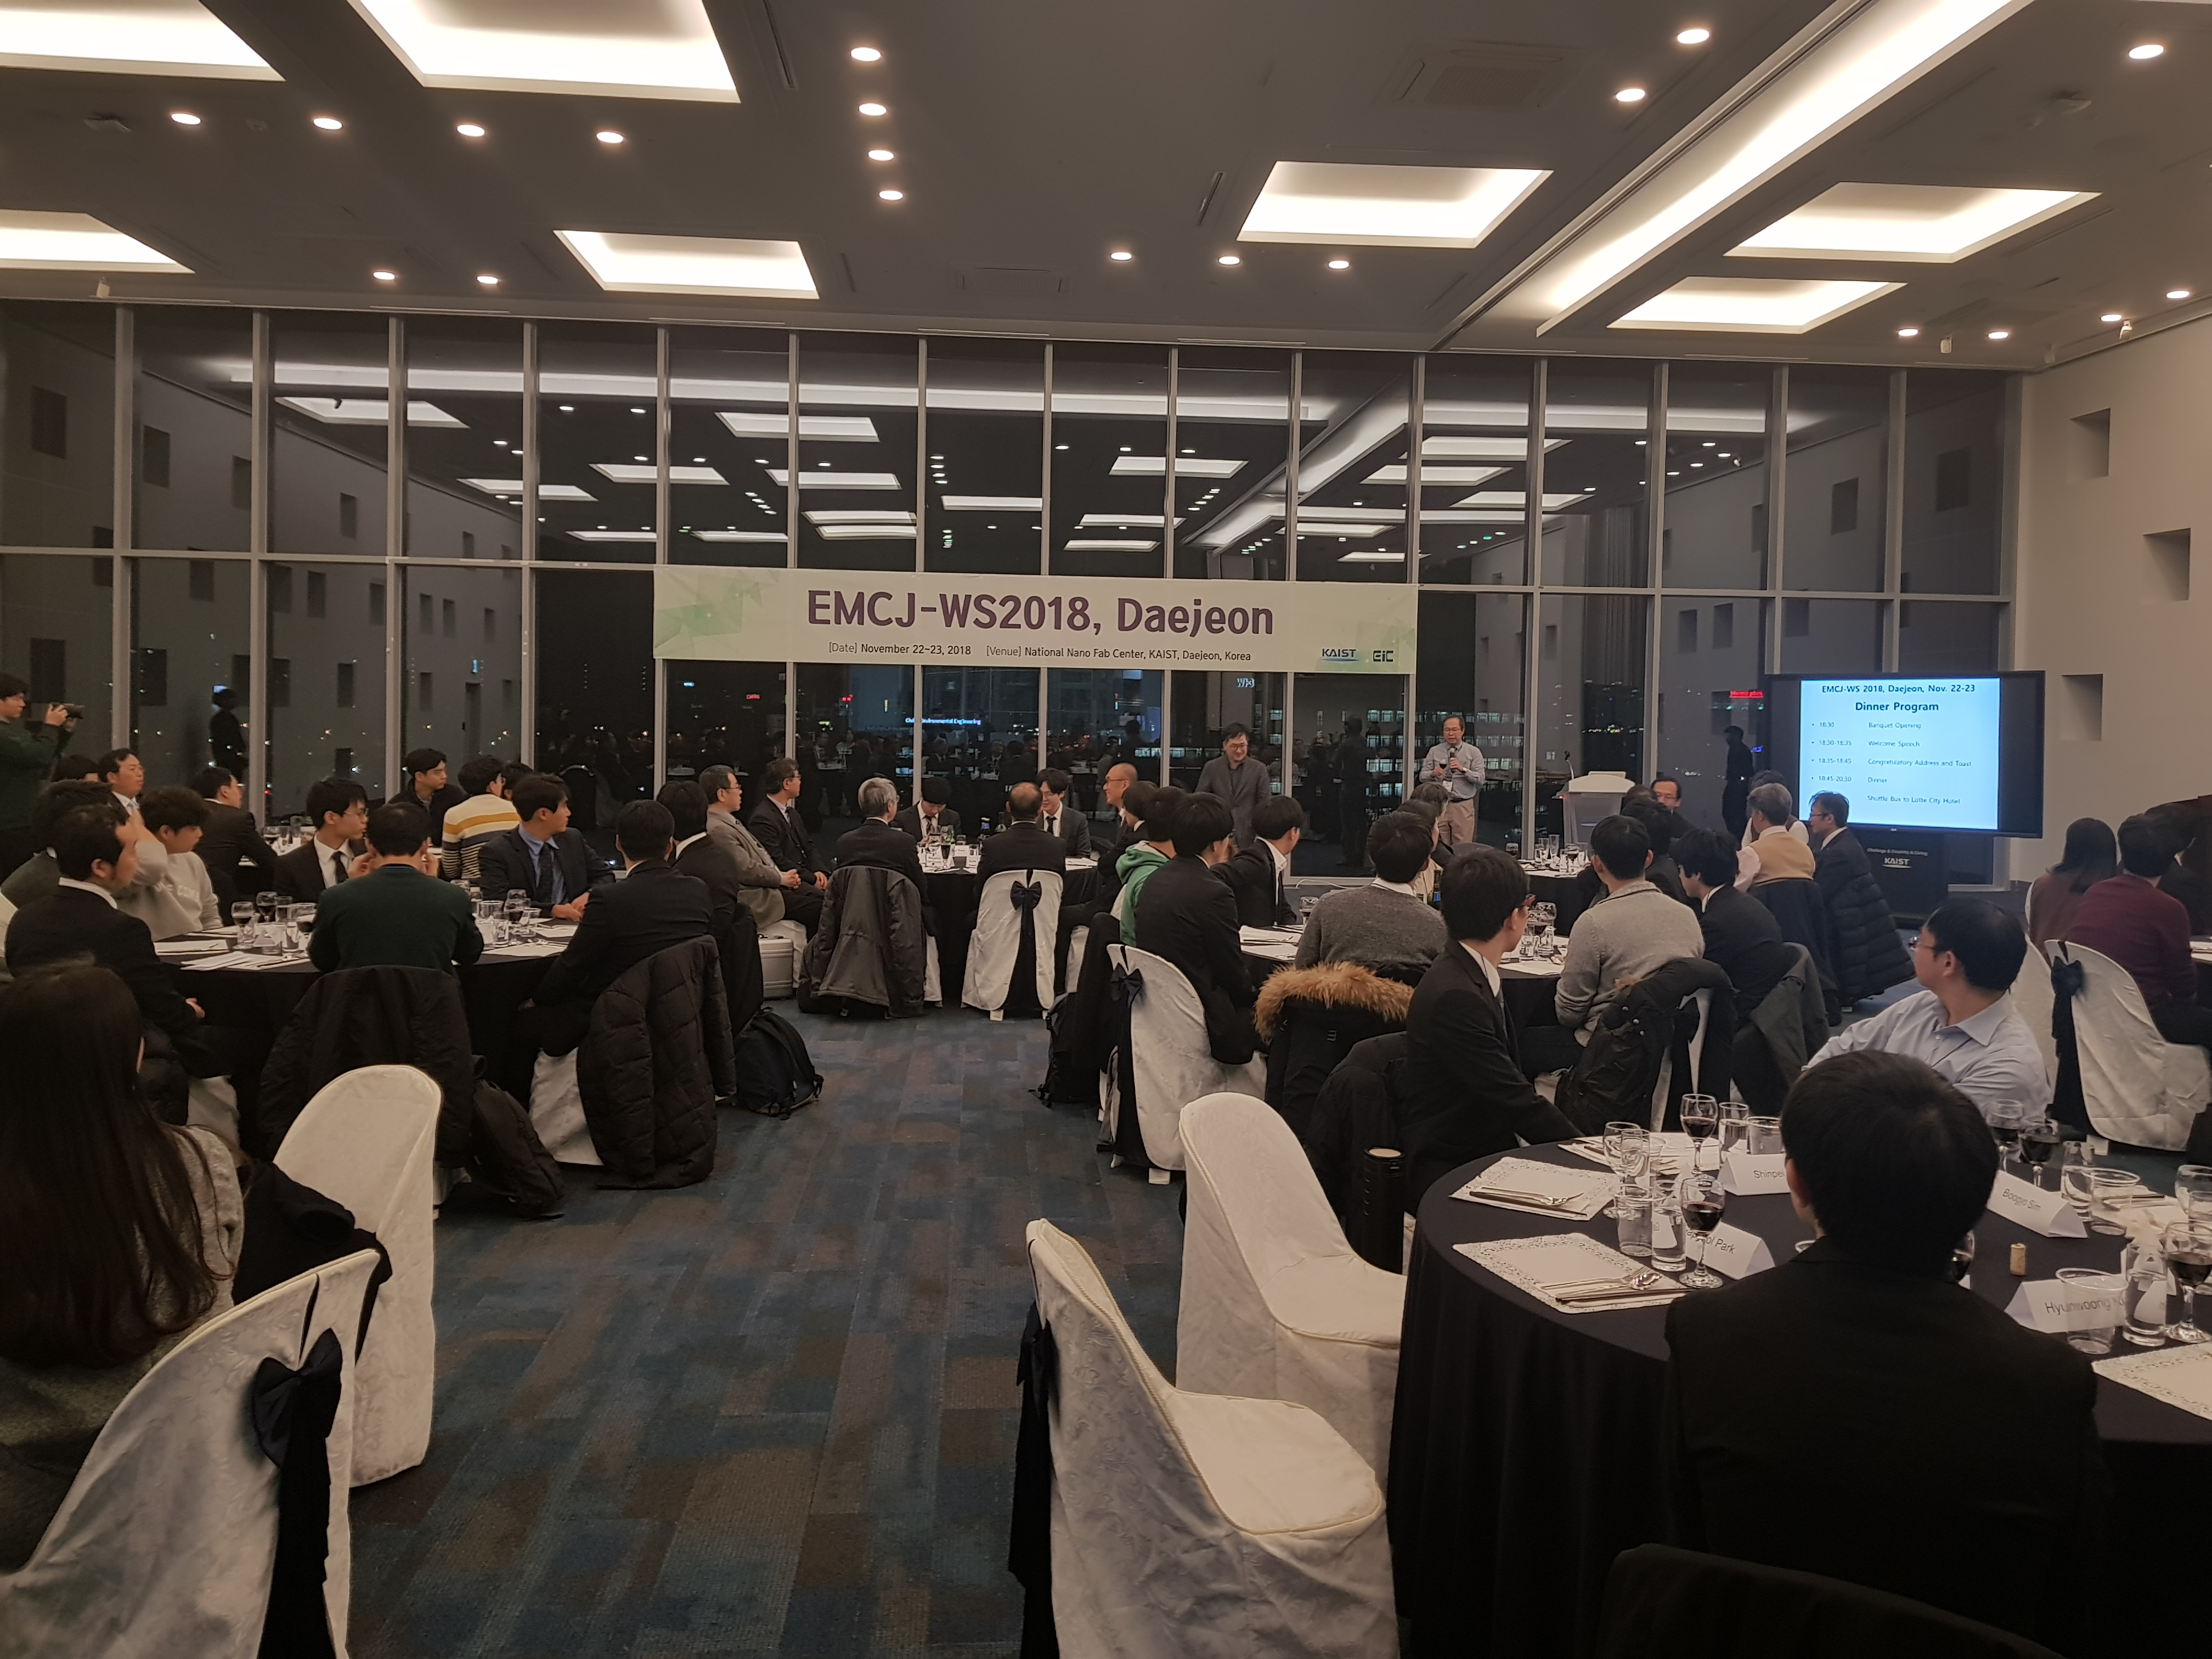
EMC Activities in Korea
APEMC, KJJC
EMC Joint Workshop (Nov. 22~23, 2018, Daejeon, Korea)
  86 participants (Japan: 41, Korea: 45)
  37 papers (Japan: 22, Korea: 15)
Notes:
We also do international symposium, meetings for collaboration, such as APEMC or Korea-Japan Joint Conference on EMC.
Last year EMC Joint workshop was held in Daejeon Korea.
You should know that politically Korea and Japan has sometimes problems, but in engineering especially in EMC area we are very, very good friends.

Slide 4
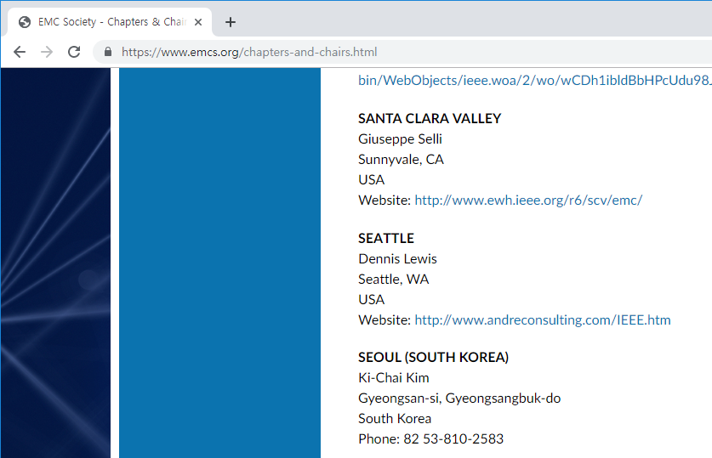
IEEE EMC Korean Chapter ?
Officially, there is no EMC chapter in Korea now.
  Didn’t submit activity report to EMC society for some years.
  Email of the chapter chair was not updated.
We are trying to re-establish an
EMC chapter in Korea.
Notes:
I’d like to say a status of EMC Korean Chapter.
Officially, there is no EMC chapter in Korea now.
There was EMC Seoul Chapter, but we didn’t submit activity report to EMC society for some years.
According IEEE rules, the EMC Seoul chapter became inactive.
So, we are trying to re-establish an EMC chapter in Korea.

Slide 5
Difficulties in the formation of Korean EMC Chapter
Difficulty 1: Requirements of Agreement Signatures
  56 members in 5 Sections (Busan/Daejeon/Gwangju/Seoul/Taegu)
  15 members in Daejeon Section
  Required # of signatures : 12
Difficulty 2: The petition must be done via IEEE Website
  The written signature is not valid.
  When a petitioner submit a petition, IEEE send request for agreement.
  However, some email addresses are wrong,
  some ignored the signature request email, and so on.
Old signature form
Notes:
However, there were some difficulties in the formation of EMC chapter in Korea.
We had difficulties in getting required signature from the Daejeon section I belong.
The petition process is changed to only online.
Once I submit the petition form, IEEE automatically send email to EMC members in Daejeon section for signature.
But some of the emails are not delivered correctly when the email is changed.
So we had long time to get the required number of signatures.

Slide 6
Other options considered
Joint Chapter with other Society
  Example: IEEE Malaysia AP/MTT/EMC Joint Chapter (https://apmttemc.org/)
  Joint Chapter with Broadcasting Technology Chapter in Daejeon
In IEEE website the petition for joint chapter is not possible.
  Some manual process is required.
We tried to contact all EMCS members in Daejeon before petition,
and waited.
Notes:
So we also considered joint chapter with other society, and at the same time, we also tried to contact all EMC members in Daejeon.

Slide 7
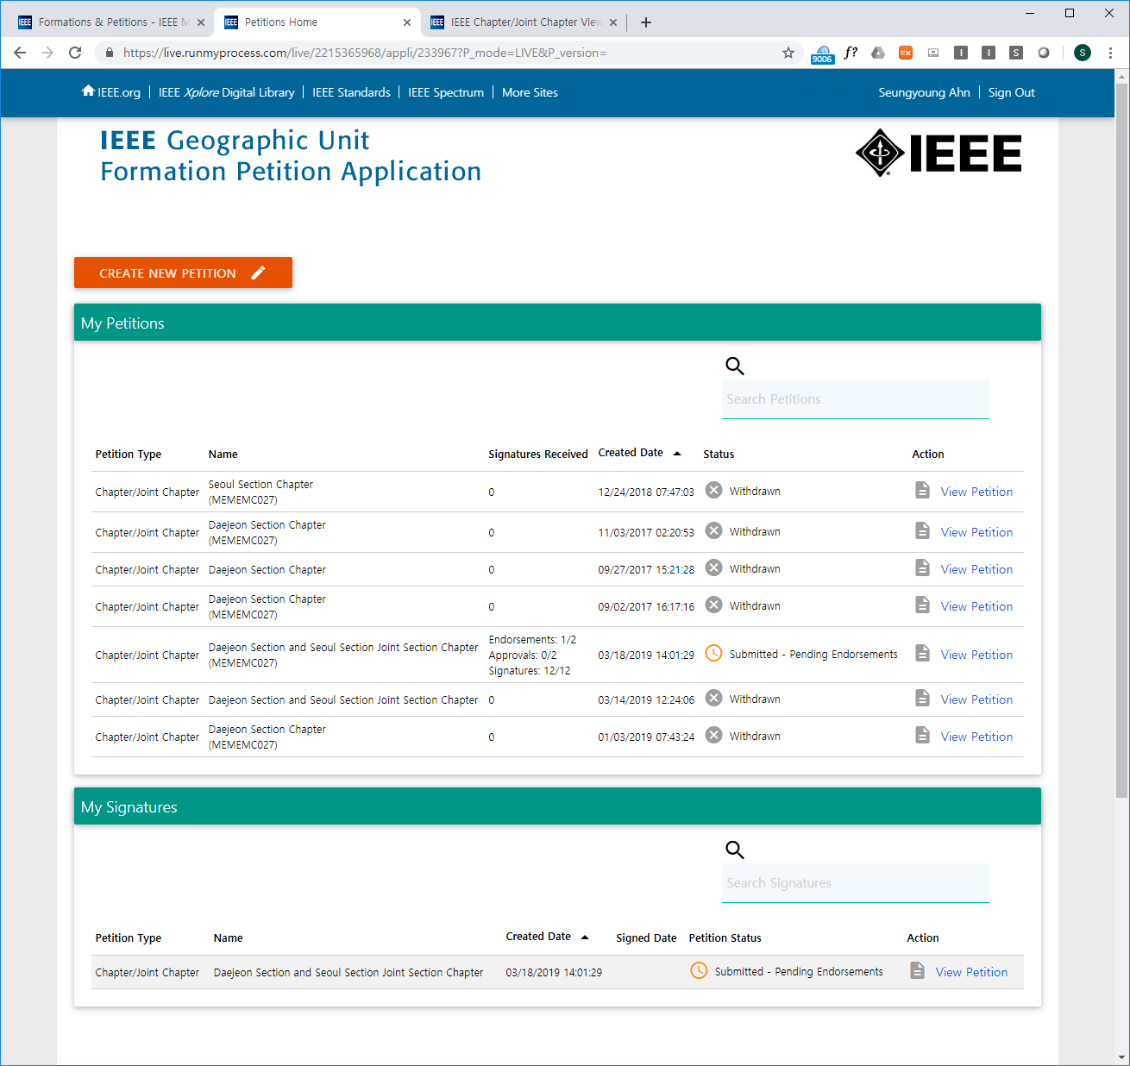
Current Status
Got all required signatures.
One more endorsement required.
Two approvals required.
We got much help from EMC society (especially from Caroline) for this problems.
Notes:
So, it took some months to get all required signatures of EMC members from Seoul Section and Daejeon Section.
Endorsements and Approvals are required.
Caroline helped us much for this problem, and we are continuing this until final approvals.

Slide 8
Re-formation of EMC Korean Chapter is still going on.
Lesson from the example of EMC Seoul section:
  Reformation would be very difficult.
  Please report regularly to EMC Society and attend every Chapter Chair Meetings. ☺
Thanks to
Ms. Caroline Chan, Dr. Vignesh Rajamani,
Prof. Yuki Fukumoto, and Prof. Hiroshi Inoue
for the help and support.

Slide 9
Current EMC Distinguished Lecturer
Marcos Rubinstein, Xiaoxiong (Kevin) Gu, Seungyoung Ahn,
Liang Zhou, Zhong Chen, Ihsan Erdin, Richard Xian-Ke Gao
Prof. Seungyoung Ahn (KAIST, Korea)
Email: sahn@kaist.ac.kr
Term: 2019-2020
Talk 1: Electromagnetic Compatibility for Wireless Power Transfer
Talk 2: Semiconductor Electromagnetic Compatibility Modeling for Power Devices and Packages
(TSV Modeling)
Notes:
One more thing, it’s an advertisement.
Currently there seven EMC Distinguished Lecturers, and fortunately I could be one of them from this year.
All of you are chapter chairs, if you are interested in this topic, I’d like to visit your country for this duty this year and the next year.
Please contact me to this email.
Thank you.

