Slide 1
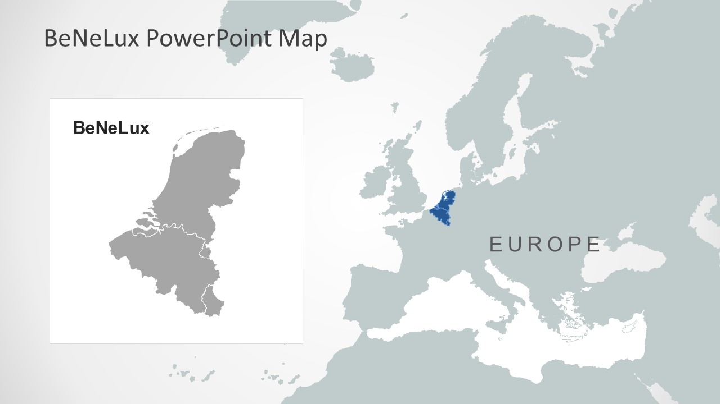
BeNeLux - Chapter
Chair: Frank Leferink
Secretary: Davy Pissoort
Treasurer: Cees Keyer
Web Manager: Anne Roc’h
http://sites.ieee.org/benelux-emcs/

Slide 2
BeNeLux – Chapter Activities
2018, Febr. 23: Matchmaking event EMVT and EMC
2018, June 25: Yearly meeting
2018, June 25: Visit Bakker Sliedrecht
2018, August 26-30: EMC Europe Symposium in Amsterdam
2018, Sept. 12: Visit Biberbunker
2018, Oct. 26: ESD meeting at NEN
2018, Nov. 20: EMC-ESD event, Leusden
2018, Nov. 23: EMC Knowledge day, Brugge

Slide 3
Strengths of the BeNeLux Chapter
Most activities are organised in collaboration with the Dutch EMC-ESD society
As a result: administrative support by FHI
IEEE DL lectures are often organised in collaboration with the German chapter to reduce travel costs (/event)
Both a strong academic and industrial network
Old tradition started again: Social event during EMC Europe -> increases involvement of members

Slide 4
BeNeLux Chapter: Plans for 2019
Invitation Distinguished Lecturer(s)
EMC & Health
EMC for Installations

