Slide 2
Rock River Valley Chapter 2016 report
Jamal Shafii
UTC Aerospace Systems
Rockford, IL, USA
Jamalshafii@ieee.org

Slide 3
Chapter Status
Serving North Central Illinois and extreme South Central Wisconsin
Founded in June 2007
15 EMC Chapter members
Holding EMC meetings in conjunction with Section meeting
Awarded the most improved chapter award in 2011 and 2014

Slide 4
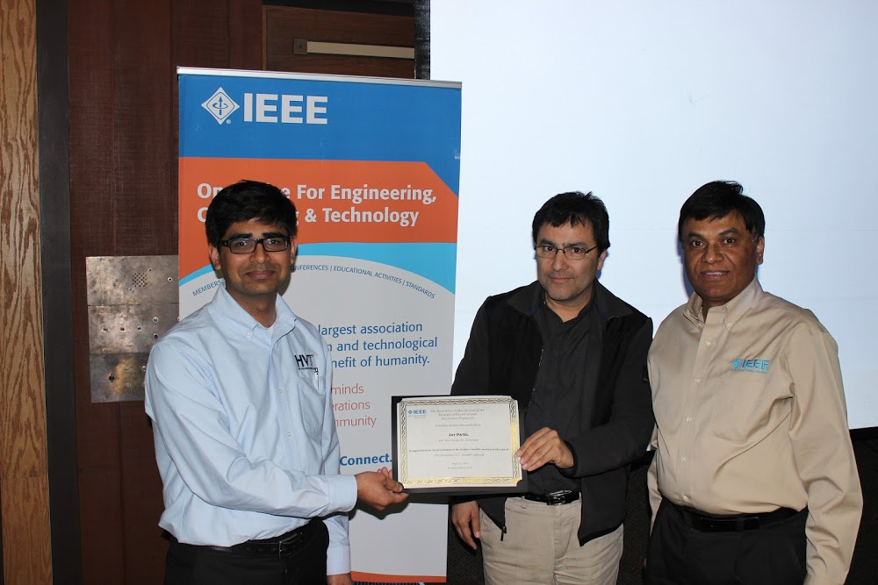
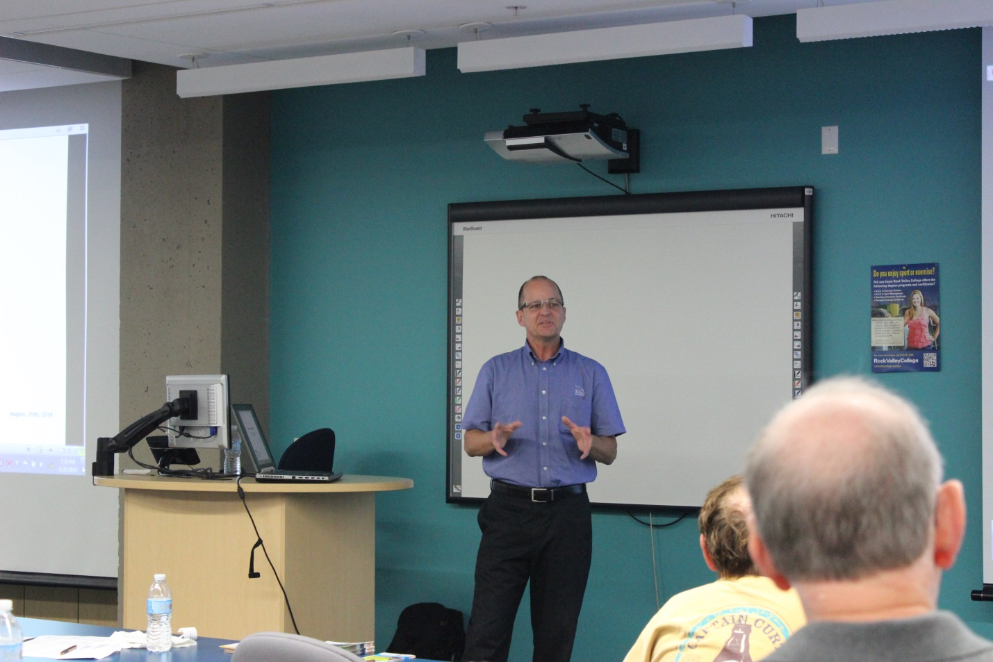
Regular Meetings
March 31, 2016
Speaker: Jay Pate
EMC Sales Manager, HV Technologies
Title: DO160 Section 22 – Aircraft Lightning
August 25, 2016
Speaker: Steve Laya
Elite Electronics Engineering, Inc
Title: Wireless Connectivity, The IoT, and Transmitter Regulatory Compliance

Slide 5
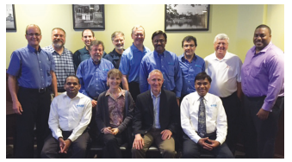
EMC Seminar
June 14, 2016
Title: Electronic Circuit and Packaging Design to Meet System EMI Requirements the First Time
Speaker: Dr. Todd Hubing
Professor Emeritus of Electrical and Computer Engineering at Clemson University and President of LearnEMC
Over 80 people attended
20 exhibitors
Very positive feedback from attendees and exhibitors
EMC magazine report: Volume 5, Issue 2, pages 13-16

Slide 6
Best Practices
Informing members about EMC meetings and activities in Midwest
Publishing meeting reports in EMC Society magazine
Organizing one-day seminars on the 2nd week of June in last 6 years
It is serving the needs of the local industries
It offers a low cost yet high quality opportunity for working engineers to further their skills.
we are a very active Chapter in a small section

Slide 7
Best Practices
As a result of EMC Chapter’s technical and financial contributions, the RRVS Section is able to pursue the following activities in the local community:
Active involvement and support of educational opportunities for middle school to high school students as part of US First and First Lego League Robotics Teams
Promoting Science and Engineering programs to benefit grade and middle school students.
Active involvement and support of IEEE – Students Chapters – Northern Illinois University and Rock Valley College Activities

