Slide 1


Slide 2
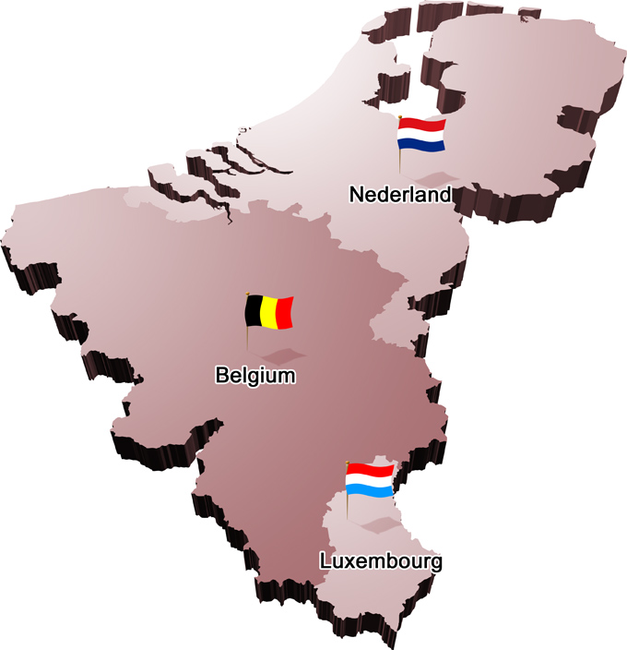
BeNeLux - Chapter
Chair: Frank Leferink
Secretary: Davy Pissoort
Treasurer: Cees Keyer
Web Manager: Anne Roc’h
http://sites.ieee.org/benelux-emcs/

Slide 3

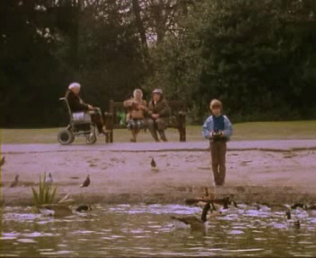
My Favorite EMI/EMC Movie

Slide 4
BeNeLux – Chapter Activities
Sept 7th 2016 : Board Meeting
Oct 19th 2016 : EMC on Tour @ Fontys University College, Eindhoven
Nov 9th 2016 : EMC-ESD in Practice, Arnhem
Nov 21st 2016 : Distinguished Lecturer Jan Niehof, Amsterdam
Dec 7th 2016 : ESD Session on ATEX @ FHI Leusden
Jan 25th 2017 : New European Legislative Framework @ FHI Leusden
Feb 23/24 2017 : 2-day course on immunity with K. Armstrong @ KU Leuven Ostend
April 6th 2017 : EMC & Power Quality @ Strukton Alblasserdam
May 3th 2017 : Distinguished Lecturer Farhad Rachidi, Amsterdam
May 16th 2017 : ESD in Medical Rooms @ Thales Hengelo

Slide 5
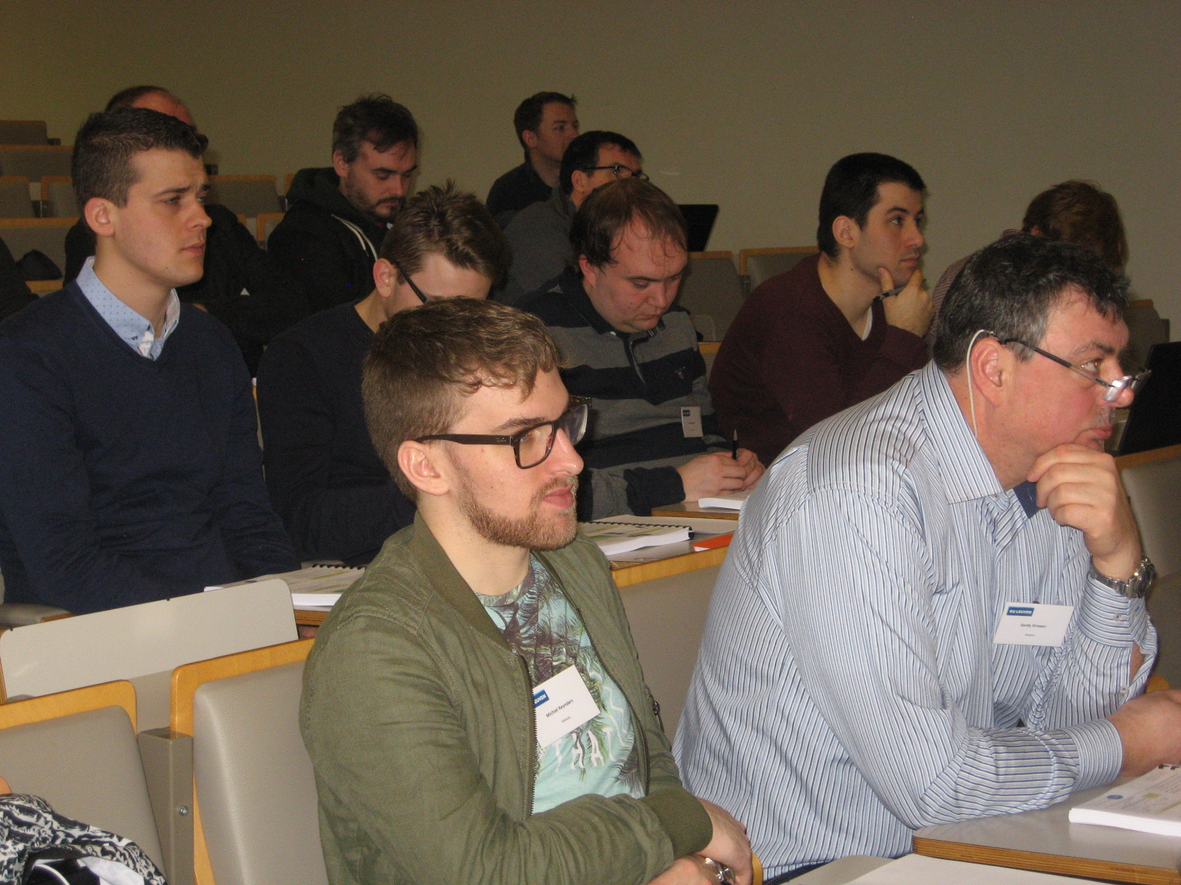
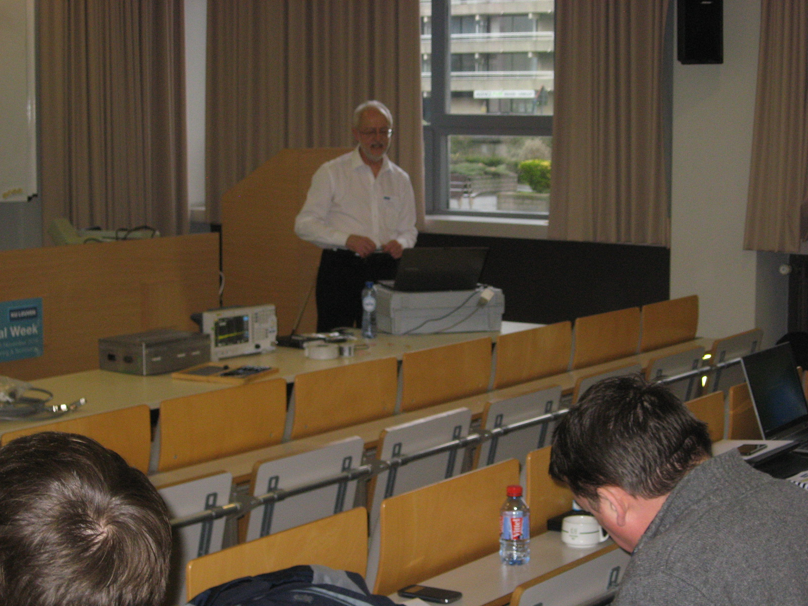
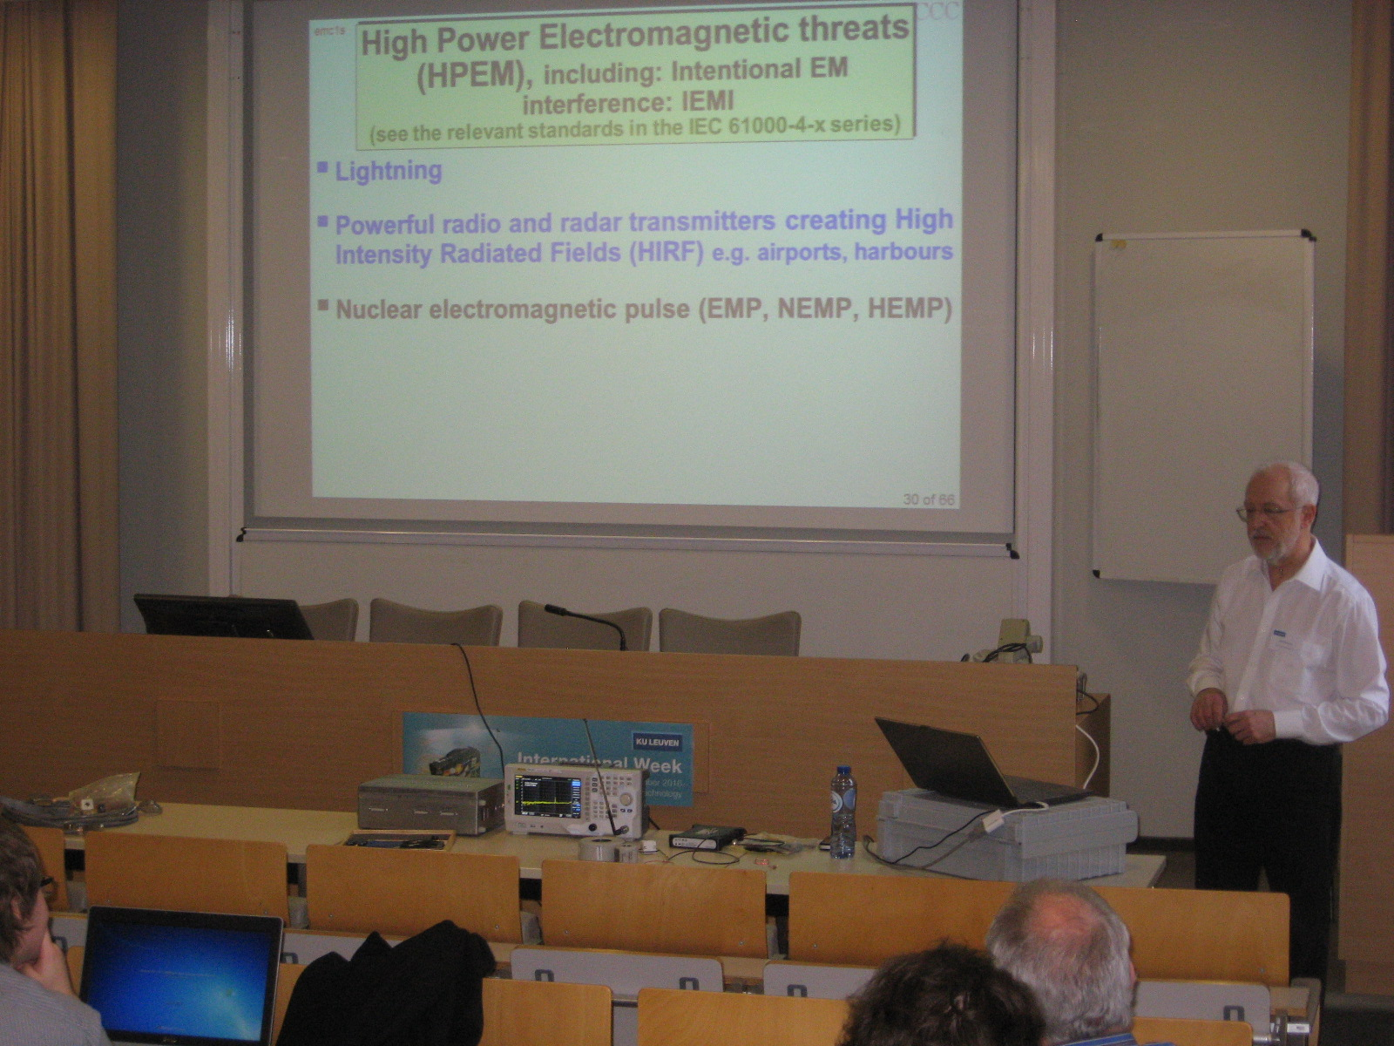
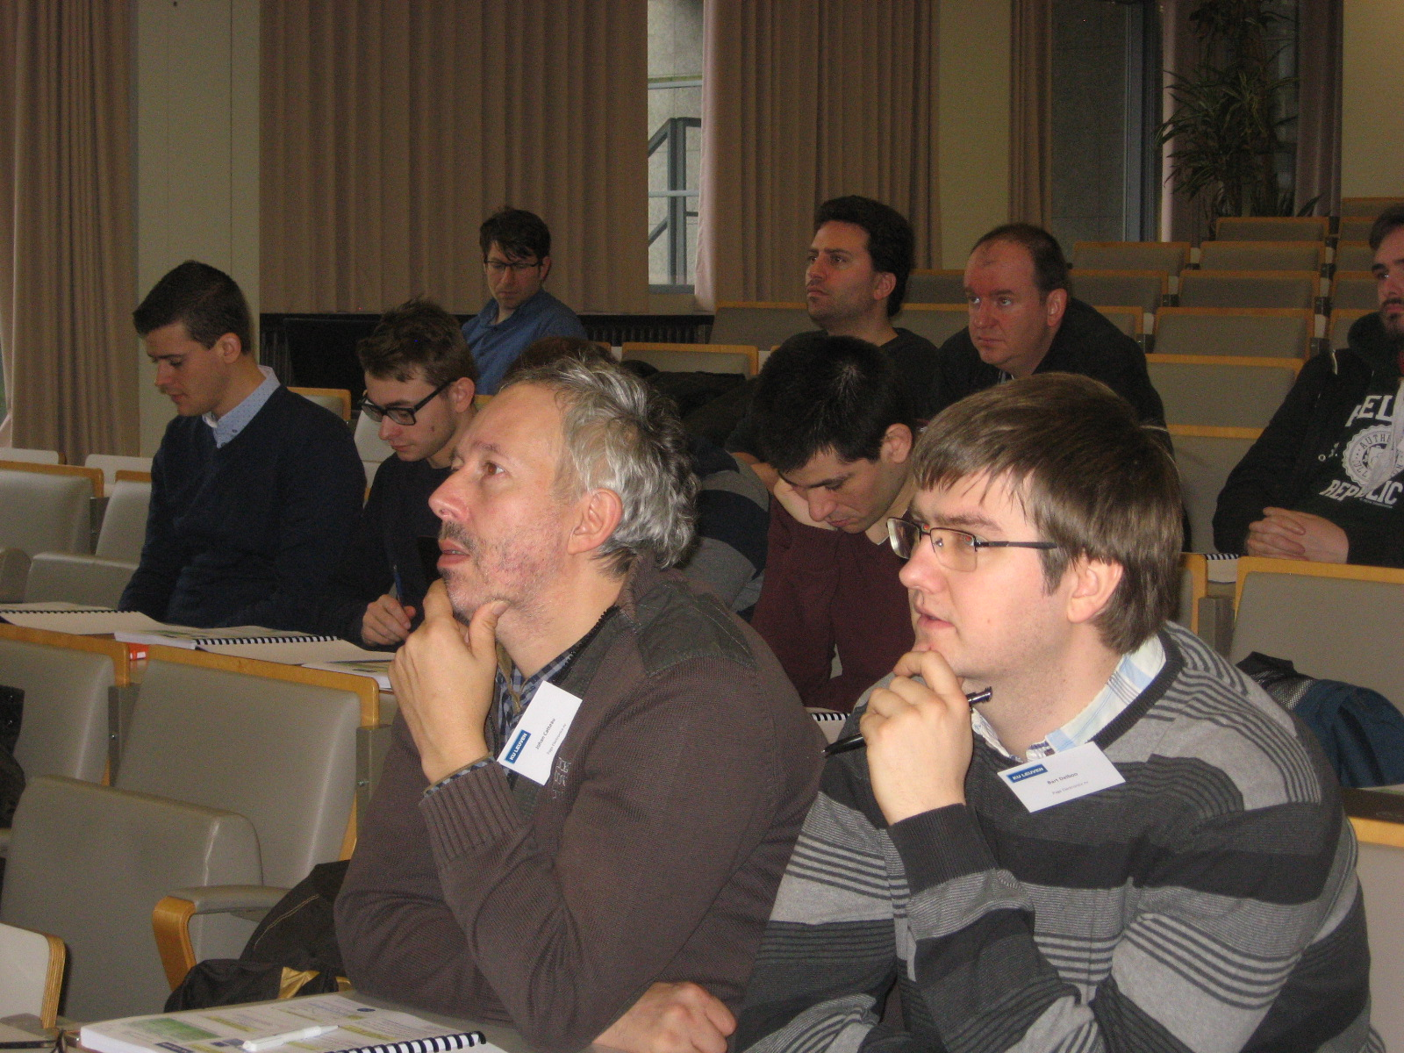
2-Day Course on Immunity with K. Armstrong

Slide 6
Strengths of the BeNeLux Chapter
Most activities are organised in collaboration with the Dutch EMC-ESD society (Cees was chair until July 18th 2015, Cees and Anne are board members)
As a result: administrative support by FHI
IEEE DL lectures are often organised in collaboration with the German chapter to reduce travel costs (/event)
Both a strong academic and industrial network
Old tradition started again: Social event during EMC Europe -> increases involvement of members

Slide 7
BeNeLux Chapter: Plans for 2017-2018
Invitation Distinguished Lecturer(s)
EMC & Health
EMC for Installations
And not to forget: 27 – 30 August, EMC Europe 2018 in Amsterdam
in city center!!!

Slide 8
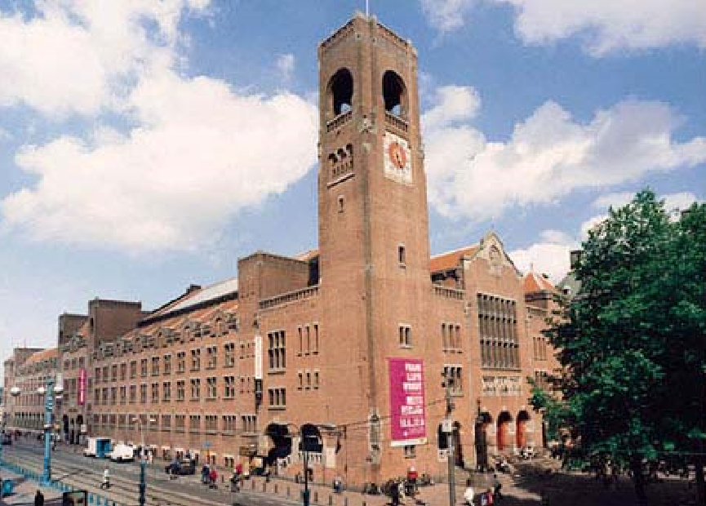
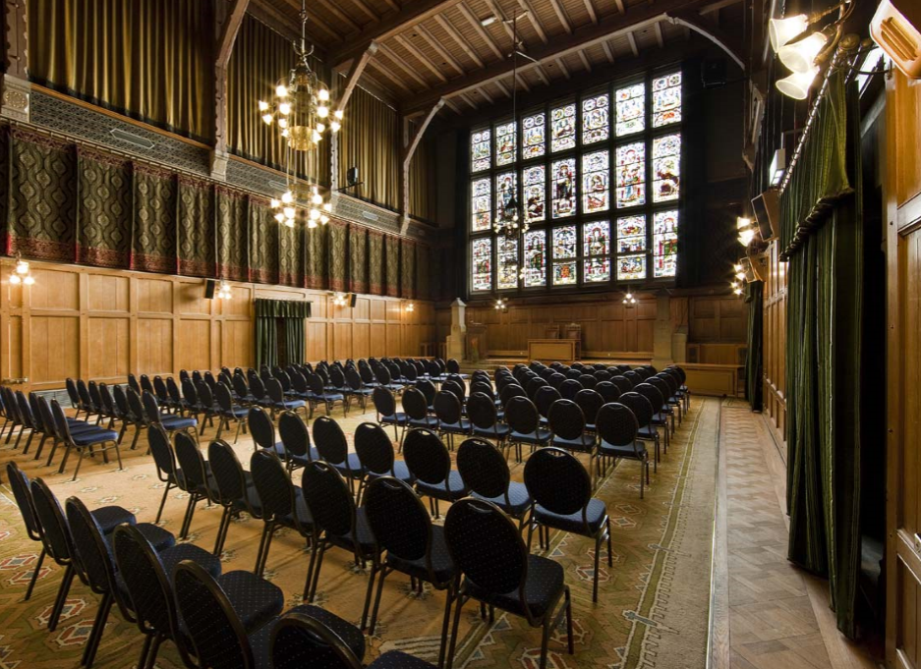
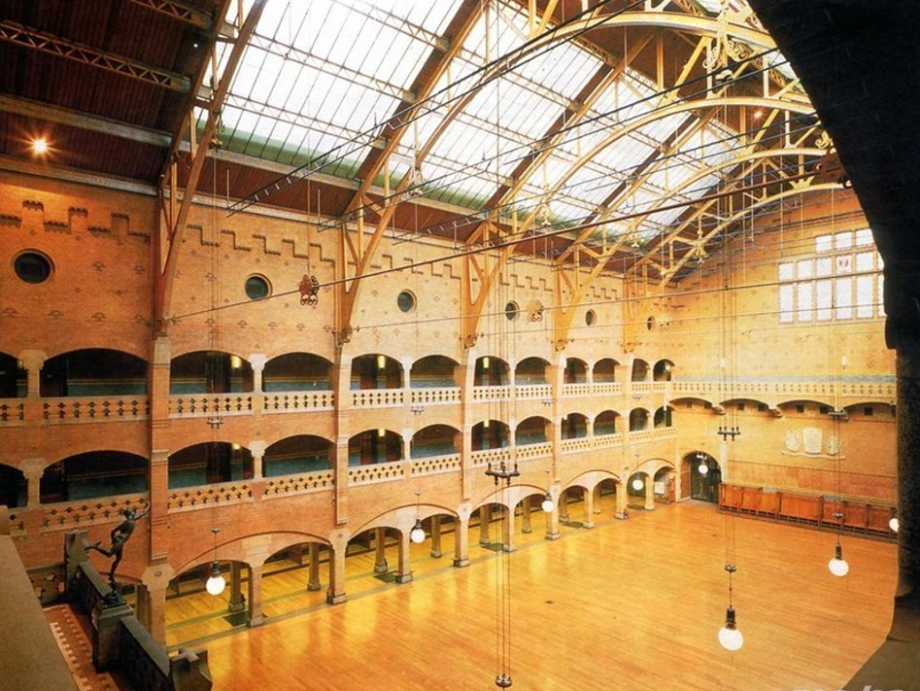
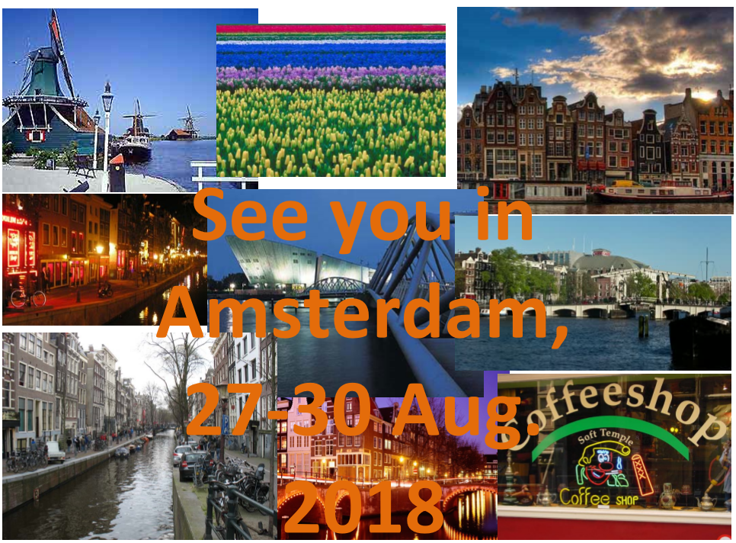
EMC Europe 2018 in Amsterdam

