Slide 1


EMCS Local Chapter Outreach
IEEE Public Visibility initiative -- seeks to increase IEEE's visibility and create a global voice for the engineering profession. The program is designed to:
  increase the public's understanding of how engineering, computing, and technology benefit humanity;
  establish the pride and prestige of the profession;
  position IEEE as the world's trusted source and forum.
How do we do that? Knowing what we know about EMC, and knowing what the public doesn’t know about EMC, there are things we can do at the local level.

Slide 2
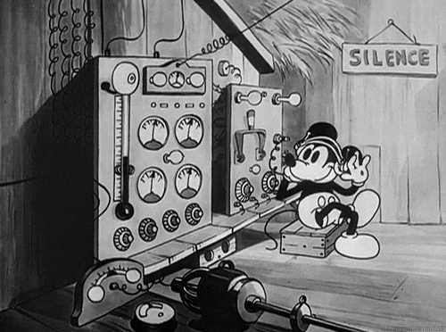
The Southeast Michigan Chapter’s program involves
basic technical introduction at local libraries.
Amateur Radio is used as the training vehicle.
Kids are invited.
Simple circuits are built and demonstrated.
STEAM (Science, Technology, Engineering, Arts, Math) skills are introduced – and it’s fun.

Slide 3
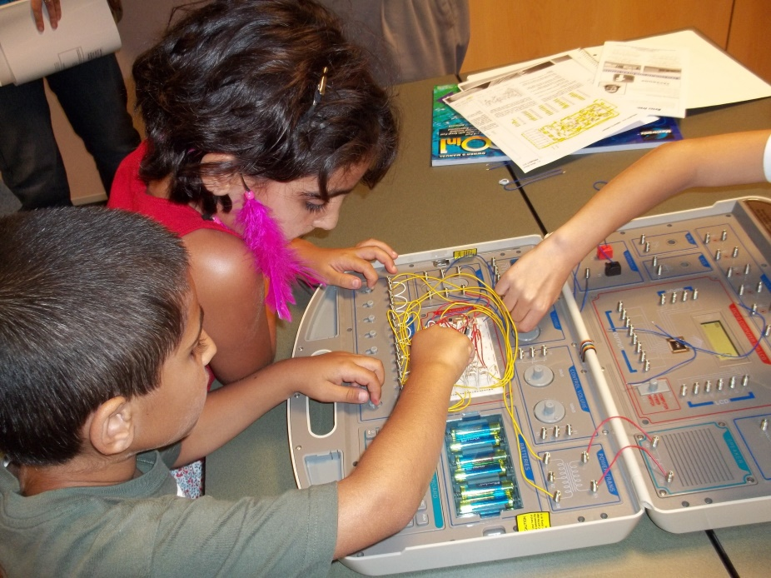
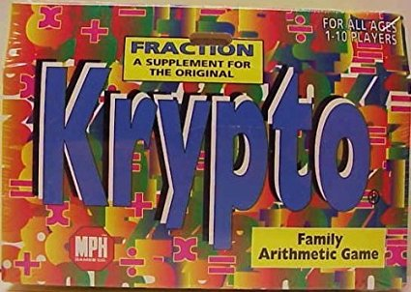
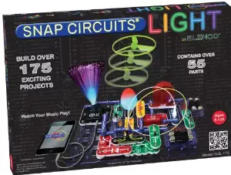
STEM Class Cycle
IEEE STEM in Southeastern Michigan has evolved these components:
Krypto: Math card game (in middle-schools)
Library (donated) science learning kits

Slide 4
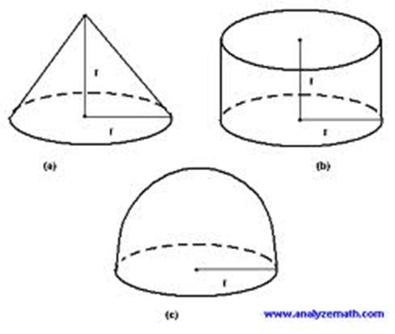
STEM Class Cycle
STEM in Southeastern Michigan has evolved these components:
Krypto: Math card game (in schools)
Library (donated) science learning kits
Observation & Measurement Class
Fundamentals of Electricity Class
Nothing to follow…..

Slide 5
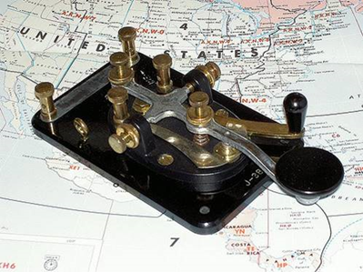
Amateur Radio Class(es)
The IEEE ‘Fundamentals of Electricity’ class is followed with ‘Amateur Radio’….
9 Week Technician License Class:
KB6NU Dan Romanchick’s (Free: On-line)
  “No-Nonsense Technician Class License Study Guide”
  (Students read each Chapter before class!!!)
Plus - Morse Code Class (Koch method)
(Students ‘practice’ using free, on-line, software.)
10th Week: VE Exam
(Optional for Students)
…Then…

Slide 6
‘Makers’ Classes
Teach safe & correct soldering methods,
    (We supply the soldering tools & equipment.)
Help students build their own* progressively challenging QRP kit projects,
*Students pay for their own kits, and then own their rigs.”
The series of kits assembles a complete Low Power (QRP), Morse code (CW) radio station,
Proof of each kit operation by ‘Elmers’
Last ‘class’ concludes w/setup and 1st contact assistance.

Slide 7
Easy-to-start kits

Slide 8
Suggested Construction Sequence
(Students pay for their own ‘kits’)
Kits
Cost $
12 Watt Load & Pwr Mtr,
Antenna Tuner (2 options)
Single Lever Keyer /Paddle
Digital Frequency Counter
Forty-9er QRP Rig
CW Audio Filter
Long Wire / Wire
Battery & Charger Sys.
$10
$25 / $35
$25
$15
$12
$20
$10
TBD

Slide 9
Next Steps
Commitment from local Amateur Radio Clubs & Other Volunteers
  License Class & Morse Code portion
  Parallel, or concurrent QRP (very low power) kit-builders workshops
  Info about local clubs
Lock in Dates with Library, School, or Other Location
  License & Code Classes
  Kit Builders Workshops
Seek funding for Soldering Equipment

Slide 10


The Chicago Chapter has been involved in two programs:
Science Kits for Public Libraries (SKPL)
SKPL seeks to make STEM learning available for children regardless
of race, gender, or income. Understanding that not all children have
access to high quality science educations due to underfunding,
resource allocations, or other conditions, the SKPL program raises funds
to provide grants to libraries to purchase science kits, which can be offered for lending just like a book.
4-week college seminar on EMC
In cooperation with the Illinois Institute of Technology, Louann Mlekodaj of the Chicago Chapter put together an EMC seminar for undergraduate engineering students. Held on four consecutive Saturdays, the program offered an introduction to EMC principles, and included lab exercises in which the students assembled and tested their own printed circuit boards for crosstalk, emission levels, and mitigation techniques.

Slide 11
Summary
EMC is not an art taught in schools or colleges, but will continue to be a vital part of the technical infrastructure.
No group of people are better equipped than the EMC Society to raise EMC awareness and show it off.
EMC is clearly scientific; it’s technical; it requires engineering; it’s an art; and it employs mathematics. All the STEAM boxes are checked.
With a modest time investment, local chapters can introduce children and young engineers to EMC and convey its importance in our growing wireless world.

