Slide 1
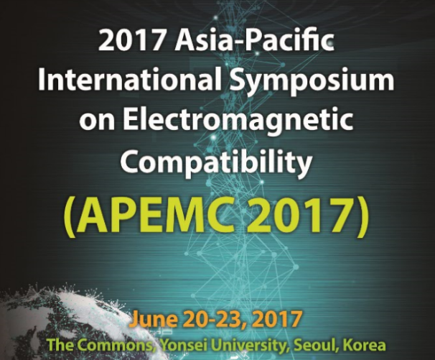
Seungyoung Ahn (KAIST, Korea)

Slide 2





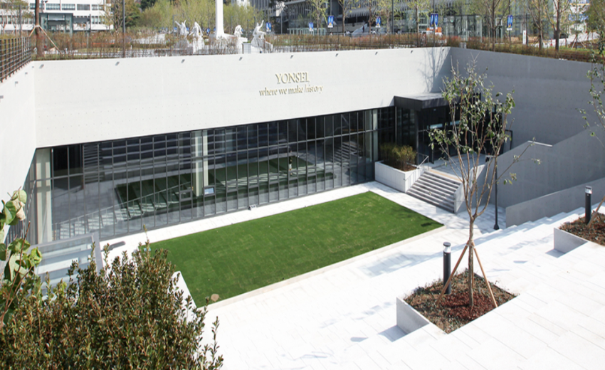
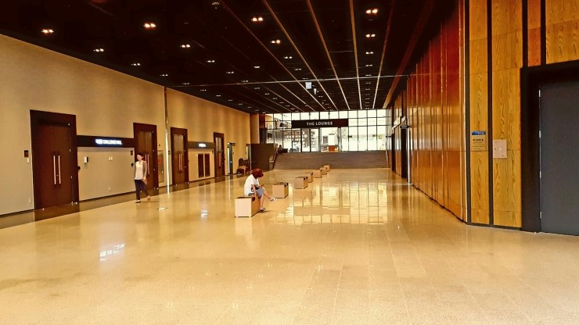
1. General Information
Title : APEMC 2017
(2017 Asia-Pacific International Symposium on Electromagnetic Compatibility)
Date : 20-23 June, 2017
Vanue : The Commons, Yonsei University, Seoul, Korea
Organized by :
Co-organized by :

Slide 3
2. Conference Summary
Papers
  Submitted: 202 (17 Countries)
  Accepted: 163
    Oral: 115
    Poster: 48
  Acceptance Ratio: 80.7%
Attendees
  Total: 415 (21 Countries)
    Conference Participants : 337
    Exhibitors : 78

Slide 4
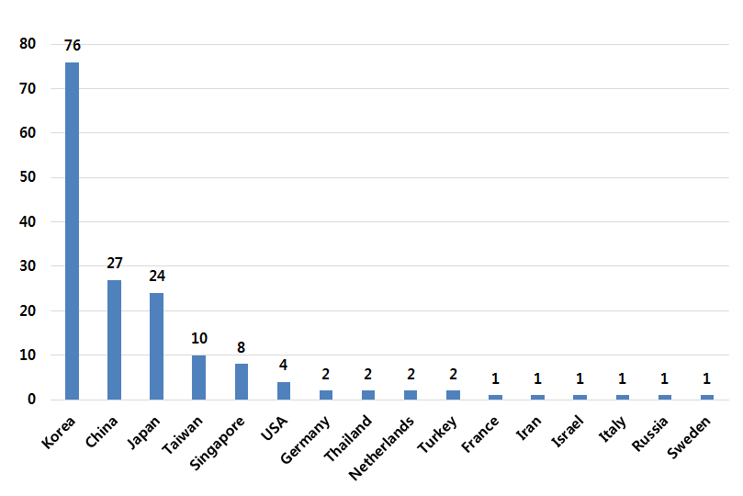
2. Conference Summary
Accepted Papers

Slide 5
2. Conference Summary
Paper Awards
1. Best Paper Awards
1) Yuta Inoue and Hideki Asai (Shizuoka University, Japan)
2) Yun-sil Lee (Ewha Womans University, Korea)
3) Chulsoon Hwang et al (Missouri University of Science and Technology, USA)
2. Best Student Paper Awards
1) Fei-Fan et al. (Nanyang Technological University, Singapore)
2) Nobuhiro Kimura and Takahiro Yoshida (Tokyo University of Science, Japan)
3) Sungwoo Lee et al (Sungkyunkwan University, Korea)
4) Di Wang, Er-Ping Li, and Jiao He (Zhejiang University, China)
5) Sangyeong Jeong, Dongil Shin, Jongpil Kim, Seokjoon Kim, and Jingook Kim (UNIST, Korea)
3. Best Poster Paper Awards
1) Weinong Sun et al (City University of Hong Kong, China)
2) Yoon Do Chung and jiseong Kim (Suwon Science College, Korea)
3) Hyun Ho Park and Eakhwan Song (The University of Suwon, Korea)
4) Yin-Cheng Chang et al (Ntional Applied Research Laboratories, Taiwan)

Slide 6
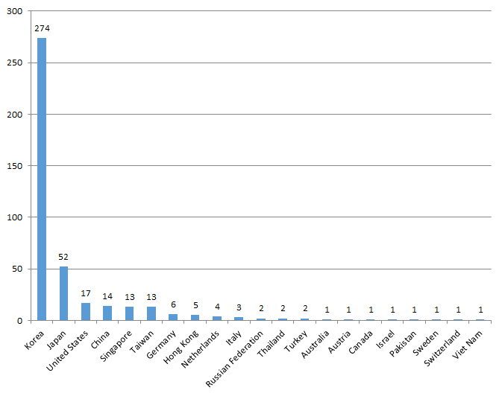
2. Conference Summary
APEMC 2017 Total Attendees : 415 (21 Countries)
Conf. Attendees + Exhibitors
Korea | 274
Japan | 52
United States | 17
China | 14
Singapore | 13
Taiwan | 13
Germany | 6
Hong Kong | 5
Netherlands | 4
Italy | 3
Russian Federation | 2
Thailand | 2
Turkey | 2
Australia | 1
Austria | 1
Canada | 1
Israel | 1
Pakistan | 1
Sweden | 1
Switzerland | 1
Viet Nam | 1
Total | 415
21

Slide 7
3. Conference Committee
Organizing Committee
Conference General Chair – Joungho Kim
Conference General Co-Chair – Jaekon Shin
Advisory Committee Chair – Wansoo Nah
TPC Chair – Jong-Gwan Yook
Regular and Special Session Chairs – Jingook Kim,
Taewon Kang
Tutorial Session Chairs – Ki Jin Han, Tae-Hoon Yoo
Workshop Chairs – Ick-Jae Yoon, Jong Hwa Kwon,
Kyung-Hee Park, Sang-Woo Kim
Industry Program Chairs – Jiseong Kim,
Cheol Soo Kim
Poster Session Chair – Kyung Sub Lee
Finance Chair - Jonghoon Kim
Publicity Chairs – Eakhwan Song, Yong Bae Park
International Relation Chairs – Dong Gun Kam,
Taeheon Jang, Sungtek Khang
Local Arrangements Chairs – So Young Kim,
Ikpyo Hong
Publication Chair – Hyun Ho Park
Exhibition Chairs – Kibum Jung, Seung-Ryeol Ryu
Government and Local Relation Chairs –
Junkyu Yang, Gunyeon Kim
Award Chairs – Hyung Do Choi, Haengseon Lee,
Jae Wook Lee
Secretary – Seungyoung Ahn

Slide 8





4. Sponsors
Diamond Partners
Gold Partners

Slide 9
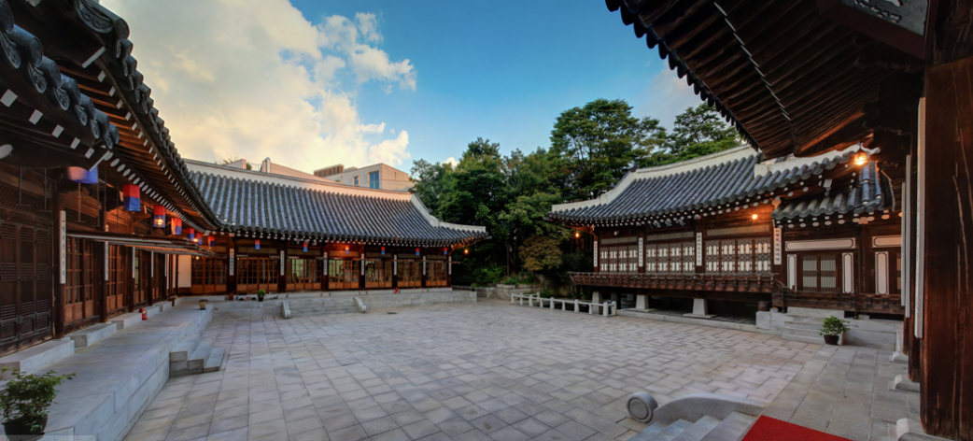

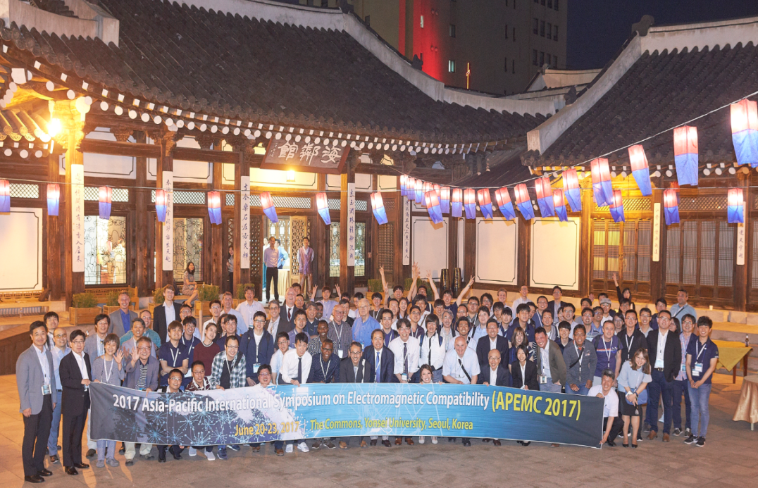
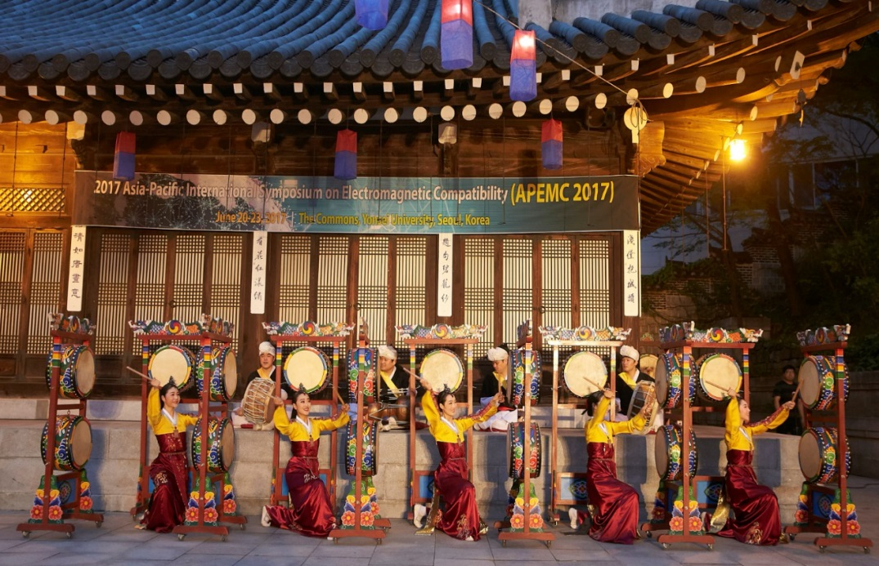
5. Events
Welcome Reception
(Day 1, June 20)

Slide 10
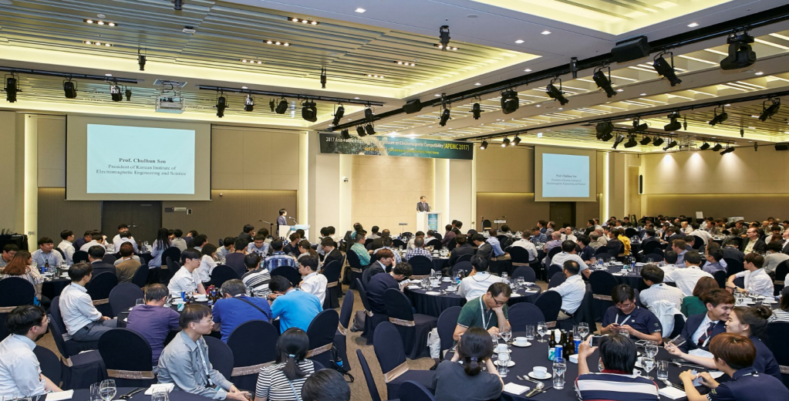
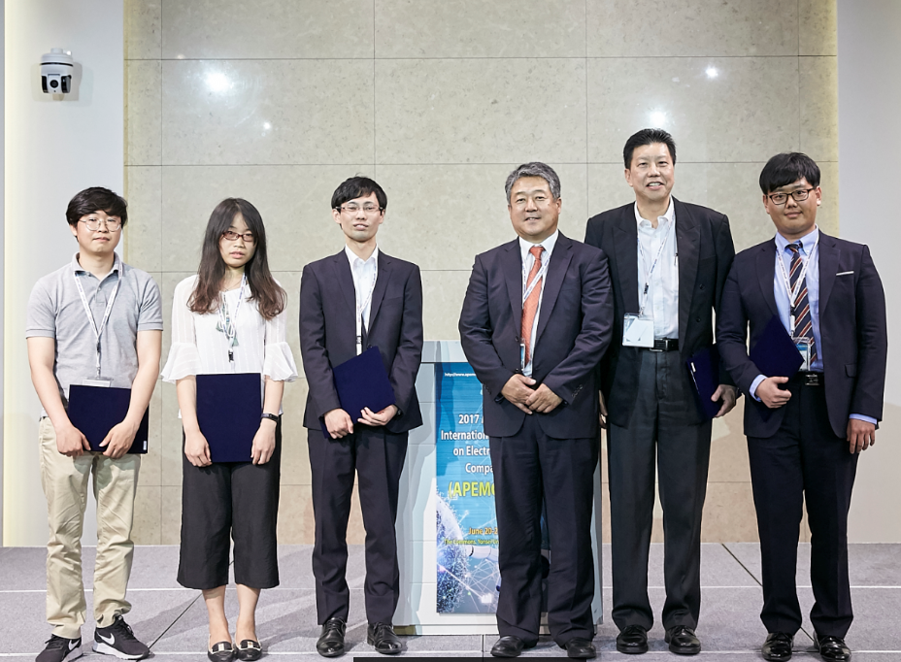
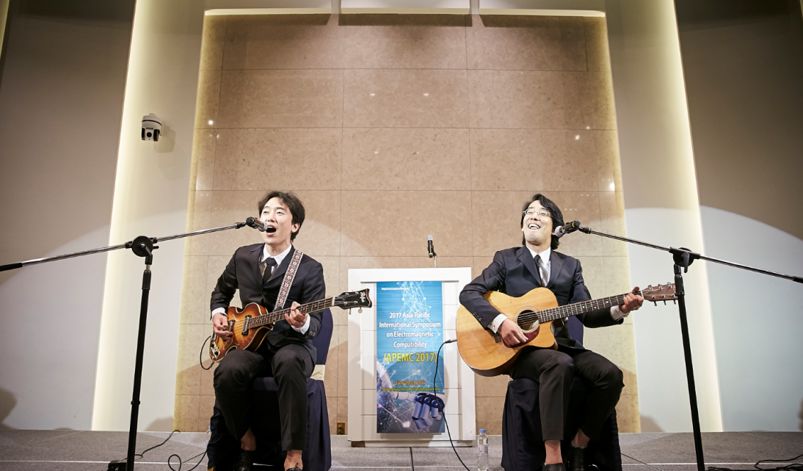
5. Events
Banquet
(Day 3, June 22)

Slide 11
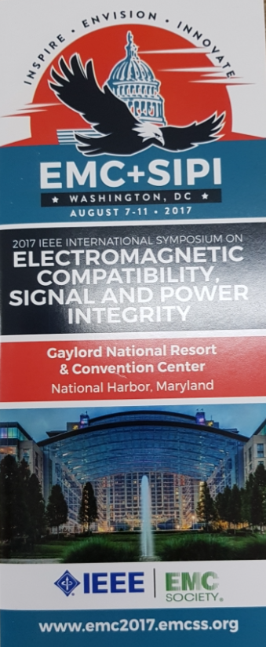
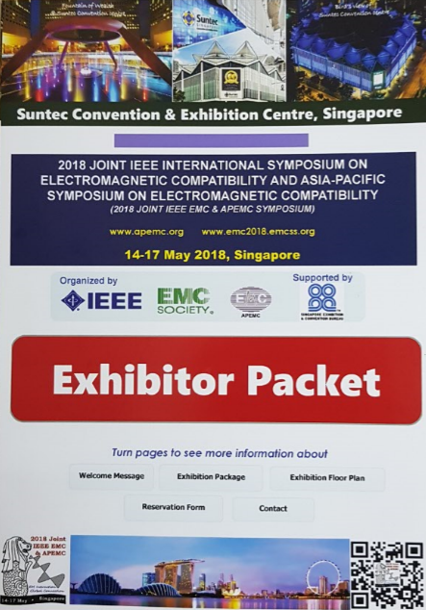
6. Upcomming Conferences
IEEE EMC Symposium 2017 at Washington DC
  7 -11 Aug, 2017
APEMC 2018 at Singapore
  14-17 May, 2018

