Slide 1


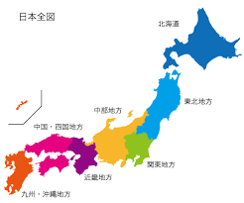
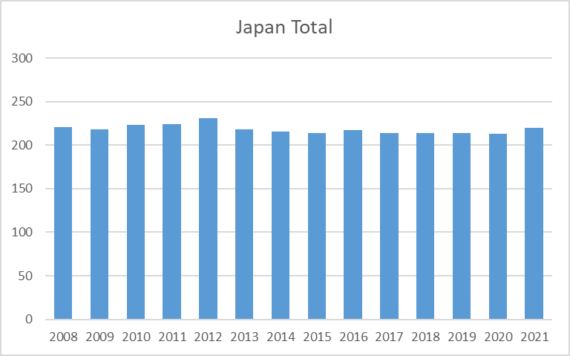
Japan Joint Chapter Repot
Aug.2020-July 2021
Sendai
Officers:
  Chair: Kimihiro TAJIMA (NTT Advanced Technology)
  Vice Chair: Yoshitaka TOYOTA (OKAYAMA University)
  Secretary: Takashi KASUGA (National Institute of Technology, Nagano College)
  Treasurer: Takehiro MORIOKA (National Institute of Advanced Industrial Science
  and Technology)
Number of members:
220 (2021, Including Sendai Chapter 21 )
Tokyo
220

Slide 2
Activities
  Japan Joint/Sendai Chapter Annual Meeting (Dec. 2020)
  Student Award 2020 (March 2021)
  Technical Meetings (August 2020 - July 2021)
  10 meetings in co-operation with meetings on EMC sponsored
  by EMCJ of IEICE* Communications Society.
  Special Lecture by Distinguished Lecturer 2021 (will be in Oct.)
*IEICE: The Institute of Electronics, Information Communication Engineers

Slide 3
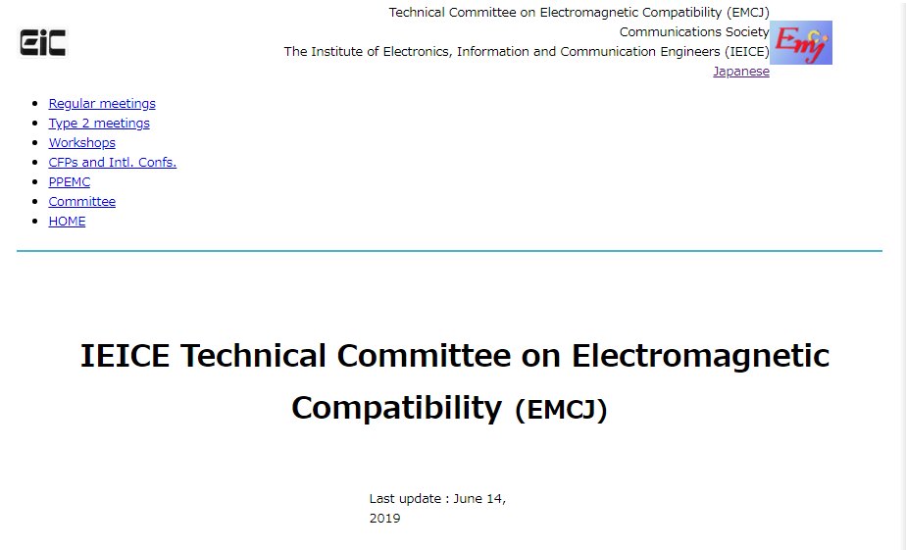
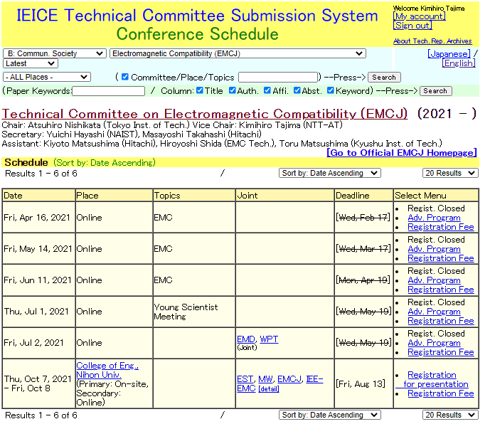
What is EMCJ ?
https://www.ieice.org/cs/emcj/Eng/index.html

Slide 4
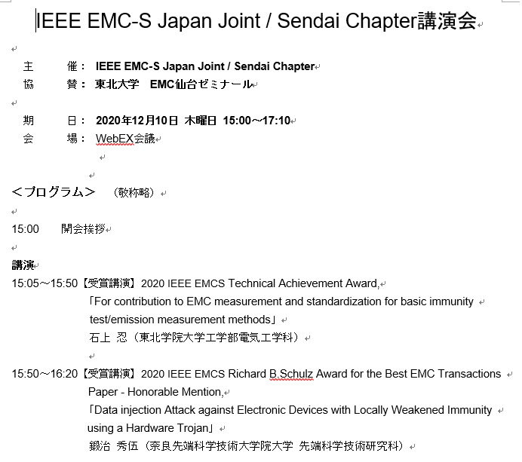
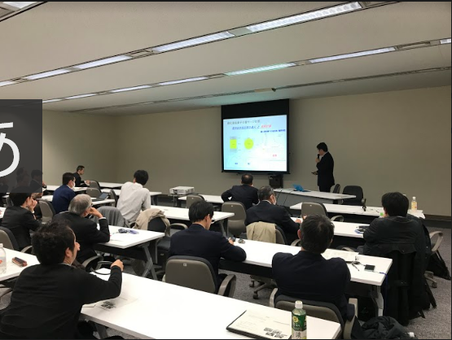
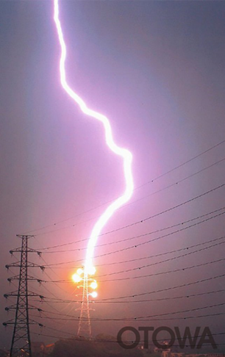
Annual chapter meeting
by Japan Joint /Sendai Chapters
IEEE Fellow Lecture
TBD in 2021
  DATE: Dec. 10, 2020
  PLACE: Web meeting (WebEX)
  Title: 5 Lectures & discussions
  Attendees: 32
  DATE: Dec. 18, 2019
  PLACE: Tokyo (NTT R&D Center)
  Title: Study on Lightning Electromagnetic
  Field Pulse Surge by prof. Baba.
  Attendees: 30

Slide 5
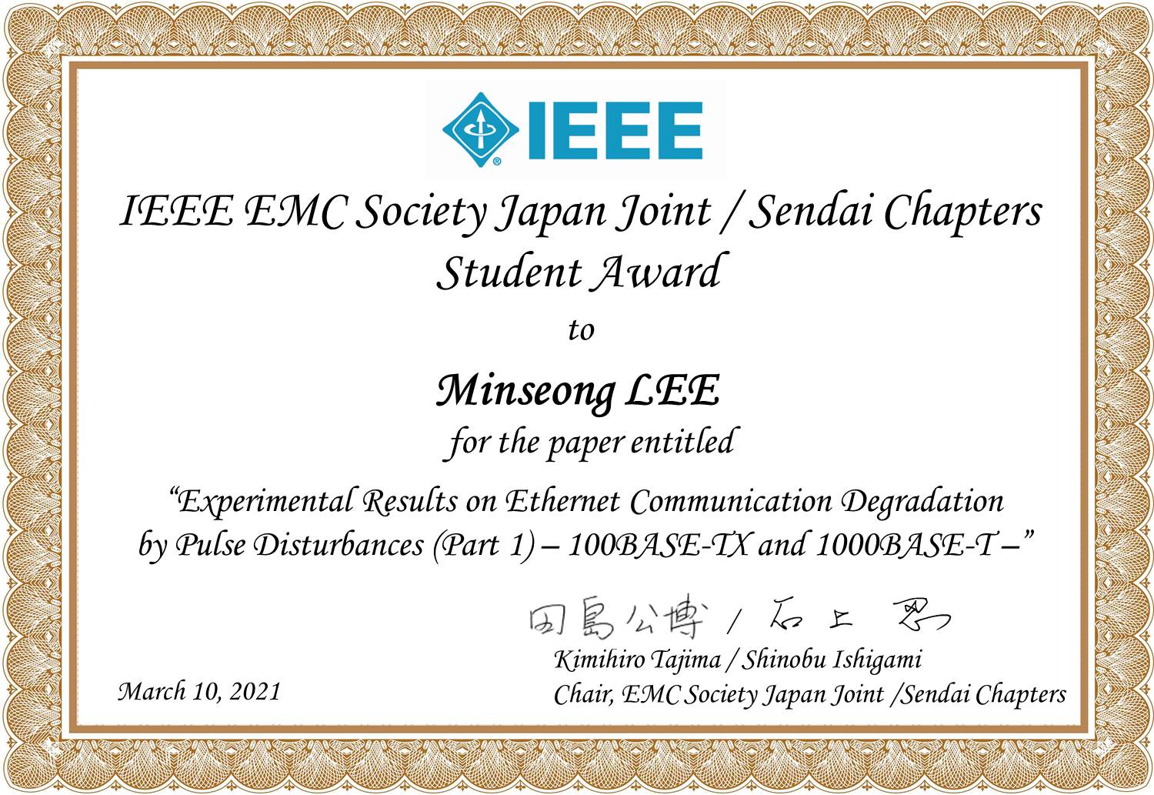
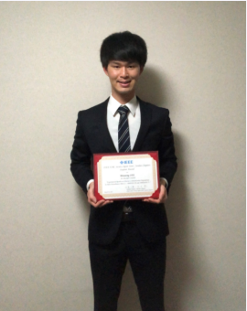
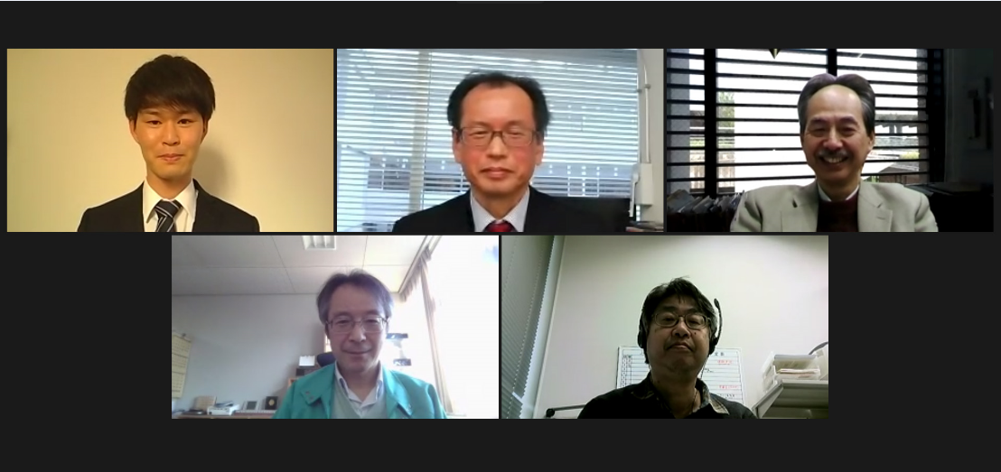
Student Award
Winner
Award ceremony
The 4th prize ceremony was held on March 10, 2021
Purpose: To motivate students, and increase of young members
Recognition: A young student who made the most excellent presentation at the
sponsored or co-sponsored technical meetings

Slide 6
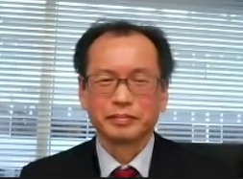

Contact
Kimihiro Tajima, Chair
EMC center, NTT Advanced Technology Corporation,
kimihiro.tajima@ntt-at.co.jp
Defeat Corona !!

